Slide 1
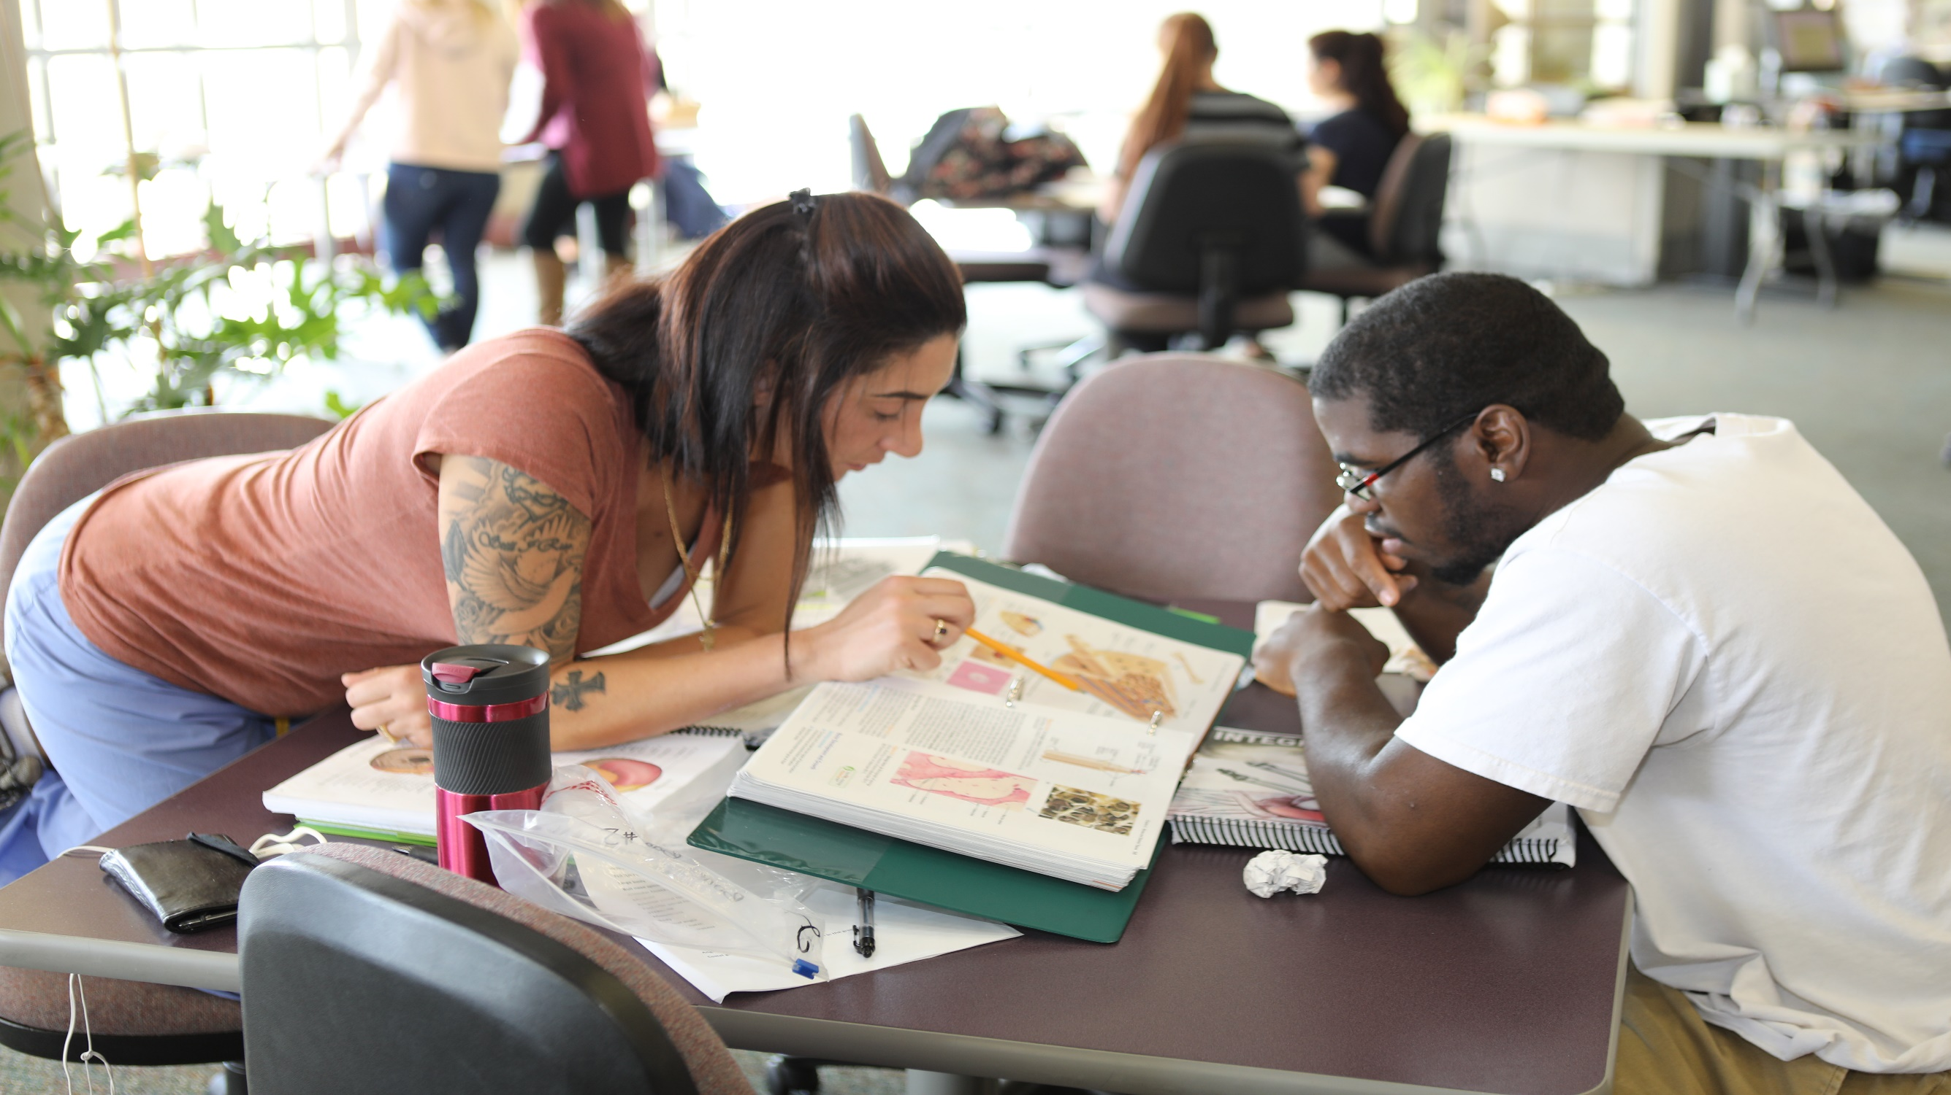
Study Strategies for Anatomy & Physiology (A&P)

Slide 2
Agenda
What to expect in A&P
Getting prepared
How to study
Resources

Slide 3
What to expect in A&P

Slide 4
What to expect
BIOL 2201 & 2202 are prerequisite courses for many healthcare programs
Prepare to be overwhelmed with information
Adapt to change – learn to be independent and work responsibly in groups
Accept that you may need to spend more time preparing and studying for this class than any other course - welcome to your new part-time job!
Assess whether it is the right time for you to take the course
It is OK to decide you are not ready (academically or due to a busy schedule) to take this course right now

Slide 5
Course design
This course includes a weekly lecture and a laboratory component
Lecture meets for 2.5 hours per week
Lab meets for 3 hours per week
Labs may be on-campus or completed online

Slide 6
Learning in the lab (on-campus) 1
Don’t leave your lab early – use the full lab to review and test yourself on all relevant materials
Review your lab assignment before lab and complete the assignments
Follow safety rules
Expect to work in groups
Study with more than one model in lab
Being able to identify a structure in multiple specimens will be helpful for the lab practical exam

Slide 7
Learning in the lab (on-campus) 2
It is OK to make mistakes
Ask the teacher questions and don’t be afraid to speak up if you’re confused
Ask professor if it is OK to take pictures of lab specimens
Take notes that will help you identify and remember the location of certain muscles, bones, etc.
This will help you immensely when you are studying from pictures at home. It will also help you on your lab practical exam

Slide 8
Learning in the lab (online)
Be sure to sign into the online programs as soon as the semester start and familiarize yourself with how the program works
Start each week by checking your syllabus
Complete the assigned reading BEFORE beginning any lab work and take notes
Complete lab work when you have time to focus on the assignment, just like in-person lab, you want to be able to complete the entire experiment in one sitting
Complete any follow-up work shortly after completing your assignments, no more than a day or two
Don’t wait until the due date to complete assignments! Things can and will go wrong.

Slide 9
Getting prepared for A&P

Slide 10
Prioritizing school
Dependent on the number of classes for which you are registered, being a college student is like having a full or part-time job
Your short-term goal is to pass your classes
Your long-term goal is to earn a college degree to help you get a better job
Put in the work for each class to earn the grade you need

Slide 11
Use every resource to succeed
Talk to your professor – go to your teacher’s office hours for help
Schedule a weekly tutoring appointment
Schedule academic coaching to improve your organizational and study strategies
Get an accommodation early if you have a disability
Work with Advising & Counseling for academic advice and personal counseling

Slide 12
Course workload
Success in A&P correlates to the amount of time you spend studying the material
Studying begins the first week of class
Get familiar with Blackboard and your online course materials
It is difficult to catch up if you put off reading and studying the first week
Plan on spending at least 15+ hours per week outside of class & lab studying
This is a time intensive course – you need to commit to studying every day

Slide 13
Time management
There are 24 hours in a day, use them intentionally
Work with an Academic Coach to create a weekly study plan
Set goals and stay on track to avoid procrastination
Use a calendar and add dates of exams, deadlines, etc.
Schedule relaxation, exercise and personal time
Set reminders in your phone
Make a “To do” list and check the list frequently
Do not over commit yourself

Slide 14
Get organized before class starts
Buy the book and all course materials as soon as possible
Print your syllabus, class assignments and PowerPoints – keep them in a binder
Read the syllabus to understand the requirements for class
Understand the grading criteria
Learn how to use Blackboard

Slide 15
Create a good learning environment
Find your comfort zone for studying – some students need:
A quiet place or
Some background noise or
A study group
Study in small chunks of time – 30, 35, or 45 minutes at a time
Take real breaks from studying – at least 15-minute breaks

Slide 16
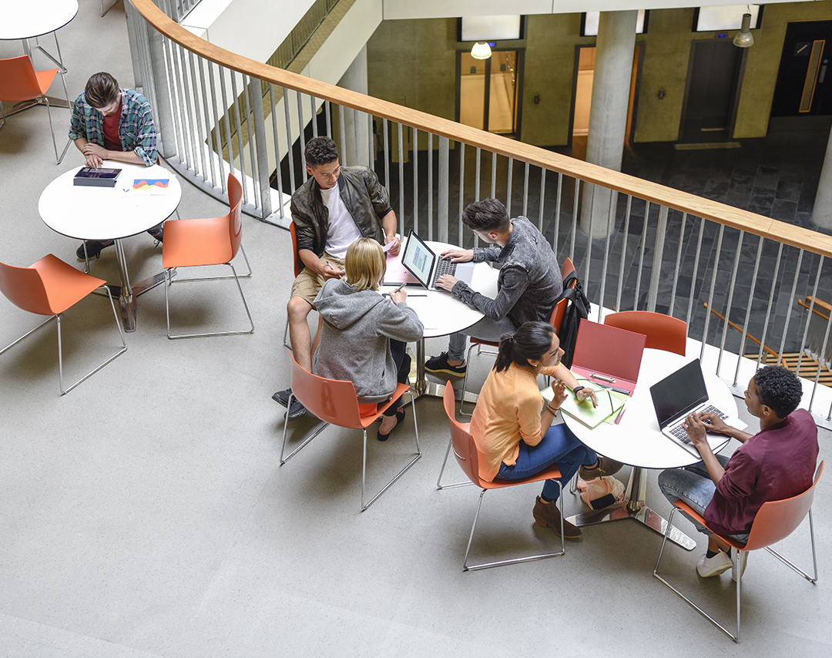
Strategies for studying A&P

Slide 17
Read your textbook & course materials
Read the assigned chapters and PowerPoints before class
Class won’t be the first time you’ve seen the material
Read difficult material out loud
Don’t skip the practice problems, reviews, and other resources in your textbook and atlas – they reinforce what you read
Identify material or terms you do not understand and ask your teacher to clarify
Use your own body to demonstrate your knowledge
Directional Terms
Flexion
Extension

Slide 18
Learn and understand the terminology
Break down complex words to identify their root
Look up definitions you do not understand
Use you own body as a guide
Take your zoological roots seriously, they will help you throughout the whole class

Slide 19
Examples of Word Roots
Prefix for Not/Without | Root Word | Word/Definition
A- | Photo (light) | Aphotic – without light
An- | Aerobic (air) | Anaerobic – without air
Non- | Renewable | Nonrenewable – cannot renew
Un- | Fused (joined) | Unfused – not joined

Slide 20
Learning to retain information
Your retention will increase the more you handle the material
Use the Mastering A&P website for study resources
Read, write, draw, watch videos
Create quizzes and answer the questions at the end of the chapters in your text
Use coloring books, create flashcards, take paper and online quizzes
Meet weekly with a tutor
Visit the Student Success Center to use learning models
Use all your senses to learn this material

Slide 21
Taking notes in lecture & lab
Use CCRI printers to print the PowerPoint slides for free
Review your slides before the lecture and lab
Use One Note – a free online note taking app available through your MyCCRI account
When your instructor emphasizes something or refers to something in the book:
Write down the page or diagram number so you can go back to it later
Don’t go overboard when writing notes because too many notes will become overwhelming to study from
Ask for permission to record and/or photograph the lecture and course materials

Slide 22
Draw your thoughts out
Drawing can help you understand a concept and remember information that would be difficult to define in words
Get used to drawing diagrams, (e.g. human heart) because you may be asked to draw and label structures on an exam or during lab
Use white boards in Student Success Center to draw and diagram what you are learning
Remember…
Repetition = Retention

Slide 23
Organizing your notes
Concept maps help organize information in a very easy and visual way

Slide 24
Prepare for your quizzes and tests
If available, use your study guide to prepare for your quiz or test. Answer questions using your textbook and lecture notes
Re-write your notes – it is time-consuming but:
Gives you a chance to review class material and make sure you didn't miss anything
Creates a well-organized and condensed set of notes to study from for the test
Have someone else quiz you (with the flash cards you created!)
Study every day of the week each week of the semester so you don’t fall behind
Sleep!

Slide 25
Resources

Slide 26
Use the Mastering A&P website

Slide 27
Mastering A&P: Your textbook options

Slide 28
Mastering A&P: Use the online Study Area

Slide 29
Mastering A&P: Art labeling activities

Slide 30
Mastering A&P: Practice tests and quizzes
Tip: Quizzing yourself is a great way to prove you understand the material. Even if you get the answer wrong, this quiz will explain why!

Slide 31
Mastering A&P: Practice Anatomy Lab (PAL)

Slide 32
Mastering A&P: PAL Flashcards

Slide 33
Ask for help
Talk with your teacher and attend their office hours if possible
Ask questions in your lecture and lab
Form a study group with students from your class
Use the anatomy models in the Student Success Center
Meet with a tutor weekly to help learn the material and to learn how to study
Tutoring appointments are made through Starfish

