Slide 1
LaunchPad
An Overview of Macmillan’s

Slide 2
What Is LaunchPad?
LaunchPad is an online resource offered by Macmillan Publishing
Access is connected to specific textbooks
Students need to purchase a code to access LaunchPad
Professors select and assign various activities for students’ learning, including reading, exercises, videos, quizzes, practice tests, etc.
Students access and complete their assignments in LaunchPad
z

Slide 3
Who will use LaunchPad?
The Psychology department uses LaunchPad
If you take a psychology class, you will be expected to use LaunchPad
z

Slide 4
How does LaunchPad work?
Student Tutorial video from Macmillan
Highlight specific Features
6 Takeaways to help you
z

Slide 5
LaunchPad Student Tutorial
(“LaunchPad Student Tutorial” 0:00-1:41)

Slide 6
MENU FEATURES
z
(“How to Use LaunchPad: Student Video” 0:04 )

Slide 7
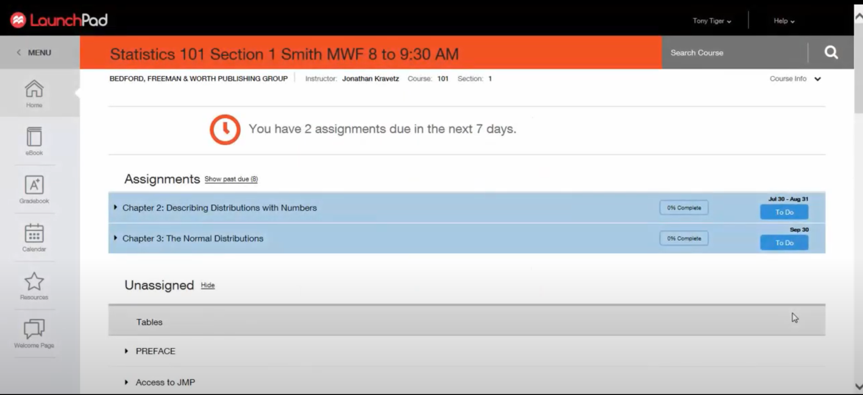
HOME
Your assignments are listed on the HOME page along with the due date and % completed
Past due assignments can also be accessed here
(“LaunchPad Student Tutorial” 0:04)

Slide 8
HOME
z
Click on an assigned unit to reveal the various tasks assigned along with their point values and due dates
Click on each assignment to complete it
(“LaunchPad Student Tutorial” 0:49)

Slide 9
E-BOOK
z
If reading is assigned, it can be accessed here as well as in the textbook
(“Launchpad Overview” 0:43)
(“Launchpad Overview” 0:34)

Slide 10
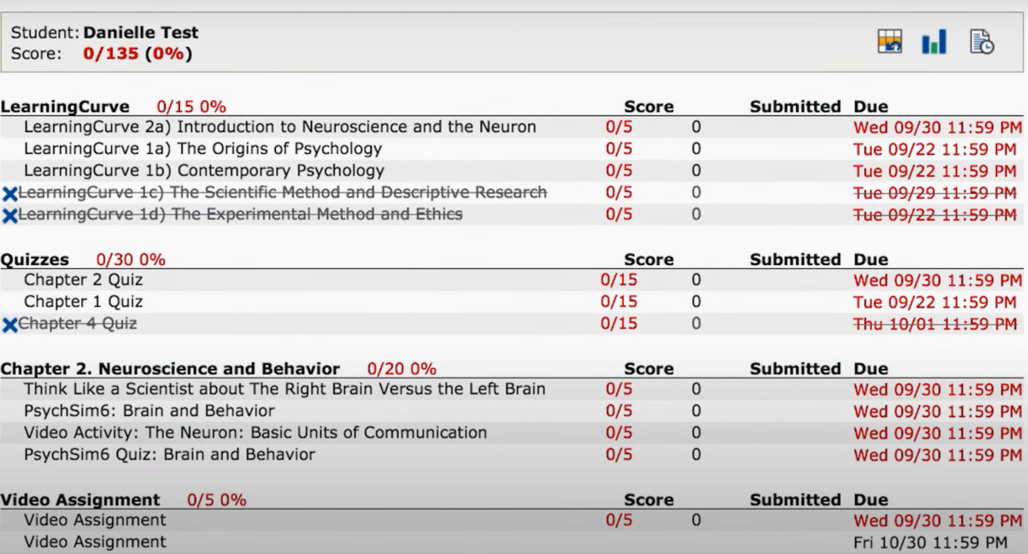
GRADEBOOK
z
Check this regularly to see your progress
Check to see assigned and completed assignments as well as grades
(“Launchpad Overview” 2:35)

Slide 11
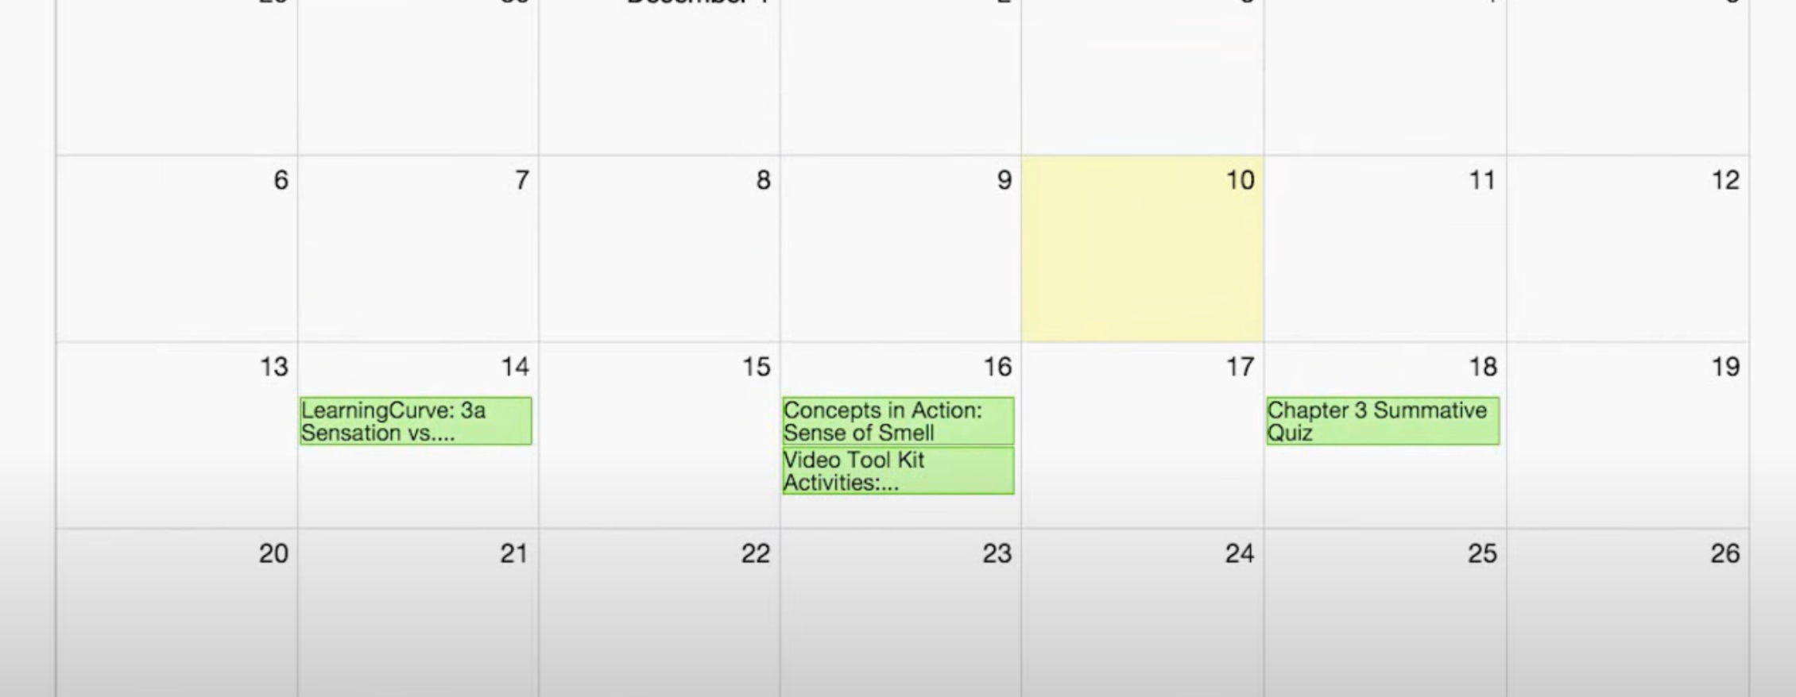
CALENDAR
z
Use the CALENDAR to get a visual of when exams, quizzes and assignments are due
Calendar items are also hyperlinks
(“Launchpad Overview” 0:26)

Slide 12
6 TAKEAWAYS
z

Slide 13
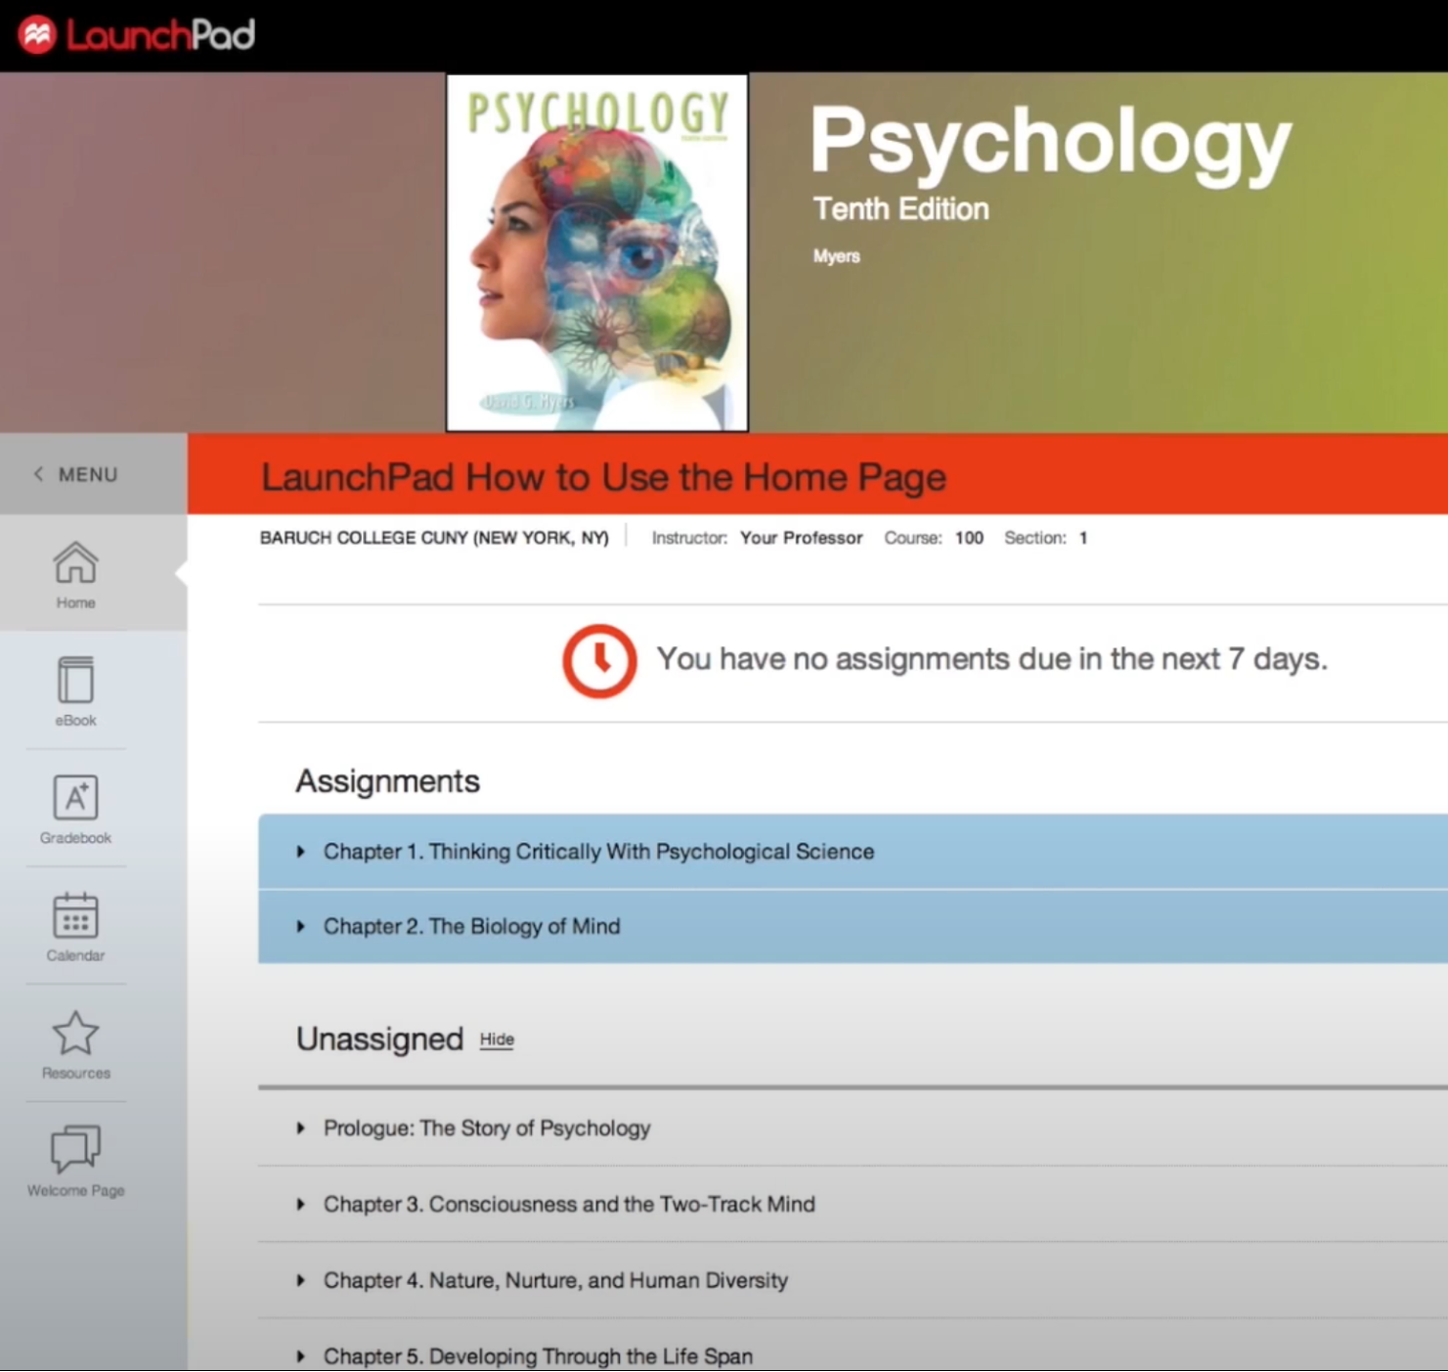
1. EXPLORE
This is NEW TO YOU. Look around and GET COMFORTABLE with it.
Use the LEFT MENU TO NAVIGATE the site
Don’t be afraid to click on items
z
(“How to Use LaunchPad: Student Video” 0:04 )

Slide 14
2. SPEND TIME ON YOUR ASSIGNMENTS
z
YOUR PROFESSOR CAN SEE:
Which ASSIGNMENTS you have OPENED
How much TIME is SPENT on each task
(“How to Use LaunchPad: Student Video” 0:14 )

Slide 15
3. KNOW IF YOUR PROFESSOR USES BLACKBOARD & LAUNCHPAD (EACH PROFESSOR IS DIFFERENT)
IF USING BLACKBOARD & LAUNCHPAD
IF USING LAUNCHPAD ONLY
Must use both Blackboard and Launchpad fully
BB will likely have syllabus & announcements
Lectures & exams may be posted in BB with exercises in LP
BB My Grade or LP Gradebook may be used
Everything will be here
Calendar gives an overview
Set a reminder to check Launchpad as it is not with your other classes in BB
LP Gradebook will show progress and assignments

Slide 16
4. PLAN AHEAD
z
Use the CALENDAR to see when exams, quizzes and assignments are due
Plan your time with these in mind
(“Launchpad Overview” 0:26)

Slide 17
5. USE THE GRADEBOOK
The GRADEBOOK can help you KEEP TRACK of assignments as well as your progress
z
(“Launchpad Overview” 2:35)

Slide 18
6. ASK FOR HELP
z
CONTACT:
Your PROFESSOR first
The STUDENT SUCCESS CENTER offers tutoring and academic coaching
IT provides assistance with technical issues

Slide 19
A special THANK YOU to Professor Ronald Schertz, Ph.D. for sharing his expertise.
z

Slide 20
WORKS CITED
“How to Use LaunchPad: Student Video.” YouTube, uploaded by Macmillan Learning, 6 Dec. 2017, www.youtube.com/watch?v=vAH5Lo1haRM.
“Launchpad Overview.” YouTube, uploaded by Macmillan Learning, 8 Jan. 2016, www.youtube.com/watch?v=e6ABKKJs2CE.
“LaunchPad Student Tutorial.” YouTube, uploaded by Macmillan Learning, 13 Apr. 2020, www.youtube.com/watch?v=j6L6Qjrdbgo.

