Slide 1
Developing a Plan to Pay for College
Paying Your Tuition Bill
Applying for Financial Aid
Scholarship Opportunities
Using MyCCRI to View Your Bill & Financial Aid

Slide 2
The Big Picture
You have to think long term when
considering college costs
You aren’t going to school for a semester, you are going for two, four, maybe six years
Are you ready for that?
Do you have a plan?
Start now!

Slide 3
Cost of College
Colleges charge students tuition to attend. CCRI is state supported and tuition is based on whether or not you are a RI resident.
Additional fees (e.g. fees for lab, technology, etc.) may be charged each semester. Books & course supplies are purchased separately by students each semester
Students are responsible for paying each semester all:
tuition
fees
books
course materials
Complete tuition and payment information is found at: http://ccri.edu/bursar/tuition_fees.html

Slide 4
Cost of College
Hidden cost of attending college include daily living and commuting costs such as:
Transportation (Automobile, Insurance, Gas, RIPTA)
Child care
Housing Costs
Utility & Internet/Cell Phone
Food & Entertainment

Slide 5
Course Load: Full or Part-time?
Full-Time or Part-Time Status
The terms full-time and part-time status at CCRI are tricky to understand. For billing and financial aid purposes a student registered for:
12 to 19 credits is considered full-time
1 to 11 credits is considered part-time
Students planning to graduate or transfer in two years should be registered for at least 15 credits per semester (successfully completing 5 courses per semester).

Slide 6
Smart Financial Planning
As a financial planning tool, if you took 15 credits instead of 12 credits each semester, you could finish your associate degree in four semesters instead of five, and save $1,975*
  But, YOU need to decide how many classes
  you can handle during a semester
  Issues that may impact success can be: bad time management skills, being underprepared academically, family responsibilities, and work
  Don’t bite off more than you can chew!
  It is better to take longer to graduate than to quit in frustration or lose your financial aid due to dropping too many courses or low grades
(*assuming tuition doesn’t increase and not counting developmental course requirements)

Slide 7
The Bursar’s Office
  Your tuition and/or financial aid needs to be paid and/or in order by the due date
  Tuition is always due before the semester begins and the Bursar Department is the office that accepts payment and issues refunds
  The Easy Pay Plan is an interest free monthly payment plan available through CCRI’s Bursar Department
  Complete payment, deadlines and refund information is available at: www.ccri.edu/bursar

Slide 8
How Do I Pay My Bill?
The Bursar’s Office sends out tuition bills and collects payments for CCRI
You may view your bill online through MyCCRI
Payments are accepted online through MyCCRI or in-person at the Bursar’s Office
http://www.ccri.edu/bursar/how_to_pay.html

Slide 9
How Do I Pay My Bill?
Cash, check or money orders
VISA, MasterCard or Discover
Federal aid (e.g. Pell Grants, Stafford Loans)
State or institutional aid (if any)
Scholarships
EasyPay Interest Free Monthly Payment plan offered by the Bursar’s Office
http://www.ccri.edu/bursar/payment-plan.html

Slide 10
Your Financial Responsibility
  If you register for courses but decide not to attend CCRI, you must drop the courses – do not assume CCRI will drop your courses due to non-payment
  Failure to drop courses prior to specific dates will incur a balance at CCRI that will deny students access to CCRI services (access to grades, transcripts, etc.)
  Past due balances must be paid prior to attending CCRI
  Delinquent accounts may impact your credit ratings as past due accounts are reported to national credit bureaus
  Complete payment, deadlines and refund information is available at: www.ccri.edu/bursar

Slide 11
Applying for Financial Aid
Completing the Free Application for Federal Student Aid (FAFSA) form is the first step to determine if you are eligible for financial assistance. The FAFSA is used for the following programs.
Pell Grants (Federal Aid)
Rhode Island Promise Scholarship (State Aid)
Institutional Aid
College Work-Study
Subsidized Direct Loans
Unsubsidized Direct Loans
Often used by state & private aid & grant organizations

Slide 12
Getting Help to Fill Out Financial Aid Forms
Educational Opportunity Center (EOC) is an office located on each campus that helps students complete financial aid forms including the Free Application for Federal Student Aid (FAFSA)
455-6028: Flanagan Campus/Lincoln
455-6028 : Knight Campus/Warwick
455-6028 : Liston Campus/Providence
851-1638: Newport County Campus

Slide 13
FAFSA Deadlines
Students must complete a FAFSA every year they wish to apply for financial aid
The FAFSA form is available starting October 1, 2016 for the upcoming academic year (Sept. to June 2017)
Must be completed by July 1 for CCRI fall priority
Complete the FAFSA as early as possible
to ensure your application gets reviewed and
approved in a timely manner

Slide 14
Refunds
Tuition refunds are available to students based on when you drop your class
Financial aid refunds may also be available
http://www.ccri.edu/bursar/refunds.html
The Bursar’s Office strongly encourages students to sign up for electronic refunds
http://www.ccri.edu/bursar/e-refund.html

Slide 15
Scholarships for CCRI Students
The CCRI Foundation & Alumni Association have several scholarships and financial awards available to CCRI students
Criteria, application deadlines, and award amounts differ
Scholarships available to incoming, continuing, transferring, and graduating students
Visit www.ccri.edu/foundation for more information

Slide 16
Using MyCCRI to View & Pay Tuition
Every student at CCRI has a username and password that is used for the college’s web portal called MyCCRI
Students may view and pay their tuition
Students may view their financial aid award through the MyCCRI portal
Your username and password are listed on your acceptance letter

Slide 17


Slide 18
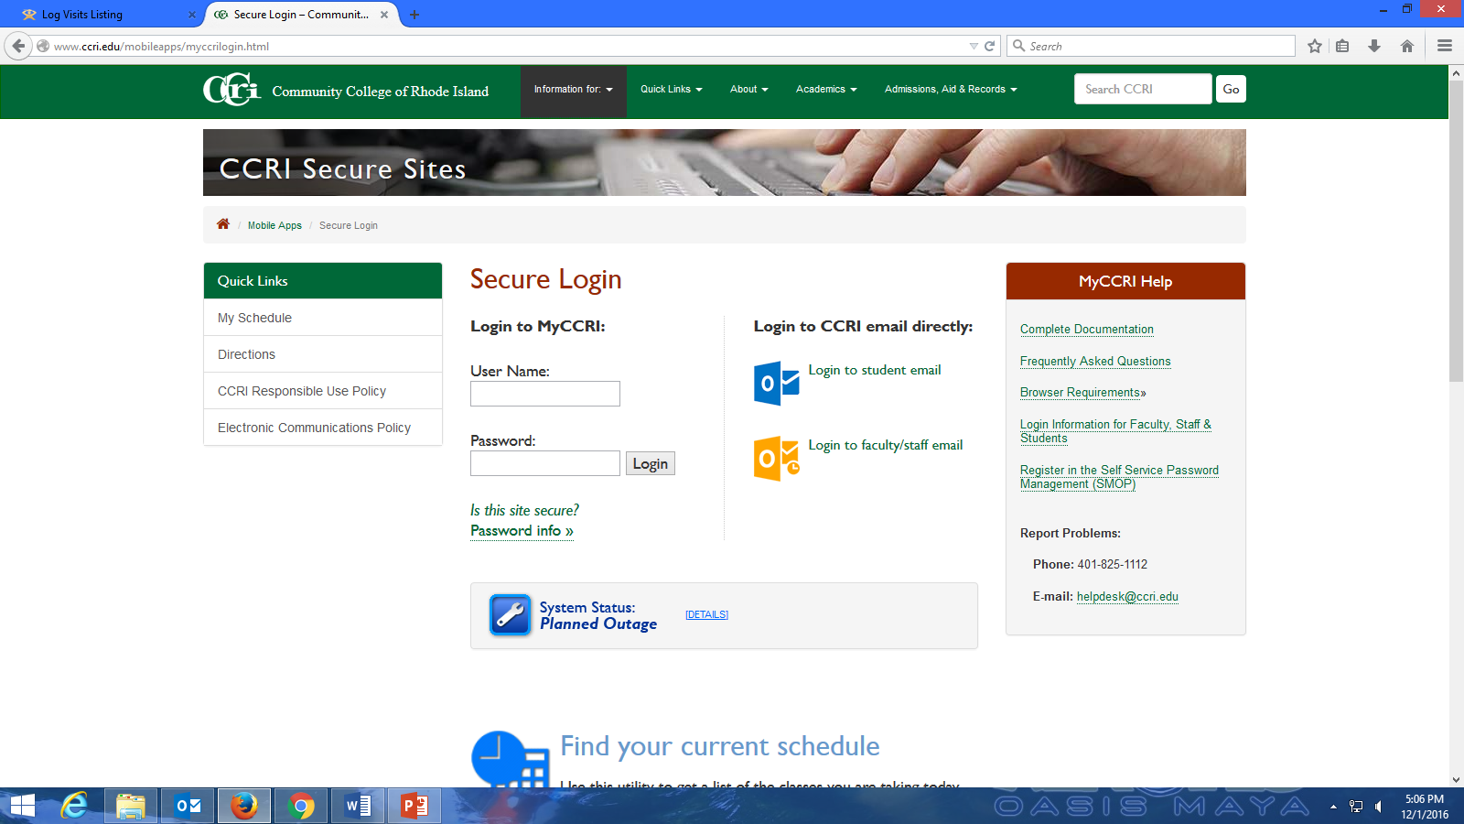

Slide 19
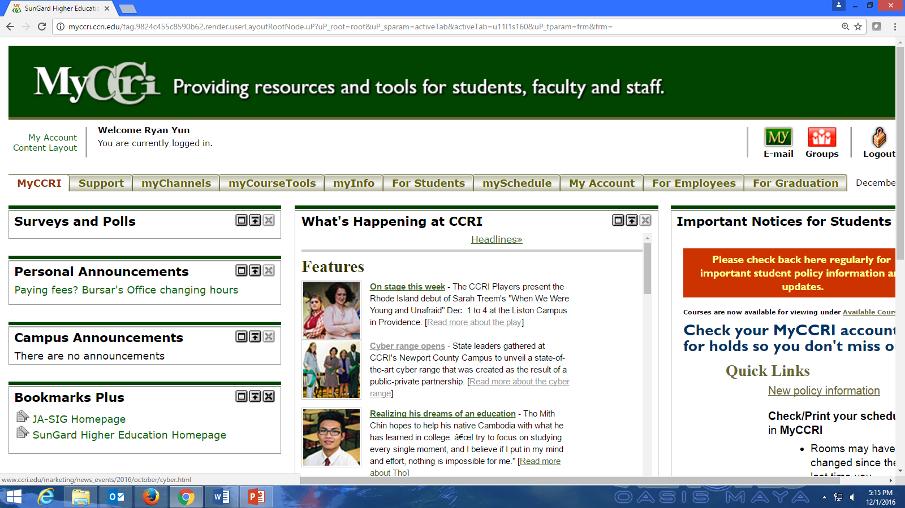

Slide 20
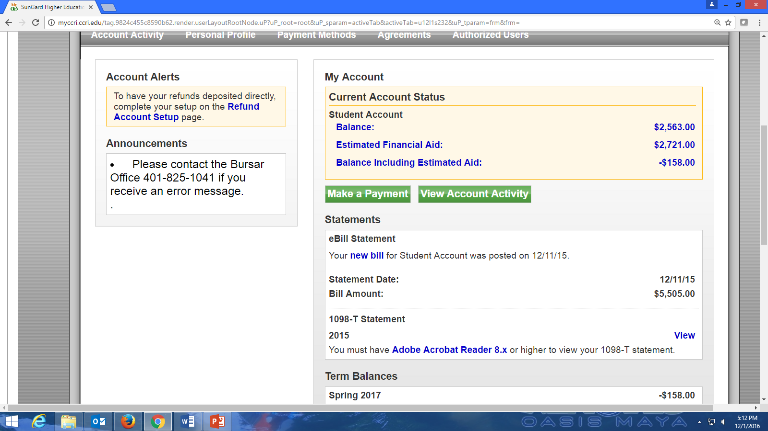

Slide 21
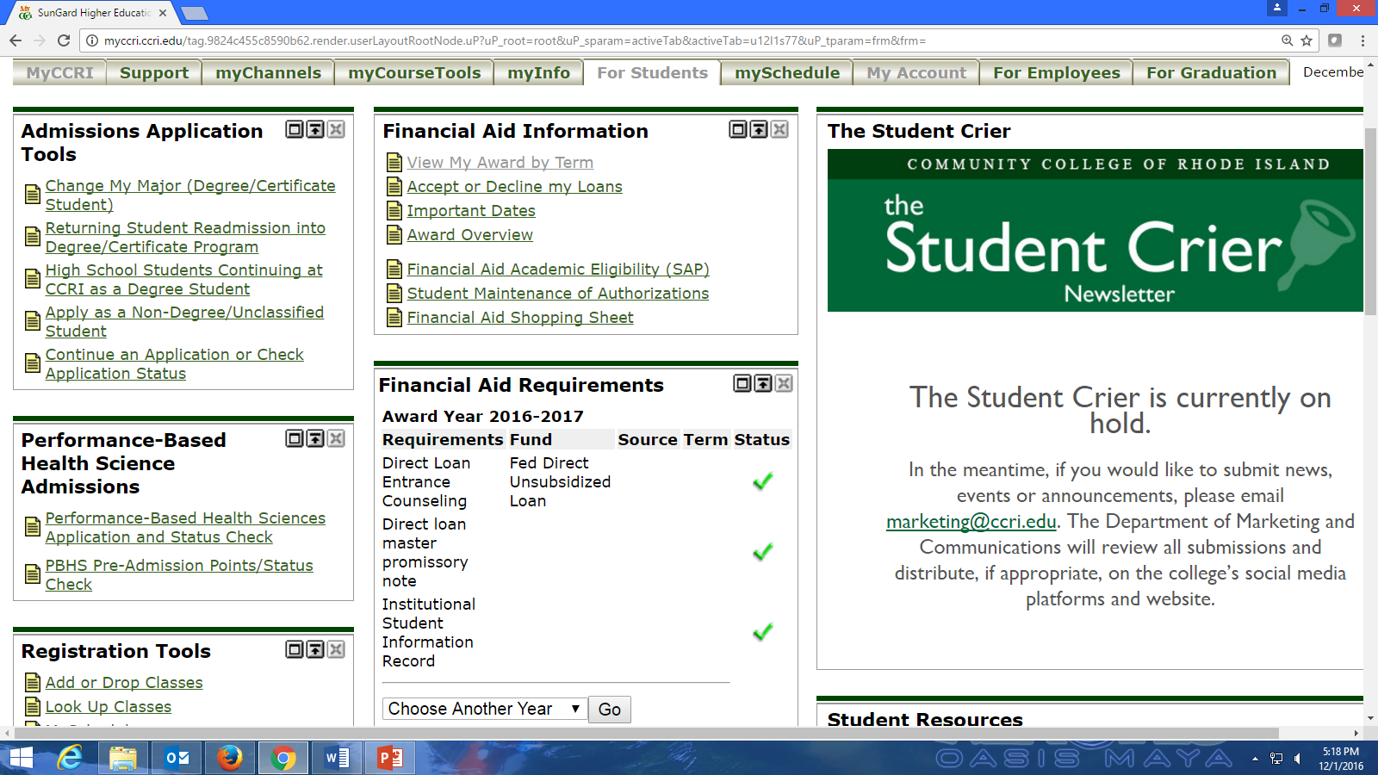
These are forms or tasks that CCRI’s Financial Aid department or FAFSA has requested you complete. If you have not submitted the form or completed the task – CCRI’s Financial Aid Office will not process your financial aid!
Green checkmarks are good – the office has your forms or you completed a requested activity.
Red flags are bad – you have not submitted the form or completed the requested task.

Slide 22
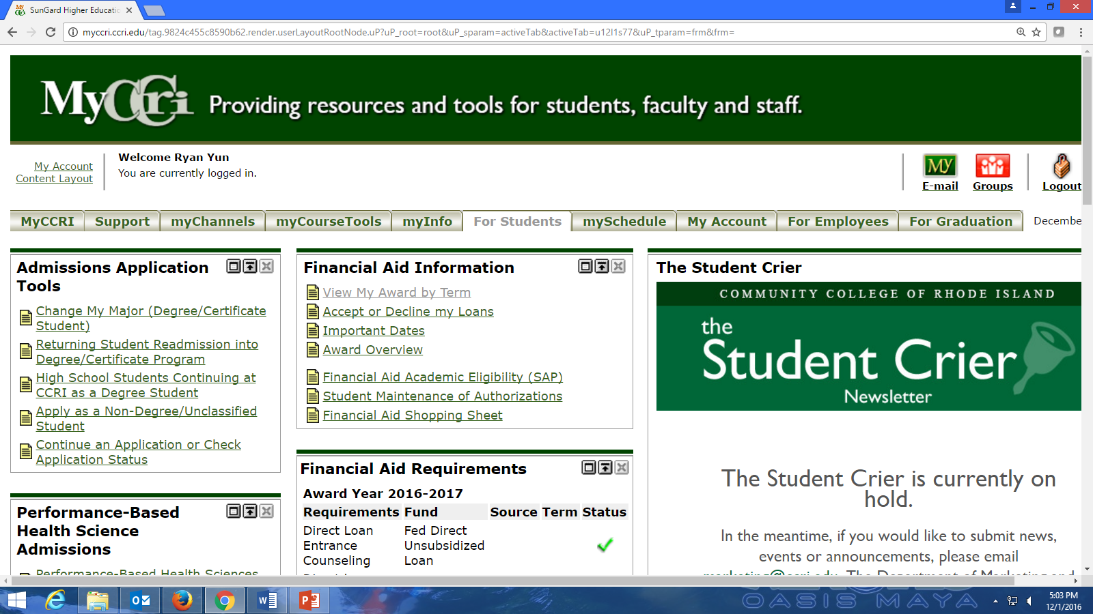

Slide 23
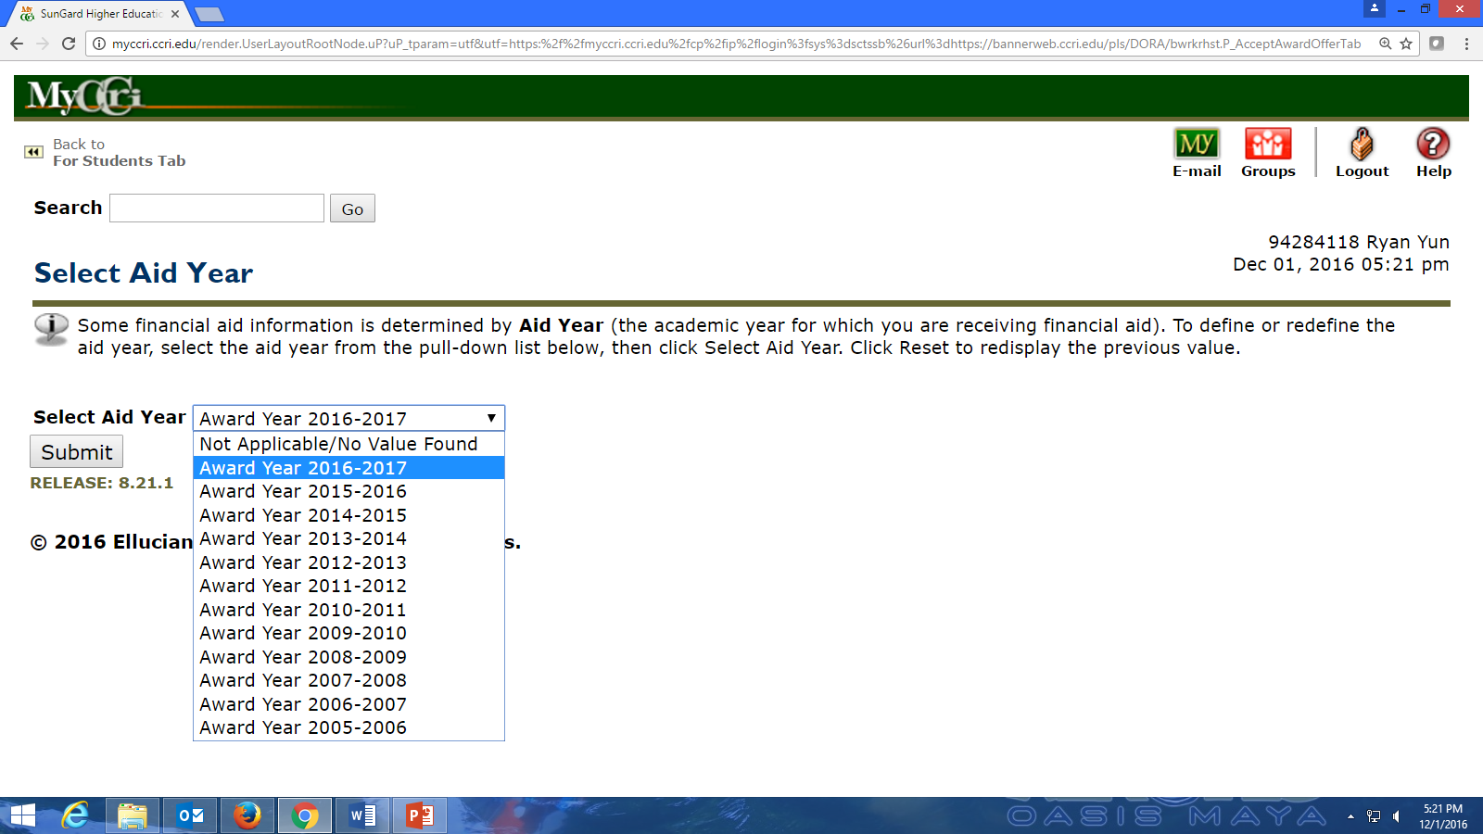

Slide 24
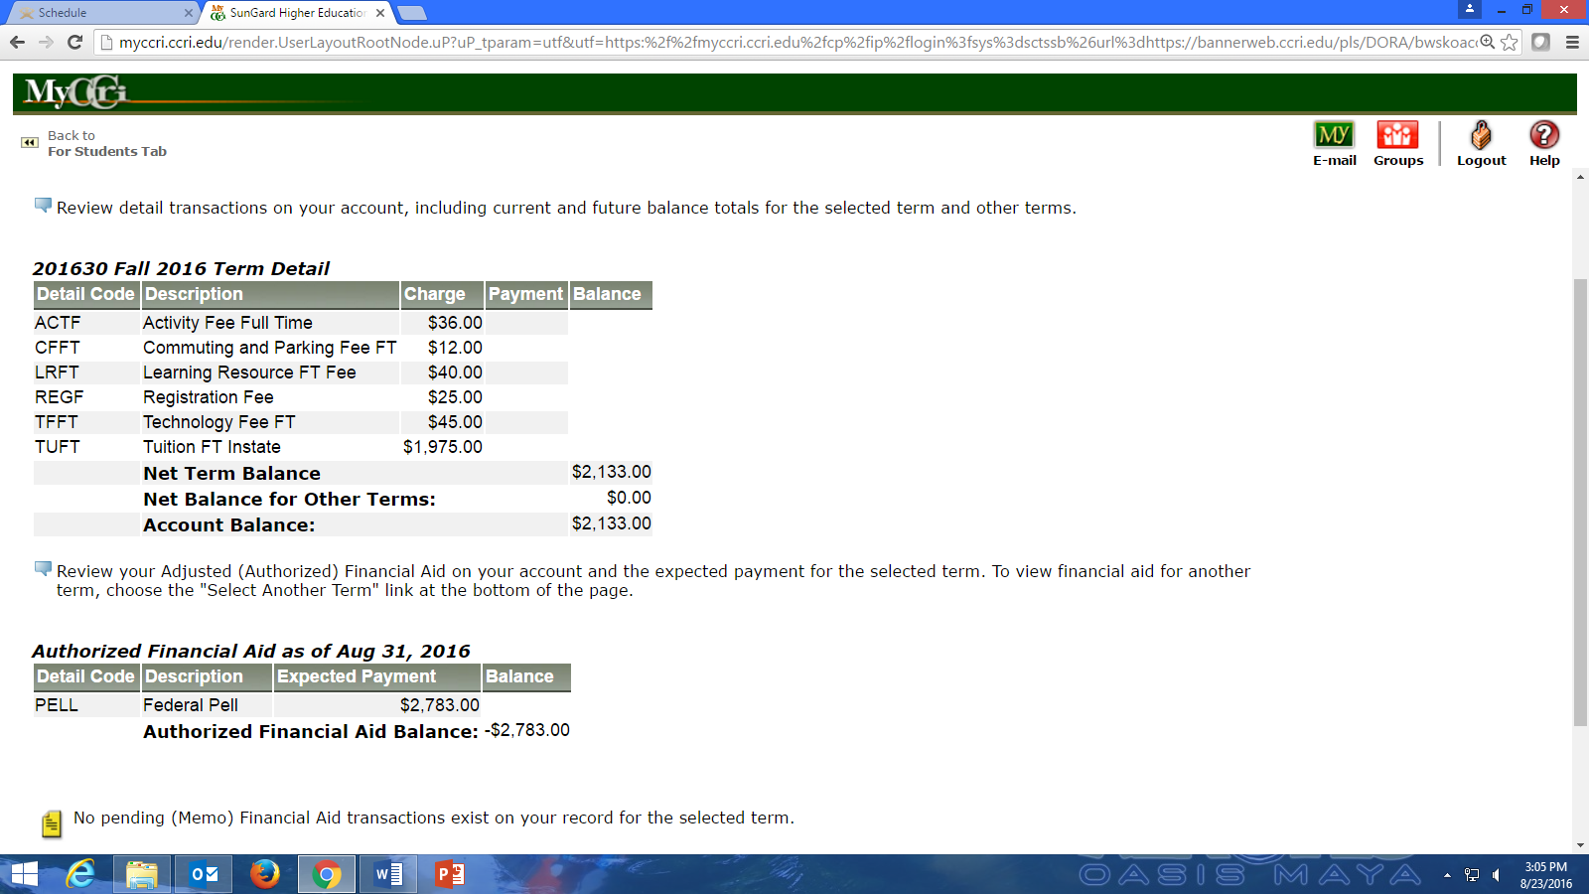
Notice this student’s Pell Grant is greater than the tuition. In this instance the student is eligible for a refund.
You may authorize CCRI to use your Pell refund (up to $600) to purchase books and supplies from the CCRI Bookstore.
All refunds will be mailed or direct deposited approximately 6-8 weeks after the semester begins.

Slide 27
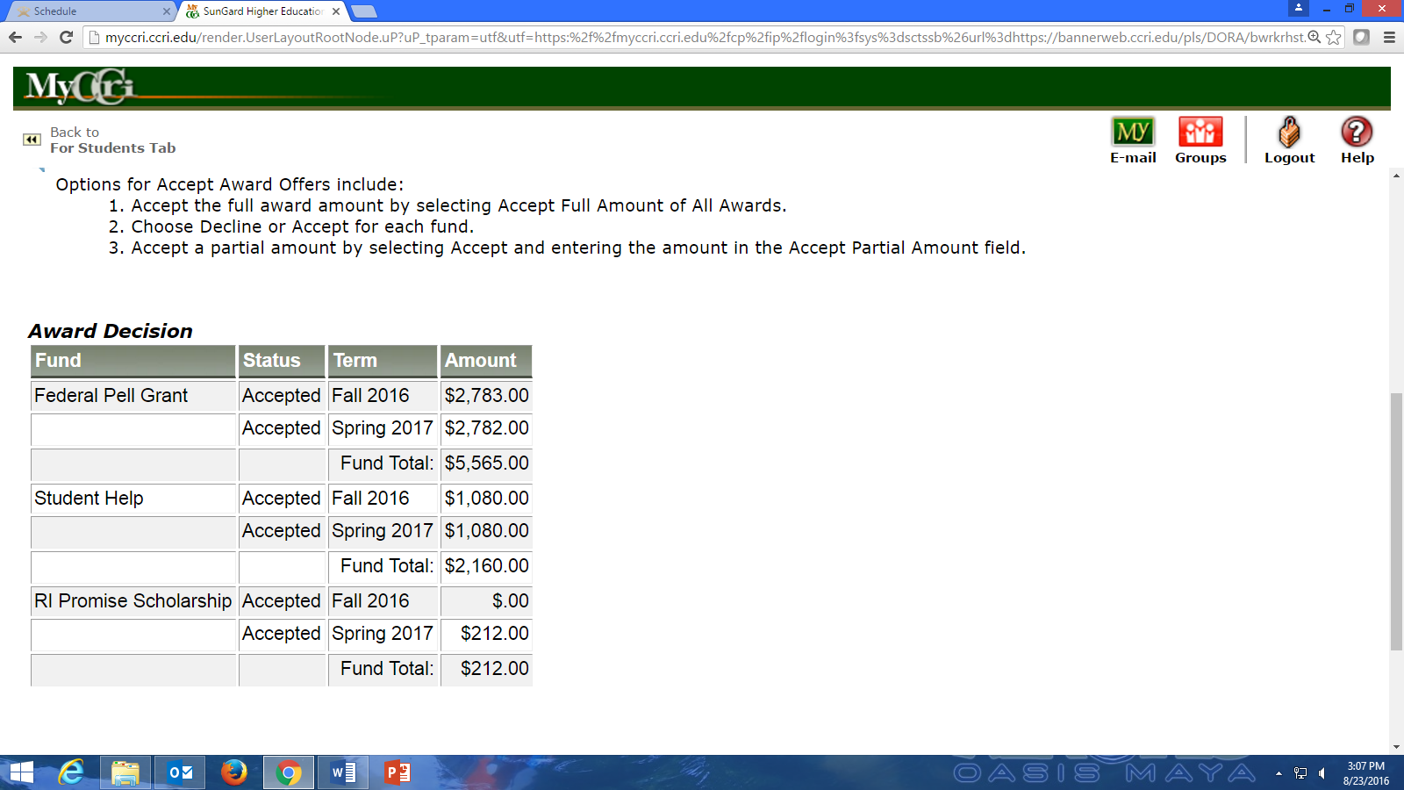

Slide 29
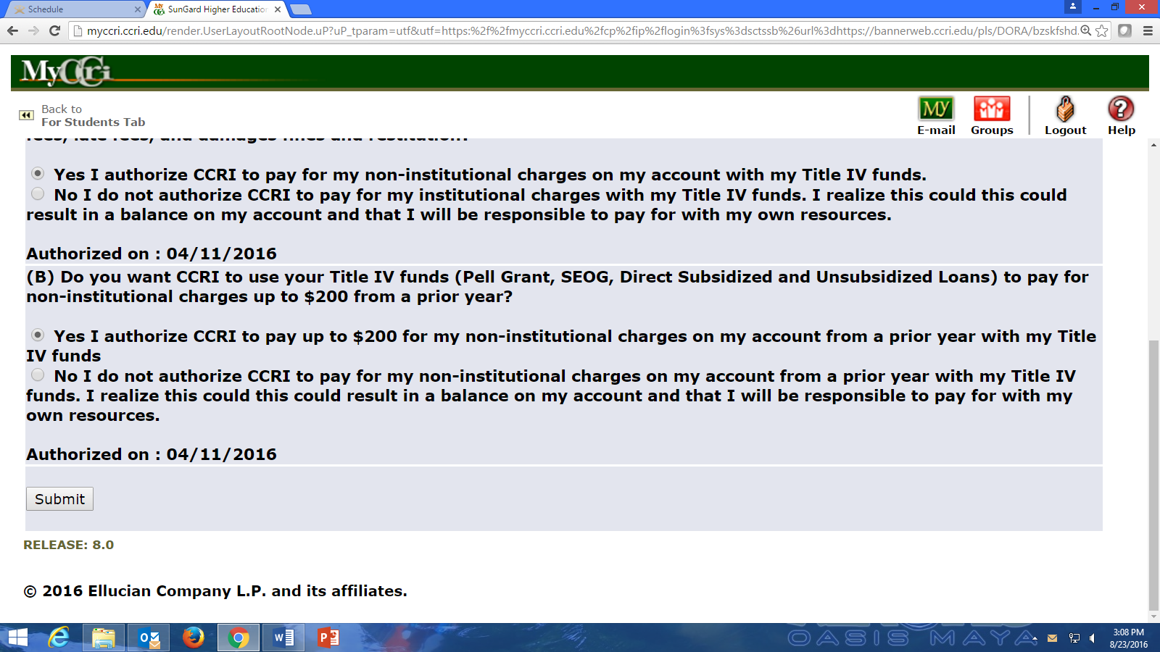

Slide 30
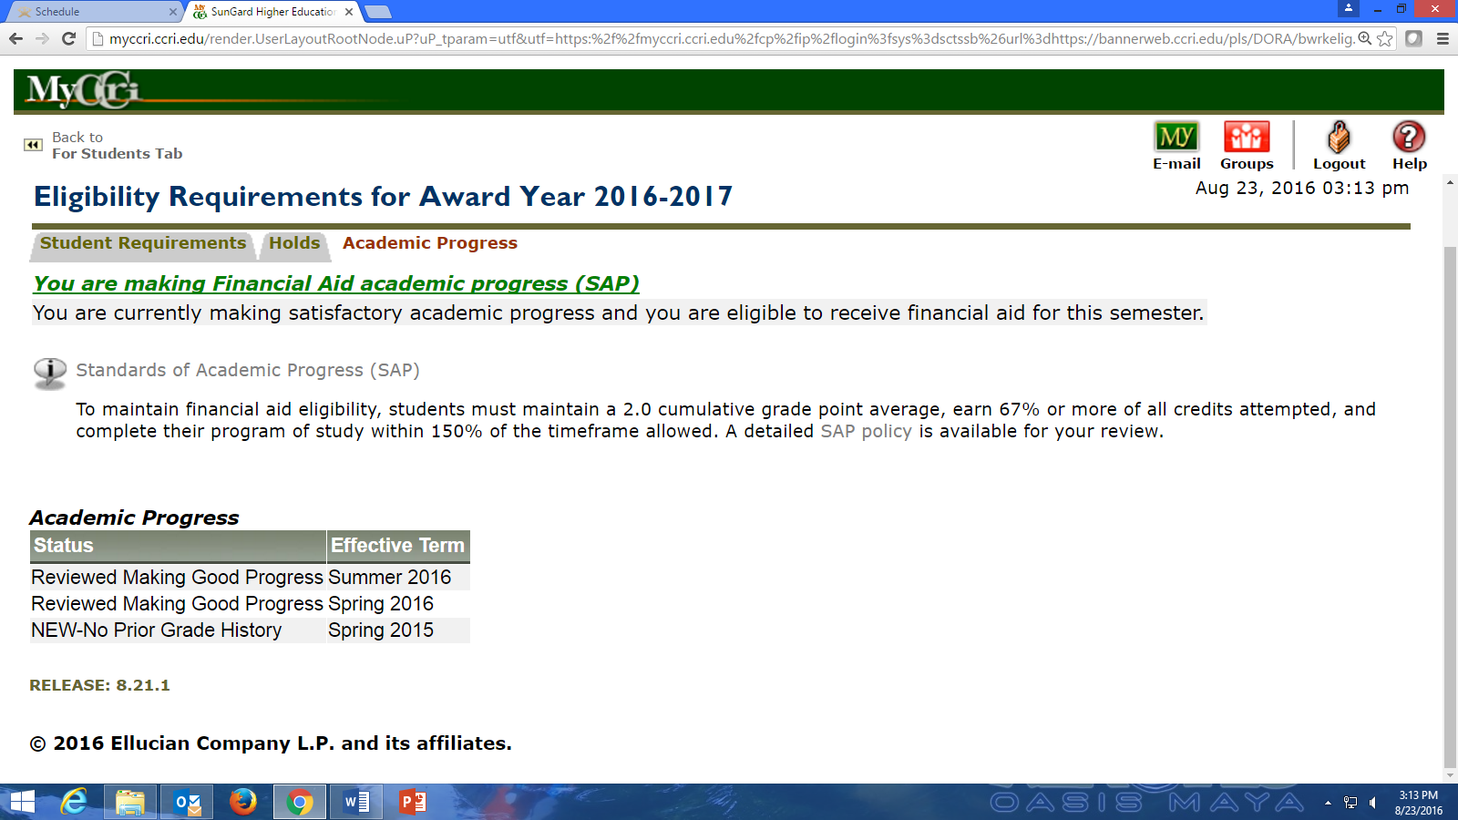
  Students who qualify and receive financial aid must meet minimum academic standards.
  To continue receiving aid, students must maintain a 2.0 grade point average (GPA) and successfully complete two-thirds of the credits they attempt each semester.

