Slide 1
IT Services for Students
Community College of Rhode Island

Slide 2
Six Tasks to Accomplish Today
Find your username
Your default password
Enroll in the Self Service Password Management Program
Change your password
Update your contact information in the MyInfo tab
Set the time to Eastern Standard Time (EST) in your CCRI email account

Slide 3
1. Looking Up Your User Name
Every new student is assigned a username and a default password which is used to access MyCCRI, Blackboard, Tutor Trac, CCRI Email
Your username was issued to you when you were accepted to CCRI
This activity will show you how to find your username
If you know your username, please wait quietly while your classmates complete this activity

Slide 4


Slide 5
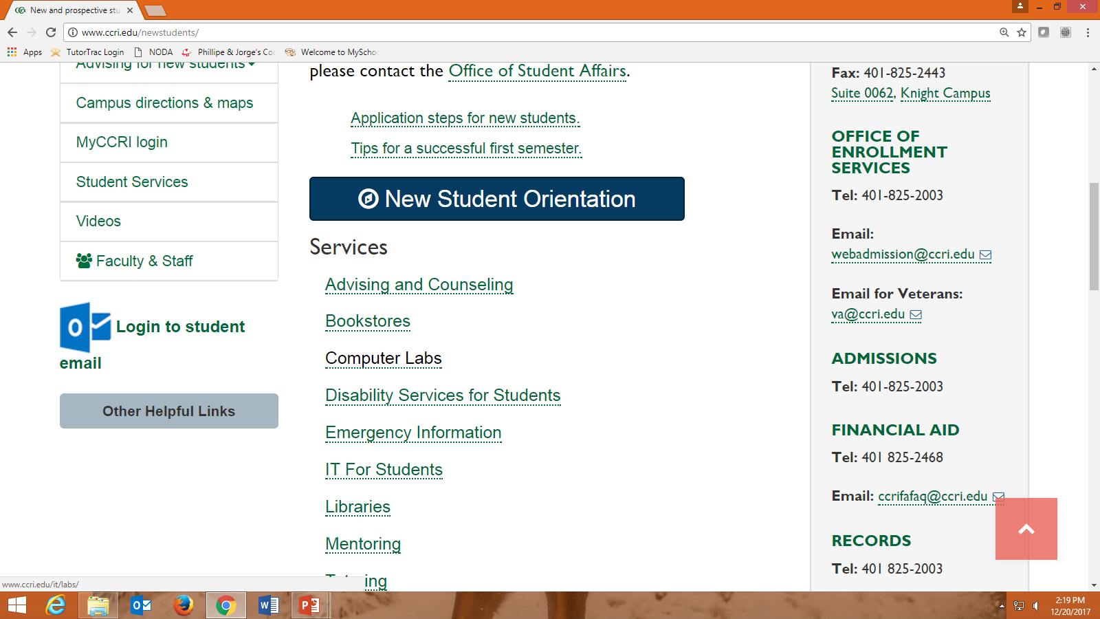

Slide 6
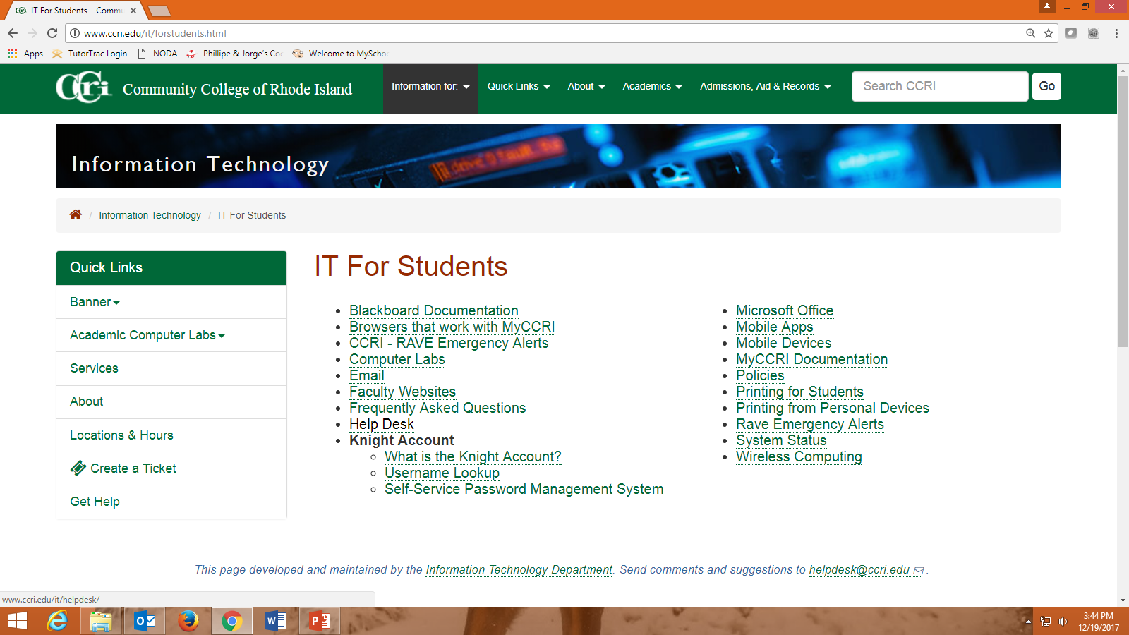

Slide 7
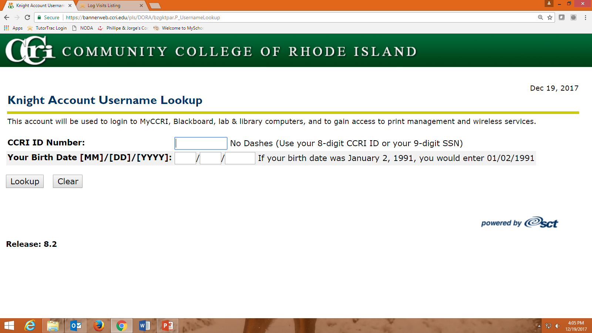

Slide 8
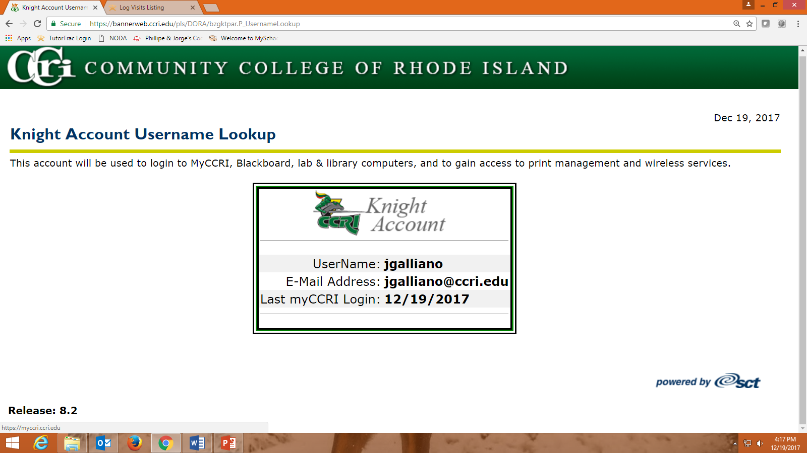
Click on the back arrow twice to return to the
IT for Students page
Write this information down or use your cell phone to take a picture of this information
You will need this information to enrollment in the password management program and change your password
nstudent
nstudent@my.ccri.edu

Slide 9
2. Your default password
Your were issued a default password when you were accepted into CCRI. Your default password is composed of:
The first three letters of your username – with the first letter CAPITALIZED
Followed by an underscore (use the shift key and dash)
The last four digits of your CCRI ID number (located on your acceptance letter and class schedule)
Write down your default password to use for the next task
Example:
Username: nstudent
CCRI ID#: 98765432
Sample default password: Nst_5432

Slide 10
3. Enrolling in the Self-Service Password Management Program
This allows you to change or reset your password without having to visit a campus and show proof of identity or wait 24 hours for the Knight Account password reset form to be processed.
After enrolling in this program, you will be able to change your default password
If you already enrolled in this program please sit quietly while your classmates complete this task

Slide 12
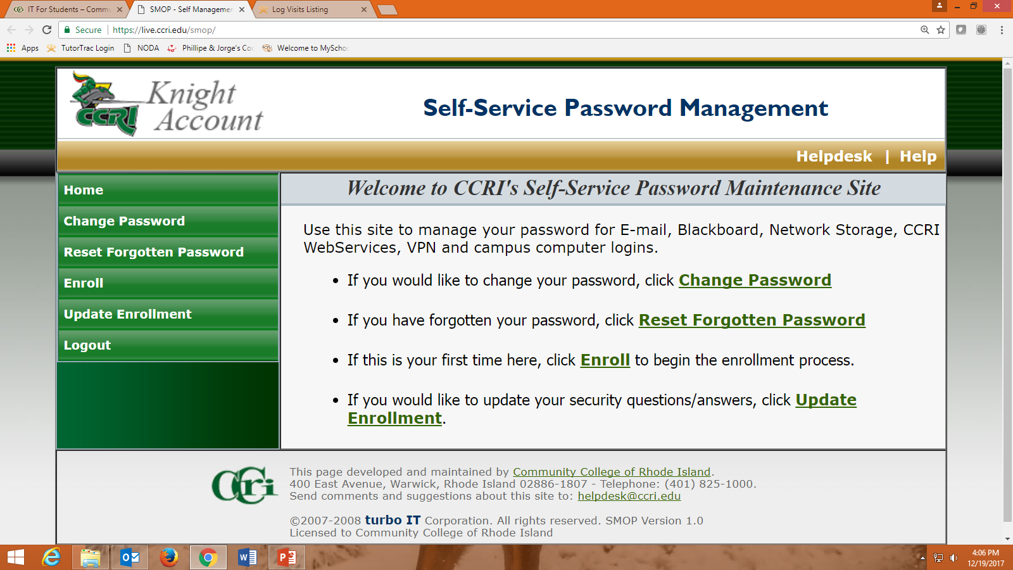

Slide 13
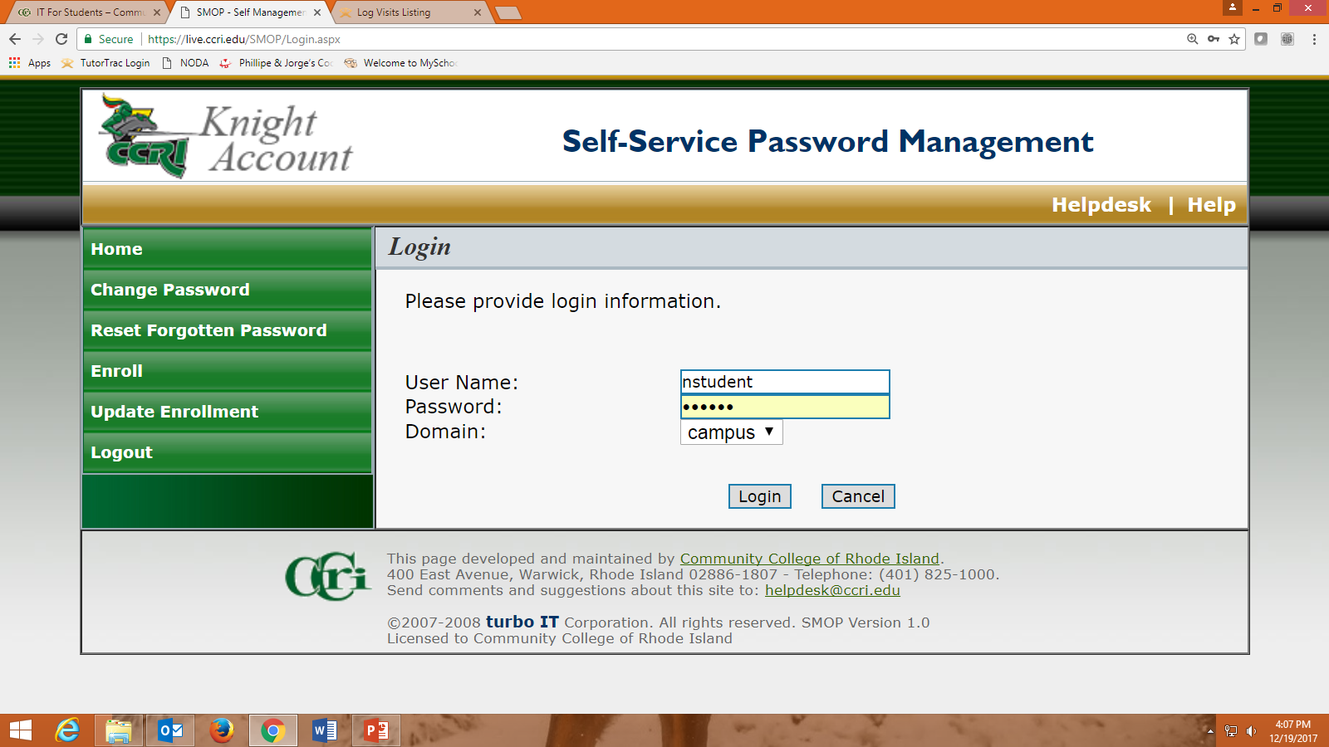
Use your default password

Slide 14
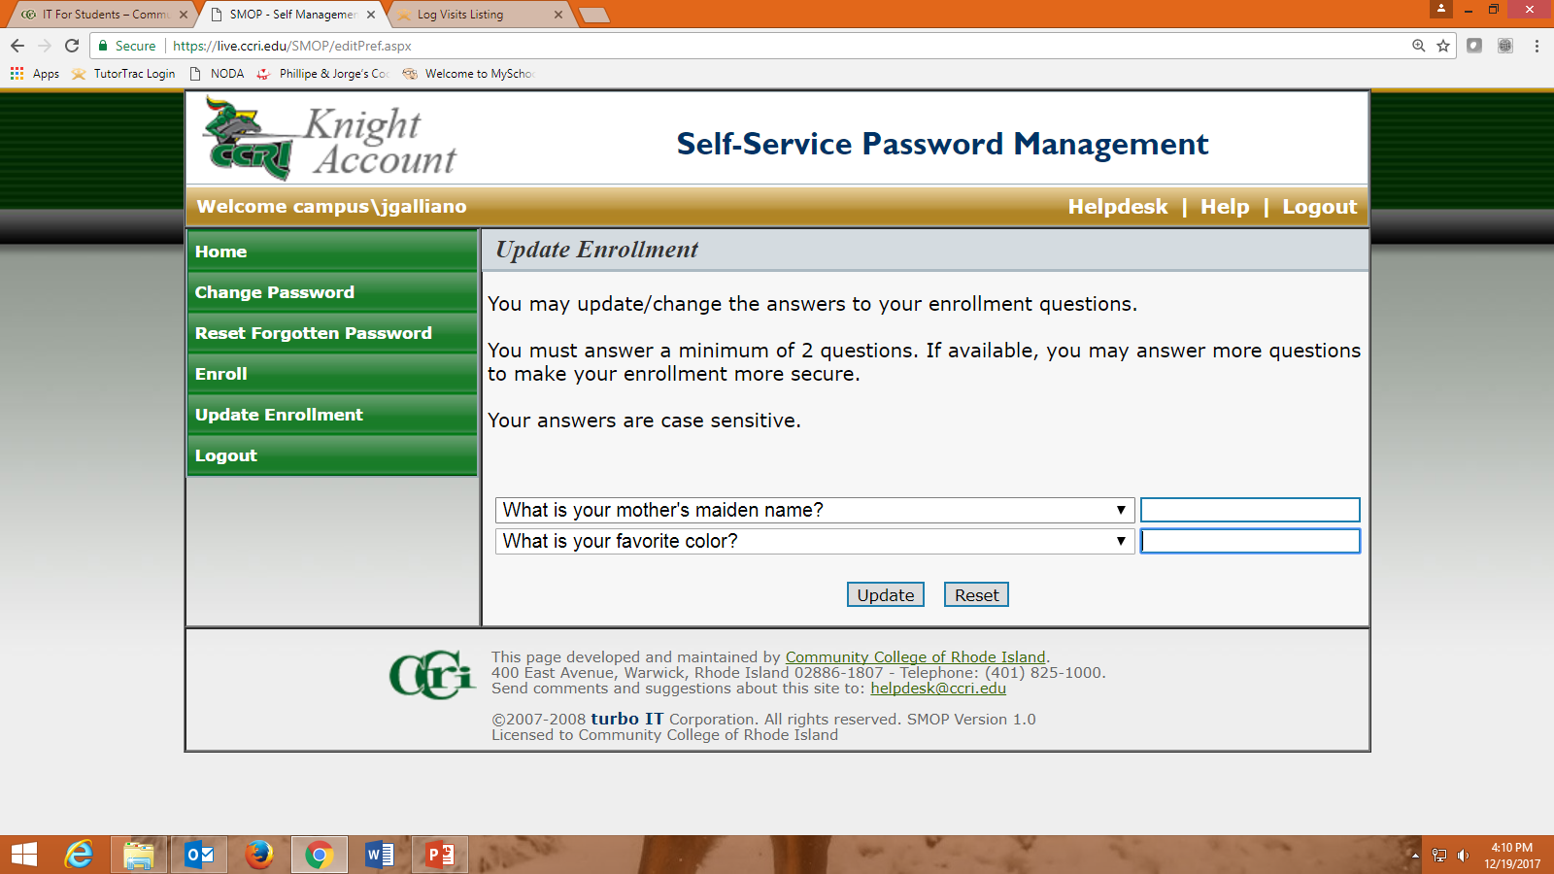

Slide 15
4. Change Your Default Password
If you already changed your default password please sit quietly while your classmates complete this task
For security reasons you must change the default password you were issued upon acceptance to CCRI. Your new password must be:
At least eight (8) characters
Must include both letters and numbers
Have at least one (1) CAPITALIZED letter
Example: 5scaryCats

Slide 17
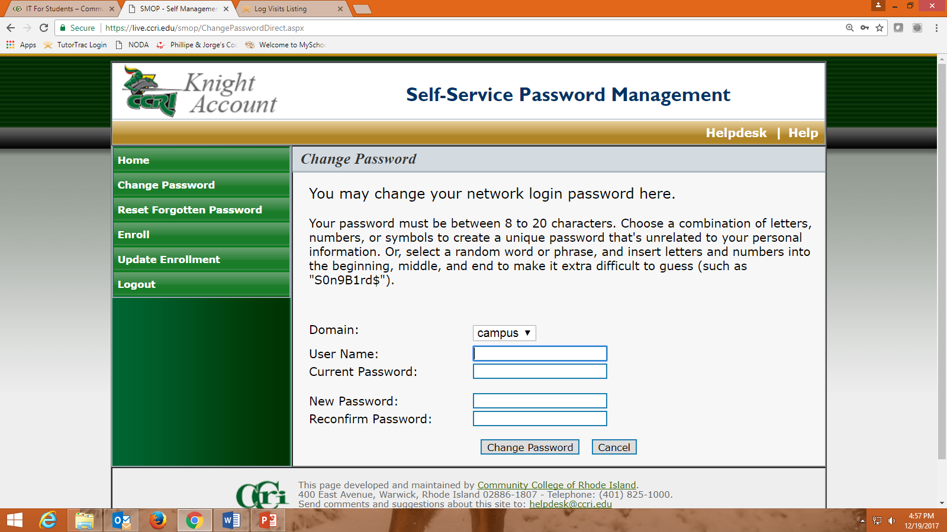

Slide 18
5. Updating MyInfo
This activity will show you how to update your mailing address, email & cell phone information with CCRI. You need to update your MyInfo tab every time you change your telephone number or mailing address!
CCRI sends information about billing, courses, scholarships and special programs throughout the year
The college needs to be able to reach you by phone, mail, email and text – Please remember to update this information if you move or get a new phone number

Slide 19
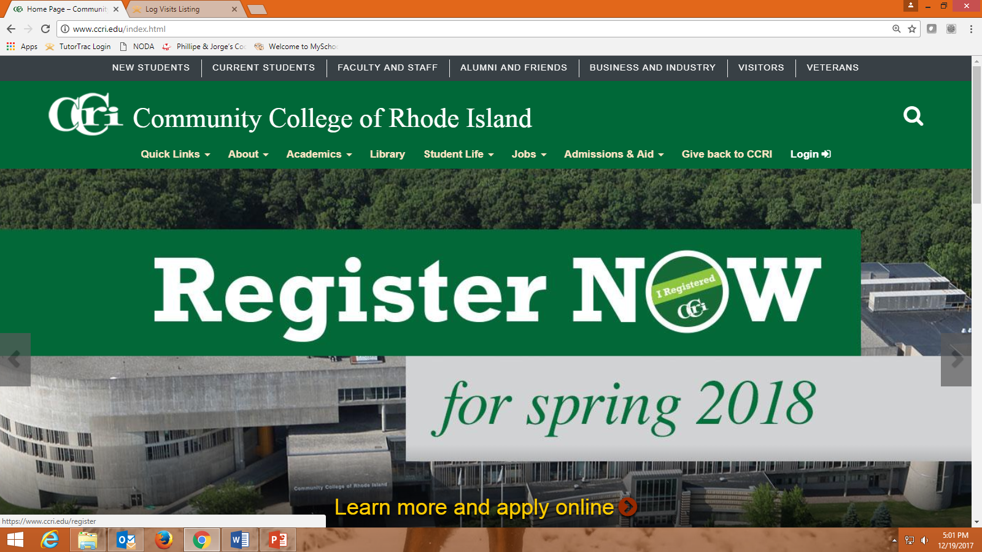

Slide 20
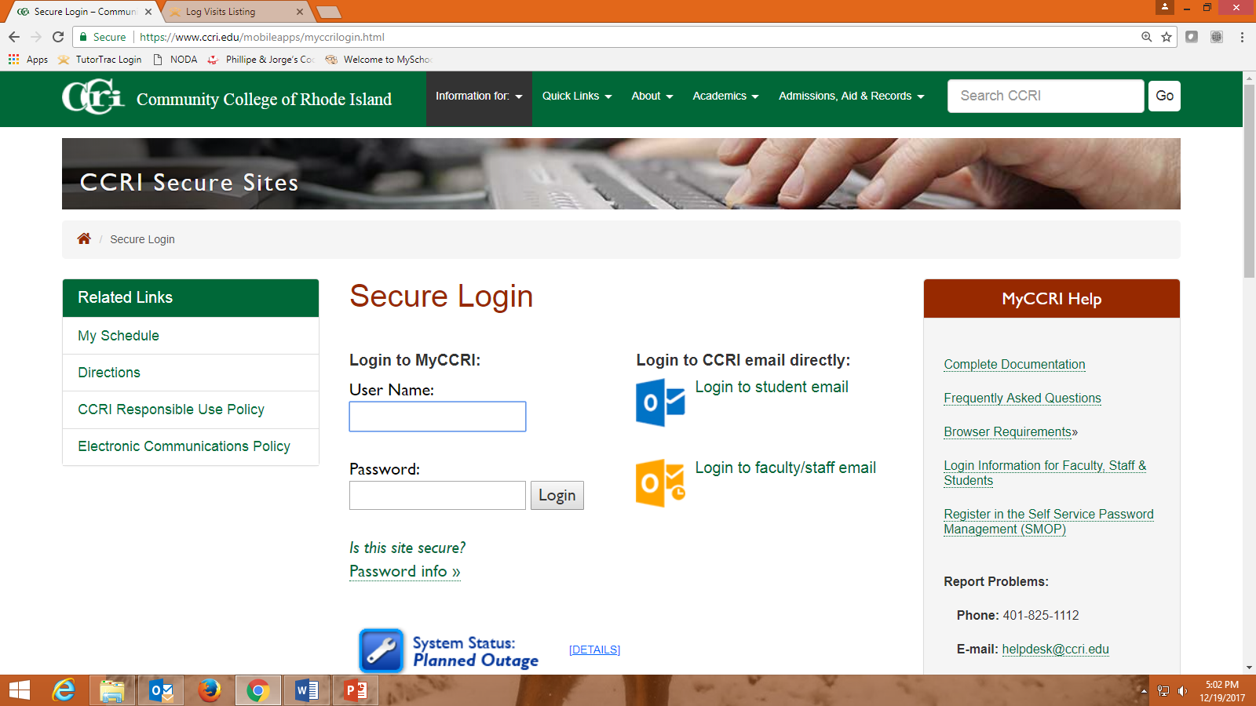

Slide 21
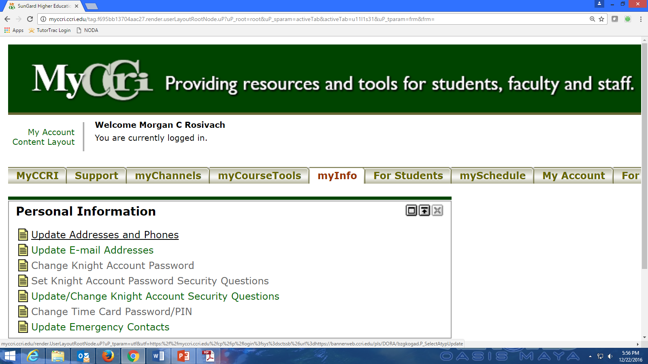

Slide 22
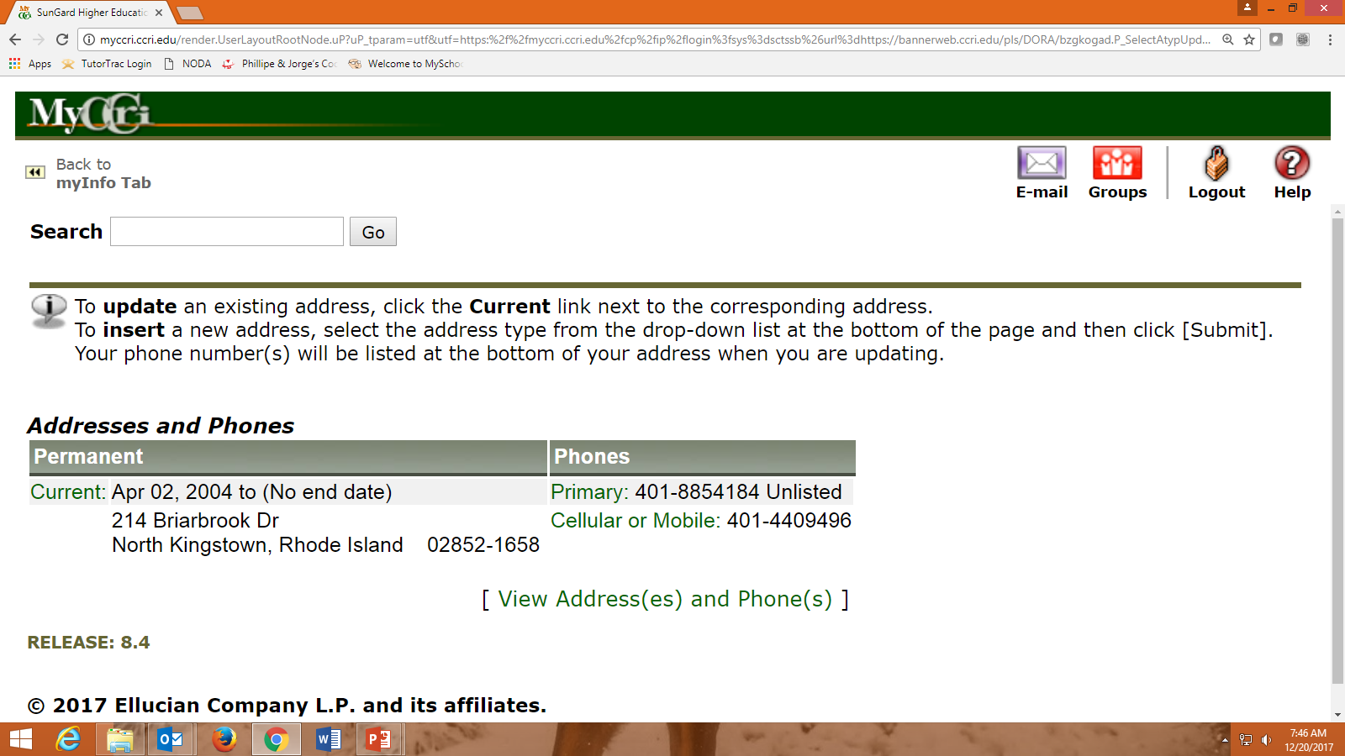
Click on the Primary Link to review and update your information
128 Poplar Drive
Providence, Rhode Island 02900-1682

Slide 23
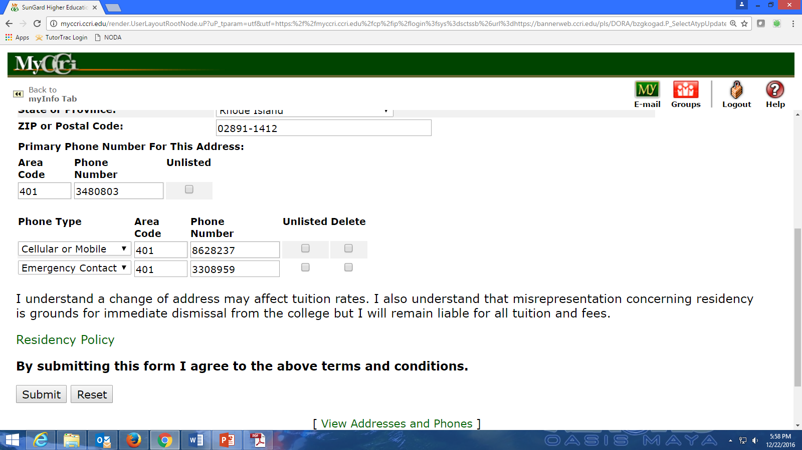
02900-1682
Review your address and telephone numbers for accuracy
Update the Cellular or Mobile telephone number to receive RAVE notifications on your cell phone
222-2222
444-4444
121-1212

Slide 24
6. Using your CCRI Email
All students are issued a CCRI email account which includes your username (e.g. nstudent@my.ccri.edu)
This is the official method of communication from CCRI
You need to check your CCRI email daily
Use your CCRI email to submit email and homework to faculty – faculty may not reply to non-CCRI email addresses
Opening your CCRI email account for the first time – setting the correct time zone (Eastern Standard Time)

Slide 25
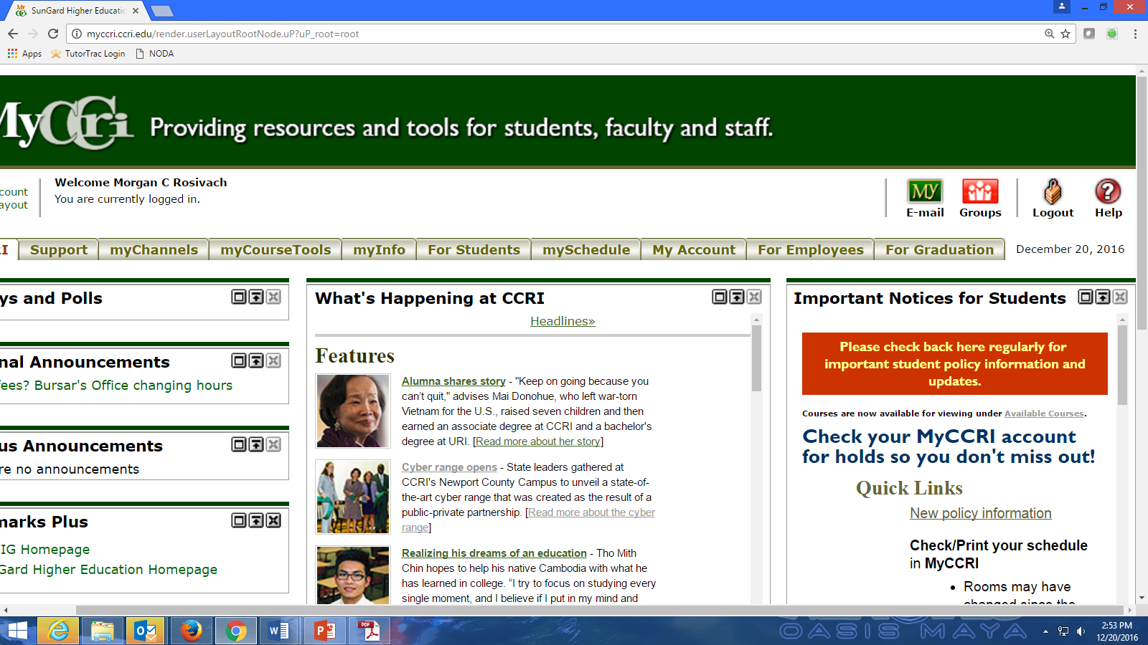
CCRI E-mail is the official means of communication between the
College and students
You should check your CCRI email DAILY
Your CCRI email is your username@my.ccri.edu

Slide 26
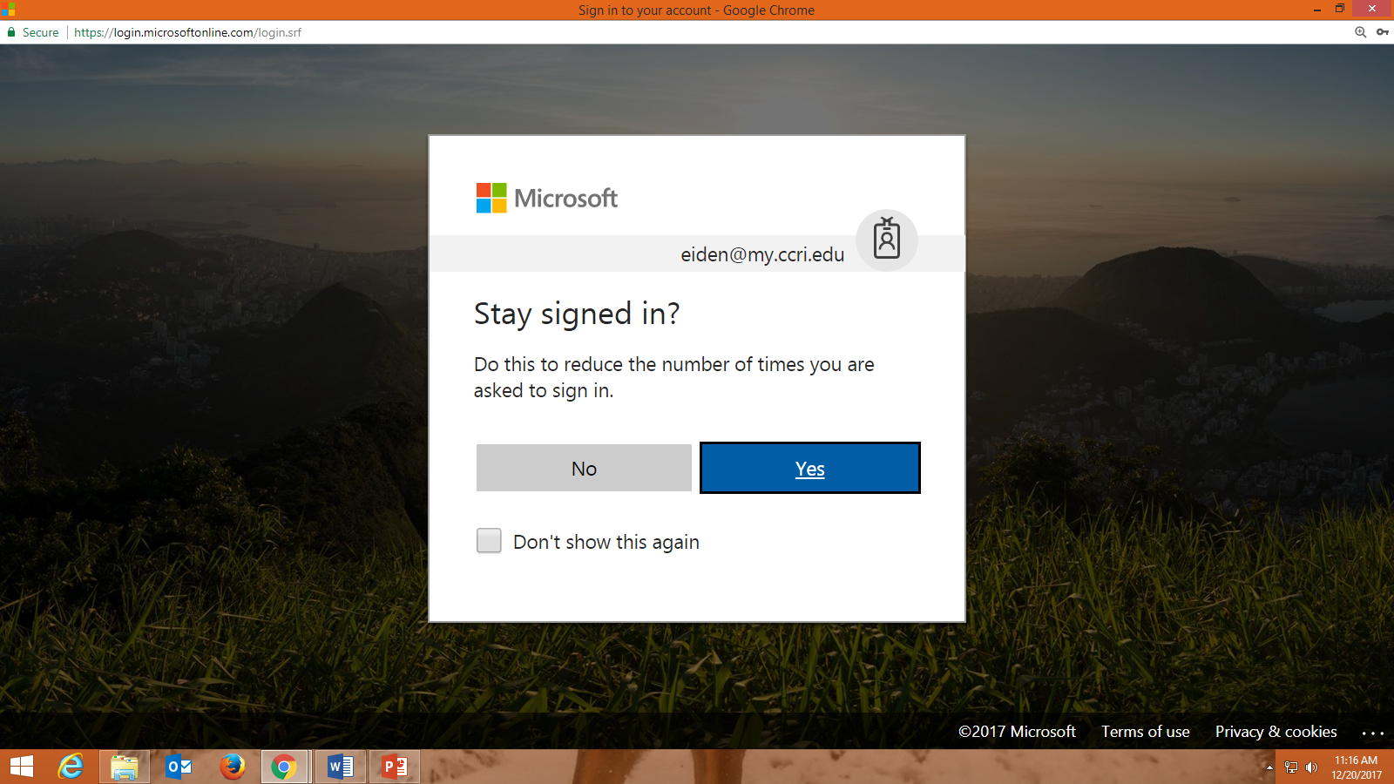
nstudent
You may receive this message
For security reasons, if you are using a public computer click No

Slide 27
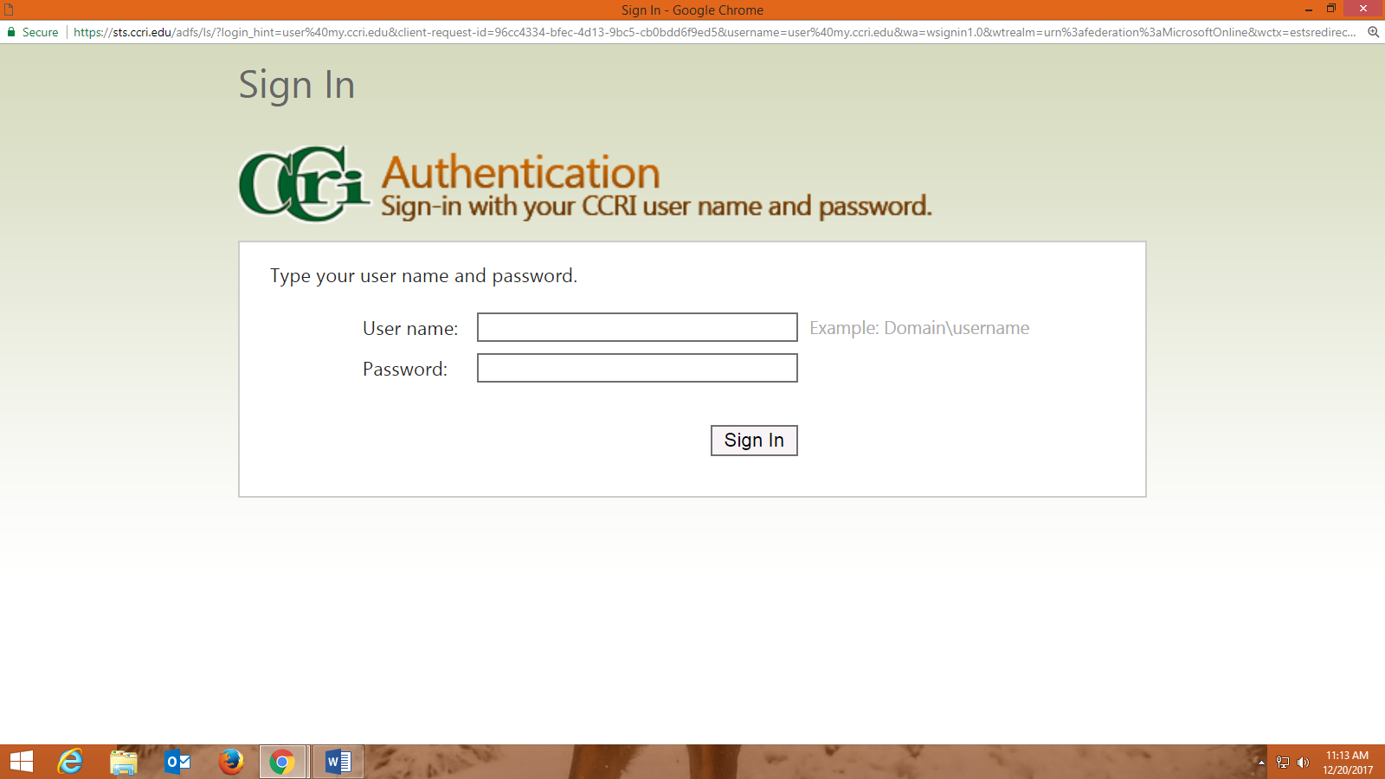

Slide 28
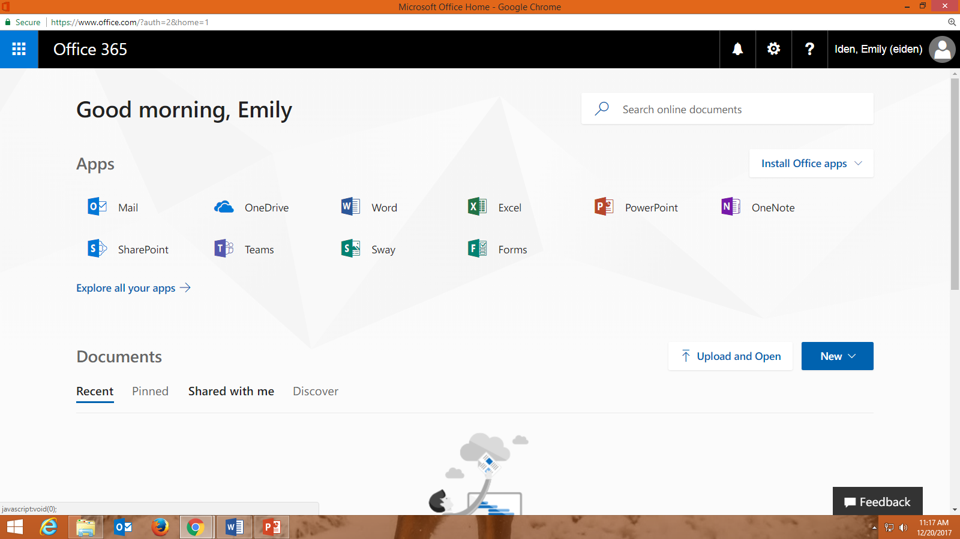
First Time Signing Into Your CCRI Email?
If this is your first time signing into your CCRI email, you are required to set the time zone to EASTERN STANDARD TIME.
Click the drop box, scroll down the list slowly
until you locate the correct time zone.

Slide 29
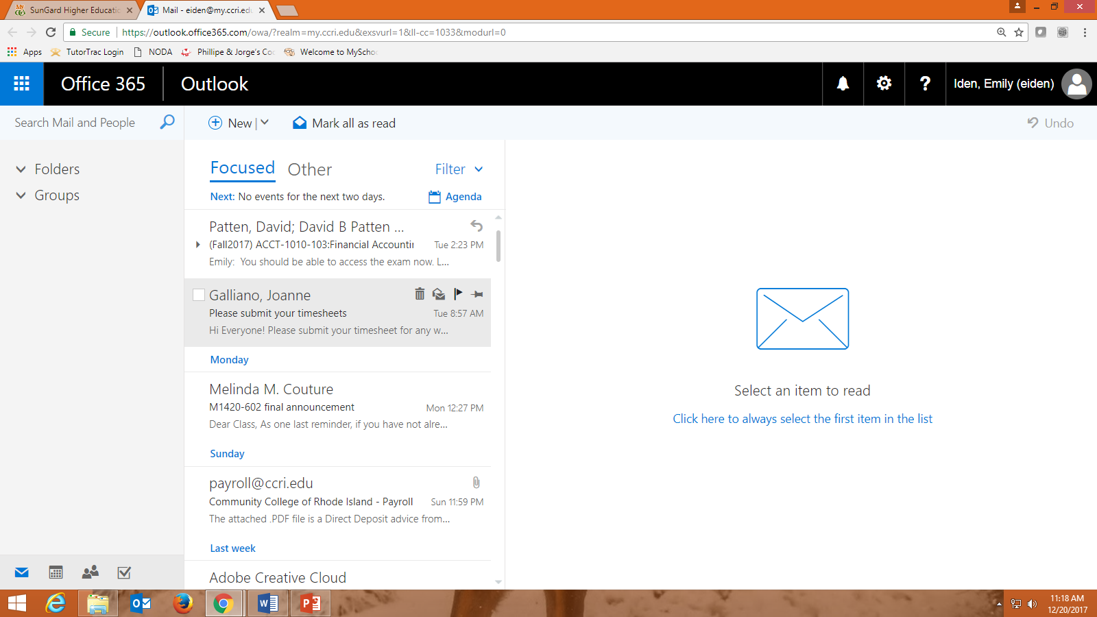
How to Forward Your CCRI Email to Another Account
Locate and click on the gear (top right corner of web page)

Slide 30
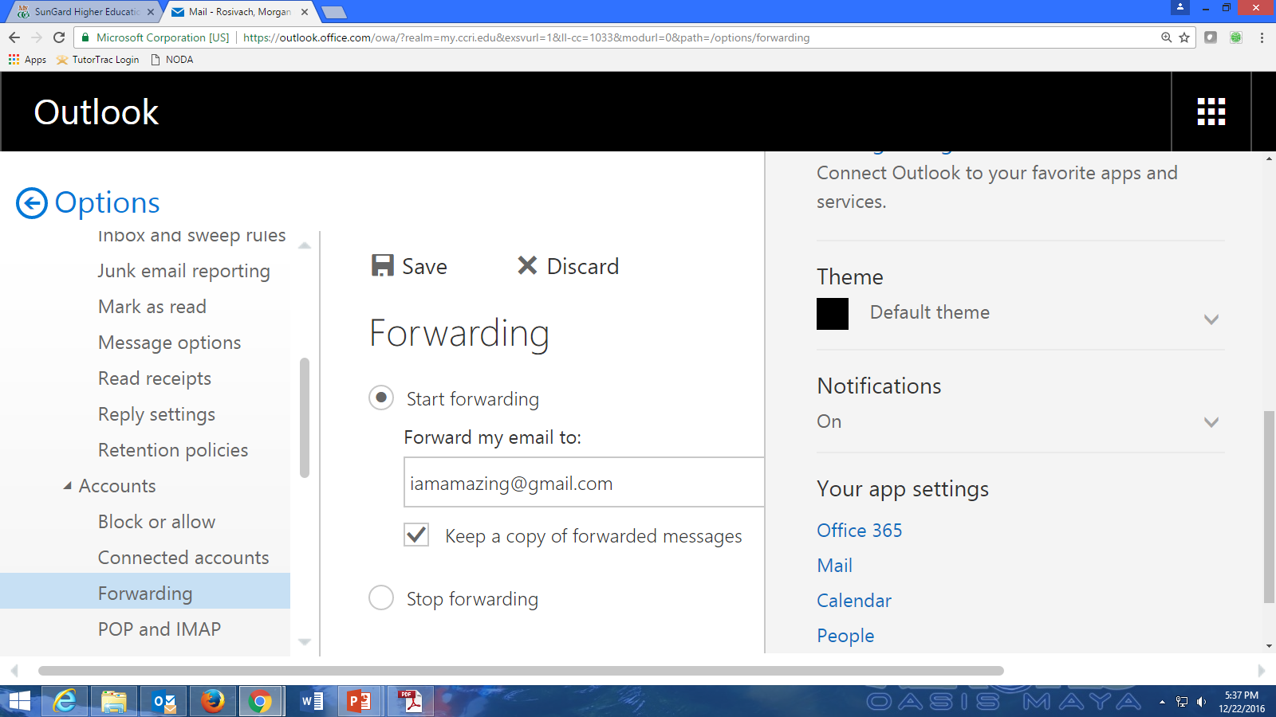
Under Your app settings, click Mail. Under Options (left side of web page) scroll down the list and click Forwarding
Type in the email address and click Keep a copy of forwarded messages and Save

Slide 31
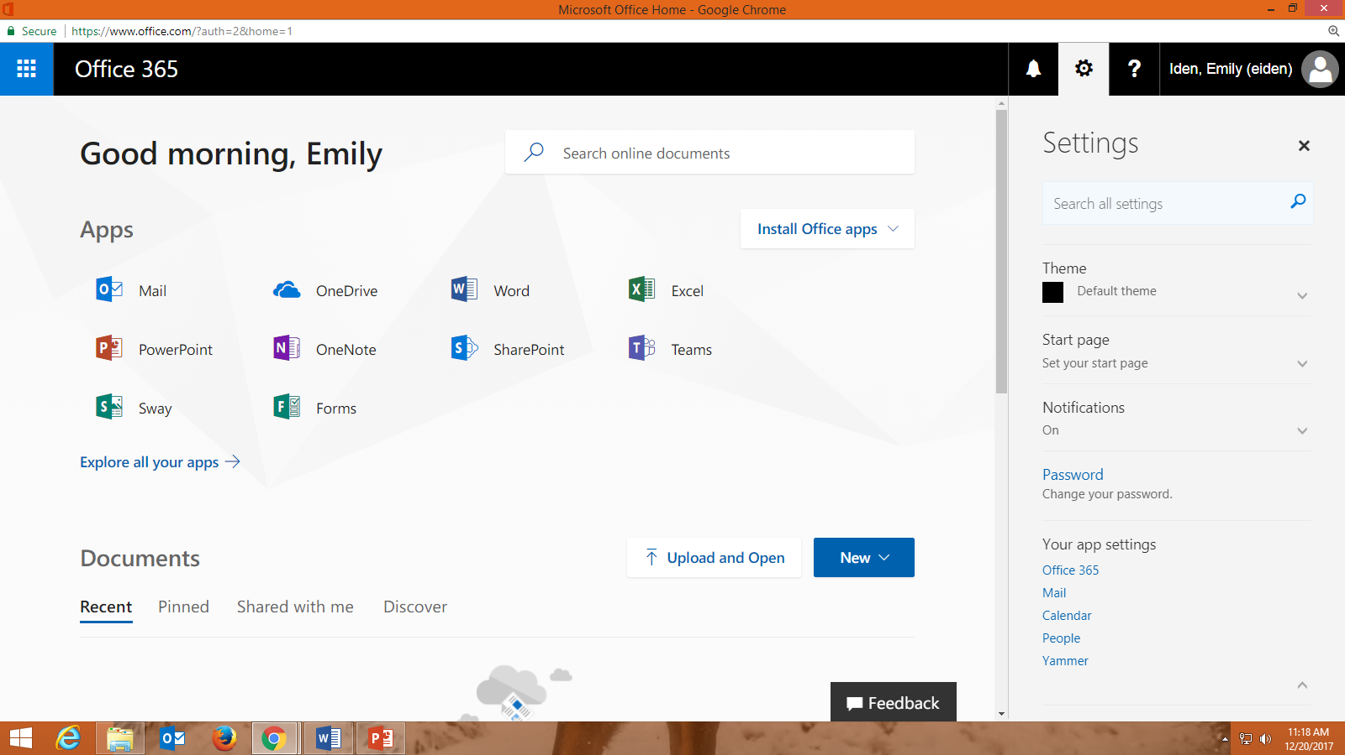
Microsoft Office 365
MS Office 365 offers students Outlook email and access to the Office Web apps for creating and editing documents, spreadsheets, and presentations online.
OneDrive allows students to save and access their files from any computer with an Internet connection. While using Office Web Apps, files are automatically saved to your OneDrive.

Slide 32
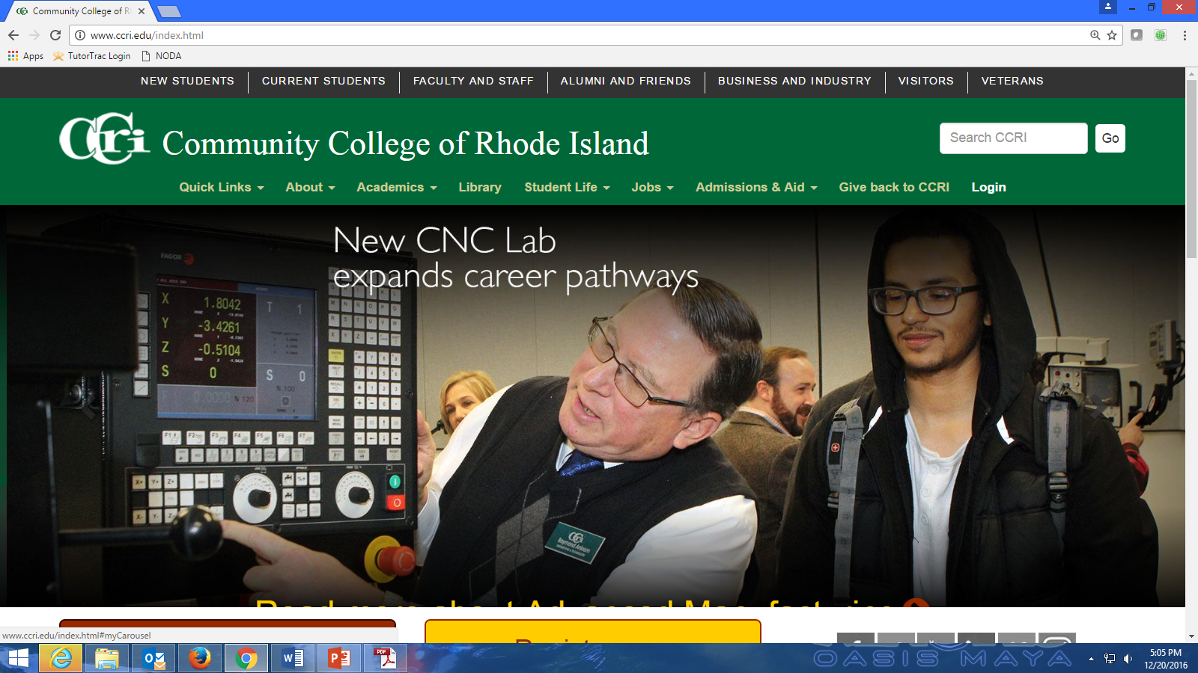
Getting Help with Technology Issues
Academic Computer Labs
Each campus has an Academic Computer Lab. This is the place to visit to get help:
to reset your CCRI password
to connecting to the CCRI wireless network
ask basic computer or software questions
To receive help, you must bring a photo ID to the Academic Computer Lab. Computers and printers are available in the Academic Computer Lab for students to use for research, homework, course registration, etc.

Slide 33
Academic Computer Lab Hours
Labs are located on each campus and are generally open:
Monday – Thursday from 8:00am – 10:00pm
Friday from 8:00am – 4:00pm
Saturday from 9:00am – 2:00pm
The Liston Campus (Providence) offers Sunday hours during the fall and spring semesters
Go to www.ccri.edu/it/labs for current lab schedules

