Slide 1
Everything you need to know for CHEM-1100
Presented by the Student Success Center
Community College of Rhode Island

Slide 2
What is necessary for CHEM-1100?
What is assumed you know:
SI Units
Unit Conversion
Significant Figures
Ideal Gas Constant
Polyatomic Ions
Mol
Temperature in Kelvin
Exothermic Reactions
Endothermic Reactions
Algebra / Pre-Calculus Math
What is covered in more depth:
Molarity / Concentration
Acid / Base Relationships
Redox Reactions
Titrations

Slide 3
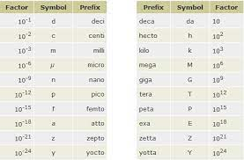
What are SI units?
SI units are the units of measurement that are used by all fields of science to ensure accuracy and precision.
Mass (g)
Length (m)
Volume (L)
Time (s)
Amount of substance (mol)

Slide 4
Unit Conversion and Significant Figures
Unit Conversion is exactly as it sounds, it’s the process of converting one unit to another. Be it from grams to liters, or from milligrams to kilograms, they all work on the same logic.
Significant Figures are the digits in a value that we are confidently able to report.
Any nonzero is significant
Zeros between nonzero digits are significant
Zeros to the right of a decimal place and a nonzero digit are significant.

Slide 5
Example #1
Convert 100 milligrams to kilograms
How many significant figures are in 0.0000034012?

Slide 6
Example #1
Convert 100 milligrams to kilograms
1 * 10^-4 or 0.0001 kg
How many significant figures are in 0.0000034012?
5 sig figs

Slide 7
The Mol ~ Chemistry's "Baker's Dozen"
Remember that the mol is a counting term used by chemists to represent how many particles they have in a particular gram sample
There is always 6.022 * 10^23 particles / formula units in a single mol. However, because different atoms have different masses each atom has a specific molar mass.
Fe = 55.845 g/mol, while C has 12.011 g/mol
Mols can be used as a "bridge" from one substance to another.

Slide 8
Example #2
If I have 0.30 grams of glucose at the end of my reaction, how much water did I have? (MM H20 = 18.01528 g/mol | MM glucose = 180.156 g/mol)

Slide 9
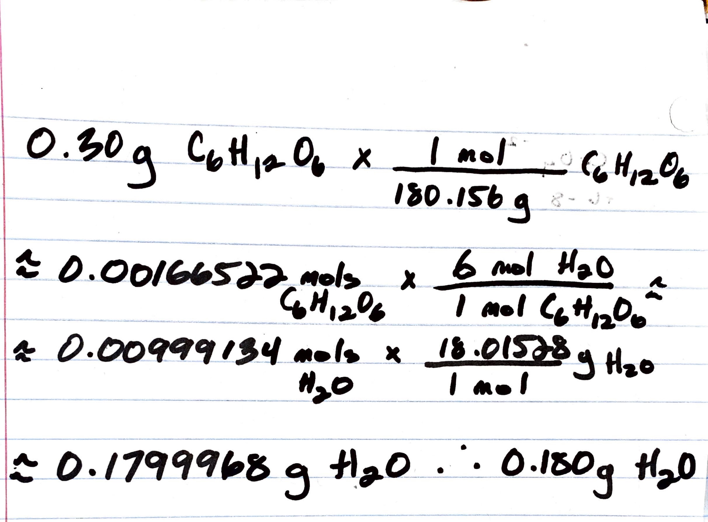
Example #2
If I have 0.30 grams of glucose at the end of my reaction, how much water did I have? (MM H20 = 18.01528 g/mol | MM glucose = 180.156 g/mol)
0.180g H20

Slide 10
Miscellaneous Concepts
Ideal Gas Constant – a mathematical equation that outlines the relationship between temperature in K, mols, pressure in atm, and volume in L. Either 0.08214 atm * L / mol * K or 8.314 J / mol * K
Temperature in K – Celsius sets zero at water freezing, while Kelvins sets zero at absolute zero. This makes Kelvin more "accurate". K = 273.15 + C
Exothermic Reaction - a reaction that releases heat/energy
Endothermic Reaction - a reaction that absorbs heat/energy

Slide 11
Miscellaneous Concepts (cont.)
Polyatomic Ions – molecules that carry an ionic charge
Remember a charge comes from the lack of electrons or surplus of electrons
Some important polyatomic ions to know:
OH (-) ~ Hydroxide
NO3 (2-) ~ Nitrate
NH3 ~ Ammonia
CO3 (2-) ~ Carbonate
SO4 (2-) ~ Sulfate

Slide 12
Algebra / Pre-Calculus Concepts
Exponents - raising a base to another number (3^4 = 81)
Logarithm (log) – the inverse of exponentiation (typically assume the base is 10) log(10)(1000) = 3
e – natural exponent, represents natural growth
Natural Logarithm (ln) - the inverse of e

Slide 13
Example #3
What is value of x in this equation? Log(x) = 30
What is the value of y in this equation? e^y = 100

Slide 14
Example #3
What is value of x in this equation? Log(x) = 30
X = 1 * 10^30
What is the value of y in this equation? e^y = 100
Y = 4.6052

Slide 15
Algebra / Pre-Calculus Concepts (cont.)
Arithmetic – addition, subtraction, multiplication, division
PEMDAS = Parenthesis, exponents, multiplication/division, addition/subtraction
Scientific Notation – a way to convey large and small numbers
0.0024 = 2.4 * 10^-2 or 1000 = 1.0 * 10^3
Ratios – relationship between two numbers
5.0M = 5.0 mol / 1.0 L or 40 g/mol = 40 g / 1 mol
Percentage – a piece of a whole
77/100 = 77%

Slide 16
Quadratic Formula
When ax^2 + bx + c = 0, simple way to solve for any quadratic formula
So, if we have 4x^2 + 18x –9.25 = 0 our quadratic formula will be:

Slide 17
Concepts covered in both CHEM-1030 and CHEM-1100
Molarity / Concentration - mol / L or M, represents the number of mols per liter of volume (always liquid)
Acids - a proton donor
Bases - a proton acceptor
Redox Reactions - a chemical reaction that occurs because of the transfer of electrons
Titrations - a reaction in which one reactant neutralizes another reactant.

Slide 18
Additional Resources
CCRI Chemistry Department Help Sessions
https://www.ccri.edu/chemistry/index.html
Achieve
https://achieve.macmillanlearning.com/start
Libretext
https://chem.libretexts.org/Bookshelves/General_Chemistry
The Organic Chemistry Tutor YouTube Page
https://www.youtube.com/c/TheOrganicChemistryTutor/videos?app=desktop
Khan Academy
https://www.khanacademy.org/science/ap-chemistry-beta
Professor Dave Explains YouTube Page
https://www.youtube.com/@ProfessorDaveExplains

Slide 19
Any Comments or Questions?

