Slide 1
HESI A2 Overview
Reading Comprehension & Language to Avoid
Notes:
Introductions
This is a general overview. It is not all inclusive.

Slide 2
PREVIEW
About the Reading Comprehension Section
A few Tips
Noticing the Language in the Questions & Answers
A Review of Reading Comprehensions Skills
  Main Idea
  Supporting Details
  Inference
  Words in Context
  Author’s Tone
  Author’s Purpose
  Fact & Opinion
  Summarizing
Language to Avoid
Works Cited
Notes:
I will stop to answer questions throughout the presentation.
We will use the passage & questions that you already completed throughout this overview.
A highlighter will be helpful during the “Noticing the Language” section.

Slide 3

ABOUT THE READING COMPREHENSION SECTION:
Each passage will have 2-3 questions
You must answer the questions in the order asked.
Once you click next, you cannot go back – if you are on #3 and you want to change #1, you cannot.

Slide 4
A Few Tips:
Reading the questions before reading the passage offers a purpose.
Use the answer choices to help you.
  Eliminate any answers you know are wrong.
Notice the language in the questions and the answer choices.
  Defining words like all, always, usually, most, best
  Negative words and prefixes like not, never, except, un-
  When asked for a negative, eliminate all choices that are true.

Slide 5
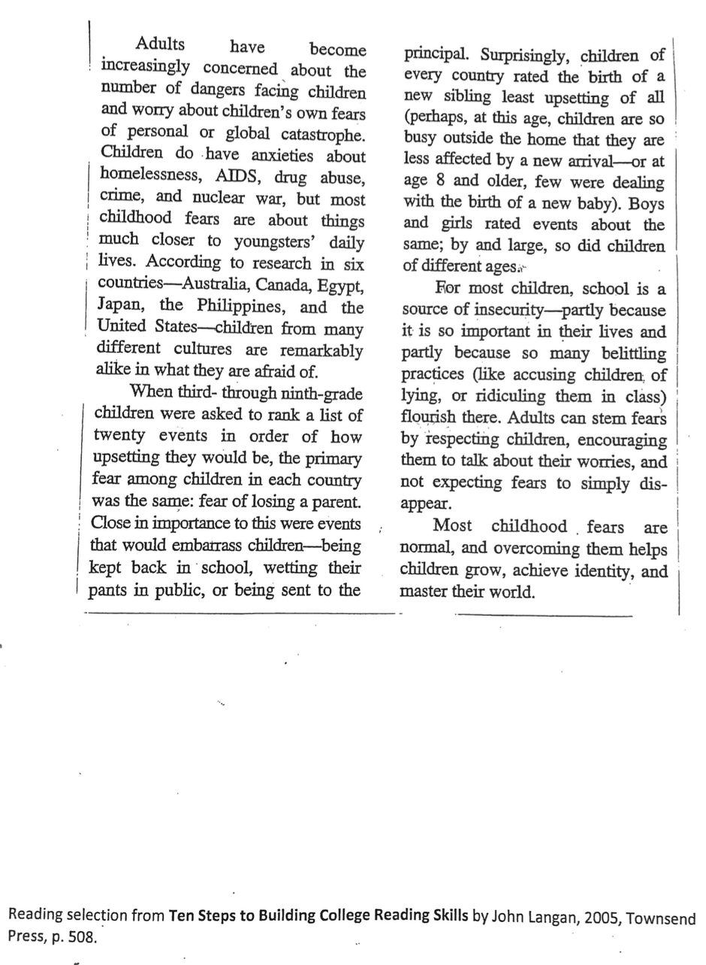
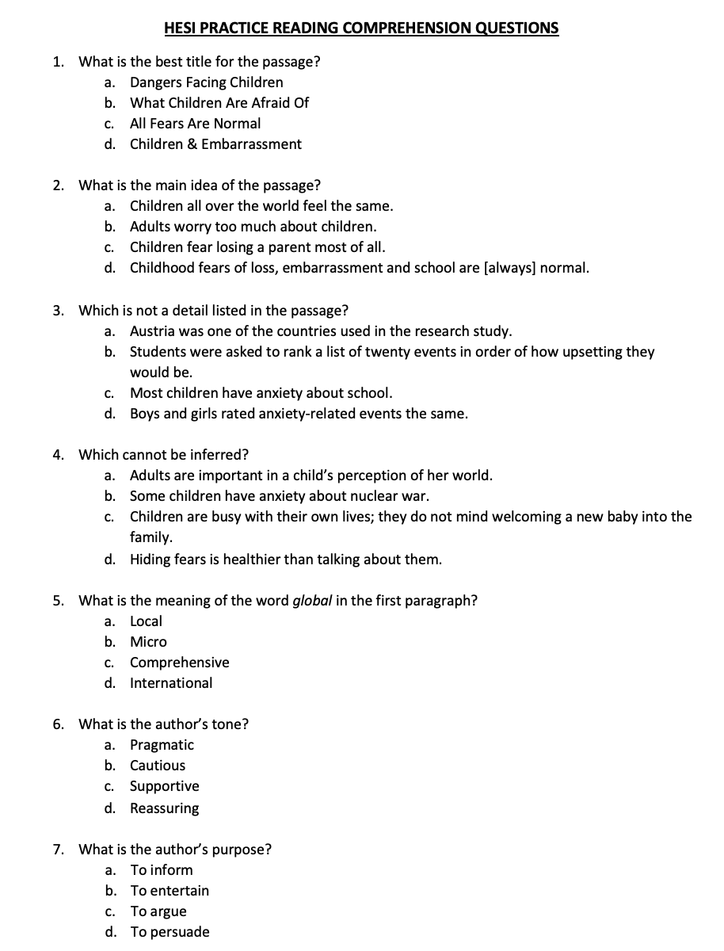
Please take out the reading passage and questions.
Notes:
And a highlighter.

Slide 6

Let’s look at the language in the questions & answers
first and highlight
key words.
Notes:
This is not in the notes. It is meant to compliment them. The notes resume with the comprehension skills.

Slide 7
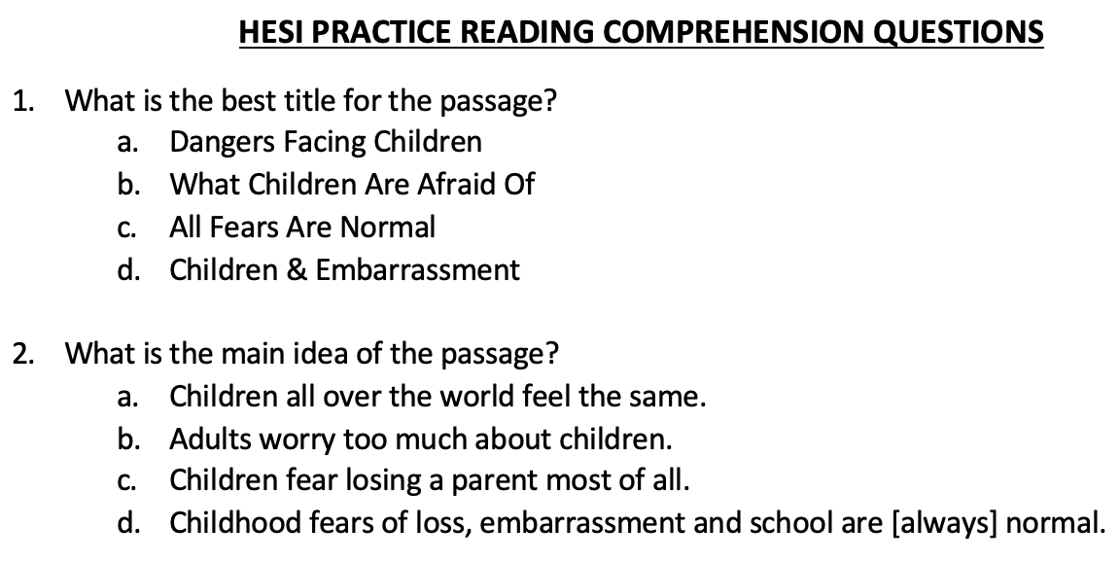
Notes:
I’ve highlighted key words in the questions to help me know my task (best title, main idea)
Notice the words all and normal. All means all inclusive – no exceptions.
Notice the language: words all., too much & most of all.
Read choice D using the word always. Now read it without the word always. Notice the difference in the statement.
Repeat with C and B.

Slide 8
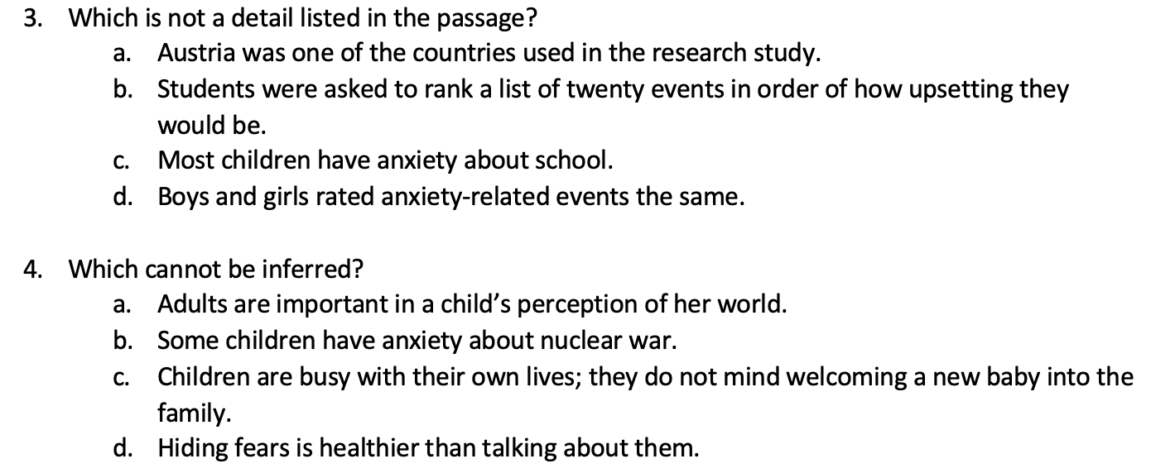
Notes:
Notice “NOT” in both questions. It changes the questions completely.
Read 3C with and without “MOST”,

Slide 9
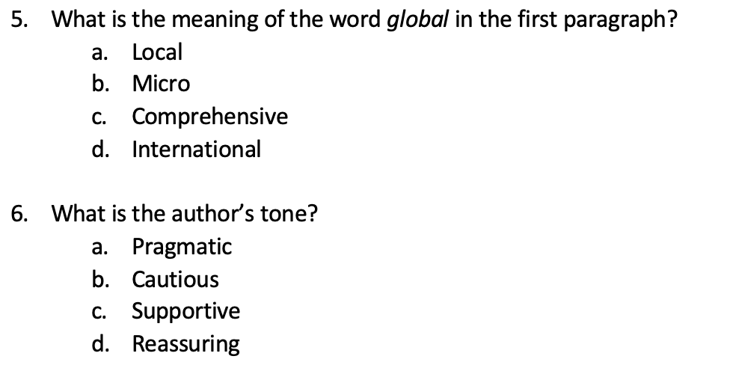

Slide 10
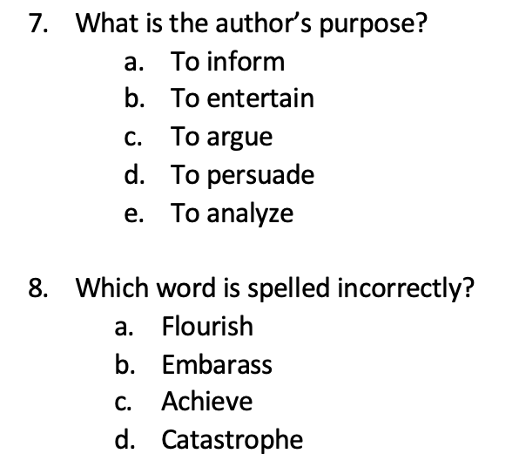
Notes:
8. Can look back in the passage for these words and see which one is not spelled correctly.
This type of question may also be in the grammar section. There is online practice for this.
Answer: B

Slide 11
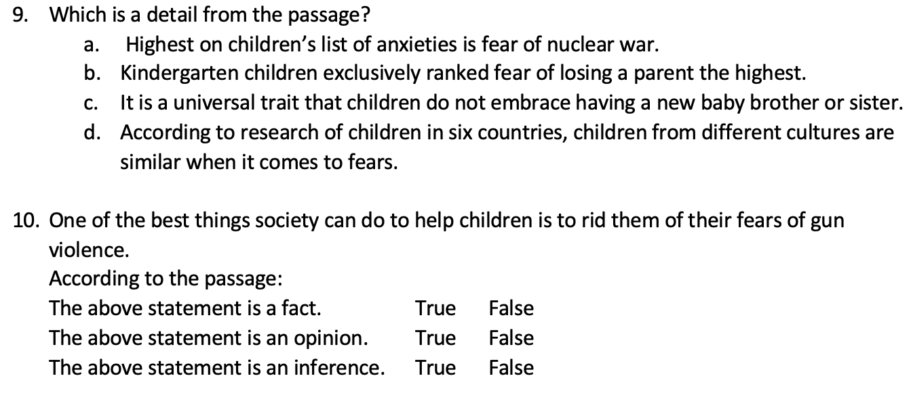
Notes:
Read 9B without exclusively to show the change in meaning.
Read 9C without universal to show the change in meaning.
Point out “NOT” in 9C.

Slide 12
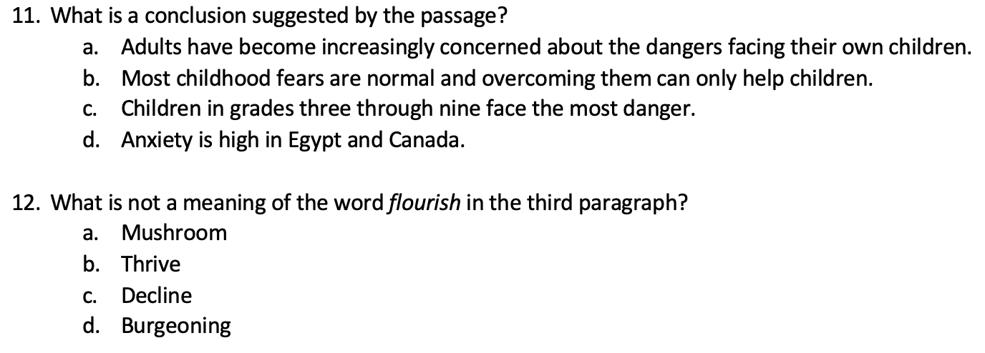

Slide 13
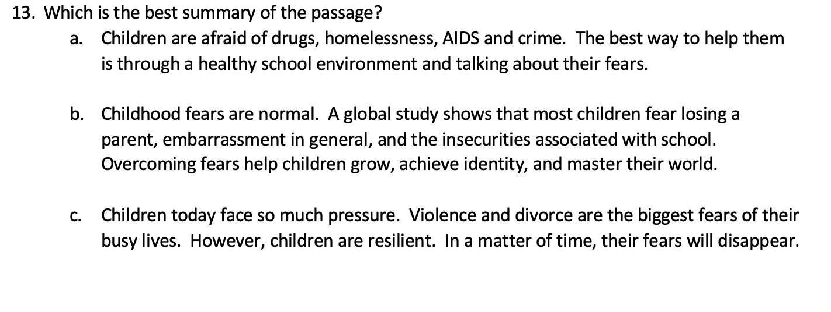

Slide 14

Notes:
Now let’s talk about the different comprehension skills.

Slide 15
MAIN IDEA
The main idea of a passage is the main point the author is speaking about. It is sometimes referred to as the “big picture”.
It is not the topic; the main idea is more specific than the topic.
The main idea may be stated in the opening paragraph as a thesis, then restated in the concluding paragraph.
Notes:
Example: topic – nursing MI-Steps to becoming a nurse MI-nursing careers
topic: - lungs MI- diseases affecting the lungs
topic – fears MI – childhood fears MI – irrational fears

Slide 16
MAIN IDEA
To determine the main idea, ask yourself these questions:
What is the passage about? (topic)
What is the main point the author wants you to know about the topic?
Try to summarize the passage in 1 sentence (Roell, “How to Find the Main Idea”). Is that one of the answer choices?
Notes:
I like to use the MI of each paragraph to help me determine the main point the author wants me to know about the topic. I can use these to try and create the 1-2 sentence summary suggested in step 3.
Not all main ideas are stated; some are implied.
Use the supporting details to determine the common link within the passage.
The supporting details are the pieces in the puzzle that build the picture.
How do the supporting details tie together? What picture do they reveal?
Everything within the passage supports the main idea.
Main idea cues: title, topic, focus, subject, emphasis

Slide 17
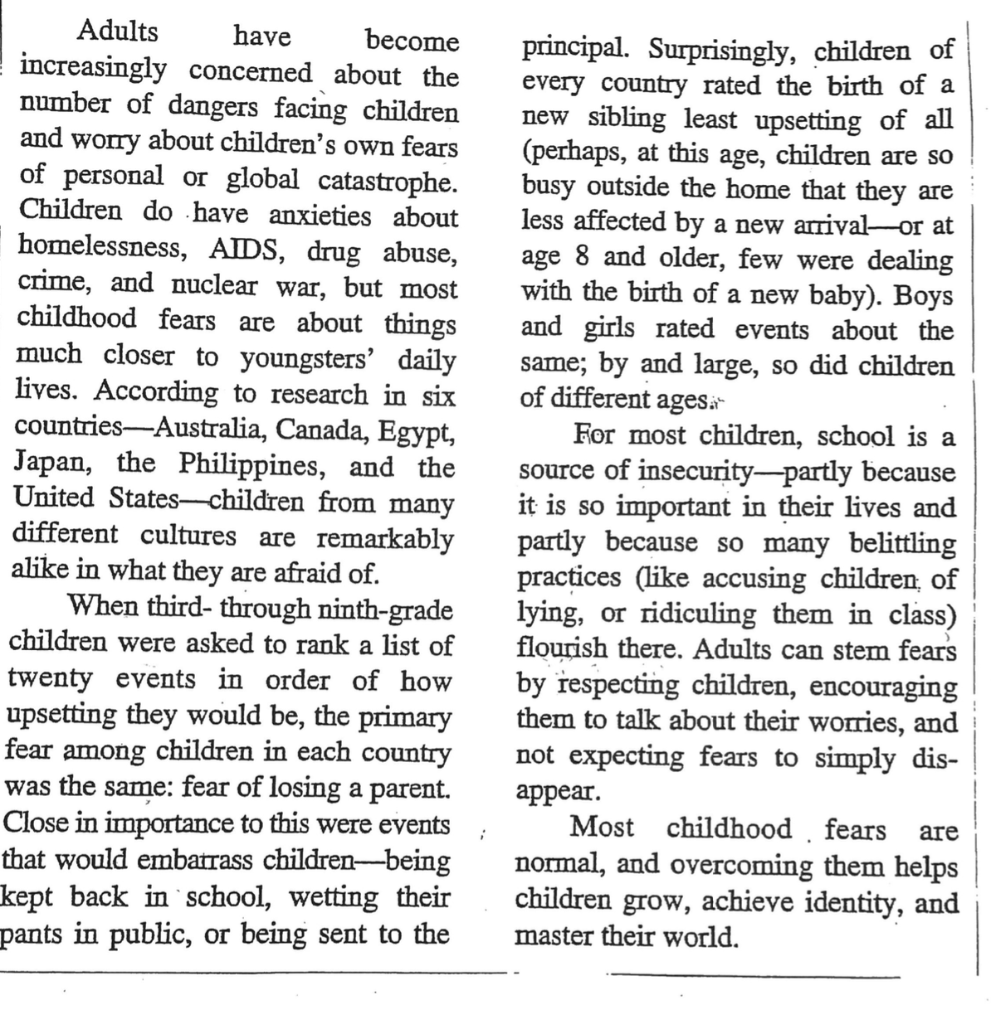





1. What is the best title for the passage?
a. Dangers Facing Children­­
b. What Children Are Afraid Of
c. All Fears Are Normal­­
d. Children & Embarrassment
2. What is the main idea of the passage?
a. Children all over the world feel the same.
b. Adults worry too much about children.
c. Children fear losing a parent most of all.
d. Childhood fears of loss, embarrassment
and school are normal.
PRACTICE:
Notes:
Blue highlights are the main ideas of each paragraph to help determine the main idea of the passage. What’s the big picture painted?
Yellow highlights other answer choices.
Let’s use the steps to answer #2 first.
Steps: What is the passage about (topic)? Childhood fears
What is the main point the writer wants you to know about childhood fears? Or
What would be a 1 sentence summary of the passage?
Children from different countries have similar fears including losing a parent, embarrassment, and school. That’s a similar statement to D.
Answers: #2. D A – only 6 countries in study. B – can’t quantify too much and not topic – topic is childhood fears. C- true, but it’s a detail
#1 B A- mentioned once in intro. paragraph C – Most, not all, fears are normal is stated in last paragraph D – embarrassment was mentioned once as a detail

Slide 18
SUPPORTING DETAILS
Supporting details are the additional information given to support the main idea.
They illustrate the main point the author is making; they draw the picture for the reader.
Supporting details offer evidence to bolster the main idea.
A detail may be a description, a reason, an example, additional information, etc.
Notes:
MI – nursing careers SD –There are many different careers in nursing including becoming a pediatric nurse.
MI – Steps to becoming a nurse SD – The final step to becoming a nurse, is passing the nursing board exam.
MI – Diseases affecting the lungs SD – according to research….

Slide 19
SUPPORTING DETAILS
To find supporting details:
Supporting details are found within the heart of the passage
They can be introduced with transition words like first, next, one, another, for example, etc. (HESI. 46).
Notes:
Cues: reasons, examples, steps, facts, first, next, last, another, finally, causes, methods, to begin, also, in addition

Slide 20












PRACTICE:
3. Which is not a detail listed in the passage?
a. Austria was one of the countries used in the
research study.
  b. Students were asked to rank a list of twenty
  events in order of how upsetting they would be.
c. Most children have anxiety about school.
d. Boys and girls rated anxiety-related events the
    same.
9. Which is a detail from the passage?
a. Highest on children’s list of anxieties is fear of
nuclear war.
b. Kindergarten children exclusively ranked fear of
losing a parent the highest.
c. It is a universal trait that children do not embrace
having a new baby brother or sister.
d. According to research of children in six countries,
children from different cultures are similar when it
comes to fears.
Notes:
3. Look back in passage to find details. Which one is missing? A – Australia was used, not Austria. (Green highlight)
9. Look in the passage for one that is completely accurate. D (blue highlights)
A – primary fear was losing a parent B- children grades 3- 9 C- birth of sibling was rated as least upsetting – and not universal-only
children grades 3-9 in 6 countries (yellow highlights)

Slide 22
INFERENCE
An inference is a logical conclusion based on given facts and the reader’s own experience.
It is an educated guess or “reading between the lines” about what the author is hinting at but does not actually state (HESI. 47).
A logical inference is supported by facts and evidence in passage.
Notes:
When inferring, use facts from the passage and your own knowledge or experience.
Use facts first, then gut, not gut first.
Example:
If the text states that there are wet shoes and an umbrella by the door, I can infer from those clues and my prior knowledge that it is/was raining outside.
If the text reads that the girl wore a coat, hat and mittens, I can use my background knowledge to infer that it is cold outside, likely winter.

Slide 23
INFERENCE
To make a logical inference:
Words like “suggest”, “infer”, and “imply” indicate an inference question.
Use the clues in the passage to draw a logical conclusion.
Look for facts and details in the passage to support the inferences in the answer choices
Notes:
When drawing a conclusion, all the information is in the passage. The facts and clues are in the passage. (Let students know this is not in their notes).
Cues: implied, suggested, draw conclusion

Slide 24



PRACTICE:
4. Which cannot be inferred?
a. Adults are important in a child’s perception of her
world.
b. Some children have anxiety about nuclear war.
c. Children are busy with their own lives; they do not mind
welcoming a new baby into the family.
d. Hiding fears is healthier than talking about them.
11. What is a conclusion suggested by the passage?
a. Adults have become increasingly concerned about the
dangers facing their own children.
b. Most childhood fears are normal and overcoming them
can only help children.
c. Children in grades three through nine face the most
danger.
d. Anxiety is high in Egypt and Canada.
Notes:
4. Look for a fact from the passage. A fact cannot be inferred. B (blue highlights)
11. Use facts from the passage only to draw a conclusion. The conclusion will not be directly stated. Need to know the main idea to determine
this. B – similar statement in last paragraph (concluding paragraph) (yellow highlights)
A- directly stated in first paragraph – it cannot be inferred C- no facts to support D- no facts to support

Slide 25
WORDS IN CONTEXT
The author often gives clues within the context to help determine the meaning of certain words. The meaning is somewhere within the text.
Use the sentences surrounding the word to determine the meaning.
The author may give the definition, a synonym, an antonym, an example, a restatement or an explanation of the word to help the reader (HESI. 46).
Notes:
The answer is there.
Antonyms are cued by words like, instead, although, but (HESI. 46).

Slide 26
WORDS IN CONTEXT
To determine the meaning of a word in context:
Look for a definition, explanation, synonym or other clarification of the word.
Be sure that the meaning you choose makes sense in the context of the passage. Reread the sentences using the meaning instead of the word (HESI. 46).
Skim the passage to find the word.
Read the sentences before and after the sentence that includes the word.
Notes:
These questions have the word in italics. Watch for it as you read.
Multiple meanings of a word may be listed, but not all work within the context of the passage. You need to choose the correct one. Step 4 helps with this.

Slide 27
PRACTICE:
5. What is the meaning of the word global in the first
paragraph?
  A. Local
  b. Micro
  c. Comprehensive
  d. International
12. What is not a meaning of the word flourish in the
third paragraph?
a. Mushroom
b. Thrive
c. Decline
d. Burgeoning
Notes:
5. Look at the choices. Skim to find global in the first paragraph. Read the sentences surrounding it.
Following “global catastrophe”, examples are given of things that happen worldwide, followed by “but” which indicates the opposite – “ but most childhood fears are about things much closer to youngsters’ daily lives.” – opposite of close to home. D (blue highlights)
12. Look at the choices. 3 will be synonyms for “flourish”. Notice that “mushroom” and “thrive” mean the same thing. ”Decline” means the opposite. You can assume that burgeoning means flourish too. C You don’t even have to look in the passage.

Slide 29
AUTHOR’S TONE
The author’s tone is the attitude or feelings the writer has toward the topic.
Word choice is the best tool to determine author’s tone. Look for facts, bias, intrigue .
Positive or negative language can point to the author’s feelings about the subject.
Notes:
There are many tone words. Review a list of tone words to become familiar with possible choices.
Examples: uncertain, confident, idealistic, optimistic, cautious, sympathetic, lighthearted

Slide 30
AUTHOR’S TONE
To determine the author’s tone, ask:
What feelings does the writer have toward the subject?
Look at the answer choices. Find words within the passage that support one of the choices.
Who is the author’s intended audience?
What words support this feeling?

Slide 31
AUTHOR’S PURPOSE
Why did the author write this piece?
For whom did the author write the piece?
An author writes to inform, persuade, entertain, analyze.
Informative- language is factual with supporting details allowing reader to form own opinion
Analytical - language will be focused and include data, evidence, results.
Persuasive – language is biased with feelings and opinions. Positive or negative language is used to convince reader (HESI. 47).
Entertaining – language is entertaining, humorous, mysterious, of general interest.
Notes:
What was the reason for writing this? Motive?
To determine the author’s purpose, one must determine the intended audience. Doctors, nurses, caregivers, general public, companies, children, parents?

Slide 32
AUTHOR’S PURPOSE
To determine the author’s purpose:
What tone did the author use? Strong positive or negative language imply persuasion.
Consider the audience.
For whom was the passage written?
Is the passage informative, entertaining, argumentative, persuasive?
Notes:
To determine the author’s purpose, one must determine the intended audience.
The words used to convey tone help convey purpose.
If the writing is trying to convince, encourage or change a mind – persuade – biased and positive and negative words used to persuade (HESI. 46-47).

Slide 33
PRACTICE:
7. What is the auth
6. What is the author’s tone?
a. Pragmatic
b. Cautious
c. Supportive
d. Reassuring
7. What is the author’s purpose?
a. To inform
b. To entertain
c. To argue
d. To persuade
e. To analyze
Notes:
6. For whom was the passage written? It may be parents.
What is the author’s attitude toward the subject? Look at the language used in the text to determine the author’s attitude, or tone.
Notice the words: “concerned” “stem fears”, “overcoming them”, “normal”. (blue highlights)
Which of the choices work with the language used in the text? That language implies reassuring. D
7. For whom was the passage written? Maybe parents
Why was it written? What is the language like? Reassuring tone, factual, used research to inform - A (yellow highlights)

Slide 35
FACT & OPINION
A fact can be proven – true or false.
An opinion is a belief. It is not provable.
Ex. The movie La La Land won the Oscar for Best Picture in 2017.
This is an incorrect fact. It can be checked.
Ex. The movie Tenet is a great movie.
Some may disagree with this. Its greatness cannot be proven.

Slide 36
FACT & OPINION
To determine fact vs. opinion:
Look at the language used.
Can the statement be proven? FACT
Is the statement a feeling or belief? OPINION
Notes:
Example: Food can be proven to be nutritious, but delicious is an opinion.

Slide 37
PRACTICE:
10. One of the best things society can do to help children is to rid them of their fears of gun violence.
According to the passage:
a. The above statement is a fact. True False
b. The above statement is an opinion. True False
c. The above statement is an inference. True False
Notes:
10. Note: questions are not worded like #10 on the HESI
Gun violence is never mentioned in the passage.
a. the fact – must be stated in the passage (according to the passage) .
Also, best is a judgmental word – hard to prove. FALSE
b. Opinion – must be stated in the passage, but as an opinion (according to the passage)
It is an opinion, but gun violence is never mentioned in the passage. FALSE
c. Inference – based on facts in the passage.
Gun violence is never mentioned in the passage FALSE

Slide 38
SUMMARIZING
A summary includes the main ideas expressed throughout the passage. Summaries may have a few important details.
Summaries are typically written in the order of the passage, but not always (HESI. 48).
A basic summary can answer the questions who, what, when, where, why and how.

Slide 39
SUMMARIZING
To determine the best summary:
Use the main ideas from each paragraph to create the summary.
Look for a summary statement that follows the sequence of the passage.
In a passage, the concluding paragraph sometimes summarizes the passage.
Be careful not to choose a summary with multiple details or inaccurate information.

Slide 40

PRACTICE:
1
13. Which is the best summary of the passage?
a. Children are afraid of drugs, homelessness, AIDS and
crime. The best way to help them is through a
healthy school environment and talking about their
fears.
b. Childhood fears are normal. A global study shows that
most children fear losing a parent, embarrassment
in general, and the insecurities associated with school.
Overcoming fears help children grow, achieve
identity, and master their world.
c. Children today face so much pressure. Violence and
divorce are the biggest fears of their busy lives.
However, children are resilient. In a matter of time,
their fears will disappear.
Notes:
Look for the main ideas of each paragraph. B
The first and third sentences of choice B are stated in the concluding paragraph of the passage, which acts as a summary.
Both are main idea statements. The middle sentence combines the main ideas of the 2nd and 3rd paragraphs.

Slide 42

Language to Avoid
Notes:
Be sure to use professional language when speaking and writing.
The following types of language are not considered to be professional.
Accurate language about the topic is expected.

Slide 43
CLICHES
Cliches are outdated and overused expressions that have lost their meaning.
Give accurate information. Say what you mean.
“sick as a dog”
Vomiting with fever & chills
“under the weather”
Headache with a mild cold
Notes:
Instead, of cliches, use facts and accurate information to describe the illness – vomiting, fever, chills, etc.
Not only have cliches lost their meaning over time, but they may not be understood by non-native speakers.

Slide 44
EUPHEMISMS
Euphemisms are often used in place of direct language to soften what needs to be stated.
Give accurate information. Say what you mean.
“passed away”
Use correct terms for body parts (HESI. 64).
“departed”
State that the patient has died
Notes:
We may think these vague terms are less offensive.
“...use accurate and anatomically correct language when referring to the body, a body part, or a bodily function” (HESI.64).

Slide 45
SEXIST LANGUAGE
Gender Neutral Titles
Sexist Titles
Chair or Chairperson
Chairman/Chairwoman
Firefighter
Waiter/Waitress
Server
Fireman/Firewoman
Notes:
Sexist language identifies gender without reason (HESI. 64).
Use gender neutral titles instead.
Use expressions like doctors and their partners or spouses instead of doctors and their wives
Don’t overuse “he” and don’t use “they” as a substitute because it is grammatically incorrect

Slide 46
PROFANITY & INSENSATIVE LANGUAGE
Be mindful of using harsh, insensitive, or offensive language when speaking and writing.
“We need to be sensitive to language that excludes or emphasizes a person or group of people with reference to race, sexual orientation, age, gender, religion, or disability.” (HESI. 65).
Notes:
Professional language is respectful.

Slide 47
TEXT SPEAK
Avoid spelling, abbreviations, punctuation, slang, and emojis used in texting.

Slide 48

WORKS CITED:
Aronoff, Wendy. “HESI Study Guide for Reading Comprehension, Vocabulary & Grammar.” Prepared for CCRI Student Success.
HESI. Admission Assessment Exam Review E-Book. 5th ed., Kindle ed., Houston, TX, Elsevier, 2021.
Langan, John. Ten Steps to Building College Reading Skills. 4th ed., Townsend Press, 2005.
Roell, Kelly. "How to Find the Main Idea." ThoughtCo, Aug. 25, 2020, thoughtco.com/how-to-find-the-main-idea-3212047.
Roell, Kelly. "How to Make an Inference in 5 Easy Steps." ThoughtCo, Aug. 26, 2020, thoughtco.com/how-to-make-an-inference-3211647.

