Slide 1

CCRI: SUCCESS MADE HERE
Sit Up, and Take Notes!
Notetaking ABCs and 123s
By Kimberley Edgar
Academic Coach
Community College of Rhode Island
Student Success Center
ktedgar@ccri.edu

Slide 2

WHAT’s IT WORTH?
Do you want to pass or fail?
Dr. Walter Pauk, of Cornell University’s Reading and Study Center, found students who record:
  No notes
    Forget 60 percent in 14 days (2 weeks)
  Some notes
    Remember 60 percent of material
  Systematic notes and study them …
    Retain 90-100 percent INDEFINITELY

Slide 3
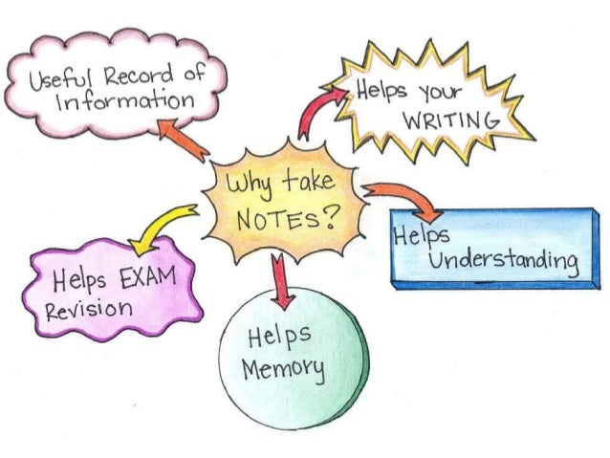
UNDERLINING VALUE
Taking good notes:
Keeps you alert
  Promotes active listening
  Improves recall, memorizing concepts
Engages your mind
  Requires thinking about writing
  Cultivates meaningful learning skills
Emphasizes, organizes info
  Helps connect topics
  Increases topical understanding
Creates a condensed study record
  Serves quality review after class
  Reduces stress when test time arrives!

Slide 4

VERSATILE STUDY SKILL
Note-taking is beneficial for:
Lectures & Labs
  Creates 2-way communication
  Promotes class participation
  Helps identify, focus questions, clarifications
  Documents observations
Readings
  Process, digest material
  Keep on target
Synchronous/Asynchronous Learning
In-person/Remote

Slide 5

COMING to TERMS
Synchronous
  Live: students, professor meet together
  In-person, online, hybrid
Asynchronous
  Student in driver’s seat
    Sets pace
    Covers material on own
    May have to view recording/s
Remote
  Off campus
  Usually online or no connection
In-person
  On campus, same physical space

Slide 6

STEP 1: BE PREPARED
Notebook – handwritten notes preferred
Writing implements – pens, pencils, colored pencils, highlighters, erasers, etc.
Listening ears – open mind and active listening
https://www.developgoodhabts.com/rock-pebbles-sand/

Slide 7
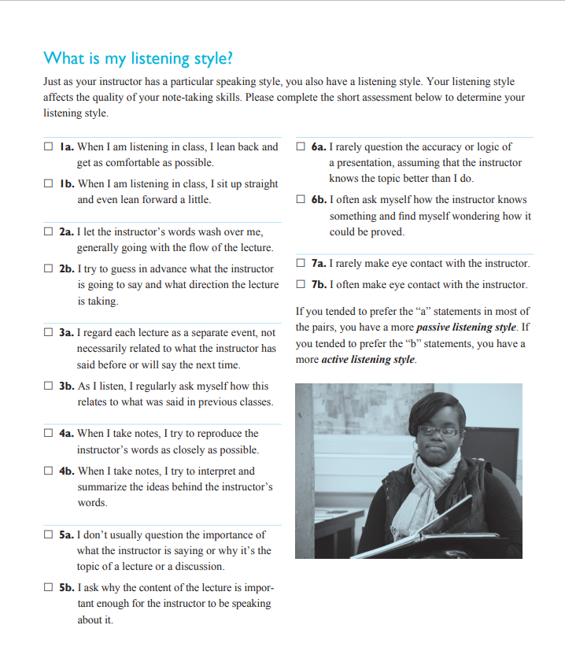

WHAT’s YOUR LISTENING STYLE?

Slide 8
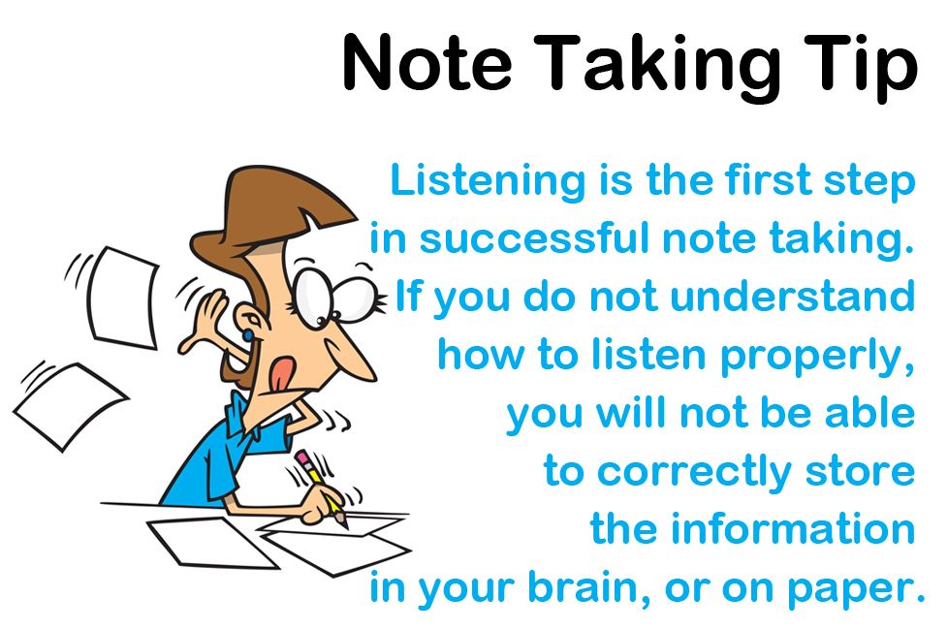
STEP 2: LISTEN UP!

Slide 9

ACTIVE LISTENING
Style
  Good note-takers are …
    Active listeners
  Active listeners …
    Are fully attentive
    Try to understand speaker’s intent
  Active listening requires …
    Physical attention
    Mental attention
    Energy
    Concentration
    Discipline

Slide 10

ACTIVE LISTENING
Strategies:
Be open, willing to learn.
Reduce distractions.
Listen to what the speaker is saying.
Concentrate: Don’t let mind wander.
Observe.
Look at the main idea/s.
Be quiet.

Slide 11
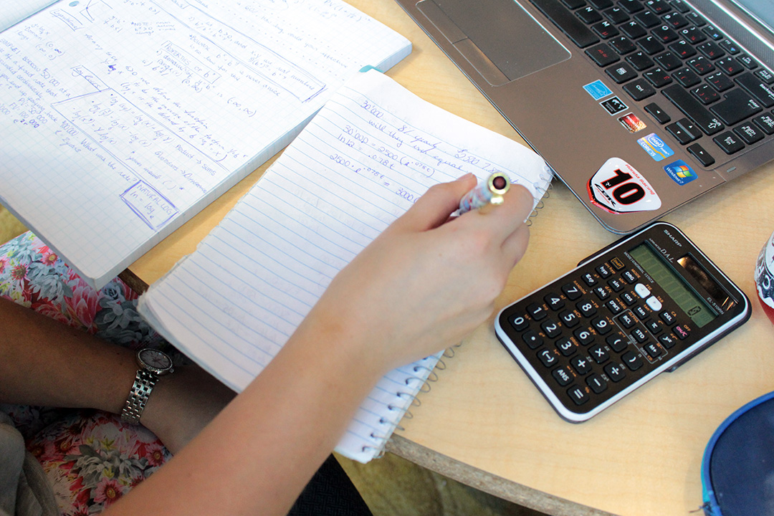
ASYNCHRONOUS NOTETAKING
Recorded Lectures:
Treat like synchronous lectures
  Schedule time in planner to view
  Plan “class” as early in day, as early in week as possible
  Watch at reg. speed w/out stopping
  (research shows benefits diminish by 1.25x if you increase speed)
  Take notes as usual in live class
Log time in the margin
Readings-only:
Treat like synchronous lectures
  Block off time in planner for “class”
  Schedule “class” as early in day, as early in week as possible
  Substitute readings in lieu of lecture
  Take notes

Slide 12
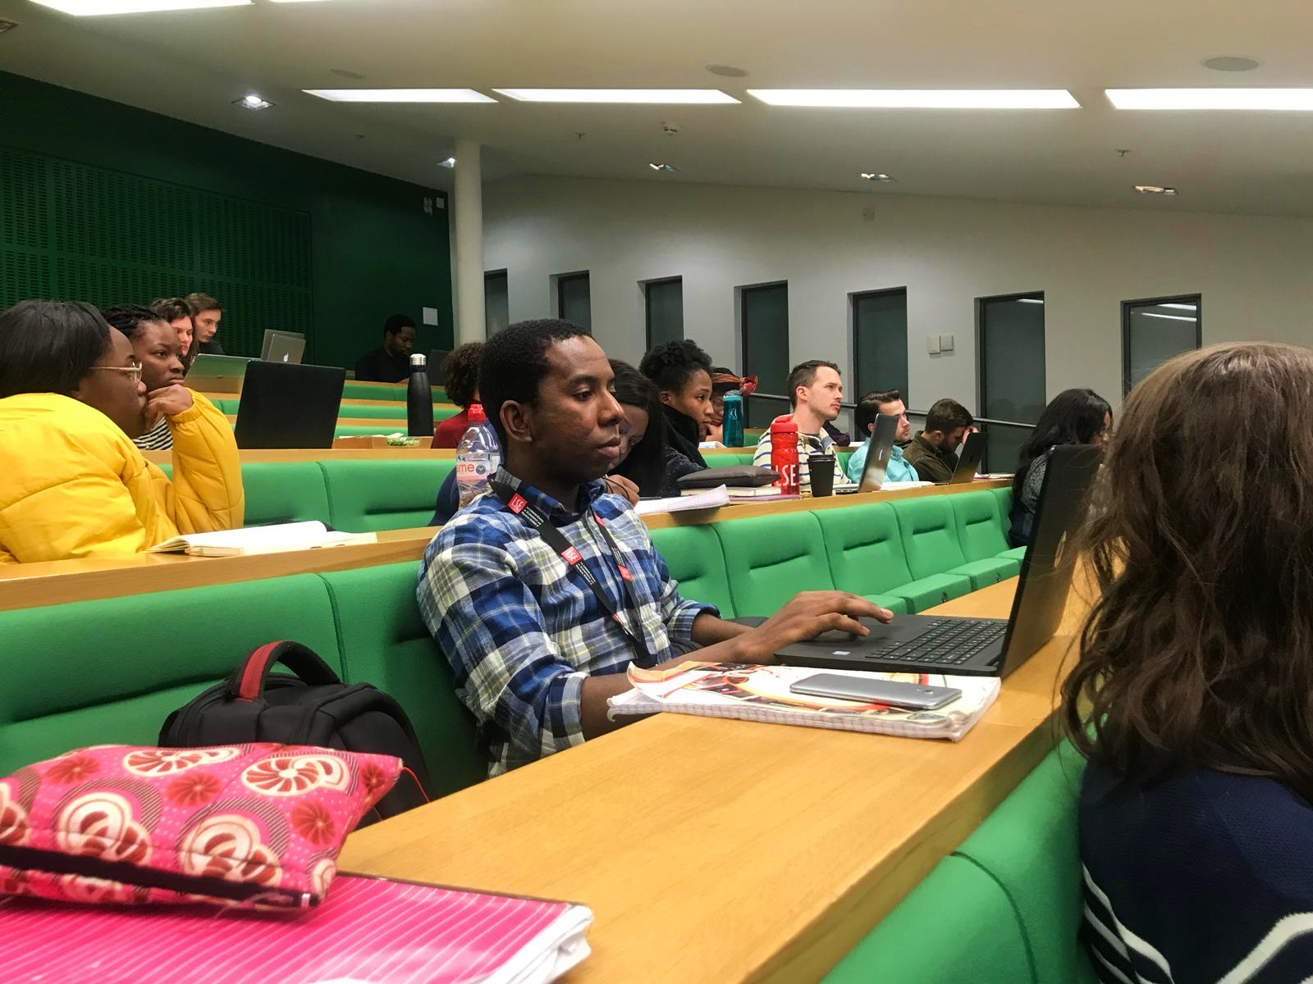
SYNCHRONICITY: LECTURE
Do’s
  Attend ALL lectures
  Be punctual
  Seek permission to record
  Take notes during lecture
  Highlight main ideas
  Organize key points
  Compare/contrast
  Watch for patterns
  Review notes weekly
Don’ts
  Write down every word
  Sit passively
  Let ?s go unasked
  Fall asleep
  Ignore study helps

Slide 13
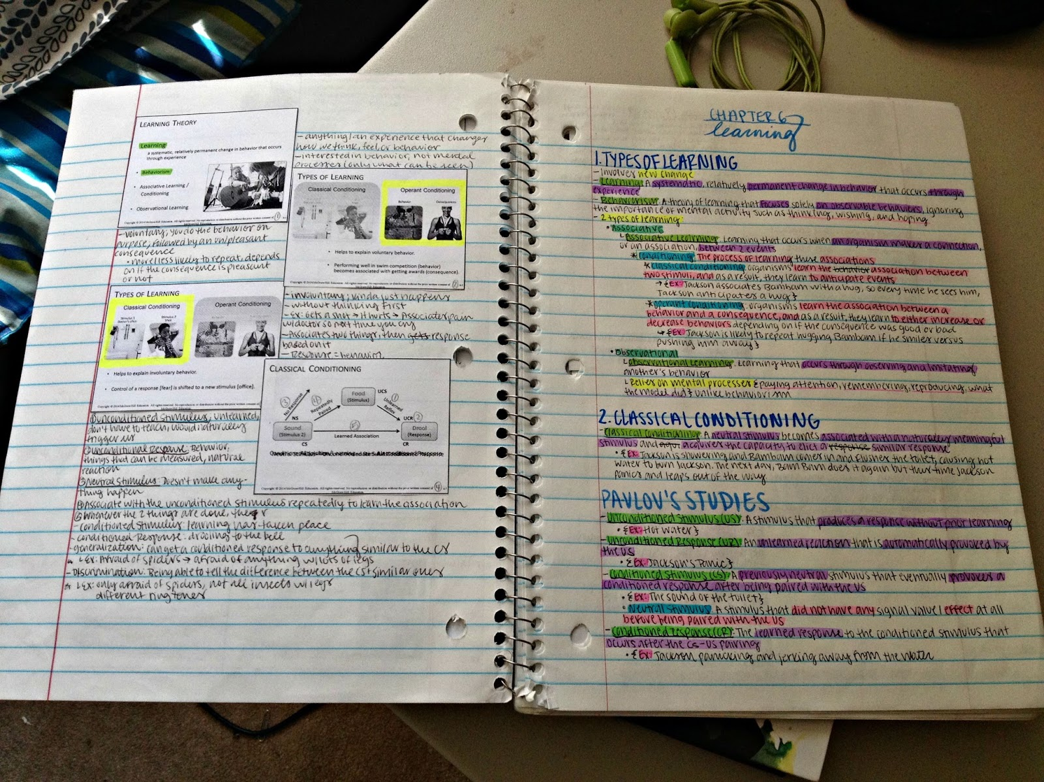
SYNCHRONICITY: READINGS
Textbooks, ebooks, etcetera
Use lecture tips, techniques
Less is more!
Vary the color
Create flashcards
Create an outline
Jot notes in margins
Talk w/your professor/s
Use your own words
Answer chapter-end ?’s

Slide 14
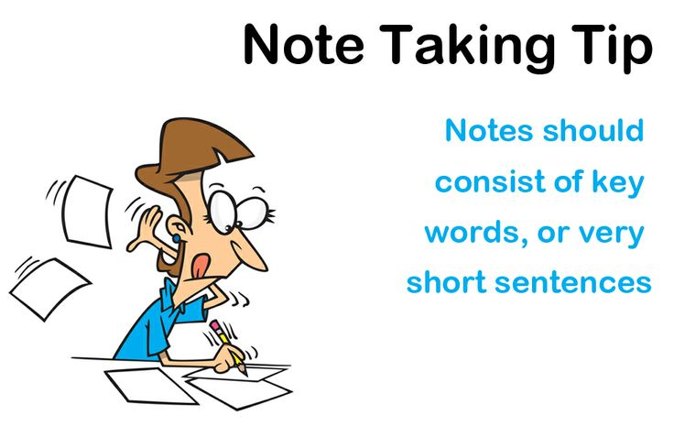

STEP 3: DECIDE WHAT TO NOTE
https://youtu.be/UAhRf3U50lM
Focus on info reflecting main themes
Key words on overheads, whiteboards, chalkboards, textbook readings, etc.
Info repeated OR confusing
Details enhancing readings, previous lectures

Slide 15
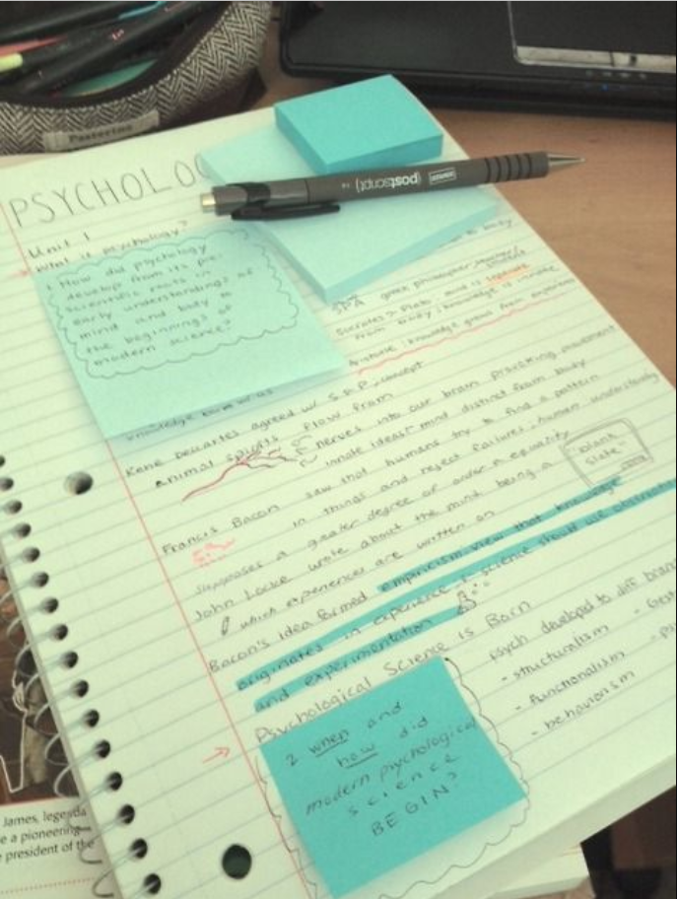
STEP 4: GET A SYSTEM
5 Main Notetaking Methods
The Cornell Method
The Mapping Method, or Mind-mapping
The Outlining Method
The Charting Method
The Sentence Method

Slide 16
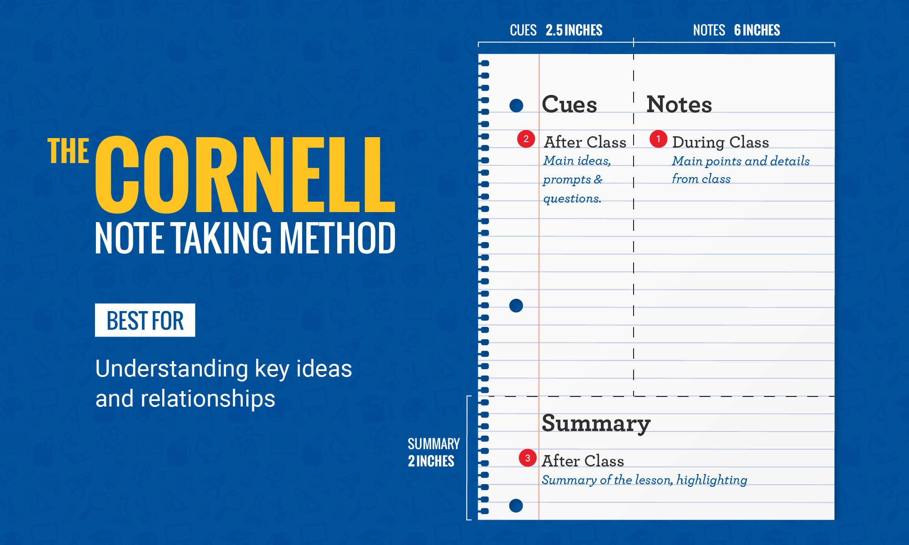
CORNELL NOTETAKING SYSTEM

Slide 17

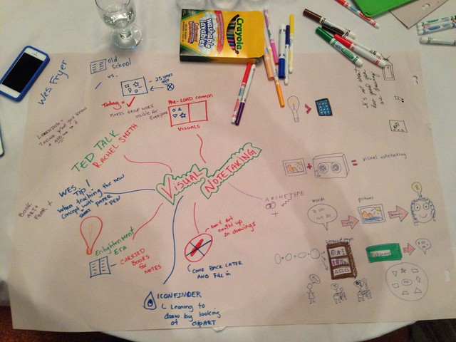
MIND-MAPPING STRATEGY

Slide 18
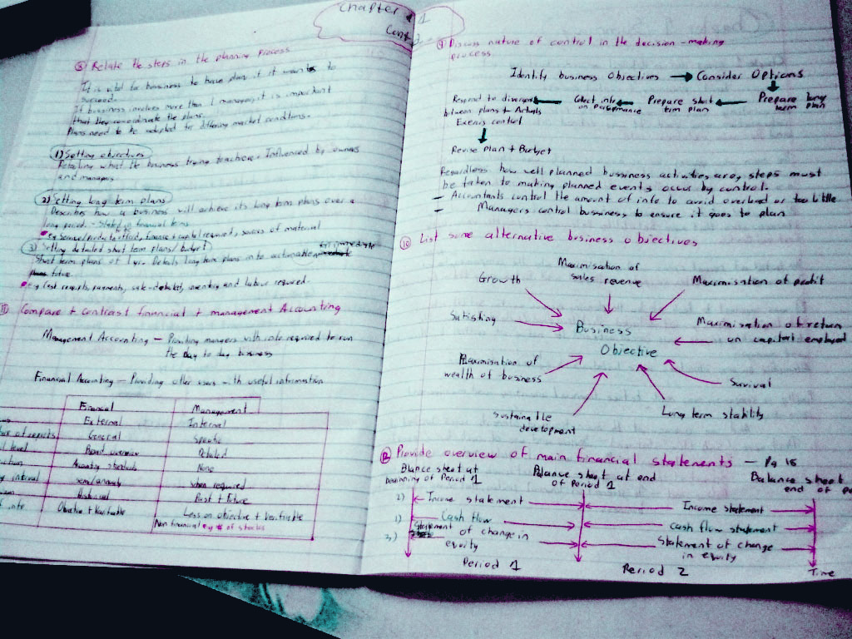
SUCCESS MADE HERE!
Student Success Center
Notetaking Skills
Social Sciences Students
Presenter: Kimberley Edgar
Academic Coach: ktedgar@ccri.edu
Resources
Notetaking Handout Listening Style Assessment, /P2
https://www.ccri.edu/success/pdf/2021_SC_Notetaking-
FINAL.pdf
Book Your Tutoring Appointment:
https://www.ccri.edu/success/

Slide 19
