Slide 1
Community College of Rhode Island
General Education
Department Chairs Committee 12/14/2021

Slide 2
Definition of an Educated Person: Overview
Four abilities
Eight sub-categories
Key indicators

Slide 3
Definition of an Educated Person
Effective Communication
  Create written work that develops and expresses ideas and that addresses a given context and target audience
  Communicate effectively via oral presentations, performances, participation in group work, and visual presentations
Critical Thinking
  Identify, analyze, and apply evidence and ideas, question assumptions, and draw logical conclusions
  Develop information literacy by locating, evaluating, synthesizing, and using information to accomplish a specific purpose

Slide 4
Definition of an Educated Person2
Quantitative and Scientific Reasoning
  Demonstrate an understanding of and apply scientific principles, theories, and methods
  Apply quantitative principles to solve problems and support arguments with quantitative evidence in a variety of formats (e.g., words, tables, graphs, equations, etc.)
Awareness of Oneself and the World
  Demonstrate an understanding of global, cultural and historical perspectives
  Function effectively in social and professional environments and make reasoned decisions based on ethical standards, self-awareness, and personal responsibility

Slide 5
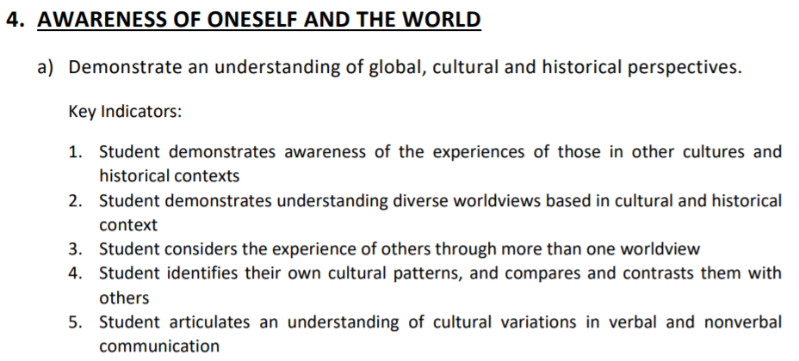
Key Indicators
Measurable outcomes
Intended to align with course-level Student Learning Outcomes
Qualifying courses link SLOs with two key indicators for each of two sub-categories

Slide 6
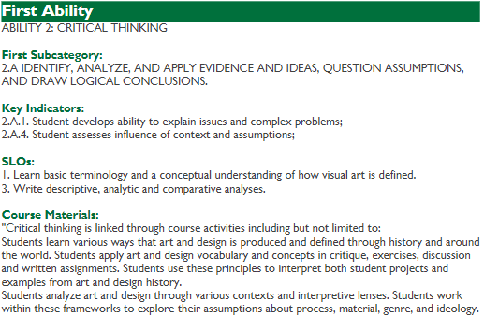
Establishing Links Between Policy and Course
ARTS 1001 learning outcomes
How SLOs will be assessed

Slide 7
Program Requirements for Courses
Three-credit courses are standard, but exceptions may be considered
Courses transfer to either URI or RIC or both as gen eds
Each course is attributed to one of the domains of knowledge (Humanities; Business, Science, Technology, and Math; and Social Sciences)
Each course must be open to any CCRI student without prerequisite courses. Exceptions might include courses that require prerequisite foundation writing or math courses, or courses that occur in a sequence, such as languages
Each course will meet the requirements of two sub-categories across the eight sub-categories listed in the Definition of the Educated Person

Slide 8
Prerequisite Exceptions
1. Courses taken concurrently
2. Accuplacer grid placement
3. Course equivalencies at URI/RIC are gen eds
4. Developmental courses
5. Limited BIOL and MATH courses required of technical and career programs

Slide 9
Program Requirements for Students
Complete a minimum of 20 credits of general education coursework, including ENGL 1010 or equivalent
Satisfactory performance in the four main abilities in the Definition of an Educated Person
Satisfactory performance in courses that are distributed across three domains of knowledge and will include a minimum of six credits from each of any two domains and three credits from the remaining domain: Humanities (HUMN), Business, Science, Technology and Math (BSTM), and Social Sciences (SSCI). In no case shall students complete the requirement by taking more than three courses having the same course code

Slide 10
1a | 1b | 2a | 2b | 3a | 3b | 4a | 4b
39 | 37 | 48 | 15 | 20 | 19 | 43 | 13
HUMN 37 | HUMN 36 | HUMN 30 | HUMN 10 including 1010/Comp I | HUMN 1 | HUMN 1 | HUMN 35 | HUMN 8 including COMM 1010
BSTM 1 | BSTM 0 | BSTM 10 | BSTM 0 | BSTM 19 | BSTM 16 | BSTM 1 | BSTM 3
SSCI 1 | SSCI 1 | SSCI 8 | SSCI 5 | SSCI 0 | SSCI 2 | SSCI 7 | SSCI 2
TOTAL: 157 courses
  HUMN 81
  BSTM 46
  SSCI 30
Deadlines
  12/31/2021: Proposals for 02/04/2022 CRC
  01/24/2022: catalog edits unrelated to courses/programs
  02/14/2022: catalog edits stemming from 02/04 CRC meeting
  02/28/2022: All catalog approvals completed

Slide 11
Application Process
https://www.ccri.edu/gened/ → “Resources for Faculty”
GEC sends applications to department chair for approval/vote
Department chair sends to academic divisional dean for approval
Dean sends to GEC for review/vote
GEC sends to VPAA for review/vote
VPAA returns to GEC
GEC sends to Records for Banner update

