Slide 1
Stress Management
Shanna Wells, M.Ed.
Coordinator, Community and Social Resources
Community College of Rhode Island

Slide 2
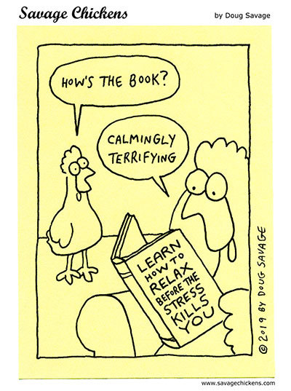
What is Stress?
Stress is a state of mental or emotional strain or tension resulting from adverse or very demanding circumstances.
8 out of 10 college students complain of stress.
45% of college students say they experience “more than average stress”.
87% of college students reported feeling overwhelmed by all they had to do at least once in the previous year.

Slide 3
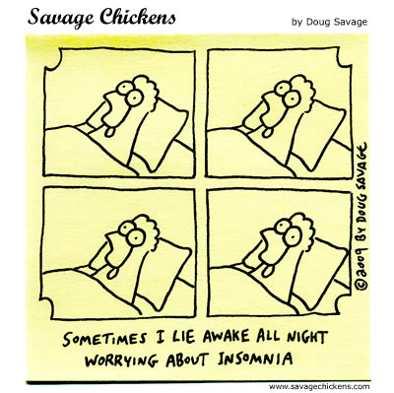
Symptoms of Stress - Cognitive
Being forgetful and disorganized
Inability to focus or concentrate
Constantly worrying
Incessant stream of thoughts
Difficulty with memories

Slide 4
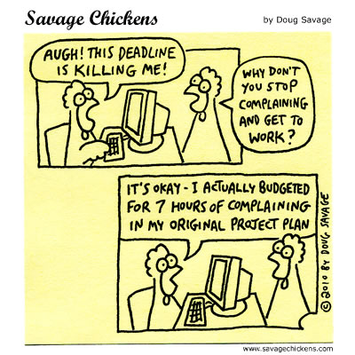
Symptoms of Stress - Behavioral
Sudden change in appetite
Avoidance of tasks and responsibilities
Increased use of alcohol, smoking, or drugs
Nervous behaviors such as fidgeting or nail biting

Slide 5
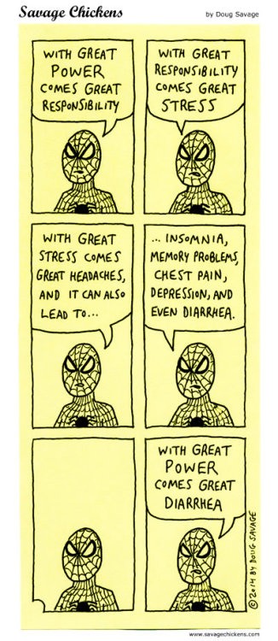
Symptoms of Stress - Physical
Tension headaches and other muscle pains, such as in the jaw
Chest pain, rapid heartbeat, shortness of breath
Stomach aches, pains, nausea
Shakiness, clammy or sweaty hands, tinnitus

Slide 6
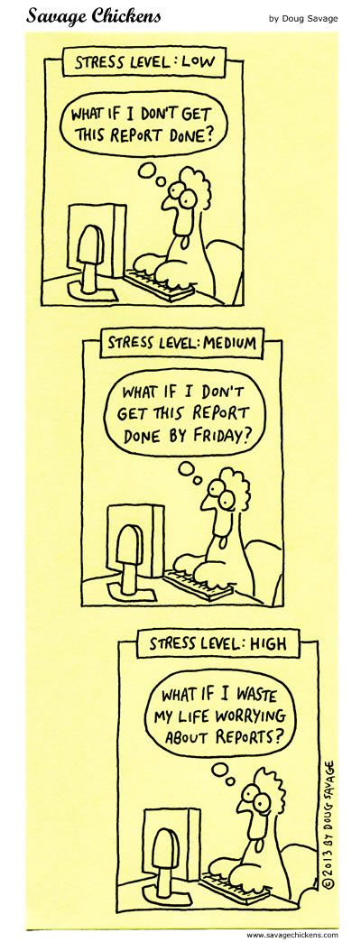
Symptoms of Stress - Emotional
Feelings of agitation or irritability
Inability to relate
Lowered self-esteem, loneliness, depression
Feeling overwhelmed or out of control

Slide 7
Stress Management Video
https://ccriezp.idm.oclc.org/login?url=https://fod.infobase.com/OnDemandEmbed.aspx?token=11150&wID=16090&plt=FOD&loid=0&w=640&h=480&fWidth=660&fHeight=530

Slide 8
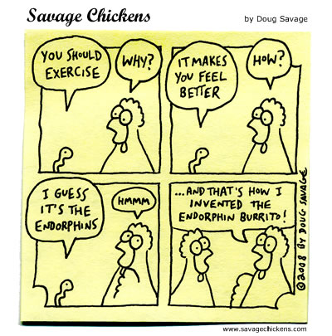
Ten Ways to Reduce Stress
Get enough sleep
Eat well
Exercise
Avoid unnatural energy boosters
Get emotional support
Don’t give up your passions
Try not to overload yourself
Avoid relaxing with alcohol
Breathe
Manage your time

Slide 9
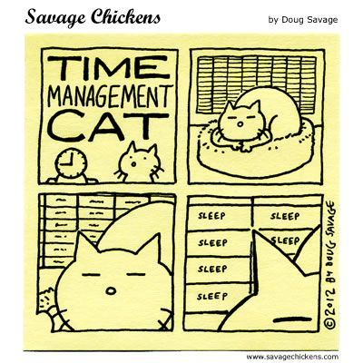
Time Management Tips
Write everything down
Use a calendar and/or a project management app
Stick to a routine
Identify time wasters and set goals
Tackle small tasks to start
Do one thing at a time
Use breaks wisely and take time off

Slide 10
Meditation
https://www.youtube.com/watch?v=y9momqG4aN8

Slide 11

Breathe!

Slide 12
Bibliography
Center for Collegiate Mental Health 2017 Annual Report
American College Health Association – 2017 National College Health Assessment
Academic Success Series: Stress Management, Dartmouth College, 2009
https://www.stress.org/stress-effects
https://www.mindbodygreen.com/0-18510/5-mini-meditations-you-can-do-in-1-minute.html
https://www.everydayhealth.com/college-health/college-life-10-ways-to-reduce-stress.aspx
https://www.purdueglobal.edu/blog/student-life/time-management-busy-college-students/
https://www.rasmussen.edu/student-experience/college-life/time-management-tips-college/
https://www.usnews.com/education/blogs/professors-guide/2009/10/14/top-12-time-management-tips

