Slide 1
Adulting 101
The Art of Being a Grown-up Shanna Wells, M.Ed.
Community College of Rhode Island
Coordinator, Community and Social Resources

Slide 2
Session 5
Crisis Management and Resilience

Slide 3
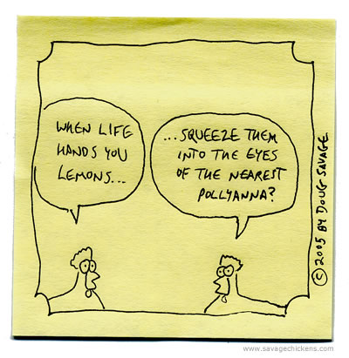
Life's Lemons
Crises and catastrophes by their nature are unpredictable, and therefore hard to plan for.
However, preparations can be made that may make things easier should a crisis occur.
It may be costly to obtain some of your emergency preparedness materials. Prioritize greatest needs and buy those first, get the rest over time.

Slide 4
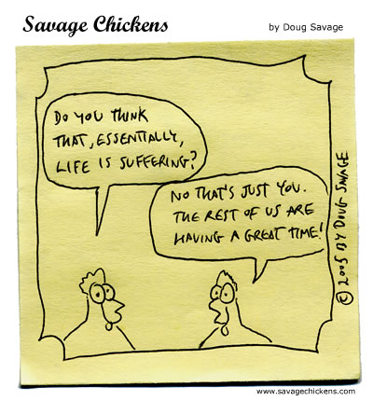
Plan Ahead
Buy a fire-proof box to store important documents
https://www.wisebread.com/11-essential-documents-you-should-keep-in-your-safe
First Aid Kits: Stock Supplies that can Save Lives
https://www.mayoclinic.org/first-aid/first-aid-kits/basics/art-20056673

Slide 5
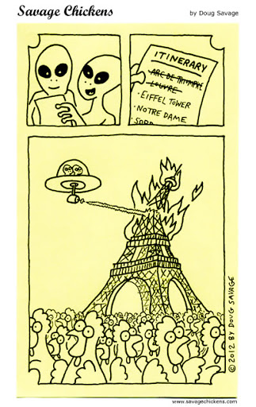
Emergencies Coming and Going
Hurricane Safety Checklists
https://hurricanesafety.org/prepare/hurricane-safety-checklists/
A Go Bag Can Make All the Difference in an Emergency
https://www.aarp.org/health/healthy-living/info-2017/packing-your-emergency-preparedness-kit-fd.html

Slide 6
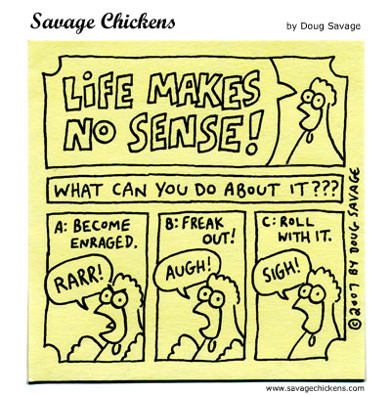
Attitude Is Everything
The ability to adapt to changing circumstances while continuing to move forward is called resilience.
Even if you are taking only little, baby steps toward your goal, you are indeed moving forward.
Everything does not have to be accomplished at once. Steady movement forward toward the goal is all that matters.

Slide 7
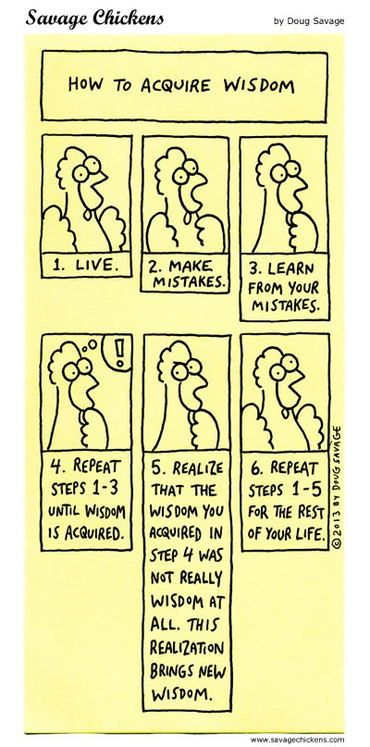
Strengths Underpinning Resilience
High frustration tolerance – The ability to endure challenging times without constantly complaining or lapsing into self-pity.
Self-acceptance and self-belief.
Humor.
Keeping things in perspective.
Emotional control.
Ability to ask for and receive help.
Curiosity.
Problem-solving skills.
Finding meaning in varied circumstances.

Slide 8
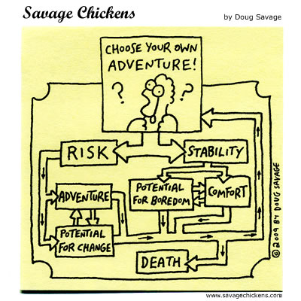
Welcome to the Rest of Your Life
Mastering basic life skills allows you to create a stable base from which to pursue your dreams and aspirations.
Only you can decide the correct balance of stability and risk that is right for you and your life circumstances.
Being an adult means we take responsibility for our choices.

