Slide 1
Adulting 101
The Art of Being a Grown Up Shanna Wells, M.Ed.
Community College of Rhode Island
Coordinator, Community and Social Resources

Slide 2
Session 4
Transportation and Insurance

Slide 3
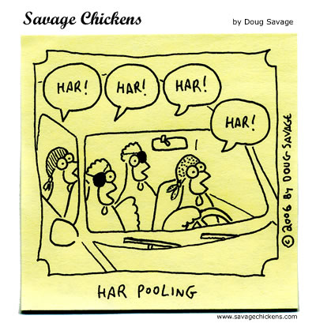
Alternatives to Buying a Car
Alternative methods of transportation are:
  Walk.
  Bus (monthly pass half-price at CCRI bookstore with student ID!)
  Ride Share (Car Pool/Uber/Lyft).
In addition to the price of a car, costs include registration, inspection, insurance, gas, regular and emergency maintenance, so consider your budget when deciding to buy a car.

Slide 4
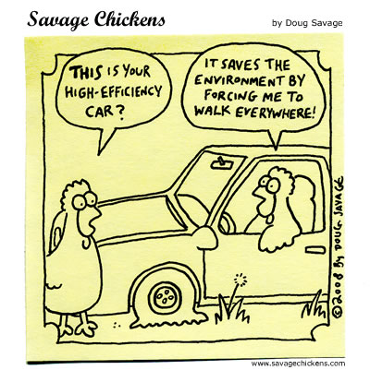
What Will It Cost to Buy and Own a Car?
How to Read an Auto Finance Contract
https://www.youtube.com/watch?time_continue=60&v=1bSycPa1Z2k
Total Cost of Owning a Car
https://www.nerdwallet.com/blog/loans/total-cost-owning-car/

Slide 5
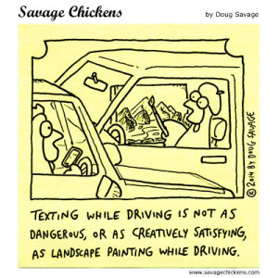
Tips for Buying a Car
Buy, don’t lease.
Buy used rather than new. For best re-sale value vehicles https://www.kbb.com/new-cars/best-resale-value-awards/
Pay cash if you can.
Don’t finance through the dealership. Find your own loan and know how much you can afford BEFORE making a deal for a car. To see if you qualify for a loan https://www.experian.com/blogs/ask-experian/will-i-qualify-for-that-car-loan/
Read the contract carefully.
Let a trusted mechanic inspect a used car BEFORE you buy.
Negotiate the price.

Slide 6

Insurance De-Mystified
Insurance helps protect you from financial loss when things go wrong. For example, you might be injured in a car accident and must pay for treatment and the cost of car repairs.
The insurer agrees to pay you money to help cover costs if something bad happens.
An insurance policy outlines what specific protection the insured receives. In exchange, you agree to pay a fee (monthly, quarterly or yearly) known as a premium.

Slide 7

Types of Insurance
WHAT YOU INSURE | TYPES OF POLICIES
Your holiday | Travel insurance
Your property | Car insurance, home insurance, renter's insurance
Your person | Health insurance https://healthsourceri.com/ Life insurance, income protection insurance, total and permanent disability insurance, term life insurance, sickness or accident insurance
Your business | Business insurance, professional indemnity and public liability insurance
Your loans | Consumer credit insurance

