Slide 1
Adulting 101
The Art of Being a Grown-up Shanna Wells, M.Ed.
Community College of Rhode Island
Coordinator, Community and Social Resources

Slide 2
Session 4
Transportation and Insurance

Slide 3
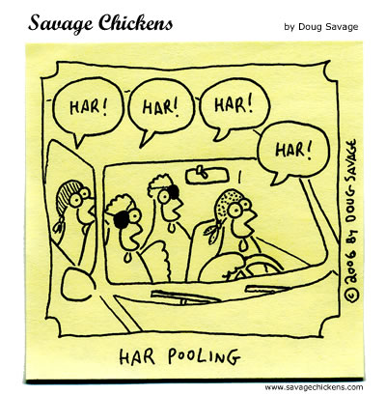
Alternatives to Buying a Car
Alternative methods of transportation are:
  Walking
  Taking the bus (monthly passes are half-price at all CCRI bookstores with student ID!)
  Ride sharing, such as carpooling or Uber/Lyft.
In addition to the price of a car, costs include registration, inspection, insurance, gas, regular and emergency maintenance, so factor that into your budget when deciding to buy a car.

Slide 4
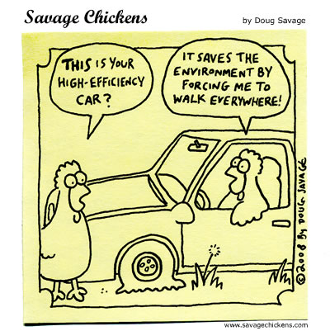
What Will It Cost to Buy and Own a Car?
How to Read an Auto Finance Contract
https://www.youtube.com/watch?time_continue=60&v=1bSycPa1Z2k
Total Cost of Owning a Car
https://www.nerdwallet.com/blog/loans/total-cost-owning-car/?trk=nw_gn1_4.0

Slide 5
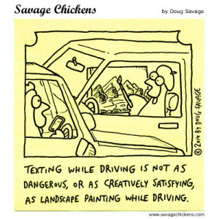
Tips for Buying a Car
Buy used rather than new. For best re-sale value vehicles https://www.kbb.com/new-cars/best-resale-value-awards/
Borrow as little as you can to finance it.
Don’t finance through the dealership. Find your own loan and know how much you can afford BEFORE making a deal for a car. To see if you qualify for a loan https://www.experian.com/blogs/ask-experian/will-i-qualify-for-that-car-loan/

Slide 6
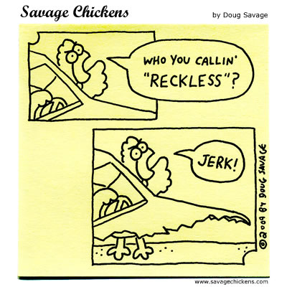
Insurance De-Mystified
Insurance helps protect you from financial loss when things go wrong.
For example, if injured in a car accident, one might have to pay for medical care and car repairs. The insurance company pays the insured to help cover costs if something bad happens.
An insurance policy outlines what specific protection the insured receives in exchange for paying a fee known as a premium.

Slide 7
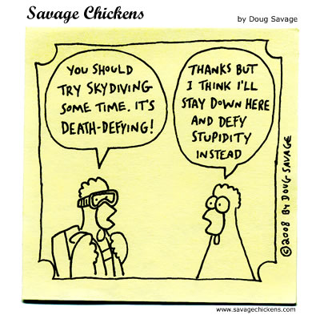
Types of Insurance
WHAT YOU INSURE | TYPES OF POLICIES
Your holiday | Travel insurance
Your property | Car insurance, home insurance, renter's insurance
Your person | Health insurance https://healthsourceri.com/ Life insurance, income protection insurance, total and permanent disability insurance, term life insurance, sickness or accident insurance
Your business | Business insurance, professional indemnity and public liability insurance
Your loans | Consumer credit insurance

