Slide 1
Adulting 101
The Art of Being a Grown Up Shanna Wells, M.Ed.
Community College of Rhode Island
Coordinator, Community and Social Resources

Slide 2
Session 3
Household Management

Slide 3
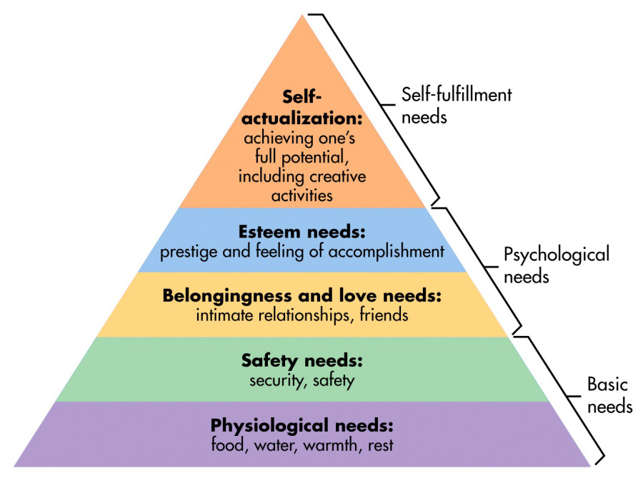
Prioritizing Needs
According to Maslow (1943), human beings are motivated by a hierarchy of needs.
Basic needs at the bottom of the pyramid must be met before higher needs. For example, it is hard to achieve your full potential academically if you are hungry in class.
The order of needs is not rigid but instead may be flexible based on external circumstances or individual differences.

Slide 4
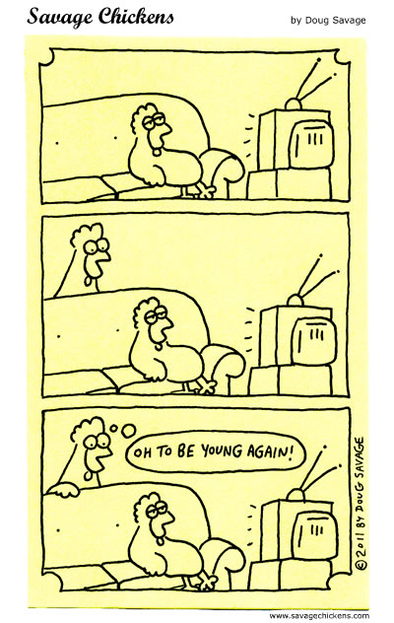
The Basics
A job is an opportunity to earn the money to support your life.
An adult is responsible for meeting their own basic needs.
If you have kids, you are responsible for meeting their basic needs too.

Slide 5
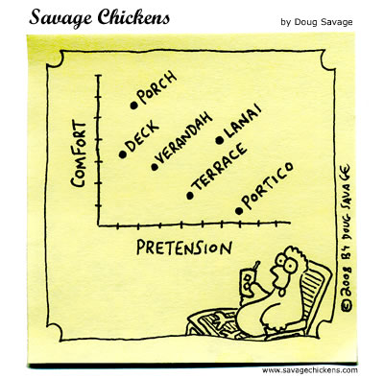
Housing
Buying a house requires a large amount of savings
https://www.moneyunder30.com/how-much-cash-do-you-really-need-to-buy-a-home
How to Rent an Apartment
https://www.youtube.com/watch?v=Ug9gb37PCRM
Tenants' Rights, Laws and Protections in Rhode Island
https://www.hud.gov/states/rhode_island/renting/tenantrights

Slide 6

The Bare Necessities
Acquiring all the things you need for your first apartment is an expensive undertaking, so go into it with a plan.
Prioritize what you need right away versus what can wait.
Consider thrift stores when buying kitchen items and non-fabric furniture (see list in Resources).
Essentials You Need for Your First Apartment
https://www.moving.com/tips/essentials-you-need-to-buy-for-first-apartment/

Slide 7
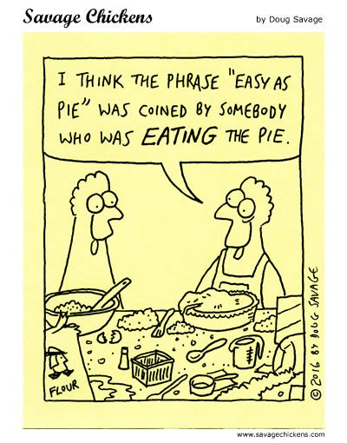
Cooking
Cooking Skills to Learn in Your Twenties
https://www.myrecipes.com/how-to/cooking-skills-to-learn-in-your-twenties
Top 30 Recipes for Starving Students
https://www.business-management-degree.net/top-30-recipes-for-starving-students/

Slide 8
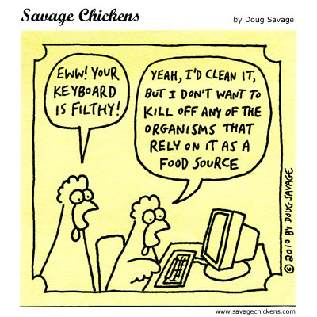
Cleaning
The Ultimate Cleaning Checklist
https://www.realsimple.com/home-organizing/cleaning/house-cleaning-schedule

