Slide 1
Adulting 101
The Art of Being a Grown Up Shanna Wells, M.Ed.
Community College of Rhode Island
Coordinator, Community and Social Resources

Slide 2
Session 2
Work and Money

Slide 3
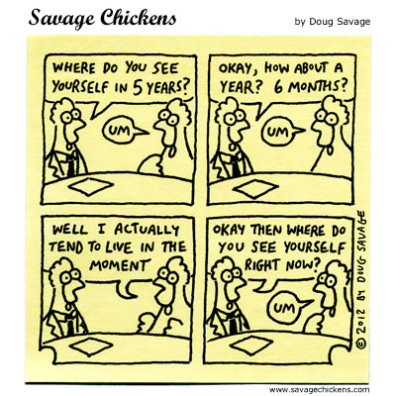
Getting a Job
Create a resume. Contact CCRI Career Services for assistance https://www.ccri.edu/cp/
Scrub your social media. If a post would offend your grandma, delete it. Get a professional sounding email address.
Research a company before applying. Know the answer to the interview question, “Why do you want to work here?”
Dress appropriately for the interview. Body and hair should be clean and neat, clothes should be clean, free of holes or frays, unwrinkled, modest or conservative in coverage.
Arrive 10 minutes early to your interview.
Practice answering the most often asked interview questions https://www.youtube.com/watch?v=BkL98JHAO_w
Treat everyone with respect, regardless of position.
Do not ask about money and benefits at the first interview unless they bring it up.

Slide 4
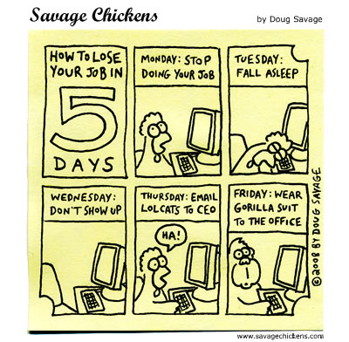
Keeping a Job
Be on time.
Focus on the work.
Be a team player.
Be flexible.
Don’t complain or gossip.
Offer to help.
Keep social media and work separate.
Be positive.
Always give two weeks' notice when leaving a job.
Work in such a way that, when you leave, they are sorry to see you go and give you a glowing reference.

Slide 5
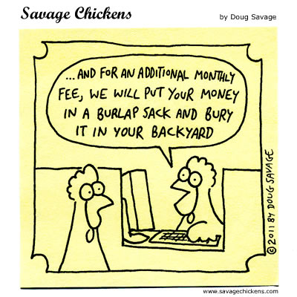
Banking
Basic Banking: Opening a Bank Account https://www.youtube.com/watch?v=uGs6CSlkc8Q
Questions to ask:
  Is there a monthly fee to have this account?
  Do I have to maintain a balance in the account to waive the fee?
  Is there a charge to use the ATM, visit the bank, or bank online?
  If I open a savings account, what is the interest rate which my savings will grow?
How to Write a Check (or money order)
https://www.youtube.com/watch?v=ukcSDS6PGms

Slide 6
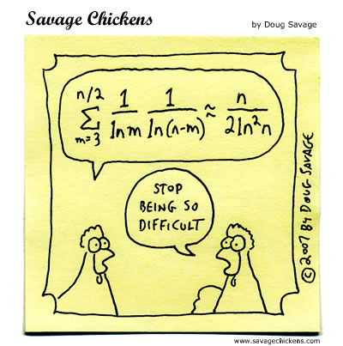
Budgeting
Steps to Better Money Management
https://www.youtube.com/watch?v=CU4l_rs50Kk
Budget Calculator
http://www.youcandealwithit.com/borrowers/calculators-and-resources/calculators/budget-calculator.shtml

Slide 7
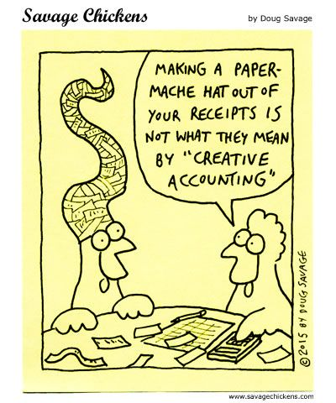
Taxes
Benjamin Franklin said only two things are certain in life: death and taxes. They are inevitable and inescapable.
Paying taxes is your responsibility and the Internal Revenue Service (national tax collector) and Department of Taxation (state tax collector) assess additional fines for delinquent payers and can garnish your paycheck – meaning they can take a portion of your check until all taxes and fines are paid off.
How to Do Your Taxes Explained
https://www.youtube.com/watch?v=ujdN7uK5kDk

