Slide 1
Adulting 101
The Art of Being a Grown-up Shanna Wells, M.Ed.
Community College of Rhode Island
Coordinator, Community and Social Resources

Slide 2
Session 2
Work and Money

Slide 3
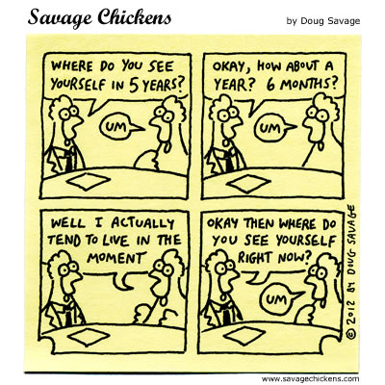
Getting a Job
Create a resume. Contact CCRI Career Services for assistance https://www.ccri.edu/cp/
At interview, your body and hair should be clean and neat, clothes should be clean, free of holes and frays, unwrinkled, modest or conservative in coverage.
Arrive 10 minutes early to your interview.
Practice answering the most often asked interview questions https://www.youtube.com/watch?v=BkL98JHAO_w

Slide 4
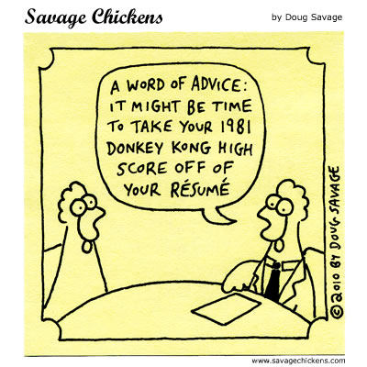
Getting a Job (continued)
Scrub your social media. If you wouldn’t want your grandma to read it, delete it.
Get a professional sounding email address.
Treat everyone with respect, regardless of position.

Slide 5
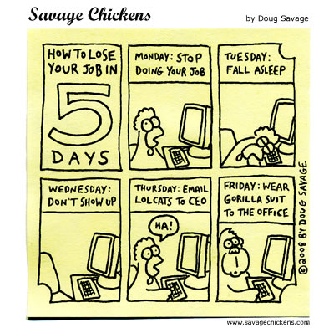
Keeping a Job
Be on time.
Focus on the work.
Be a team player.
Be adaptable.
Avoid the complainers and gossipers.

Slide 6
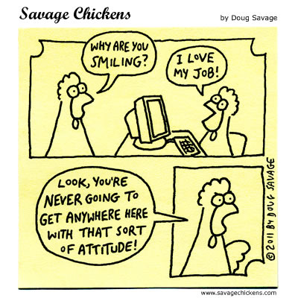
Keeping a Job (continued)
Offer to help.
Keep social media separate from work.
Be positive.
Give two weeks' notice when leaving a job.
Work in such a way that, when you leave, they are sorry to see you go and give you a glowing reference.

Slide 7
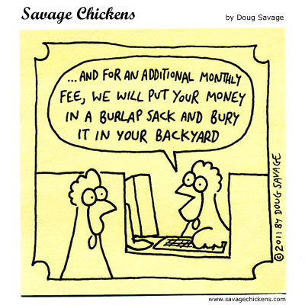
Banking
Opening a Bank Account https://www.youtube.com/watch?v=uGs6CSlkc8Q
How to Write a Check (or money order)
https://www.youtube.com/watch?v=ukcSDS6PGms

Slide 8
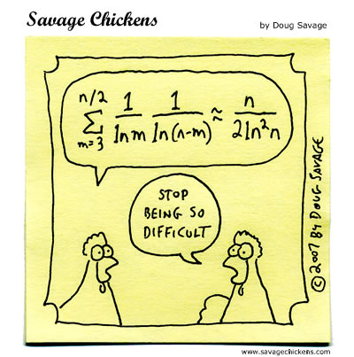
Budgeting
Steps to Better Money Management
https://www.youtube.com/watch?v=CU4l_rs50Kk
Budget Calculator
http://www.youcandealwithit.com/borrowers/calculators-and-resources/calculators/budget-calculator.shtml

Slide 9
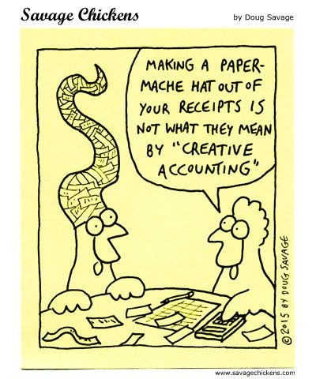
Taxes
Benjamin Franklin said, “Only two things are certain in life: death and taxes.” They are inevitable and inescapable.
Paying taxes is your responsibility and the Internal Revenue Service (national tax collector) and Department of Taxation (state tax collector) fine delinquent payers and can garnish your paycheck – meaning they can take a portion of your check until all taxes and fines are paid off.
How to Do Your Taxes Explained
https://www.youtube.com/watch?v=ujdN7uK5kDk

