Slide 1
Adulting 101
The Art of Being a Grown Up Shanna Wells, M.Ed.
Community College of Rhode Island
Coordinator, Community and Social Resources

Slide 2
Session 1
What is an Adult?

Slide 3
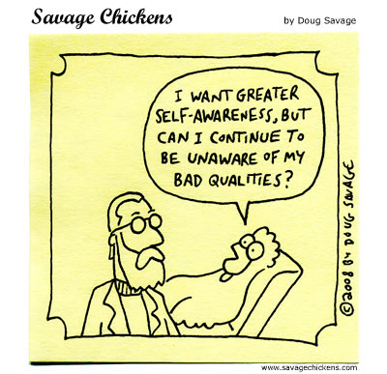
Definition
At the heart of being an adult is awareness — of our strengths, weaknesses, skills, and challenges. We accept that we’re not perfect, that we’ll never be perfect, and the most we can do is become the best version of ourselves, based on our moment-to-moment choices.

Slide 4
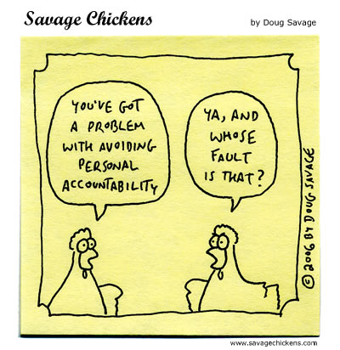
The Art of Responsibility
In adolescence we:
are not used to accepting personal responsibility.
often blame other people for our problems and assume that everyone is out to ruin our lives.
often believe that adults should be able to read our minds.
have trouble asking for help, or expect others to fix our problems for us.
may not have learned or been taught the skills needed to be independent.

Slide 5
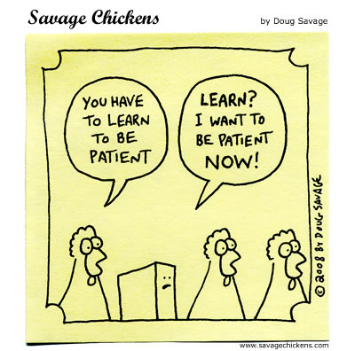
The Art of Responsibility (continued)
In adulthood we:
say what we mean and mean what we say.
show up on time.
meet deadlines.
pay bills.
take care of our physical needs (housing, transportation, money, health, etc.)
adjust to changing circumstances.
understand that the world does not revolve around us.
cooperate with others.
apologize when wrong and commit to doing better.

Slide 6
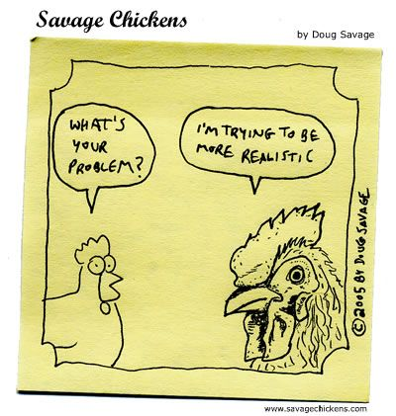
Helpful Hints
Becoming an adult is a marathon, not a sprint.
Admitting a weakness and figuring out a work-around until you develop that skill, is more effective than denial, and far less stressful.
If you don’t know, Google it.
If you still don’t know, ask.
Every day, be as encouraging to yourself as you are to your best friend when they’re down in the dumps.
Kindness costs nothing.

