Slide 1
Adulting 101
The Art of Being a Grown-up Shanna Wells, M.Ed.
Community College of Rhode Island
Coordinator, Community and Social Resources

Slide 2
Session 1
What is an Adult?

Slide 3
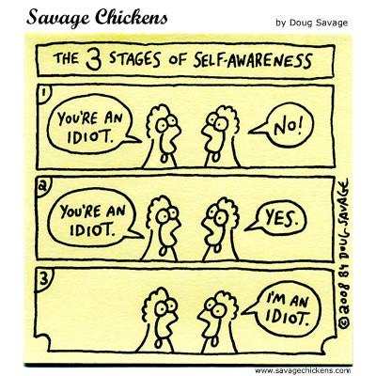
Defining Adulthood
At the heart of being an adult is awareness of your:
  Strengths
  Weaknesses
  Skills
  challenges.

Slide 4
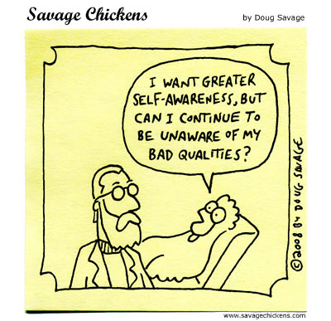
Defining Adulthood (continued)
We learn to accept:
we’re not perfect
we’ll never be perfect
the most we can do is become the best version of ourselves, based on our moment-to-moment choices.

Slide 5
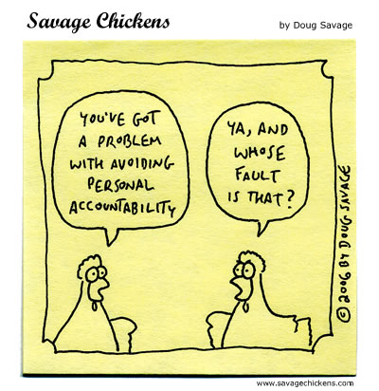
The Art of Responsibility
Adolescents:
are not used to accepting personal responsibility.
often blame other people for their problems and assume that everyone is out to ruin their lives.
often believe adults should be able to read their minds.
have trouble asking for help or expect others to fix their problems for them.
may not have learned or been taught the skills needed to be independent.

Slide 6
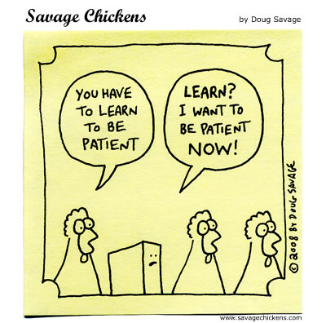
The Art of Responsibility (continued)
In adulthood we strive to:
say what we mean and mean what we say.
show up on time.
meet deadlines and pay bills.
take care of our physical needs (housing, transportation, money, health, etc.)
adjust to changing circumstances.
understand the world does not revolve around us.
work cooperatively with others.
apologize when wrong and commit to doing better.

Slide 7
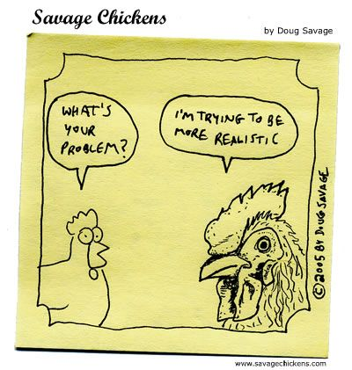
Helpful Hints
Becoming an adult is a marathon, not a sprint.
Admitting a weakness and implementing a work-around until you develop that skill is more effective in the long-run than denial, and far less stressful.
If you don’t know, Google it.
If you still don’t know, ask.
Every day, be as encouraging to yourself as you are to a loved one when they’re down in the dumps.
Kindness and a sense of humor cost nothing, and they breed good will.

