Slide 1


OSCQR²

Slide 2
OSCQR [5-40]
RSI
Learners have an opportunity to get to know the instructor.
Social presence is the ability of learners to project their personal characteristics into the community of inquiry, thereby presenting themselves as ‘real people.’ (Garrison, Anderson, & Archer, 2001).

Slide 3
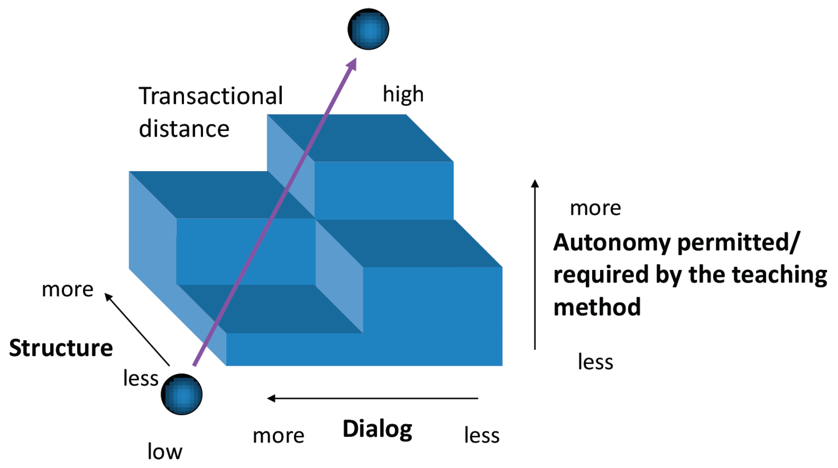
OSCQR [5-40]
RSI
https://www.mdpi.com/2227-7102/13/2/112

Slide 4
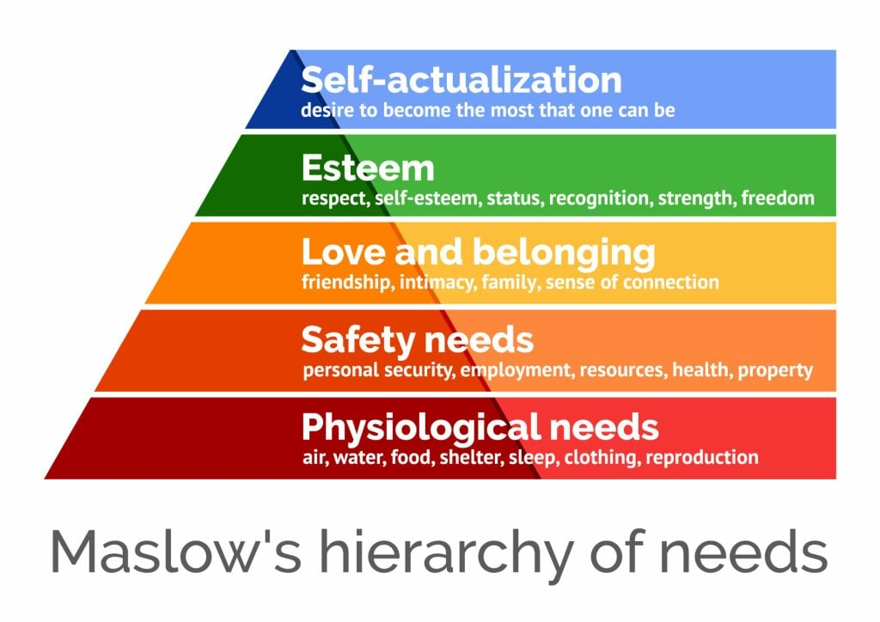
SoB Sense of Belonging
Maslow’s work in 1962
“the need for belonging is one of the most important needs for all students to function well in all types of learning environment”(Jackson, Cashmore, & Scott, 2010).

Slide 5
OSCQR [5-40]
RSI
Take the Teaching Presence Survey by SUNY
How & Why to HUMANIZE YOUR ONLINE CLASS – Michelle Pacansky-Brock, Foothill-DeAnza Community College

Slide 6
Practices – VoiceThread is great for this
Self-Affirming Icebreaker
Share something that is important to their identity.
A photo and story about their favorite object, place, food etc..
Share a Google slide deck where each student create a slide that represents them
Identity Haiku

Slide 7

Practices – Google form or test tool in Blackboard
Get to Know You Pre-Assessment
Ask students about:
Name pronunciation/ nicknames
Pronouns
where are they in their educational journey
if they prefer audio, video or text feedback
what might interfere or challenge their success in the course
how they feel about the course in general
if they need anything
if they wan you to know something about them
long term goals
Work schedule

Slide 8
Other Practices
Welcome video
Warm Instructor Intro video
Schedule Progress Meetings
Ask students to create a course playlist
Start each week off with an inspiring quote or poem
Share your pets on screen during videos or sessions

Slide 9
OSCQR [6-48]
ADA
Learners are informed when a timed response is required. Proper lead time is provided to ensure there is an opportunity to prepare an accommodation.
All learners need clear guidance on when learning activities and assignments are due, and what they need to do in order to meet those deadlines.

Slide 10

Practices
Add inclusive statement to syllabus
Add accommodation statement
Personalize the accommodation statement
Accommodation can be taken at any point during the semester.
Accommodation will not be given until all documentation has been completed and an intake meeting.

Slide 11
References
Aragon, S. R. (2003). Creating Social Presence in Online Environments. New Directions for Adult & Continuing Education, (100), 57-68.
Garrison, D. R., Anderson, T., & Archer, W. (2000). Critical inquiry in a text-based environment: Computer conferencing in higher education. The Internet and Higher Education, 2(2-3), 87-105.
Pacansky-Brock, M., Smedshammer M., & Vincent-Layton, K.(2020). Humanizing online teaching to equitize higher education. Current Issues in Education, 21(2). Retrieved fromhttp://cie.asu.edu/ojs/index.php/cieatasu/article/view/1905This submission is part of a special issue, Shaping the Futures of Learning in the Digital Age, guest-edited by Sean Leahy, Samantha Becker, Ben Scragg,and Kim Flintoff.
Hammond, Z. L. (2014). Culturally Responsive Teaching and the Brain: Promoting Authentic Engagement and Rigor Among Culturally and Linguistically Diverse Students. Thousand Oaks, CA: Corwin Publishers.

Slide 12

Request an OSCQR Review
Now reviewing online courses for 34 OSCQR standards.
Register at:
https://ccri.edu/onlinefaculty/trainings/cdr.html
Get Knight points and digital badge for LEVEL 2

Slide 13

Questions?

