Slide 1


OSCQR²

Slide 2
OSCQR [1-8]
DOE/NECHE
Course provides appropriate guidelines for successful participation regarding technical requirements (e.g., browser version, mobile, publisher resources, secure content, pop-ups, browser issues, microphone, webcam).
Help Desk and the Impact Center take care of the basics for you.

Slide 3
OSCQR [1-8]
DOE/NECHE
Two new websites are online:
https://ccri.edu/onlinefaculty/
https://www.ccri.edu/online/

Slide 4
Designing for Mobile
Test the course on mobile device.
Divide content into small, manageable chunks.
Minimize the number of ‘clicks’ to reach content and reduce scrolling. 1 LEVEL of FOLDERS
Communicate appropriate methods and devices for accessing publisher websites and other software.
Ensure that directions for content are applicable for all delivery devices (i.e., mobile devices, laptops, or desktop computers).
Ensure any apps that are required for students are available on both Android and iOS mobile platforms.
Avoid the use of tables and multiple levels of indents.

Slide 5
OSCQR [1-9]
NECHE
Course objectives/outcomes are clearly defined, measurable, and aligned to learning activities and assessments.

Slide 6
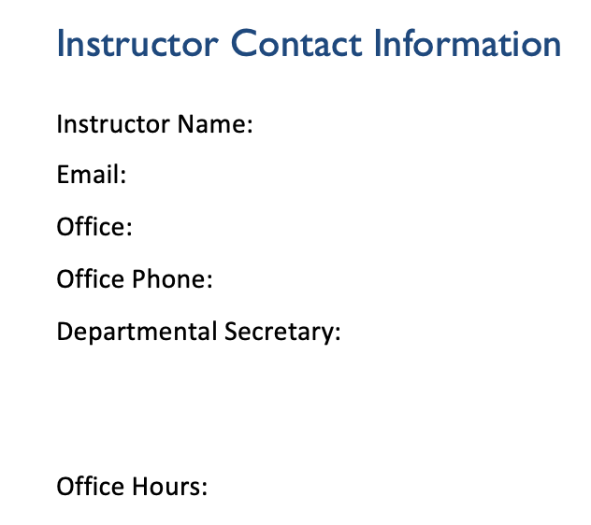
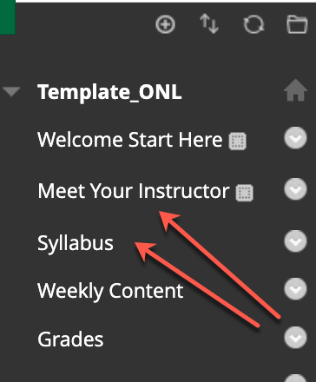
OSCQR [1-10]
DOE/NECHE
Course provides contact information for instructor, department, and program.

Slide 7
OSCQR [2-14]
FERPA
Course includes links to privacy policies for technology tools. https://studentprivacy.ed.gov/
Anthology Blackboard , SafeAssign, Annotate and Ally Privacy
Respondus Privacy
MEDIALecture Privacy
VoiceThread Privacy
Starfish
Zoom Privacy
Class Collaborate Privacy
Publishers
Apps like Quizlet, Padlet, FlipGrid, etc.
Other Software

Slide 8
OSCQR [4-33]
Copyright
US Copyright Office Fair Use Act
The Purpose and Character of the Use
The Nature of the Copyrighted Work
The Amount or Substantiality of the Portion Used – 1 Chapter
The Effect of the Use on the Potential Market for or Value of the Work

Slide 9

Request an OSCQR Review
Now reviewing online courses for 34 OSCQR standards.
Register at:
https://ccri.edu/onlinefaculty/trainings/cdr.html
Get Knight points and digital badge for LEVEL 2

Slide 10

Questions?

