Slide 1


OSCQR²

Slide 2
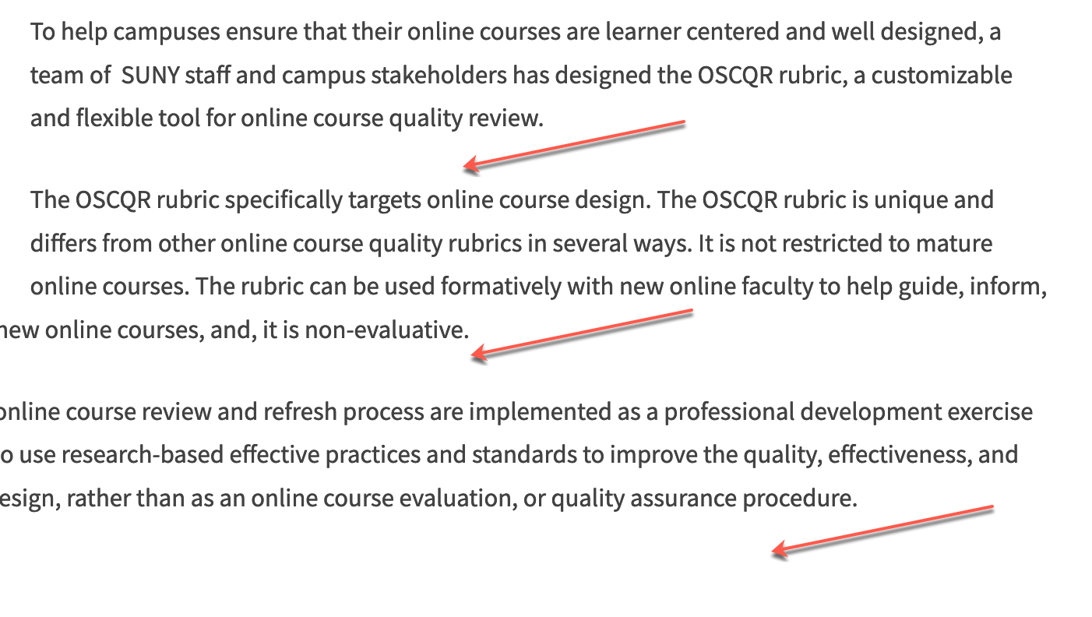
OSCQR [3-17]
ADA/508
Large blocks of information are divided into manageable sections with ample white space around and between the blocks.

Slide 3
OSCQR [3-18]
ADA/508
Contrast Checker
contrast ratio of at least 4.5:1
There is enough contrast between text and background for the content to be easily viewed.
Highlighted Text is hard to read for certain eye conditions.
Bee Line Reader is available through Ally Alternative Format.

Slide 4
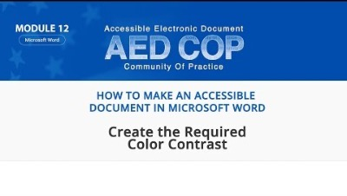
OSCQR [3-18]
ADA/508
Contrast Checker from WebAim

Slide 5
OSCQR [3-20]
ADA/508
Course is free of grammatical and spelling errors.

Slide 6
OSCQR [3-21]
ADA/508
Text is formatted with titles, headings, and other styles to enhance readability and improve the structure of the document.
See Style Sheet

Slide 7
OSCQR [3-22]
ADA/508
Flashing and blinking text are avoided.

Slide 8
OSCQR [3-23]
ADA/508
A sans-serif font with a standard size of at least 12 pt. is used.
Some principles to consider:
Use simple, familiar, and easily-parsed fonts.
Avoid character complexity
Avoid character ambiguity
Use a limited number of typefaces, fonts, and font variations.
Consider spacing and weight.
Ensure high contrast between the text and the background.
Avoid small font sizes.
Avoid ALL CAPS
Avoid italics
Avoid underlining
Use bold for emphasis

Slide 9
OSCQR [3-23]
ADA/508
A sans-serif font with a standard size of at least 12 pt. is used.
Examples of Serif fonts (do not use)
Georgia
Times New Roman
Courier New
Most fonts have a readable 12 pt. Use MS Calibri for small font sizes.
But become more difficult at 10 pt.
PPT at 28pt.
Examples of Sans-serif fonts (use these!)
Arial
Calibri
Verdana

Slide 10
OSCQR [3-24]
ADA/508
When possible, information is displayed in a linear format instead of as a table.
Example
Day and Time | Location
Tuesday, 9:00 am – 9:50 am | Knight
Location
Tuesdays, 9:00 am-9:50 am, Knight

Slide 11
OSCQR [3-26]
ADA/508
Average Weight of Contaminate B in Soil Samples 2022-2025
Table header rows and columns are assigned.
Date | Contaminate B (grams)
1/6/2022 | 1.007
1/27/2023 | 1.060
3/30/2023 | 1.5
4/6/2024 | 1.02
1/26/2025 | 1.004

Slide 12
OSCQR [3-25]
ADA/508
Tables are accompanied by a title and summary description.
Average Weight of Contaminate B in Soil Samples 2022-2025
Date | Contaminate B (grams)
1/6/2022 | 1.007
1/27/2023 | 1.060
3/30/2023 | 1.5
4/6/2024 | 1.02
1/26/2025 | 1.004
The table gives information about the presence of Contaminate B in the Sunrise Quarry in Warwick, Rhode Island. The samples were taken during the Site Study under the EPA guidelines for Super Sites.
Summarize the information by selecting and reporting the main features and make comparisons where relevant.

Slide 13

Request an OSCQR Review
Now reviewing online courses for 34 OSCQR standards.
Register at:
https://ccri.edu/onlinefaculty/trainings/cdr.html
Get Knight points and digital badge for LEVEL 2

Slide 14
Resources
WebAim

Slide 15

Questions?

