Slide 1


OSCQR & RSI

Slide 2
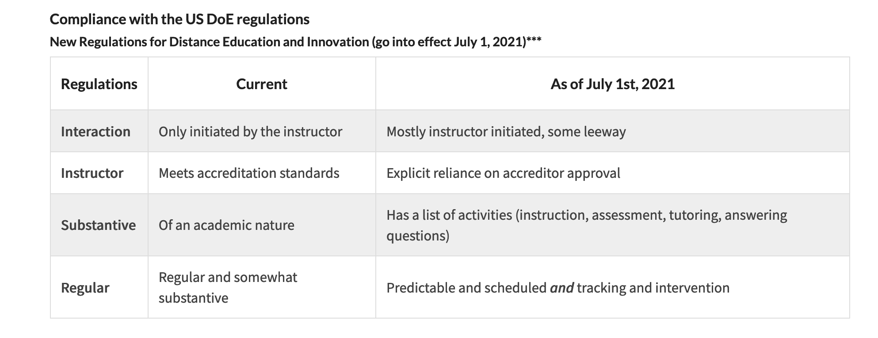
US DOE Regulations
Section102 (a)(3)(B) of the HEA: “an institution is not eligible to participate in Title IV programs if 50% or more its students are enrolled in correspondence courses during the latest complete award year.”
(Updated in 2022)

Slide 3
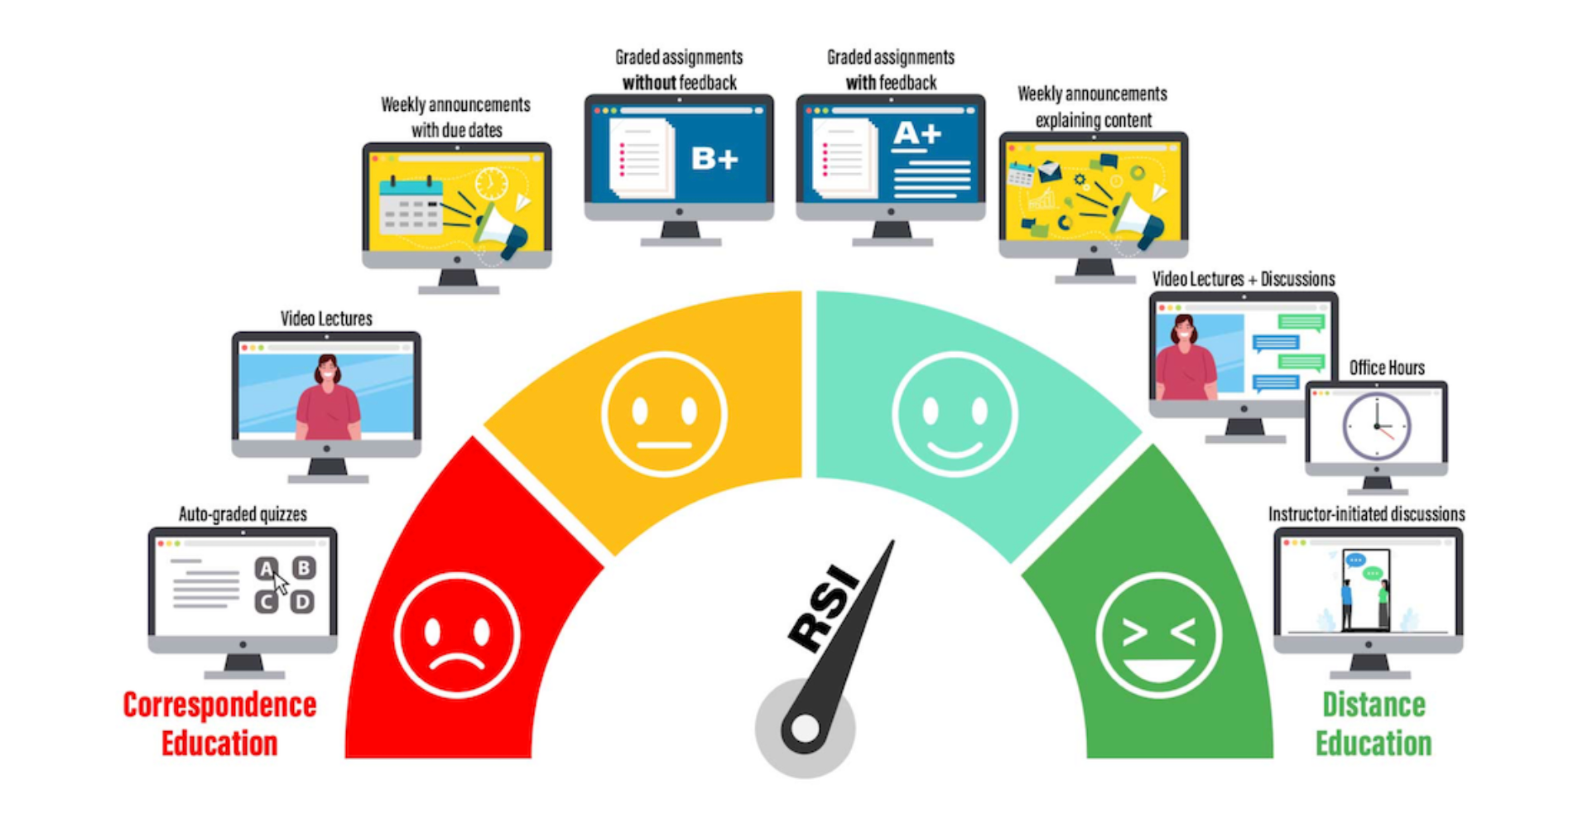
RSI
Empire State College

Slide 4
OSCQR
REGULAR SUBSTANTIVE INTERACTIONS
MEETS

Slide 5
OSCQR = REGULATIONS
Standards that Meet RSI: 2, 3, 29, 38, 39, 41, 43
Standards that Support RSI: 1, 6, 9, 10, 19, 30, 31, 40, 44, 45, 46, 47
Standards that Meet ADA, 504/508: 4, 15, 16, 17, 18, 20, 21, 22, 23, 24, 25, 26, 27, 28, 34, 35, 36, 37, 48
Standards that Meet Copyright: 33
Standards that Meet FERPA: 14
Standards that Meet DOE/NECHE: 5, 7, 8, 11, 12, 13, 49, 50

Slide 6
OSCQR
LEVEL 1
IS DETAILED

Slide 7
OSCQR
LEVEL 2
IS FAST

Slide 8
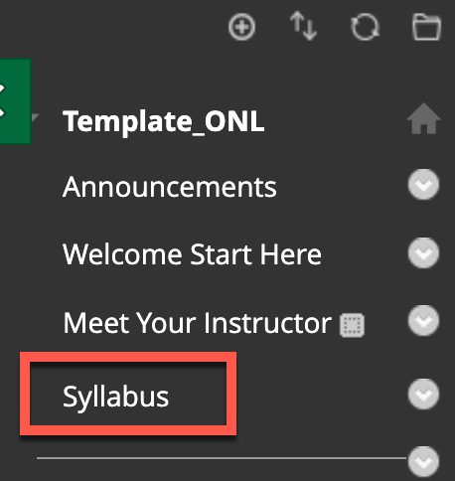
OSCQR [1-3]
Course includes a course information area and syllabus that make course expectations clear and findable.

Slide 9
OSCQR [1-5]
DOE/NECHE
Course includes links to relevant campus policies on plagiarism, computer use, filing grievances, accommodating disabilities, etc.
Use Syllabus Quiz to Familiarize Learners with Course Policies and Expectations
Create a Course Contract Assignment
Create a Syllabus Scavenger Hunt

Slide 10
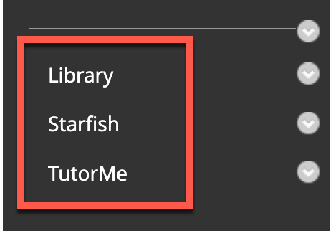
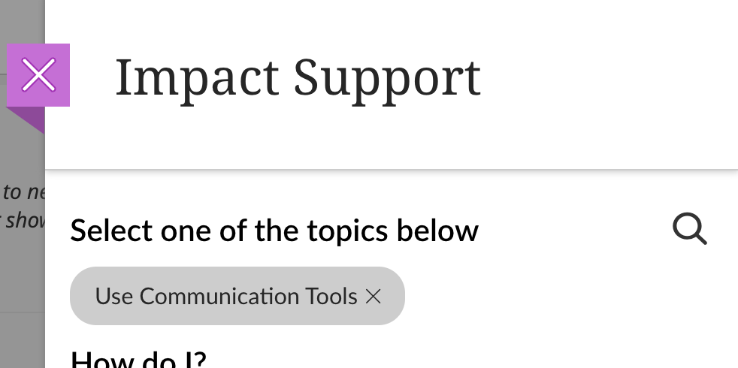

OSCQR [1-6]
Course provides access to online learner success resources (support services, orientation, academic honesty, tutoring, technical help).
New Student Orientation
https://ccri.edu/orientation/

Slide 11
OSCQR [1-7]
DOE/NECHE
Course information states whether the course is fully online, blended, or web-enhanced.

Slide 12
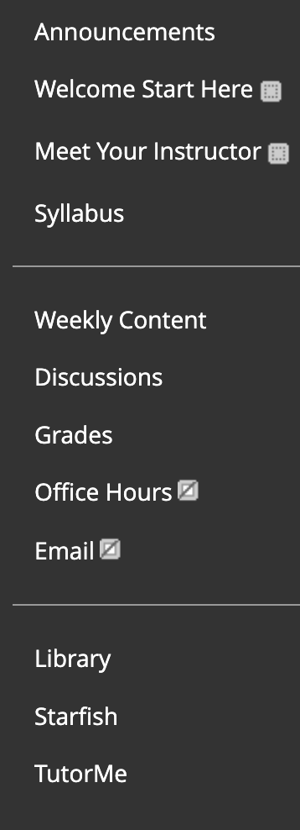
OSCQR [2-13]
DOE/NECHE
Frequently used technology tools are easily accessed. Any tools not being utilized are removed from the course menu.

Slide 13

Request an OSCQR Review
Now reviewing online courses for 34 OSCQR standards.
Register at:
https://ccri.edu/onlinefaculty/trainings/cdr.html
Get Knight points and digital badge for LEVEL 2

Slide 14
Resources
WCET RSI Resources
U.S. Regulations for Online Classes & here
Regular and Substantive Interaction (RSI) Examples
Regular and Substantive Interaction: Regulatory & Pedagogical Implications presentation by WCET (Recording)
Regular and Substantive Interaction: Background, Concerns, and Guiding Principle. (2018, November 30). Retrieved January 19, 2021, from https://eric.ed.gov/?id=ED593878
Trump administration rejects inspector general’s critical audit findings on Western Governors. (n.d.). Retrieved January 19, 2021, from https://www.insidehighered.com/news/2019/01/14/trump-administration-rejects-inspector-generals-critical-audit-findings-western
U.S. Department of Education Negotiated Rulemaking for Higher Education
RSI regulation – see pp. 339-341. Found in Department of Education, Office of Postsecondary Education, Distance Education and Innovation
34 CFR Parts 600, 602,and 668 Docket ID ED-2018-OPE-0076 RIN 1840-AD38
U.S. Department of Education Issues Final Rules on Distance Education and Innovation: NC-SARA. (2021, January 11). Retrieved January 19, 2021, from https://nc-sara.org/news-events/us-department-education-issues-final-rules-distance-education-and-innovation

Slide 15

Questions?

