Slide 1
Topic
Burnout
Understanding Burnout and How to Prevent It

Slide 2
Tired Teaching and Working
The profession we chose moves in constant cycles.
Falling Into a Rut
“We can start by facing the reality of tired teaching, no longer pretending everything will be OK if we just get to bed earlier.”
-Maryellen Weimer, PhD
Just as we begin to get things under control,
the next semester cycle begins.
Physical Tiredness
Emotional Tiredness
Cognitive Tiredness

Slide 3
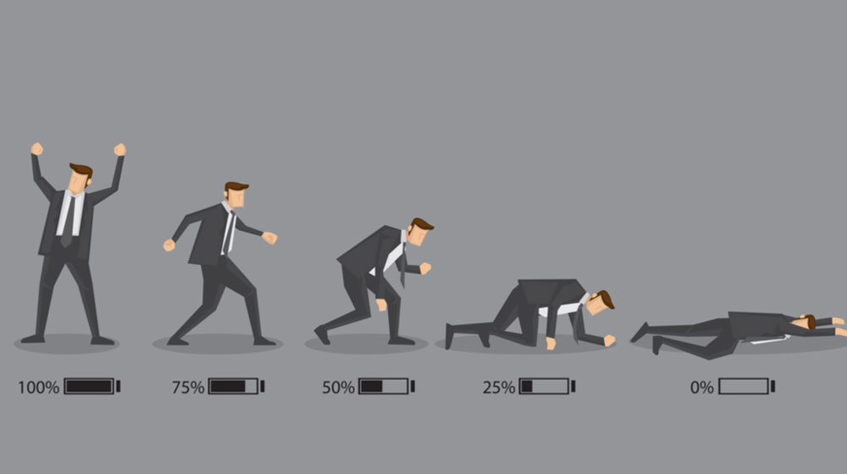
Tiredness Leads to Burnout
Burnout can be a serious condition.
“I think we have to start by recognizing that some form of tired teaching happens to all of us at one time or another during our careers. It’s an occupational hazard when you work in environments that prize always being rational and objective.”
- Maryellen Weimer

Slide 4
Poll
Are you working and teaching tired?

Slide 5
Have you become cynical or critical at work?
Do you drag yourself to work and have trouble getting started?
Have you become irritable or impatient with co-workers, students?
Do you lack the energy to be consistently productive?
Do you find it hard to concentrate?
Do you lack satisfaction from your achievements?
Do you feel disillusioned about your job?
Have your sleep habits changed?
Are you troubled by unexplained headaches, stomach or bowel problems, or other physical complaints?
GROUP WORK 5 MIN
Ask Your Colleagues
Consider how to know if you've got job burnout

Slide 6
Burn Out Symptoms
“Burnout is a state of emotional, mental, and often physical exhaustion brought on by prolonged or repeated stress. Though it’s most often caused by problems at work, it can also appear in other areas of life, such as parenting, caretaking, or romantic relationships.” – Psychology Today
01
02
03
04
Cause
Are You Affected?
Is it Just Stress?
Lack Empathy
You not in control of how a job is carried out, at work or at home, or asked to complete tasks that conflict with your sense of self. Lack of support to complete the work.
Feeling like you can no longer do your job effectively. A sense of dread when going to work or while working.
If the stress feels never-ending and comes with feelings of emptiness, apathy, and hopelessness, it may be indicative of burnout.
You may notice dwindling compassion toward those in your care or lose hope in your ability to care.

Slide 7
Shame
Negative self-talk
“When a more systemic, big-picture view of the causes of burnout is missing, we are made to feel personally responsible for our condition, and often feel ashamed, as though we have failed at a personal level.”
Loss of confidence
Everyone else seems to be handling the workload fine.
Why can’t I?
Loss of self-respect
Burnout Paradox, March 2022, Gary Drevitch

Slide 8
50% Experience Burnout Once
A survey of 7,500 full-time employees by Gallup established the top five reasons for burnout.
Lack of communication and support from their manager
Lack of role clarity
Unreasonable time pressure
Unfair treatment at work
Unmanageable workload
Gallup Poll, July, 2018

Slide 9
Cost of Burnout
63%
1/2
Although burnout has become "just part of the job" for many workers, the organizational cost of burnout is substantial
More likely to take a sick day
Half as likely to discuss how to approach performance goals with their manager
2.6
23%
13%
2.6 times as likely to leave their current employer
More likely to visit the emergency room
Less confident in their performance
Gallup Poll, July, 2018

Slide 10
Distinguish between what we can control and what we cannot
What can we do?
Take an inventory of the external factors that keep contributing
“Not everything is a question of personal responsibility and willpower – sometimes there really are structures out there that make us ill, no matter how strong and resilient and hard-working and effective we may be.”
- Gary Drevitch
Build Resiliency
Burnout Paradox, March 2022, Gary Drevitch

Slide 11
Practices
Say no
Collaborate
Self-care
Show Compassion
Be selective in which things you choose to commit and under what time frame.
Build a support system of allies and help motivate each other.
Reclaim your weekend. Unplug. Carve some time for yourself. Use your vacation time.
Show students and
colleagues a little grace.
Regroup and Refocus: Strategies to Avoid Professor Burnout By Katie D. Lewis, EdD, and Nicole Hesson, EdD Faculty Focus on December 18, 2020

Slide 12
Hands-on Strategies
Consider adopting some of the following strategies. These contribute to decreasing stress in your life.
Use software effectively
Be clear with communications
Use your calendar wisely
Don’t skip breaks
Automate processes and set up FAQs to reduce one-one communication.
Set up times where you will answer emails. Post turnaround time.
Block off time on your calendar for tasks. Block off a “catch up” time.
Your brain needs food and pauses in order to not overload cognitively.
Why You Should Be a Selfish Instructor By Shazia A. Ahmed, PhD, and Juliet V. Spencer, PhD. The Path to Wellbeing: Overcoming Burnout and Reigniting Your Teaching

Slide 13
What strategies made sense to you?
Which will you be able to implement quickly?
Are their colleagues close to you to form a support system?
Have you tried to automate processes, create a FAQ or placed common resources in an accessible area?
Can you block off time in your calendar to manage your task list?
Have you communicated to your manager about your workload?
Can you organize breaks or lunch with colleagues a few times per week?
How will you monitor your self-care?
Are you willing to unplug?
GROUP WORK 5 MIN
Ask Your Colleagues
Consider practices that you are willing to try to reduce burnout.

Slide 14
Recognize what is in your control.
Summary
Take care of yourself. Take time for yourself.
Let’s take care of each other.
Let’s take care of our students.
For more resources to tackle burnout:
Athletic Facilities
Beacon Wellness Program
Christina Rondeau Kickboxing
Use the techniques and practices to put you back in control of your work environment.

