Slide 1
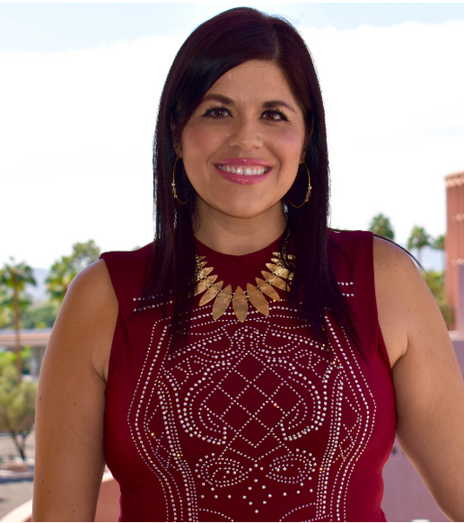
"The goal of engaging or promoting civil discussion about diversity and difference, as well as opportunities to engage in self-reflection and self-efficacy, is to promote the intellectual development of ourselves and others by helping us understand connections between controversial topics and our everyday lives.
If we don't interrogate our place in the world, consider our own diversity and that of those around us, we aren't engaging in the plurality of our democratic nation.
You needn't agree with what is being said. Your goal is simply to understand where a person is coming from."
Dr. Jessica Solyom
Associate Research Professor
School of Social Transformation
Arizona State University

Slide 2
Use positive and inclusive language everyday
Mish McIntyre (she/her/hers)
Allison Robinson (she/her/hers)
Jess Wilke (she/her/hers)
Kristen Swithers (she/her/hers)
Kevin Dias (he/him/his)
Kevin Salisbury
James Hinsey (he/him/his)

Slide 3
Message from Pres. Hughes

Slide 4
I am not an expert
I want to ACKNOWLEDGE my biases.
I want to GROW in empathy and compassion.
I want to model INCLUSIVENESS.
I want to be part of an INCLUSIVE COMMUNITY.
I want to SHARE what I have learned with my community.
I will continue to make MISTAKES.
We have 40 MIN

Slide 5
Are we a caring campus?
Our community EXPERIENCES conscious and unconscious bias. Our community EXPERIENCES discrimination. Our community EXPERIENCES systemic bias.
We have BIAS. We experience BIAS.
We play a critical role in modeling INCLUSION for our community.
We can ground our work in EMPATHY and COMPASSION. We can take care of one another.
We can HUMANIZE our systems and practices.

Slide 6
Lack of diversity
It is important to understand that a lack of diversity in our lives inhibits us from truly recognizing and addressing our own biases.
To overcome this, we must develop relationships with people of different backgrounds to foster greater awareness and inclusion for everyone.
(To Be Welcoming, 2021)

Slide 7
Inclusion
How Do We Create Equity and Inclusion Together?

Slide 8
Inclusive statement
Add a statement of inclusion to web pages and syllabi.
“I am committed to the principle of universal learning. This means that our classroom, our virtual spaces, our practices, and our interactions be as inclusive as possible. Mutual respect, civility, and the ability to listen and observe others carefully are crucial to universal learning. Active, thoughtful, and respectful participation in all aspects of the course will make our time together as productive and engaging as possible. I will give you periodic feedback on your participation.” (Inclusive Teaching, Brown University, 2019)
“The university is committed to a campus environment that is inclusive, safe, and respectful for all persons, and one that fully embraces the Carolinian Creed. To that end, all course activities will be conducted in an atmosphere of friendly participation and interaction among colleagues, recognizing and appreciating the unique experiences, background, and point of view each student brings. You are expected at all times to apply the highest academic standards to this course and to treat others with dignity and respect.” (Center of Teaching Excellence, University of South Carolina, 2019)

Slide 9
integrate Diverse Voices in publishing
Gather data on how many of our courses offer texts by BIPOC, LGBTQIA, and authors with disabilities.
Make it a priority to use WCAG AA publishers that have included BIPOC, LGBTQIA, and authors with disabilities.
Use Free or low-cost Open Educational Textbooks which include BIPOC, LGBTQIA and authors with disabilities.

Slide 10
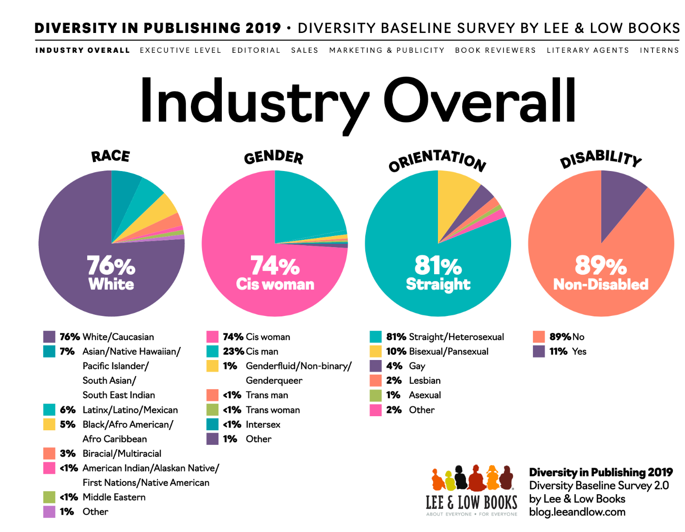

Slide 11
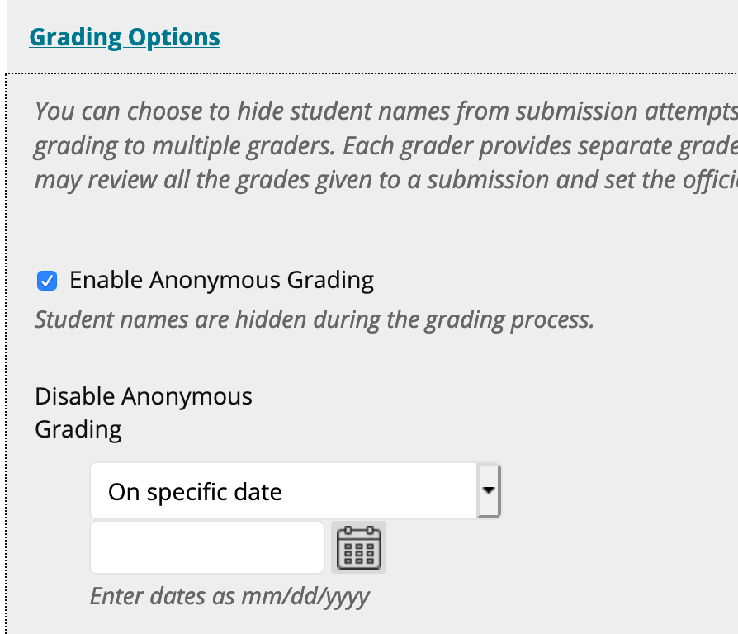
Grade anonymously
Blackboard can hide students' names to limit bias.

Slide 12
Jess Wilkie
Director Guided Pathways, Office of VP of Academic Affairs

Slide 13
James HInsey
Paraprofessional nursing

Slide 14
Kevin Salisbury
Interim Director Athletics, Office of Athletic Director

Slide 15
Inclusive Language:
Students with Disabilities
April 30, 2021
Allison Robinson, CCRI DSS

Slide 16
Once we recognize that biases do exist we can begin the process of creating a fully inclusive environment.
It strains credulity to assume that everyone is going to be completely bias free. Instead, approach conversations eager to learn and willing to recognize we all come to the table with our own histories and assumptions.
Acknowledge the importance of peoples' lived experience by creating environments in which people feel free to express themselves.

Slide 17
Inclusive Language:
Disabilities
“Language is a powerful tool. The written and spoken words that we use and the images that we create reflect our attitudes, beliefs, and assumptions.
Language shapes the way those around us speak and treat one another and conveys the respect we have for others.
It affects how we behave. The use of appropriate language about people with disabilities is an important tool in building a community that accepts ALL people” (Central Oregon Disability Support Network, 2016).

Slide 18
Examples of Person-First Language
Person-First.....
Rather than....
"Individual with a disability"
"Student who uses a wheelchair"
"Student with accommodations"
"Handicapped person"
"Disabled person"
"Confined to a wheelchair"
"Special student"

Slide 19

Inclusive Language
Regarding Accommodations
Collaborate
Maintain a collaborative, supportive tone/attitude rather than conveying that accommodations are a burden
Discuss
Frame conversations around the notion of "leveling the playing field" rather than "unfair to the rest of the class"
Respect
Speak to students about their accommodations privately- never in front of the whole class
Adapt
Adapt the classroom environment to be inclusive
Furniture placement
Virtual platforms accessible

Slide 20
Use of Language Related to
Mental Health
"Research suggests that the majority of people hold negative attitudes and stereotypes towards people with mental illness.
From a young age, children will refer to others as “crazy” or “weird”; these terms are used commonly throughout adulthood as well.
Dr. Michael Friedman, Psychology Today, 2014

Slide 21
Examples of Stigmatizing Words Related to Mental Health
You're so Crazy/ That's crazy/ Mad crazy
That's insane/You're insane
Psycho!
You're nuts/That's nuts/nutty
Lunatic!
Schizo!
Deranged
https://everymind.org.au/mental-health/understanding-mental-health/language-and-stigma

Slide 22
Person-First Language: Mental Health Focus
PERSON-FIRST...
RATHER THAN...
"Individual with a mental health disorder"
"Individual living with depression"
"Student with a substance use disorder"
"She's mentally ill"
"He's bipolar"
"He's suffering from depression"
"An addict"

Slide 23
Kristen swithers
Assistant Professor, biology

Slide 24
Fall 2019 Student Diversity Data: All of CCRI
n = 14775

Slide 25
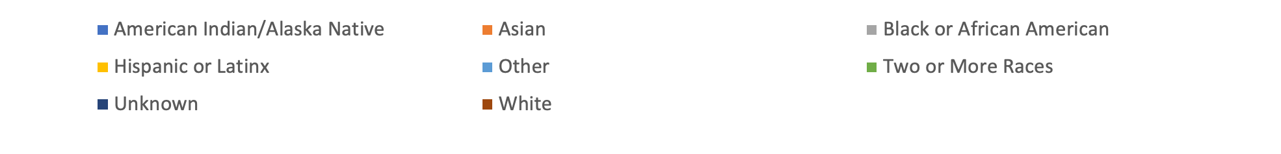
Fall 2019 Student Diversity Data: Each Campus
n = 2091
n = 3873
n = 6544
n = 945

Slide 26
Kevin Dias
Information Services Tech II, Office of the Dean of HARS

Slide 27
How to Pronounce a Name Phonetically
Example: How do you pronounce “Dias?”
There are a total of 3 ways that I have heard my last name pronounced:
American Dialect: Dye-iss
Spanish Dialect: Dee-az
Portuguese Dialect: Dee-uhzh
How do you know which dialect version to use?
Ask the person how they would like their last name pronounced and go with that.
If you forget, ask again until you remember. Most people would rather you keep trying than give up.

Slide 28
Some Apps That Can Help
NameCoach
Namez
NameShouts
Google Translator
Website with additional information about the importance of names and proper pronunciation:
  https://www.mynamemyidentity.org/

Slide 29
q & A

Slide 30
National resources
  National Suicide Prevention Lifeline: 1-800-273-8255 and Chat Function
  National Domestic Violence Hotline: 1-800-799-SAFE (1-800-799-7233) and Chat Function
  National Sexual Assault Hotline (RAINN): 1-800-656-HOPE (1-800-656-4673) and Chat Function
  The Trevor Project (National LGBTQ Youth Crisis Intervention): 1-866-488-7386 and Chat Function
  Gay, Lesbian, Bisexual, Transgender, National Hotline: 1-888-843-4564
  National Runaway Safeline: 1-800-786-2929 and Chat Function
  National Eating Disorders Association: 1-800-931-2237 and Chat Function.

