Slide 1
Universal Design for Learning (UDL)
Yan Huang
Instructional Design Specialist

Slide 2
Universal Design
Accessible Design
people with disabilities
Universal Design
everyone, in different situations.
(including people with disabilities)

Slide 3
Why UDL?

Slide 4
1. Learners have different learning styles

Slide 5
2. Learners may have disabilities
Physical disability
Learning disability
ADD/ADHD
Hidden disability
Notes:
12 percent of civilian, non-institutionalized population report a disability. (United States Census Bureau, American Fact Finder 2011.)

Slide 6
UDL Goals
- Remove barriers in instruction
Provides flexibility in the ways
information is presented
students respond or demonstrate knowledge and skills
students are engaged
Notes:
reduces barriers in instruction. The theory behind it is: The flexibility in teaching is to stimulate different parts of the human brain.

Slide 7
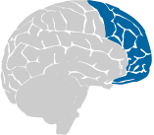
Recognition Networks
How we learn facts
Strategic Networks
How we organize and express our ideas
How we solve a problem
Affective Networks
How we get engaged and stay motivated
Notes:
Point 1: the different ways of presenting information. Point 2: allows different ways for students to demonstrate what he learn.

Slide 8
Provide Multiple Means of Representation
Recognition Networks
How we learn facts
Size of texts; color of pictures
Image/video/audio, interactive demonstration
Transcript for audio/video
Clarify complex definition
Visualized complex ideas
To-do list
Notes:
Learners differ in the ways that they perceive and comprehend information that is presented to them. For example, those with sensory disabilities (e.g., blindness or deafness); learning disabilities (e.g., dyslexia); language or cultural differences, and so forth may all require different ways of approaching content. Others may simply grasp information quicker or more efficiently through visual or auditory means rather than printed text.

Slide 9
Provide Multiple Means of Action and Expression
Strategic Networks
How we organize and express our ideas
How we solve a problem
Allow various ways of communication
Material compatible with assistive technology (spell-checkers)
“stop and think” section

Slide 10
Provide Multiple Means of Engagement
Affective Networks
How we get engaged and stay motivated
Various activities
Various sources of information
Feedback
Challenging tasks; exploration and experimentation
Self-reflection
Notes:
Some learners are highly engaged by spontaneity and novelty while other are disengaged, even frightened, by those aspects, preferring strict routine. Some learners might like to work alone, while others prefer to work with their peers.

Slide 11
Teaching Ideas…
Videotaping the class (Timing of videos)
Breaks/chance to move around
Outline before class
Lecture notes available online
Differentiation (learning styles)
Work sharing (wiki, Google Doc)
Alternatives to assignment delivery
Choice of tasks
Select content of study
Exceptions (test exception, longer due dates…)

Slide 12
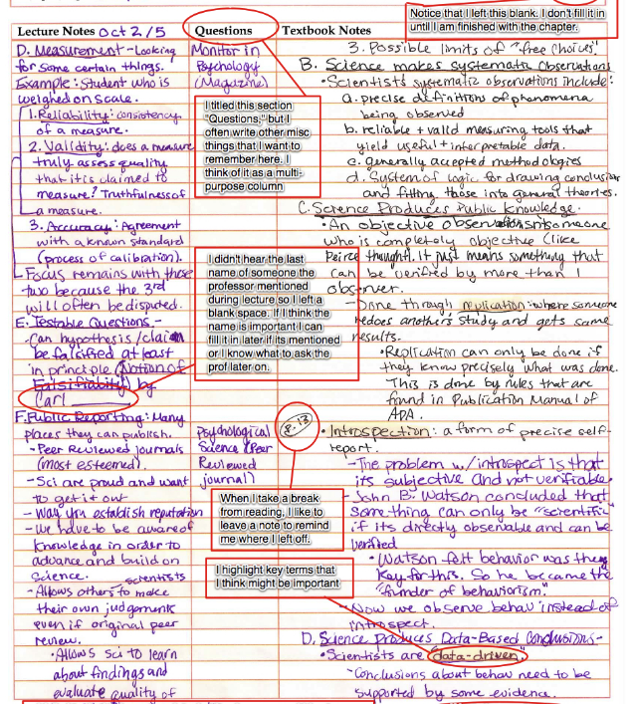
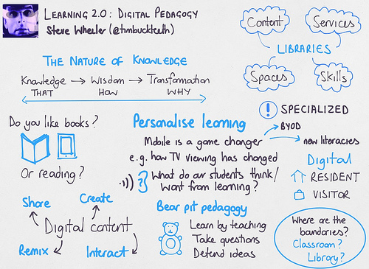
Note-taking

Slide 13
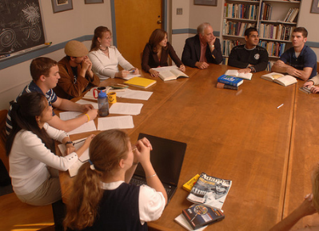
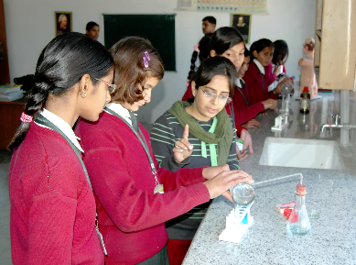
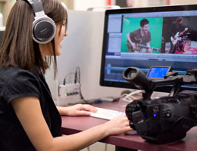
Final Words…
UDL aims to provide students more ways to
access
participate
demonstrate learning

Slide 14
Final Words… (cont.)
Not an afterthought
More cost-effective than retrofitting
More elegant and easy to use
e.g.
Digitalized text at the beginning,
Script before recording.

Slide 15
For more information…
www.cast.org
www.udlcenter.org

