Slide 1

Making Your Own Media
Simple Tools for Creating Media for Your Course
Winter Symposium, 2015

Slide 2
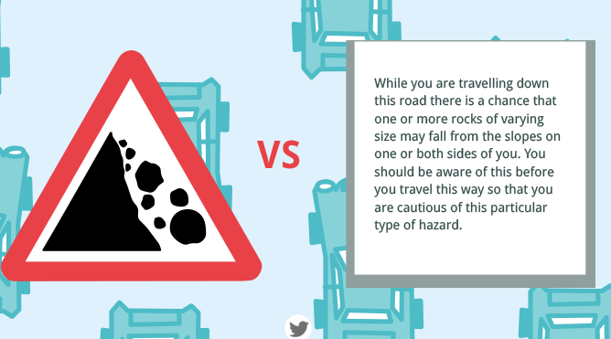



A Case for Multimedia in Learning
Credit: NeoMam Studios
Winter Symposium, 2015

Slide 3
How Multimedia Can Improve Student Learning
Visualization of change over time.
  MBTA: An Animated History
Illustration of abstract concepts.
  Evolution of an alphabet
Better representation of real-world processes.
  How a key opens a lock
Illustration of relationships between things.
  UK vs. Great Britain vs. England
Winter Symposium, 2015

Slide 4
Searching for Existing Content
MERLOT: Multimedia Educational Resource for Learning and Online Teaching
YouTube Education
Educational GIFs Subreddit
Google Image - Search Tools
Winter Symposium, 2015

Slide 5
Creating Your Own Multimedia
Exploring PowerPoint ( drag & drop - right click - shift )
  Graphics
  Animations
Equipment
  Smartphone – example camera app list
  Flip Cams – CCRI tech-guide
Advanced Graphics Editing
  Pixlr – pixlr.com
  Photoshop – Lynda.com tutorials
Advanced Video Editing
  Camtasia Relay & Camtasia Studio - Lynda.com tutorials
  iMovie (mac/iOS) - Lynda.com tutorials
  Windows Movie Maker (PC) - Lynda.com tutorials
Winter Symposium, 2015

Slide 6
Additional Online Media Resources
VIDEOS
YouTube EDU - youtube.com/education
Video clips of lectures, demonstrations, animations, & simulations on a wide range of educational topics.
TED-Ed - ed.ted.com
Short, animated tutorials on traditional school lessons, presented in an engaging way (ex. Euclidean Geometry, Population Dynamics, Economic Trends).
TED Talks -.ted.com/talks
Engaging and thought-provoking lectures from experts, typically relating new research and findings from their field (ex. Engineering, Design, Social Sciences, Music, Art, Psychology, Biology, Physics, Mathematics).
Kahn Academy -khanacademy.org
Video tutorials on traditional school topics (ex. Algebra, Macroeconomics, Photosynthesis). Includes some interactive activities as well.
PBS - pbs.org
Large library of videos (and other resources) from PBS’s award-winning programming (ex. Frontline, NOVA, Nature, American Masters)
Books & Articles…
Winter Symposium, 2015

Slide 7
Additional Online Media Resources – cont.
BOOKS & ARTICLES
Google Scholar -scholar.google.com
A searchable database of academic research articles.
iBooks (iOS only) - itunes.apple.com/us/app/ibooks
Interactive textbooks authored by educational publishers as well as independent educators.
Podcasts…
Winter Symposium, 2015

Slide 8
Additional Online Media Resources
PODCASTS
Audio programs on a wide variety of topics and interests. In addition to device specific apps, podcasts are also often available to stream or download from provider websites (ex. npr.org/podcasts).
For Mac and PC – iTunes - apple.com/itunes
For iOS – Podcasts App by Apple - goo.gl/7ZCy0
For Android – Stitcher Podcast App for Android - goo.gl/L1R0xf
Open Online Courses…
Winter Symposium, 2015

Slide 9
Additional Online Media Resources
OPEN ONLINE COURSES
edX - edx.org
Complete online academic courses from colleges and universities, including Harvard, MIT, Berkley, and McGill.
Class Central - class-central.com
Searchable database of many different open online courses.
Multimedia, Interactives & Simulations…
Winter Symposium, 2015

Slide 10
Additional Online Media Resources
MULTIMEDIA, INTERACTIVES, & SIMULATIONS
MERLOT - merlot.org
Multimedia Educational Resource for Learning and Online Teaching - A searchable database of online learning materials.
Winter Symposium, 2015

