Slide 1
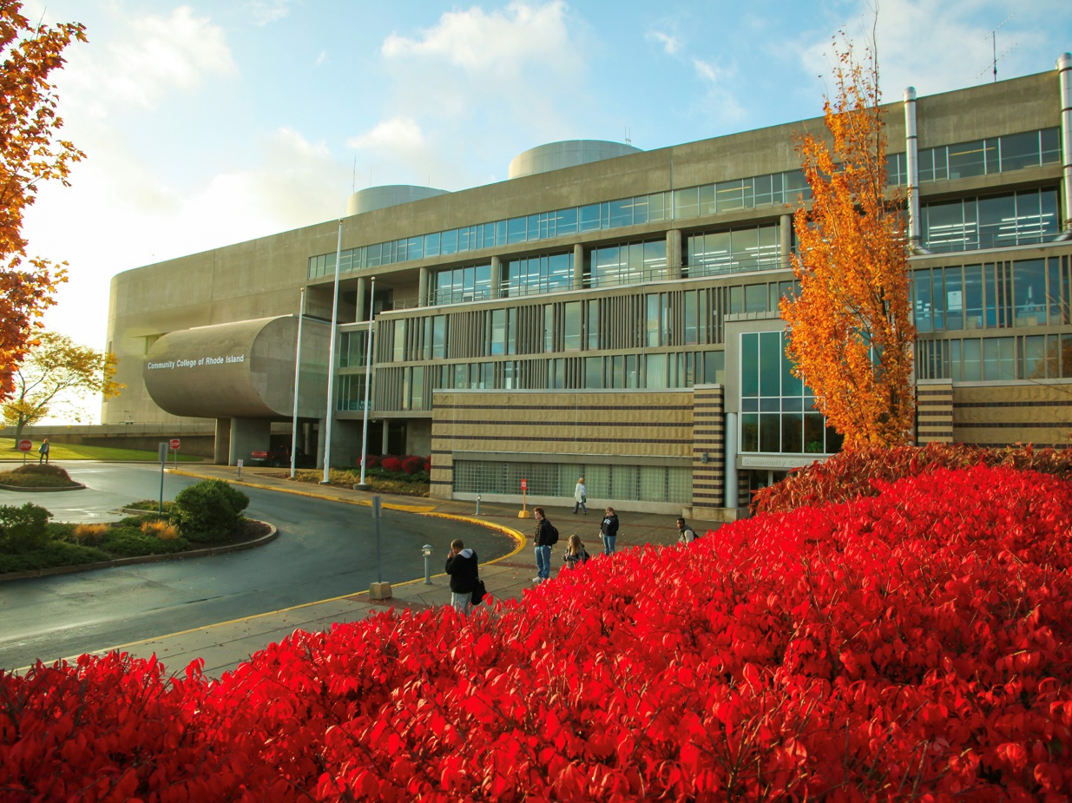
New Staff Orientation and Onboarding
In-Person Session

Slide 2

CCRI's Division of Institutional Equity, Human Resources, and Organizational Development
General Information for New Hires

Slide 3




Institutional Equity, Human Resources, and Organizational Development
Hours
Phone
Main Office
Email
Monday – Friday 8:00 a.m. - 4:00 p.m.
Phone: 401-825-2311
Fax: 401-825-2345
Room 3118 Knight Campus
humanresources@ccri.edu (general)
hiring@ccri.edu (talent acquisition)

Slide 4
Institutional Equity, Human Resources, and Organizational Development Leadership
Employee | Title
Alix Ogden | VP, Institutional Equity, Human Resources, and Organizational Development
Sybil Bailey | Executive Director, Labor and Personnel Relations
Terri-Ann Milligan | Associate Director, Human Resources
Kara DiPaola | Assistant Director, Office of Civil Rights and Title IX
Mickey Dargon | Associate Director, Labor and Employee Relations
Carlin Weirick | Manager, Talent Acquisition & Diversity Recruiting

Slide 5
Institutional Equity, Human Resources, and Organizational Development Staff
Employee | Title | Email | Focus
Carely Brens | Talent Acquisition Specialist | cbrens1@ccri.edu | Classified & part-time recruiting Part-time payroll and reauthorization Employment verification
Kristen Boyorek | HR Coordinator | kmboyorek@ccri.edu | Faculty new hire paperwork Tuition waivers
Robin Donnelly | HR Coordinator | rdonnelly@ccri.edu | Personnel data entry and management
Raekwon Grace | Senior Facilitator | rmgrace@ccri.edu | Organizational Development & Diversity, Equity and Inclusion
Jacqueline Hogan | Executive Assistant | jhogan1@ccri.edu | Scheduling General questions
Amy Zervas | HR Coordinator | azervas1@ccri.edu | Staff new hire paperwork and employee updates

Slide 6
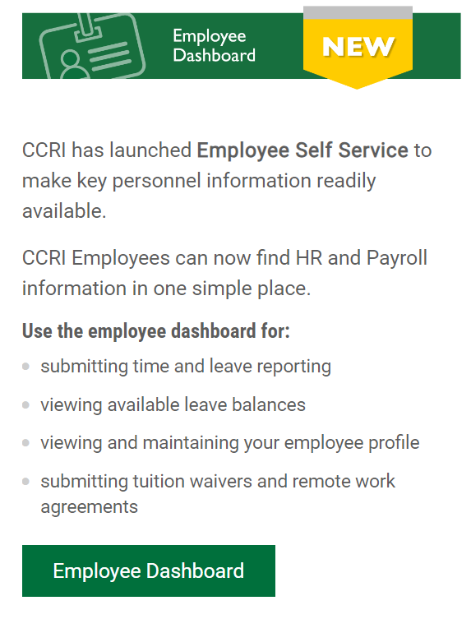
Institutional Equity, Human Resources, and Organizational Development
New website coming!
Employee Dashboard in MyCCRI
Submit time
Check leave balances
See pay stubs
Submit forms like Remote Work Agreement & Tuition Waiver Request

Slide 7
Institutional Equity, Human Resources, and Organizational Development
Benefits Information
Most benefits are managed through the State's Workterra site: https://sori.workterra.net/
Workterra user guide
Some benefits are managed through CCRI
Leave balances
Tuition waivers
Remote Work & Alternative Work agreements
Questions? Contact humanresources@ccri.edu

Slide 8




Everyone Supports Student Success
Say ”Hi”
Lead with Equity
Talk to your colleagues about our students
Learn about enrollment trends
Be part of making CCRI welcoming.
Be part of creating a sense of belonging for all.
Be a student-centered mentor
Be aware about what enrollment and retention of students means for the college

Slide 9
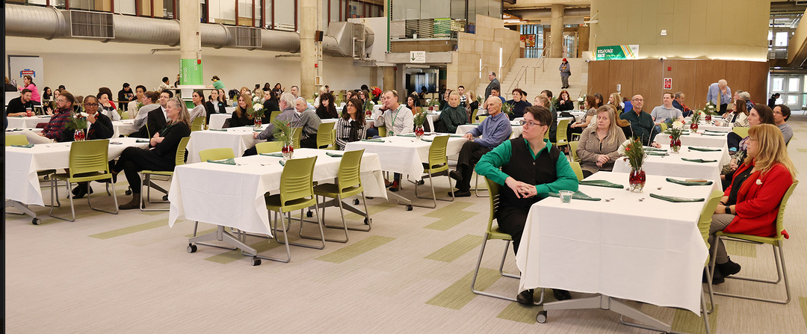
Labor and Employee Relations
Employee concerns and complaints
Conduct fair and just investigations into allegations.
Ensure a safe and productive work environment
Complying with contractual obligations
Employee Reviews both Probationary and Annual

Slide 10
Collective Bargaining Agreements & Employee Handbooks
Professional Staff Association (PSA) Non-Classified
Educational Support Professional Association (ESPA) Classified
Board of Education Non-Union
CCRI Employee Handbook
State of Rhode Island Employee Handbook
Policies
Board of Education Personnel Policy Manual
Staff Assembly

Slide 11
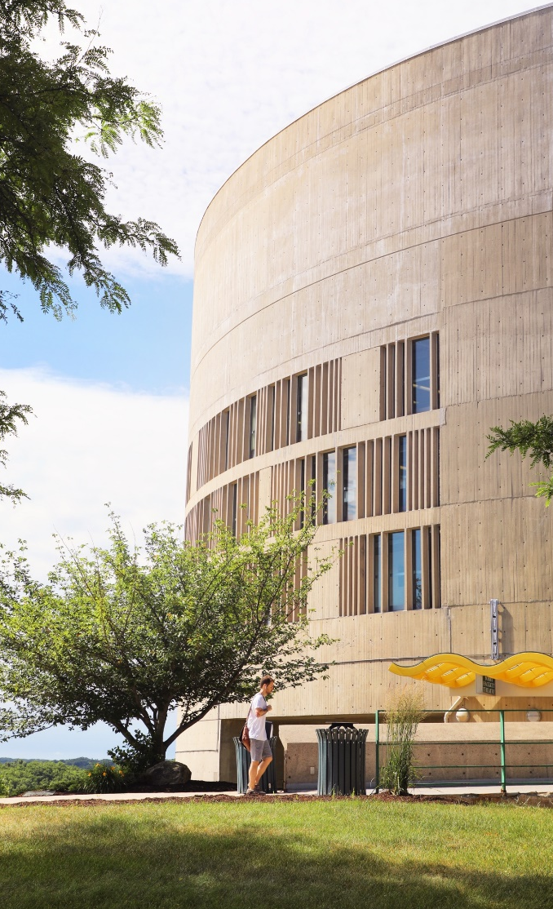
Kara DiPaola, Esq.
Title IX Coordinator
ADA/504 Coordinator
Civil Rights & Title IX

Slide 12
TITLE IX
"No person in the United States shall, on the basis of sex, be excluded from participation in, be denied the benefits of, or be subjected to discrimination under any education program or activity receiving federal financial assistance."
All forms of unlawful sexual harassment occurring within CCRI’s educational programs or activities are prohibited.
Sexual harassment, which includes acts of sexual violence, is a form of gender-based discrimination prohibited by Title IX. It creates a hostile environment that has no place on our campus. It is something we take very seriously.
Prohibits discrimination and harassment on the basis of sex, gender, gender identity & expression, and sexual orientation
Sexual violence is a type of sexual harassment.
Policy can be found on CCRI website
Applies to all within the CCRI community- faculty, staff and students.

Slide 13
Title IX - Prohibited Conduct
Sexual harassment: conduct on the basis of sex (incld. gender/gender identity/sexual orientation) that constitutes quid pro quo sexual harassment, hostile environment sexual harassment, sexual assault, domestic violence, dating violence, or stalking.
Quid pro quo sexual harassment: a person conditions giving an aid, benefit or service on another person's participation in unwelcome sexual conduct
Hostile environment sexual harassment: conduct that is severe, pervasive and objectively offensive, effectively denies a person access to CCRI’s educational program or activities
Does not have to be of a sexual nature (e.g., bullying, physical aggression, intimidation, hostility, etc.)
Can be shown by a pattern targeting individuals of the same sex, gender, gender identity, sexual orientation

Slide 14
Title IX- Prohibited Conduct
Sexual assault
Sexual touching/actions without consent
Domestic Violence & Dating Violence
Violence committed by someone in a romantic or intimate relationship with the victim
Stalking
Course of conduct that causes a person fear of harm; acts that follow or monitor someone, including on social media, in a way that causes fear or emotional distress

Slide 15
Pregnancy Accommodations
Title IX protections & support for pregnant individuals
Protection from discrimination
Support in continuing their education/work
Entitled to medically necessary accommodations
Excused absence
Breaks from work
Equipment modifications
Applies to students
–Rescheduling course work, tests, exams, homework
-Right to continue in classes, to leave of absence & return
Lactation Rooms on each campus, available for all
To request, contact Kara DiPaola kddipaola@ccri.edu
Knight Campus in Warwick, room 3118
401-825-1126, 401-895-1095

Slide 16

Nondiscrimination Policy
CCRI prohibits discrimination and harassment based on any individual’s race, color, creed, national or ethnic origin, gender, gender identity or expression, religion, disability, age, sexual orientation, genetic information, marital status, citizenship status, veteran status, and any other legally protected characteristic.
Can be found on CCRI’s website
Applies to all within the CCRI community- faculty, staff and students.

Slide 17
Nondiscrimination Policy- Prohibited Conduct
Harassment
Verbal or physical conduct (including using technology) directed towards an individual because of their membership in a protected class that has the purpose or effect of interfering with their educational performance, or creating an intimidating, hostile or offensive academic environment
Discrimination
Treating someone differently because of their membership in a protected class; there is a negative impact on their educational environment, individuals outside the protected class receive more favorable treatment, and there is no legitimate reason for the action

Slide 18
Nondiscrimination Policy- Prohibited Conduct
Sexual Misconduct
Sexual assault
Sexual action/touching without consent
Non-consensual sexual contact
Sexual touching without consent
Sexual exploitation
Taking advantage of someone in a sexual manner without consent
Ex: sharing private photos/videos without consent
Dating/domestic violence
Violence committed by someone in a romantic or intimate relationship with the victim
Stalking
Course of conduct that causes a person fear of harm; acts that follow or monitor someone, including on social media, in a way that causes fear or emotional distress

Slide 19
Intervention
When it is safe to do so, you can intervene if you witness an instance of harassment or discrimination.
Direct
Directly address this conduct in the moment. Saying something like, “That’s enough.” or “That isn’t funny.”
Delegate
If you don’t feel comfortable engaging, you can ‘delegate’ to an authority figure, like supervisor, Title IX Coordinator, or Campus Police.
Employees must report instances reported to them or witnessed by them to the Title IX Coordinator or to Campus Police.
Distract
Changing the subject or help remove the target of the harassment/discrimination from the situation.
Delay
Sometimes you’re not able to do something in the moment. You can follow up with the targeted person later to share that you witnessed the situation and thought it was wrong, You can offer to accompany them to report.

Slide 20
Resources
Campus Police
Non-emergencies: 401-825-2109; emergencies: 401-825-2000
Can report a crime or make a confidential report
Title IX Coordinator
Kara DiPaola
Knight Campus in Warwick, room 3118
401-825-1126, 401-895-1095
Investigation, non-criminal discipline
Faculty/Staff
Must report to the Title IX Coordinator and/or Campus Police
Provide reporter my information

Slide 21

Resolution
What are the best ways of handling these types of situation after they occur?
What are our jobs? Who is best situated to handle which aspect of the situation?
Obligation to report? To whom?
Notes:
The last thing I want to talk about today is how you should handle the situation if you either experience harassment or discrimination directly, or if you witness it, or are told about it.
If you experience this type of behavior directly, I would urge you to come talk to me. Even if you aren’t sure if what you experienced fits neatly in one of the types of behavior we discussed, that is ok! I can work with you and set you up with resources that can help, like getting the behavior to stop, getting you academic assistance, counseling, days off, or other types of support. Reporting is good because I can get you help, and it’s good for me to know what’s going on in a particular area on campus- even if it isn’t so bad that it warrants discipline, I might decide that a certain group needs training. If the behavior does violate one of our policies, I will start an investigation and there may be range up discipline up to suspension or expulsion.
If you hear of an event happening to someone else, the best course of action is to advise someone where they can report (Campus Police, me), and you can offer to go with them- and continue to support them or be a shoulder to cry on- but you should not be taking action that attempts to control the narrative, control what the victim wants, or control any type of consequences. Coming out too strong, acting in ways the victim may not want you to, risks re-traumatizing the person and causes them to lose control of their own experience.

Slide 22
Americans with Disabilities Act/Sec. 504
Employees are entitled to reasonable accommodation​s on the basis of a disability
Case-by-case, individualized analysis of need and solution​
Process​
Submit request​
Physician form​
Medical records​
Discussion with you, your supervisor​
Contact Kara DiPaola
Knight Campus, room 3118
401-825-1126, 401-895-1095
A reasonable accommodation is any change to the job, to the way the job is done, or the work environment that allows a person with a disability who is qualified for the job to perform the essential functions of that job and enjoy equal employment opportunities.
Accommodations that generally are considered reasonable include:
Provide reserved parking.
Improve accessibility in a work area.
Change the presentation of tests and training materials.
Provide or adjust a product, equipment, or software.
Allow a flexible work schedule.
Provide an aid or a service to increase access.

Slide 23
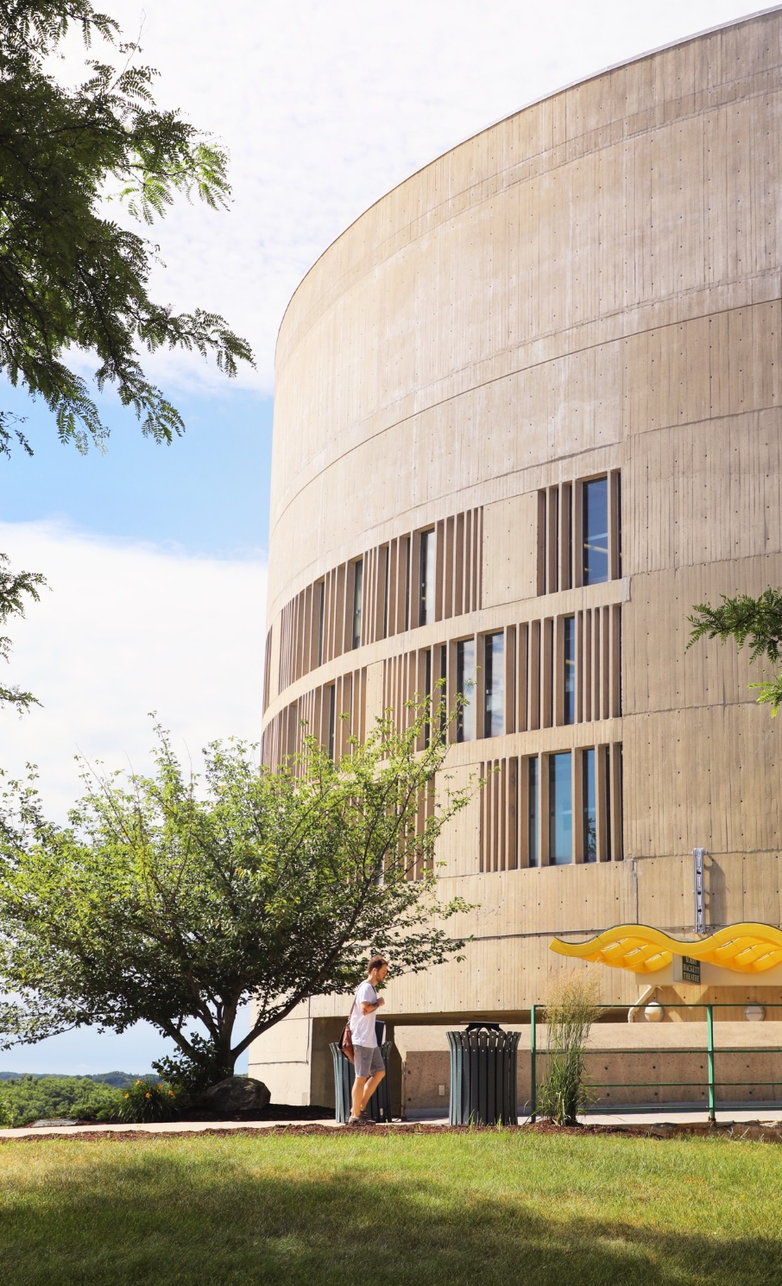
Campus Police
Chief Hopkins

Slide 24
Policing and Emergency Response for the College Community

Slide 25
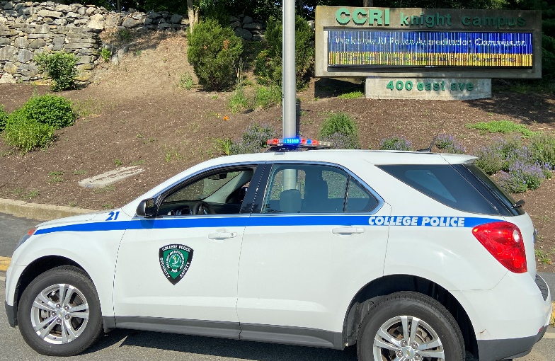
YOUR COLLEGE POLICE DEPARTMENT
24/7 Law Enforcement Agency – all 4 campuses
Routine 825-2109
Emergencies call 825-2000 or 911
LOCATIONS
-Warwick: PD HQ’s (ground floor, rear entrance); 2nd floor kiosk
-Lincoln: Substation (basement); 1st floor kiosk
-Providence: Main entrance kiosk
-Newport: Main entrance kiosk

Slide 26
YOUR COLLEGE POLICE DEPARTMENT
Criminal complaints and information
Working relationships with Police Departments sharing jurisdiction for investigation hand-off
Reporting methods
In-person any campus
On website including anonymous and confidential reporting
Building security
Parking
Handicapped
Assigned parking
Lost & Found
Escorts
Safe Zones/Blue Lights (Flanagan & Liston)/Emergency Phones

Slide 27

WARNING SYSTEMS
RAVE app is the primary Timely Warning method
Standardized emergency templates for Active Killer, LockDown, Shelter – in – Place and Evacuation, by campus
Alertus one step activation system through RAVE
Located at Knight campus, installation in progress at
other campuses
Desktop takeover feature
PA Systems at each campus
Electronic Door Lockdown is a feature that locks all electronic door locks with one step
-Will deny an attacker access
-You can still exit these doors or unlock them with your ID if you have approved access

Slide 28
RESPONSE
EVACUATION
SHELTER – IN – PLACE
LOCKDOWN
New Emergency Management Plan – 1st Draft
Annual emergency exercise every January
Police conduct drills every summer during our in-service training week.

Slide 29
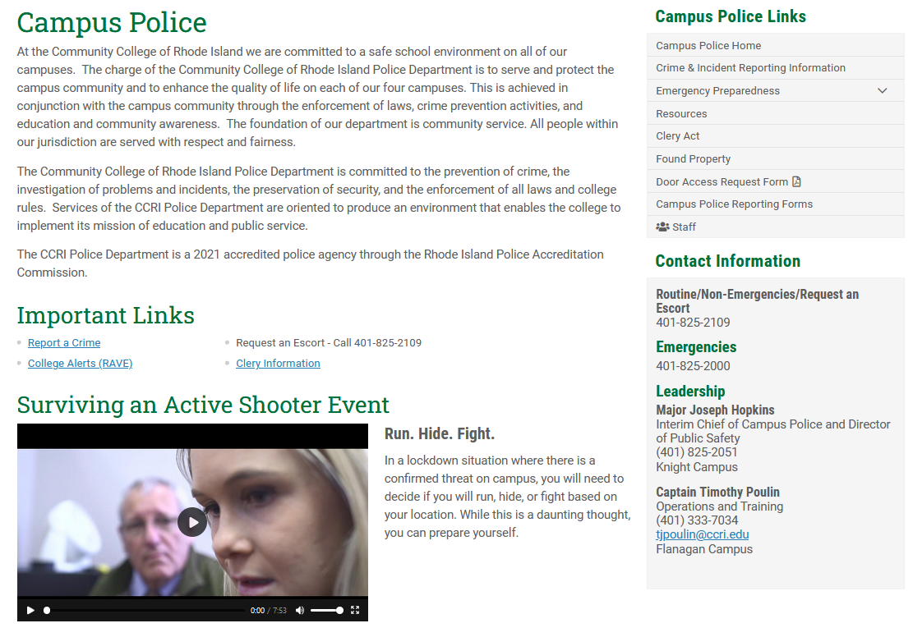
RUN HIDE FIGHT AVOID DENY DEFEND

Slide 30
FIRST RESPONDERS
CCRI PD will confirm an active killer event or threat
Send out the warning
Coordinate outside agency responses
Officers will respond to isolate/distract the attacker, assist those able to RUN and provide medical aid
Responding police will have firearms drawn
They have one purpose only – stop the threat
They will be moving quick, will not stop to talk and render aid
They will shout directions as they move, follow them
“Show your hands” , “Get down” , “Run this way”
They will shout questions as they move, answer them if you can

Slide 31
CLERY ACT
Daily Crime Log and Annual Security Reports
Campus Security Authorities (CSA’s) – designated persons with significant responsibility for student/campus activities with responsibility to report crimes
Confidential Reporting – when in doubt report it

Slide 32
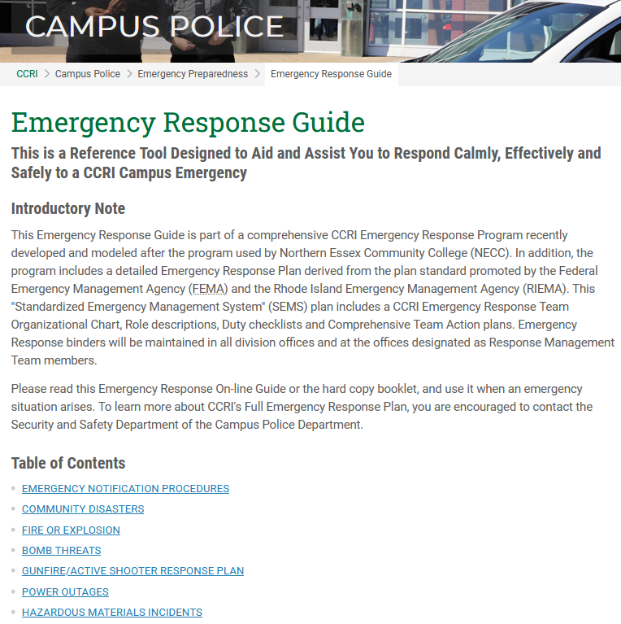
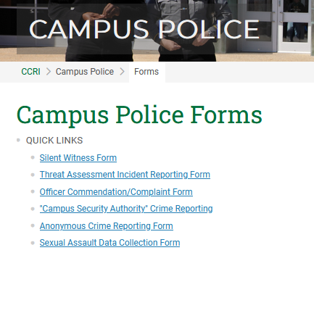
RESOURCES

Slide 33
IT New Employee Orientation
Michael Hudspeth
Director, IT Customer Support & Quality Assurance
David Rowbotham
Information Security Officer

Slide 34





IT Department
Chief Information Officer
James Bradley
jbradley3@ccri.edu
IT User Services
Michael Hudspeth
mhudspeth
@ccri.edu
Enterprise
Rajeev Jayadea
rjayadeva@ ccri.edu
Operations
Vacant
Security
David Robotham
drowbotham
@ccri.edu

Slide 35




IT User Services
Helpdesk
Desktop Computer Support
Audio Visual Support
Software Distribution and Updates

Slide 36
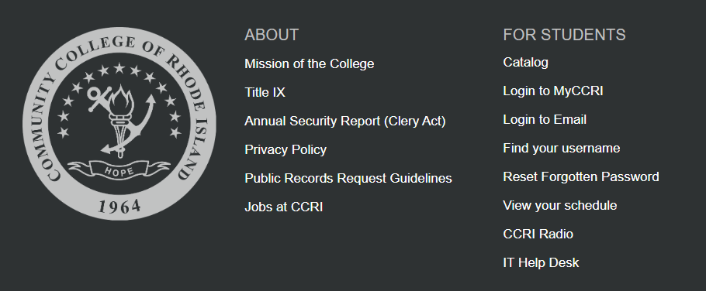
Helpdesk
Helpdesk can be accessed using a link at the bottom of our website.

Slide 37
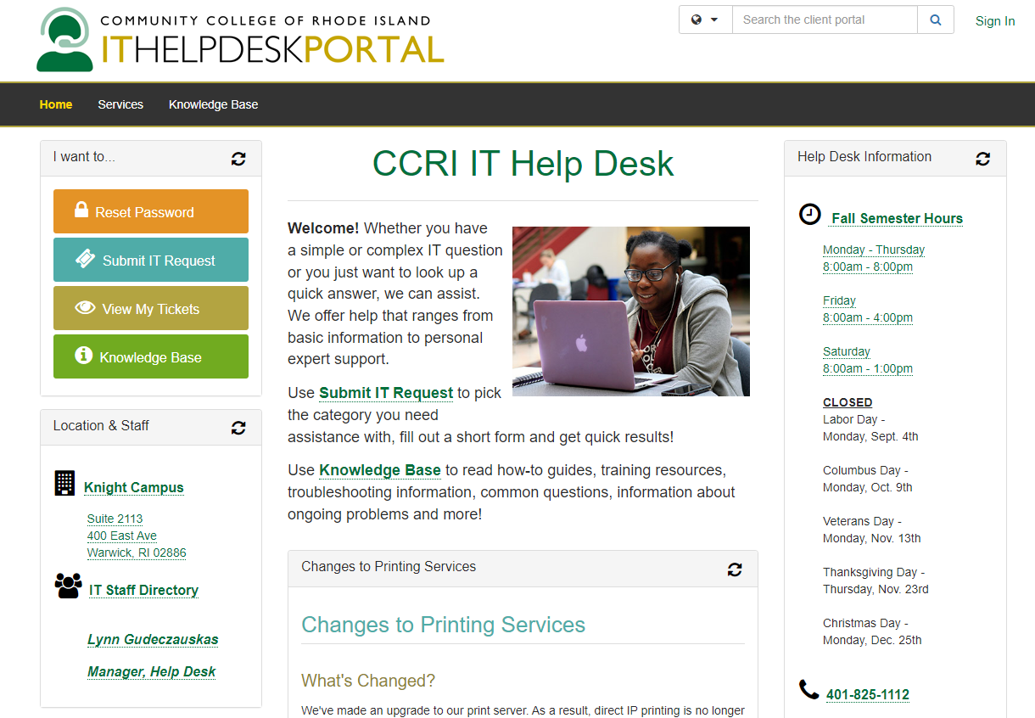
Submitting an IT Request & Viewing Tickets
Can also submit ticket by emailing
helpdesk@ccri.edu
(401) 825-1112

Slide 38
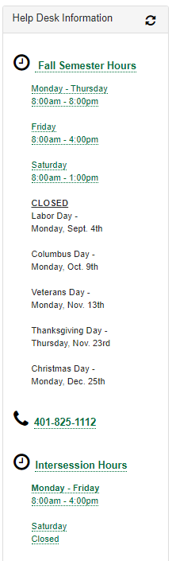
When is helpdesk available?

Slide 39
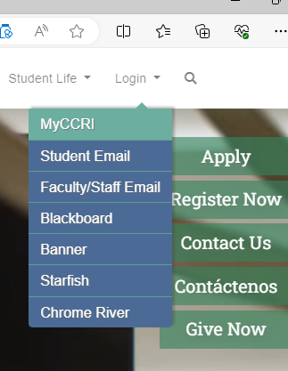
My CCRI
Available at
www.ccri.edu
Click on Login from top-right corner and select MyCCRI

Slide 40
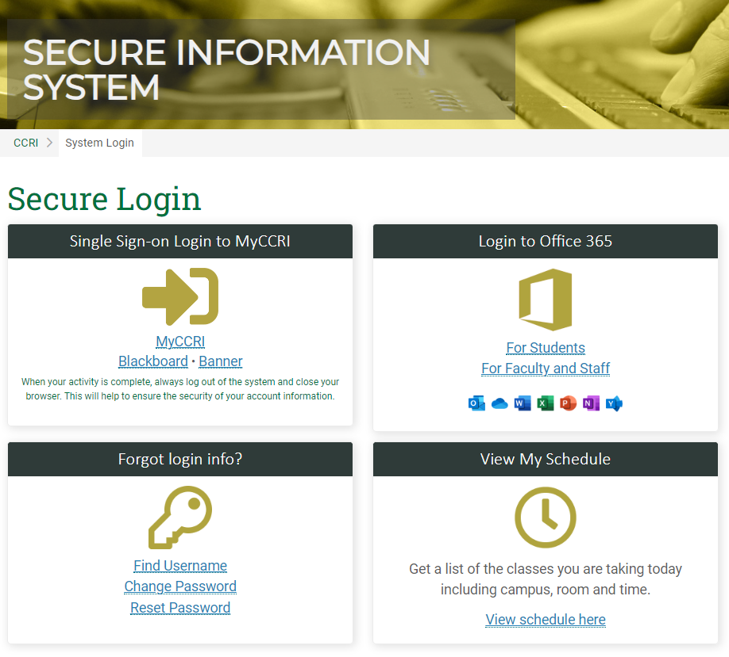
My CCRI
Links to
Blackboard (LMS)
Banner
Office 365
Forgot Login Info

Slide 41


In our digitally connected world, cybersecurity isn't just an IT concern—it's a responsibility we all share.
Whether you're a student, faculty, or staff member, your actions online impact not just you but the entire CCRI community.
CCRI - Cyber Safe Program
www.ccri.edu/it/cybersecutity
Information Security:
Everyone is Responsible
Presented by:
David Rowbotham – Information Security Officer
Duke Merisier – Cyber Security Engineer

Slide 42
CCRI – Navigating Regulatory Frameworks
FERPA: The Family Educational Rights and Privacy Act protects students' educational records, such as grades, transcripts, and disciplinary records. Ensuring the confidentiality and security of these records is paramount.
GLBA: The Gramm-Leach-Bliley Act requires us to protect the privacy of student financial information, including loan applications, financial aid details, and bank account numbers.
PCI DSS: Payment Card Industry Data Security Standard is a must to protect against fraud for those involved in handling credit card transactions. This includes credit card numbers, security codes, and transaction histories.
HIPAA: HIPAA’s requirements must be followed for those in our Mental Health, Dental Clinic and some of our Allied Health programs. This includes medical records, insurance information, and any personally identifiable health information (PHI).
Rhode Island Privacy Laws: Regulations on personally identifiable information (PII).
FOIA: The Freedom of Information Act mandates public access to government records, ( exempts sensitive educational records and personal information, safeguarding student privacy and security).

Slide 43
CCRI – Top Items to Stay CyberSafe
Strong Passwords with Two-Factor Authentication (2FA): Use complex, unique passwords for different accounts. CCRI standard is 14 unique characters with number and symbol complexity.
Use “Passphrases” like:
“CyberSafe@CCRi2024!” ( Do not use my password ! )
“Il2pGolf@4:30pm” - I like to play Golf at 4:30pm
Phishing Awareness: Learn to identify and report phishing attempts. 85%+ of e-mail is Malicious / Spam
Regular Patching Updates: Keep your software and devices updated to protect against the latest threats.
Secure Connections: Use secure, encrypted connections when accessing college systems remotely.
Data Privacy: Be mindful of the information you share online and through emails. When in doubt, verify the legitimacy of requests for information.
IT Support: Familiarize yourself with how to contact IT support. Remember, our helpdesk is here to assist you with any cybersecurity concerns.

Slide 44
Questions?

Slide 45

Office of Organizational Development and
Diversity Equity & Inclusion at CCRI

Slide 46
OFFICE OF ORGANIZATIONAL DEVELOPMENT AND DEI
Purpose
Goal
Serve to create an environment that welcomes and champions the success of all CCRI community members.
Identify and execute OD and DEI priorities that will achieve our strategic goals and increase overall engagement.

Slide 47
Organizational Development at CCRI
Building the capacity to change and achieve greater performance, by developing, improving, and reinforcing strategies, structures, people and processes at CCRI.
Notes:
The way we start, is to build a structure that is foundational to our purpose and goal, and recognize that OD is essentially at the heart of everything we are focusing on, so we need to start by defining it.
This does not just live within our office, and is happening throughout the college. However, as relates to workforce management and discussed in HR practice, we start with OD to build out what we call…Centers for Employee Success.

Slide 48
Centers for Employee Success
JEDI-B (justice, equity, diversity, inclusion and belonging) – a structure to provide consultation and build processes that will achieve equitable outcomes and build inclusive environments college-wide.
Performance Management and Evaluations – a process that establishes department goals, evaluations and development plans that will optimize employee performance
Learning and Development – an infrastructure that enables colleagues to participate in professional development and to boost engagement and retention
Equitable Systems – a process for continuous improvement and innovation that will enable transformational equity.
Notes:
These are the (4) areas we see being directly tied to OD and are drivers for ensuring employee success.

Slide 49
OD Centers for Success – Scope of Work
JEDI -B
DEI Council activity
Cultural Training (monthly)
Diversity recruiting strategy
Student belonging strategy
Equity resource alignment
Performance management program
Reporting and analytics
Engagement and Development
Climate survey and action planning
LMS build out and management
Performance Management
New hire orientation and onboarding
Event planning and coordination
Equitable Systems
Bias incident reporting, tracking and response
EEO reporting and analytics for recruiting strategy
Policy review, updates and creation
Professional development
Reporting and analytics
Performance evaluation process
Coaching and feedback support
JEDI dashboard
Reporting and analytics
Affinity build out and engagement

Slide 50
Inclusive Excellence at CCRI
We are strengthened by the diversity of our community, and committed to building an inclusive culture that focuses on advancing equitable practices, to drive student success and employee engagement
Notes:
The focus of JEDI will be to operate within a framework that build inclusive excellence at CCRI. IE shows we are…

Slide 51

JEDI-B: Building Inclusive Excellence at CCRI
Inclusive Excellence Framework is the structure used at CCRI for delivering JEDI-B trainings to the community
Cultural Identity - the mixture of characteristics and experiences of an individual that are seen and unseen that make up identify of people from different cultural backgrounds
Cultural Humility - a commitment to self-evaluation and self-critique of one’s own beliefs and cultural identities, and the ability to learn about and from other cultures
Cultural Safety - the act of creating spaces and advocating for anyone to think and act authentically within shared environments.
Inclusive Language – using words and phrases that avoid biases, and expressions that discriminate against groups of people based on their identity
Inclusive Leadership – being aware of own biases and actively seek out and consider different perspectives to inform decision-making and collaborate more effectively with others.
Building Cultural Competence
Leveraging Inclusive Practices
Notes:
5-point framework is designed to integrate DEI concepts into the core of how the institution operates and to give every employee and student the resources and tools to learn, and engage in this work, so they can positively contribute to achieving the mission statement of the college.
The way will build this capability is to learn as a community. The office will be building interactive and robust activity plans to allow us all to learn at different paces, for each point. We will offer concepts and tools to help navigate and build cultural awareness and resources to enhance your inclusive excellence wherever you go in college.
Each concept will also provide how you can make it practical in your role.
This will be our focus for the next few years, to focus on making transformative changes that will show inclusive excellence at CCRI.

Slide 52
JEDI-B Partnership Structure
DEI Council (DEIC) Members
Serves to identify and execute program and education sessions related to building cultural awareness and sense of belonging
Advocates to address JEDIB-related needs and works to prioritize shared goals related to building inclusive excellence
DEIC Campus Champions
Serve as a DEIC lead for all campus activity related to building cultural awareness and inclusive excellence
Serves on the Diversity Advisory Team (DAT)
Up to (2) per campus
Diversity Advisory Team (DAT)
A cross governance body of DEI leaders that focus on driving JEDI-B forward throughout the institution, including all governing bodies – Faculty Senate and Staff Assembly and DEI Council
Meets to align on shared priorities and identifies opportunities to collaborate on JEDI-B activity

Slide 53


Diversity, Equity and Inclusion Council (DEIC)
DEIC is made up of CCRI faculty and staff who develop ways for the community to build our cultural competence and address JEDI-B* matters.
We are committed to increasing equitable outcomes for all and build inclusive excellence by focusing on:
Accessibility and Belonging
Data and Incident Reporting
Safety and Prevention
Student Engagement and Retention
Employee Engagement and Retention
Justice, Equity, Diversity, Inclusion and Belonging*

Slide 54

Partner with Us!
Build program or initiatives that focus on integrating JEDI-B practice and concepts into how we work
Cultural trainings to build inclusive excellence within division/dept/team
Build performance and development opportunities for employees and students
External JEDI-B initiatives and community partnerships
Create and improve policies and practices to increase equitable outcomes

Slide 55
CONNECT WITH US!
Website: Office of Diversity, Equity, Inclusion and Organizational Development – CCRI
Email: dei@ccri.edu
Raekwon Grace
Senior Facilitator of Diversity, Equity and Inclusion & Organizational Development
rmgrace@ccri.edu

Slide 56
EsPa
Educational Support Professional association

Slide 57
Our Mission
To unify and strengthen the Educational Support Professional Association by working to secure and to maintain equitable salaries, sick leave, retirement, and other working conditions necessary to support the dignity of the Association.
To establish and maintain communication among the members of the association as well as with the Community College of Rhode Island and the State of Rhode Island.
To encourage the personal and professional development of the members of ESPA-CCRI/NEARI.
To encourage the members to further their contributions to the Community College of Rhode Island by becoming a part of the policy-making mechanism of the College community.
To work toward improving the State Classified System so that it becomes a system which encourages equality and upward mobility.

Slide 58


Together we have a stronger voice!
Member benefits
A voice in the workplace
Job security
Fair wages
Representation
Grievance rights
Collective bargaining

Slide 59
Know your Local Union Representatives
President: Bob Antonson
Vice President: John Henry
Secretary: Sherry Zinn
Treasurer: Linda Fergurson
Grievance Chair: Mark Keenan
Member Organizer: Jennifer Restrepo
Campus Area Reps
Newport: Leslie Kennedy
Warwick: Michelle Lourenco-Souza
Providence: James Reed
Lincoln: TBA

Slide 60


