Slide 1
New Perspectives on Microsoft Access 2016
Module 3:
Maintaining and Querying a Database

Slide 2
Objectives
Session 3.1
Find, modify, and delete records in a table
Hide and unhide fields in a datasheet
Work in the Query window in Design view
Create, run, and save queries
Update data using a query datasheet
Create a query based on multiple tables
Sort data in a query
Filter data in a query

Slide 3
Objectives (Cont.)
Session 3.2
Specify an exact match condition in a query
Use a comparison operator in a query to match a range of values
Use the And and Or logical operators in queries
Change the font size and alternate row color in a datasheet
Create and format a calculated field in a query
Perform calculations in a query using aggregate functions and record group calculations
Change the display of database objects in the Navigation Pane

Slide 4
Updating a Database
Updating, or maintaining, a database is the process of adding, modifying, and deleting records in database tables to keep them current and accurate
Modifying Records
To make minor changes, or select the field value to replace it entirely
The F2 key is a toggle that you use to switch between navigation mode and editing mode
In navigation mode, Access selects an entire field value. If you type while you are in navigation mode, your typed entry replaces the highlighted field value
In editing mode, you can insert or delete characters in a field value based on the location of the insertion point

Slide 5
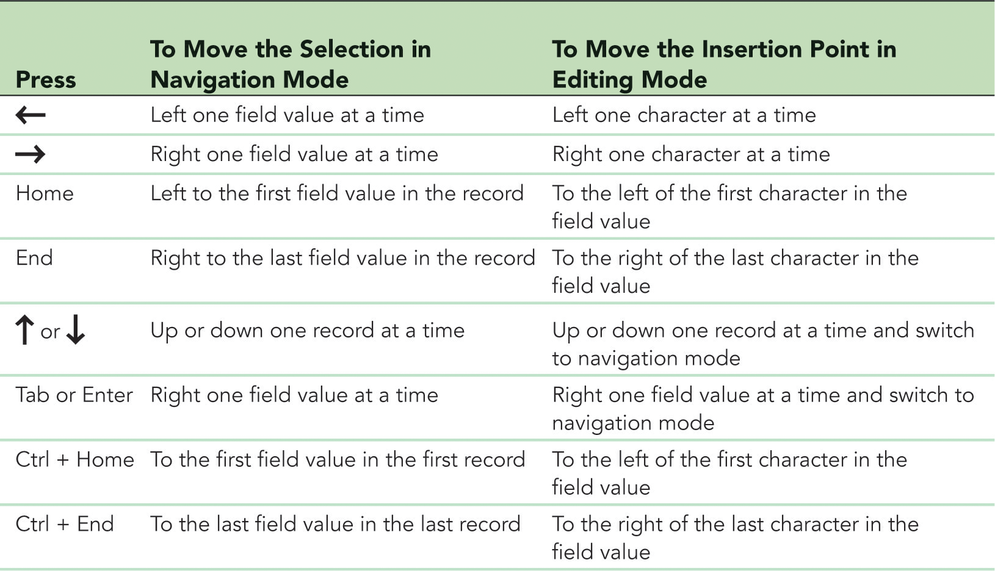
Updating a Database (Cont.)

Slide 6
Updating a Database (Cont.)
Hiding and Unhiding Fields
When you are viewing a table or query datasheet in Datasheet view, you might want to temporarily remove certain fields from the displayed datasheet, making it easier to focus on the data you’re interested in viewing
The Hide Fields command removes the display of one or more fields
Can be especially useful in a table with many fields
The Unhide Fields command redisplays any hidden fields

Slide 7
Updating a Database (Cont.)
Finding Data in a Table
Access provides options you can use to locate specific field values in a table
The Find command searches a table or query datasheet, or a form, to locate a specific field value or part of a field value
Deleting Records
To delete a record, you need to select the record in Datasheet view, and then delete it using the Delete button in the Records group on the HOME tab or the Delete Record option on the shortcut menu

Slide 8
Introduction to Queries
Access provides powerful query capabilities that allow you to do the following:
Display selected fields and records from a table
Sort records
Perform calculations
Generate data for forms, reports, and other queries
Update data in the tables in a database
Find and display data from two or more tables
The answer to a select query is returned in the form of a datasheet
The result of a query is also referred to as a recordset because the query produces a set of records that answers your question

Slide 9
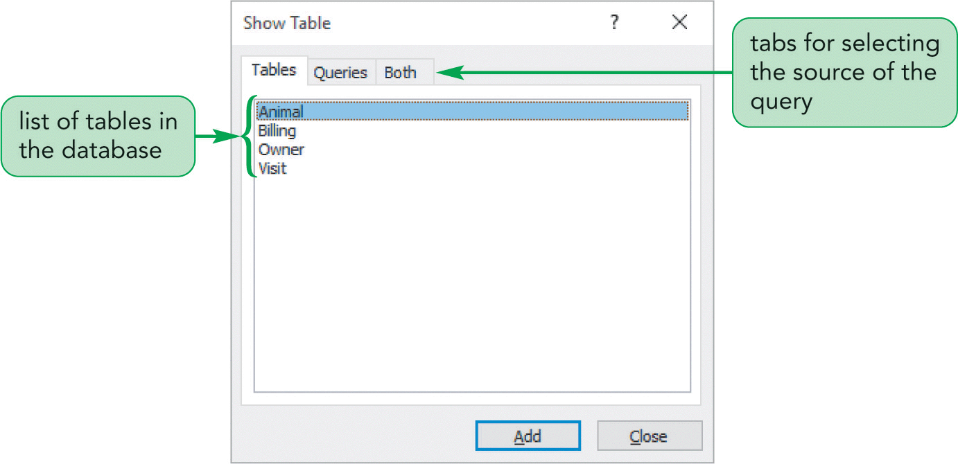
Introduction to Queries (Cont.)

Slide 10
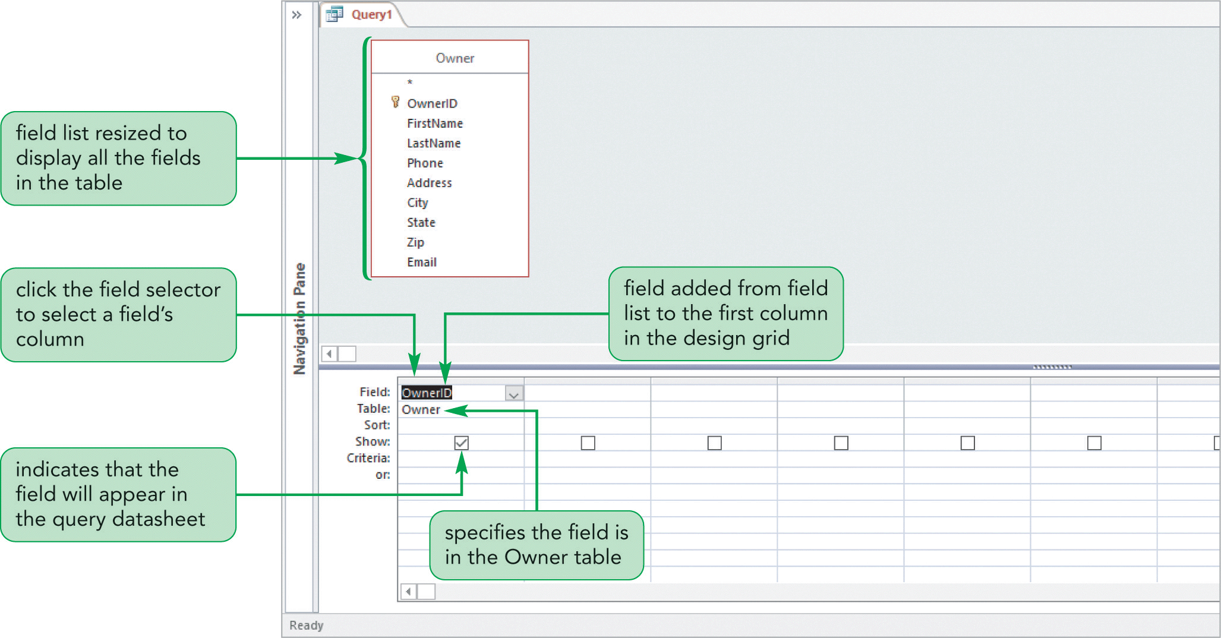
Creating and Running a Query

Slide 11
Updating Data Using a Query
A query datasheet is temporary and its contents are based on the criteria in the query design grid
You can still update the data in a table using a query datasheet
Instead of making the changes in the table datasheet, you can make them in the OwnerEmail query datasheet because the query is based on the Owner table
The underlying Owner table will be updated with the changes you make

Slide 12
Creating a Multitable Query
A multitable query is a query based on more than one table
If you want to create a query that retrieves data from multiple tables, the tables must have a common field

Slide 13
Sorting Data in a Query
Sorting is the process of rearranging records in a specified order or sequence
Sometimes you might need to sort data before displaying or printing it to meet a specific request
To sort records, you must select the sort field, which is the field used to determine the order of records in the datasheet
When working in Datasheet view for a table or query, each column heading has an arrow to the right of the field name
Arrow gives you access to the AutoFilter feature, which enables you to quickly sort and display field values in various ways

Slide 14
Sorting Data in a Query (Cont.)
Sorting on Multiple Fields in Design View
Sort fields can be unique or nonunique
A sort field is unique if the value in the sort field for each record is different
A sort field is nonunique if more than one record can have the same value for the sort field
When the sort field is nonunique, records with the same sort field value are grouped together, but they are not sorted in a specific order within the group
To arrange these grouped records in a specific order, you can specify a secondary sort field, which is a second field that determines the order of records that are already sorted by the primary sort field (the first sort field specified)

Slide 15
Sorting Data in a Query (Cont.)

Slide 16
Filtering Data
A filter is a set of restrictions you place on the records to temporarily isolate a subset of the records
Lets you view different subsets of displayed records so that you can focus on only the data you need
An applied filter is not available the next time you run the query or open the form (unless it has been saved)
The simplest technique for filtering records is Filter By Selection
Lets you select all or part of a field value in a datasheet or form, and then display only those records that contain the selected value in the field
Another technique for filtering records is to use Filter By Form, which changes your datasheet to display blank field

Slide 17
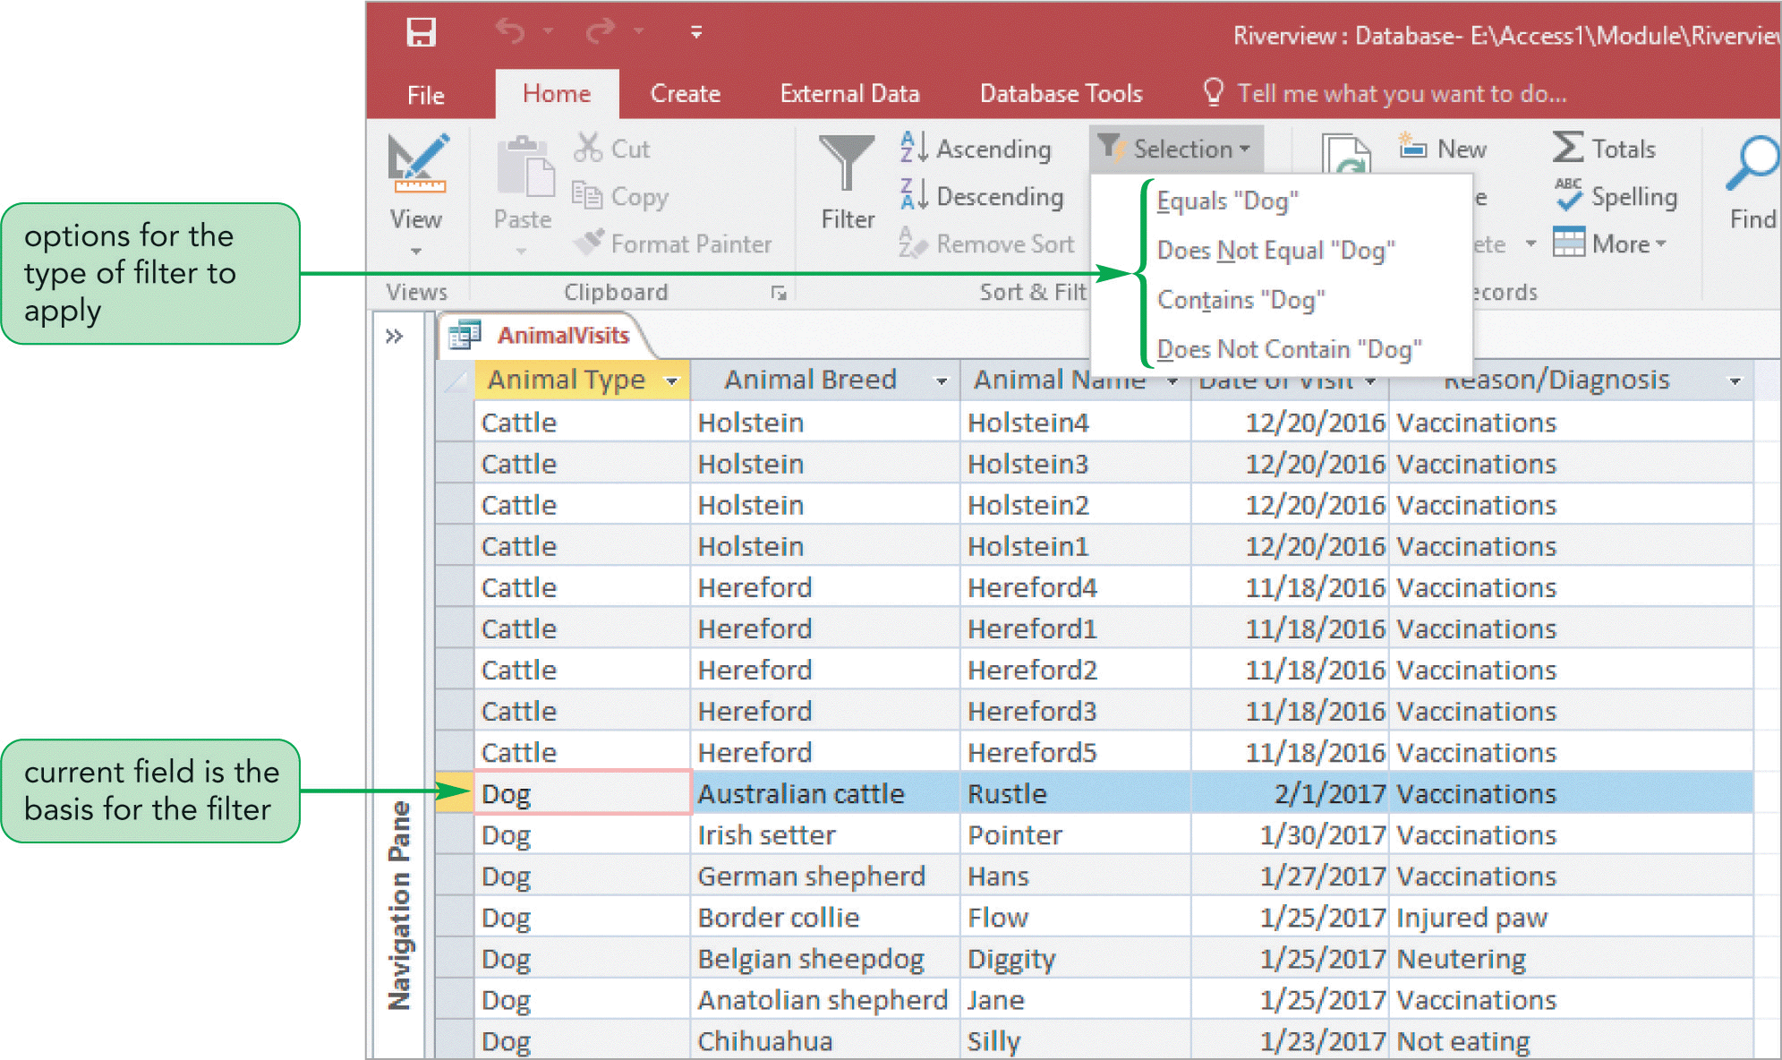
Filtering Data (Cont.)

Slide 18
Defining Record Selection Criteria for Queries
To tell Access which records you want to select, you must specify a condition as part of the query
A condition usually includes one of the comparison operators
Specifying an Exact Match
Create a query that will display specific records
This type of condition is an exact match because the value in the specified field must match the condition exactly in order for the record to be included in the query results

Slide 19
Defining Record Selection Criteria for Queries (Cont.)
Modifying a Query
After you create a query and view the results, you might need to make changes to the query if the results are not what you expected or require
Using a Comparison Operator to Match a Range of Values
After you create and save a query, you can double-click the query name in the Navigation Pane to run the query again
Click the View button to change its design
You can also use an existing query as the basis for creating another query

Slide 20
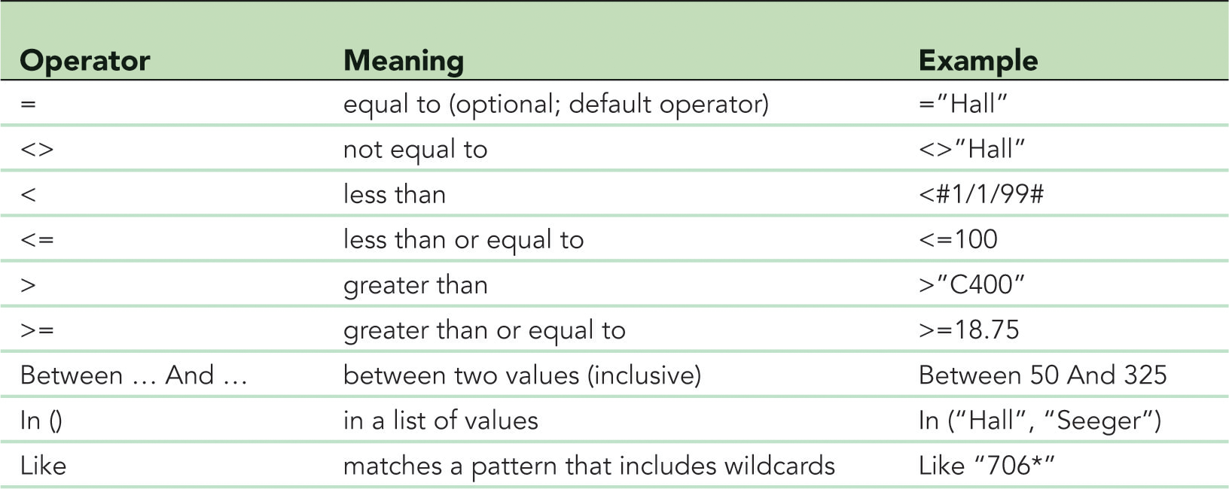
Defining Record Selection Criteria for Queries (Cont.)

Slide 21
Defining Multiple Selection Criteria for Queries
Multiple conditions require you to use logical operators to combine two or more conditions
Need to use the And logical operator
If you place conditions in separate fields in the same Criteria row of the design grid, all conditions in that row must be met in order for a record to be included in the query results
If you place conditions in different Criteria rows, a record will be selected if at least one of the conditions is met
If none of the conditions are met, no records are selected
When you place conditions in different Criteria rows, you are using the Or logical operator

Slide 22
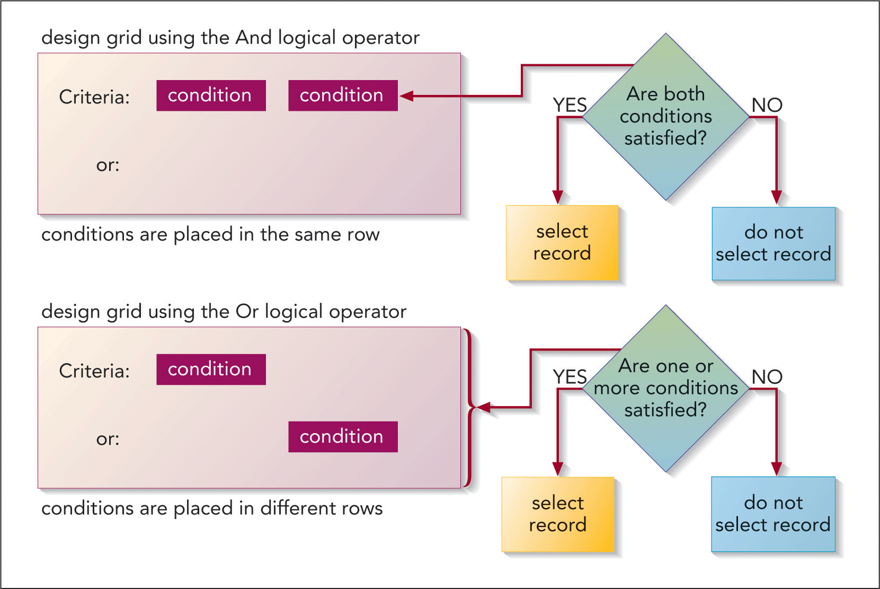
Defining Multiple Selection Criteria for Queries (Cont.)

Slide 23
Defining Multiple Selection Criteria for Queries (Cont.)
The And Logical Operator
In the query design, both conditions you specify will appear in the same Criteria row; therefore, the query will select records only if both conditions are met
The Or Logical Operator
In the query design, either one of two conditions is satisfied or when both conditions are satisfied

Slide 24
Changing a Datasheet’s Appearance
You can make many formatting changes to a datasheet to improve its appearance or readability
Font type, size, color, alignment of text, apply different colors to the rows and columns
Modifying the Font Size
Depending on the size of the monitor you are using or the screen resolution, you might need to increase or decrease the size of the font to view more or fewer columns of data

Slide 25
Changing a Datasheet’s Appearance (Cont.)
Changing the Alternate Row Color in a Datasheet
Access uses themes to format the objects in a database. A theme is a predefined set of formats including colors, fonts, and other effects that enhance an object’s appearance and usability
The Office theme, which formats every other row in a datasheet with a gray background color to distinguish one row from another, is the default

Slide 26
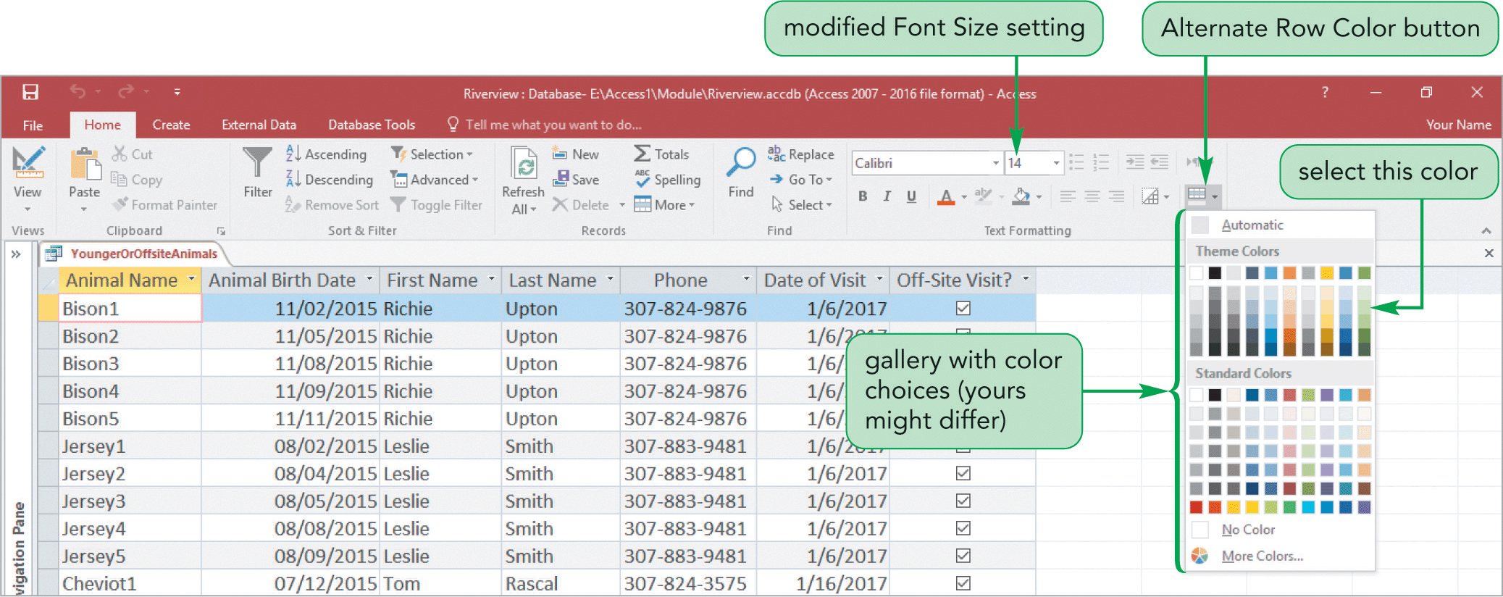
Changing a Datasheet’s Appearance (Cont.)

Slide 27
Creating a Calculated Field
Queries can perform calculations
Must define an expression containing a combination of database fields, constants, and operators
A calculated field is a field that displays the results of an expression but it does not exist in a database
The Zoom box is a dialog box that you can use to enter text, expressions, or other values
Expression Builder is an Access tool that makes it easy for you to create an expression
It contains a box for entering the expression, an option for displaying and choosing common operators, and one or more lists of expression elements, such as table and field names

Slide 28
Creating a Calculated Field
Formatting a Calculated Field
You can specify a particular format for a calculated field, just as you can for any field, by modifying its properties

Slide 29
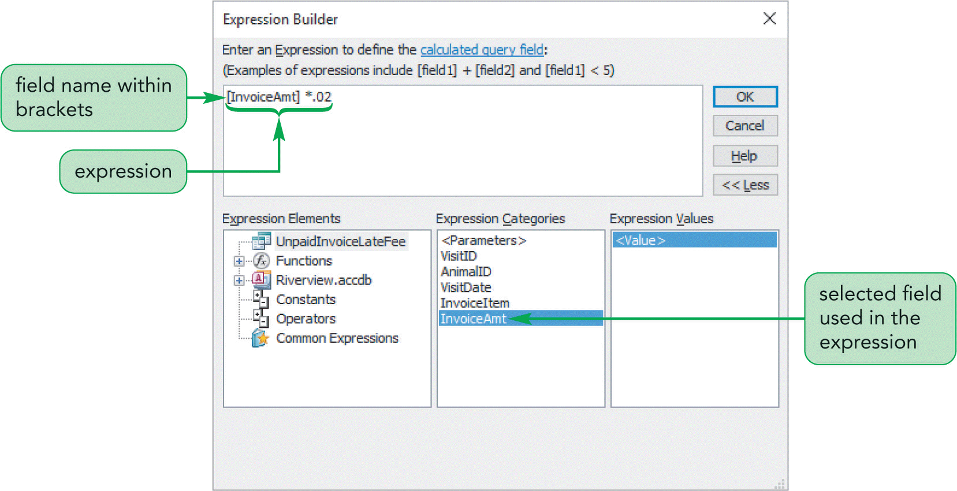
Creating a Calculated Field (Cont.)

Slide 30
Using Aggregate Functions
You can calculate statistical information, such as totals and averages, on the records displayed in a table datasheet or selected by a query
Use the Access Aggregate functions which perform arithmetic operations on selected records in a database
Working with Aggregate Functions Using the Total Row
To quickly perform a calculation using an aggregate function in a table or query datasheet, you can use the Totals button in the Records group on the HOME tab
When you click this button, a row labeled “Total” appears at the bottom of the datasheet
Choose one of the aggregate functions

Slide 31
Using Aggregate Functions (Cont.)
Creating Queries with Aggregate Functions
Aggregate functions operate on the records that meet a query’s selection criteria
You specify an aggregate function for a specific field, and the appropriate operation applies to that field’s values for the selected records
Using Record Group Calculations
In addition to calculating statistical information on all or selected records, you can calculate statistics for groups of records
The Group By operator divides the selected records into groups based on the values in the specified field

Slide 32
Using Aggregate Functions (Cont.)
Those records with the same value for the field are grouped together, and the datasheet displays one record for each group
Aggregate functions, which appear in the other columns of the design grid, provide statistical information for each group

Slide 33
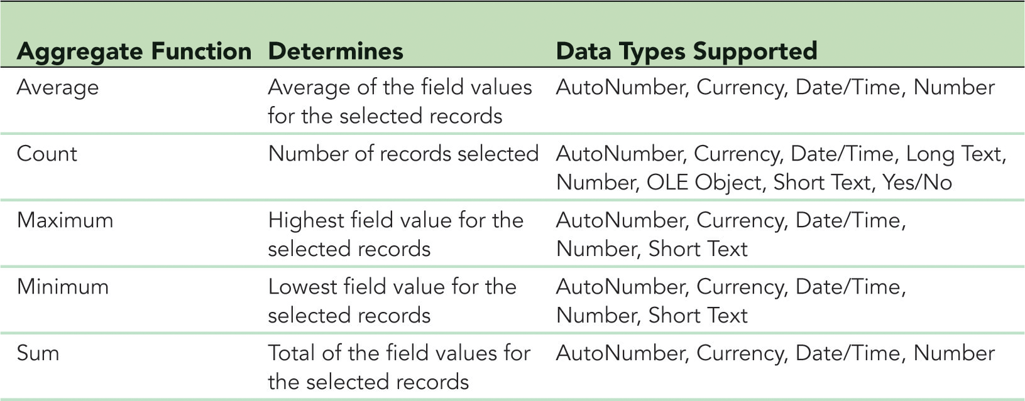
Using Aggregate Functions (Cont.)

Slide 34
Working with the Navigation Pane
The Navigation Pane is the main area for working with the objects in a database
Provides options for grouping database objects in various ways to suit your needs
Divides database objects into categories, and each category contains groups
The default category is Object Type, which arranges objects by type—tables, queries, forms, and reports
The default group is All Access Objects, which appears at the top of the Navigation Pane

Slide 35
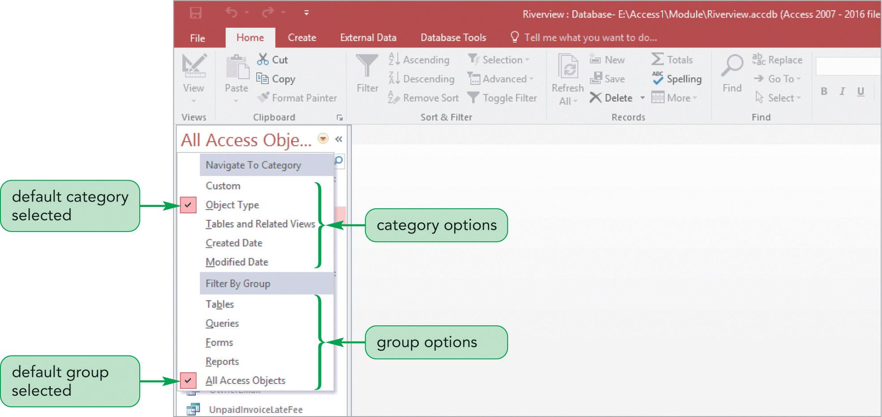
Working with the Navigation Pane (Cont.)

