Slide 1
New Perspectives on Microsoft Access 2016
Module 2:
Building a Database and Defining Table Relationships

Slide 2
Objectives
Session 2.1
Learn the guidelines for designing databases and setting field properties
Create a table in Design view
Define fields, set field properties, and specify a table’s primary key
Modify the structure of a table
Change the order of fields in Design view
Add new fields in Design view
Change the Format property for a field in Datasheet view
Modify field properties in Design view

Slide 3
Objectives (Cont.)
Session 2.2
Import data from an Excel worksheet
Import an existing table structure
Add fields to a table with the Data Type gallery
Delete and rename fields
Change the data type for a field in Design view
Set the Default Value property for a field
Import a text file
Define a relationship between two tables

Slide 4
Guidelines for Designing Databases
Case – Riverview Veterinary Care Center
Database currently contains one table, named the Visit table
User wants to track information about the clinic’s animals, their owners, and the invoices sent to them for services provided
This information includes such items as each owner’s name and address, animal information, and the amount and billing date for each invoice
Create three new tables—named Billing, Owner, and Animal—to contain the additional data Kimberly wants to track
After adding records to the tables, you will define the necessary relationships between the tables, and learn how to modify the fields

Slide 5
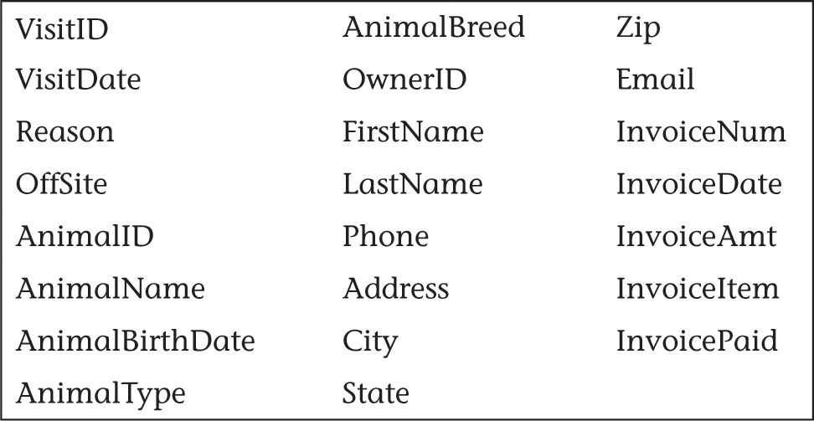
Guidelines for Designing Databases

Slide 6
Guidelines for Designing Databases
Identify all the fields needed to produce the required information
Organize each piece of data into its smallest useful part
Group related fields into tables
Determine each table’s primary key
Include a common field in related tables
Avoid data redundancy

Slide 7
Guidelines for Setting Field Properties
Naming Fields and Objects
You must name each field, table, and other object in an Access database
Assigning Field Data Types
Each field must have a data type
Data types are assigned automatically by Access or specifically by the table designer
The data type determines what field values you can enter for the field and what other properties the field will have

Slide 8
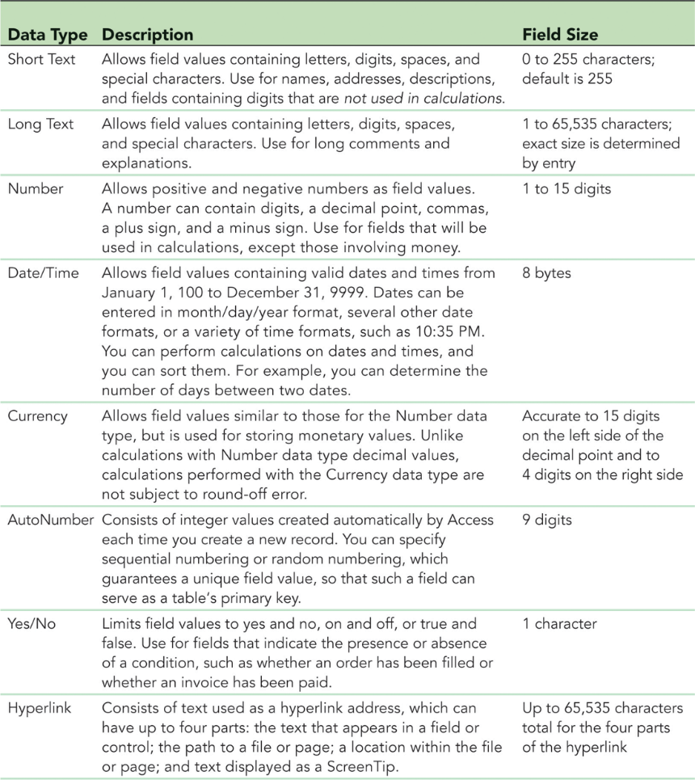
Guidelines for Setting Field Properties (Cont.)

Slide 9
Guidelines for Setting Field Properties (Cont.)
Setting Field Sizes
The Field Size property defines a field value’s maximum storage size for Short Text, Number, and AutoNumber fields only
The other data types have no Field Size property because their storage size is either a fixed, predetermined amount or is determined automatically by the field value itself
Setting the Caption Property for Fields
The Caption property for a field specifies how the field name is displayed in database objects
If you don’t set the Caption property, Access displays the field name as the column heading or label for a field

Slide 10
Creating a Table in Design View
Creating a table in Design view involves entering the field names and defining the properties for the fields, specifying a primary key for the table, and then saving the table structure
Defining Fields
When you first create a table in Design view, the insertion point is located in the first row’s Field Name box, ready for you to begin defining the first field in the table
Enter values for the Field Name, Data Type, and Description field properties, and then select values for all other field properties in the Field Properties pane
These other properties will appear when you move to the first row’s Data Type box

Slide 11
Creating a Table in Design View (Cont.)

Slide 12
Creating a Table in Design View (Cont.)
Specifying the Primary Key
A primary key uniquely identifies each record in a table
Access does not allow duplicate values in the primary key field
When a primary key has been specified, Access forces you to enter a value for the primary key field in every record in the table (entity integrity)
You can enter records in any order, but Access displays them by default in order of the primary key’s field values
Access responds faster to your requests for specific records based on the primary key
Saving the Table Structure
The last step in creating a table is to name the table and save the table’s structure

Slide 13
Modifying the Structure of an Access Table
Moving a Field in Design View
To move a field, you use the mouse to drag it to a new location in the Table Design grid
You can move a field in Datasheet view by dragging its column heading to a new location, doing so rearranges only the display of the table’s fields; the table structure is not changed
To move a field permanently, move the field in Design view
Adding a Field in Design View
To add a new field between existing fields, you must insert a row
Begin by selecting the row below where you want the new field to be inserted

Slide 14
Modifying the Structure of an Access Table

Slide 15
Modifying Field Properties
Changing the Format Property in Datasheet View
The Formatting group on the FIELDS tab in Datasheet view allows you to modify formatting for certain field types
When you format a field, you change the way data is displayed, but not the actual values stored in the table
Changing Properties in Design View
Each of the Short Text fields has the default field size of 255, which is too large for the data contained in these fields

Slide 16
Adding Records to a New Table
Adding Records to a New Table
The Billing table design is complete and you would like to add records to the table so it will contain the invoice data
Add records to a table in Datasheet view by typing the field values in the rows below the column headings for the fields

Slide 17
Adding Records to a New Table (Cont.)

Slide 18
Importing Data from an Excel Worksheet
When data you want to add to an Access table exists in another file—like Word or Excel—you can bring the data from other files into Access in different ways
Copy and paste the data from an open file
Import the data, which is a process that allows you to copy the data from a source without having to open the source file

Slide 19
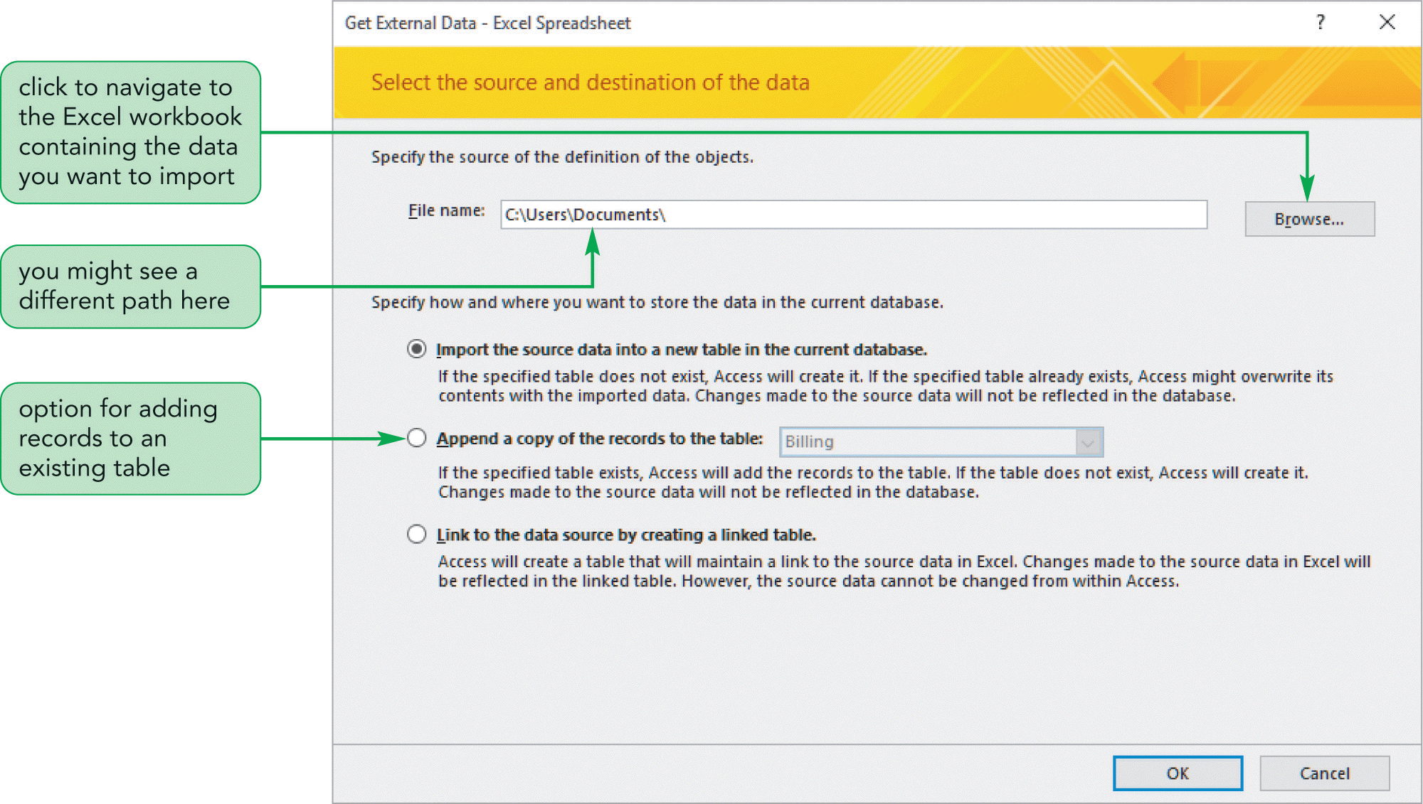
Importing Data from an Excel Worksheet (Cont.)

Slide 20
Creating a Table by Importing an Existing Table or Table Structure
If another Access database contains a table—or even just the design, or structure, of a table—that you want to include in your database, you can import the table and any records it contains or import only the table structure into your database

Slide 21
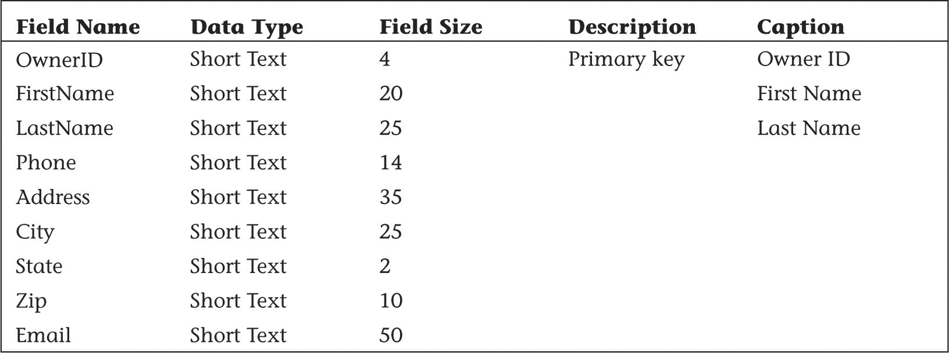
Creating a Table by Importing an Existing Table or Table Structure

Slide 22
Adding Fields to a Table Using the Data Type Gallery
The Data Type gallery (in the Add & Delete group on the FIELDS tab) allows you to add a group of related fields to a table at the same time, rather than adding each field to the table individually

Slide 23
Modifying the Structure of an Imported Table
Deleting Fields from a Table Structure
After you’ve created a table, you might need to delete one or more fields (which also deletes all the values for that field from the table)
Before you delete a field, you should make sure that you want to do so and that you choose the correct field to delete
Fields can be deleted in either Datasheet view or Design view
Renaming Fields in Design View
To match the design for the Owners table, you need to rename the State/Province and ZIP/Postal fields
Fields can be renamed in Datasheet view or Design view

Slide 24
Modifying the Structure of an Imported Table
Renaming Fields in Design View
To match the design for the Owner table, you need to rename the State/Province and ZIP/Postal fields
Fields can be renamed in Datasheet view or Design view
Changing the Data Type for a Field in Design View
All of the fields in the Patient table, except Birth Date, should be Short Text fields
The table structure you imported specifies the Number data type for the Phone field—it should be Short Text
The Data Type can be changed in Datasheet view or Design view

Slide 25
Setting the Default Value Property for a Field
The Default Value property for a field specifies what value will appear, by default, for the field in each new record you add to a table

Slide 26
Adding Data to a Table by Importing a Text File
Many ways to import data into an Access database
Importing an Excel spreadsheet
Created a new table by importing the structure of an existing table
Import data contained in text files

Slide 27
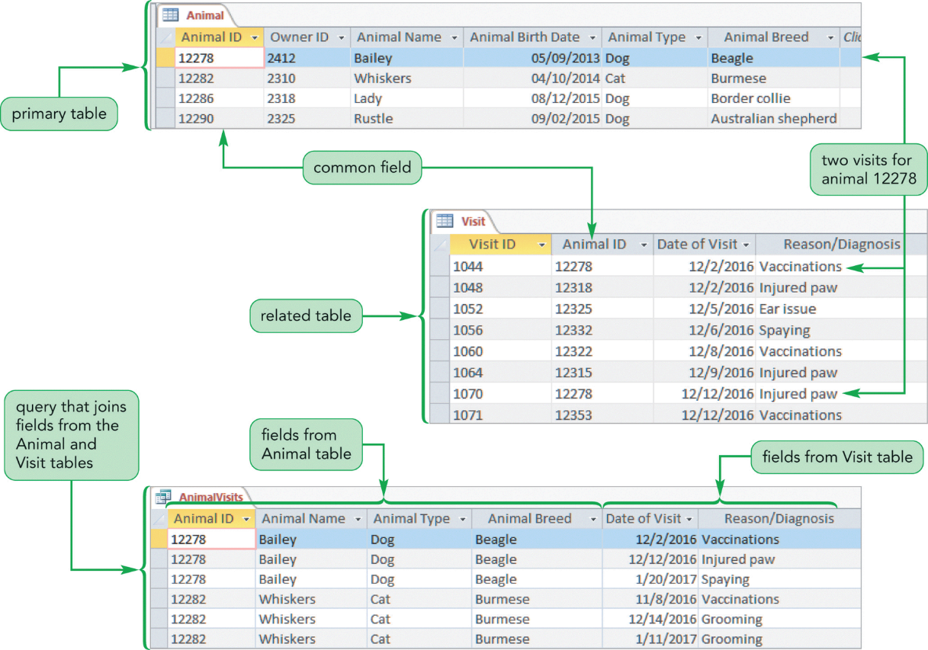
Defining Table Relationships

Slide 28
Defining Table Relationships (Cont.)
One-to-Many Relationships
A one-to-many relationship exists between two tables when one record in the first table matches zero, one, or many records in the second table, and when one record in the second table matches at most one record in the first table
Referential Integrity
A set of rules that Access enforces to maintain consistency between related tables when you update data in a database

Slide 29
Defining Table Relationships (Cont.)
Referential Integrity
When you add a record to a related table, a matching record must already exist in the primary table, preventing the possibility of orphaned records
If you attempt to change the value of the primary key in the primary table, Access prevents this change if matching records exist in a related table
With the Cascade Update Related Fields option, Access permits the change in value to the primary key and changes the appropriate foreign key values in the related table
If you attempt to delete a record in the primary table, Access prevents the deletion if matching records exist in a related table. However, if you choose the Cascade Delete Related Records option, Access deletes the record in the primary table and also deletes all records in related tables that have matching foreign key values

