Slide 1
COMI-1230 Systems Analysis & Design

Slide 2
Week 4 Outline
Review Needs Analysis
Project Kick-Off
Modeling Current Environment

Slide 3
Information Support Circle
Information Support Circle
Useful for determining interaction of critical stakeholders
Three major roles
Custodian
Broker
Manager
Five functions
Identify Concepts and Measures
Collect and Store Data
Restructure and Analyze Facts
Deliver and Report Information
Use and Influence Decisions

Slide 4
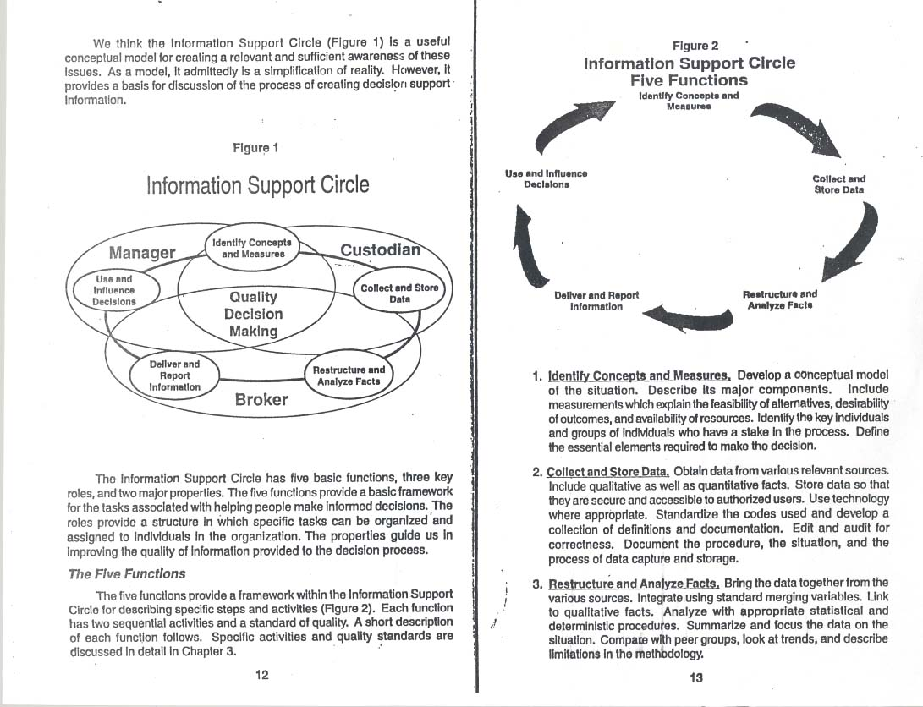
Information Support Circle

Slide 5
Project Kick-Off
Q. We’re about to embark on an administrative system selection and we want to start off on the right foot. Is there a set of guidelines you could give us to make sure we do this the right way?
A. There are four critical success factors that should be present to make this important project successful. 1) Support from top administration for the effort: involvement, encouragement, a sense of this being a high priority, a declaration that this is something very important for the institution to do with the same level of quality that it does other things. 2) Buy-in, involvement, and ownership of the project by the user community, from the selection of a system all the way through the implementation. 3) Enough resources to make sure the institution is in a position to reap the full range of benefits and protect its investment. 4) A willingness to consider new approaches to information management and business practices to take full advantage of the features a new system will offer.

Slide 6
Project Kick-Off
Origination of systems projects
Why was it requested?
Service
To improve or enhance service to end user
Performance
Correct errors / improve response time / add functionality
Information
Convert data from previous system / new requests
Controls
Security issues / cross system connectivity
Economy
Cost savings / react to new opportunities

Slide 7
Project Kick-Off
Origination of systems projects
Who made request?
Org. Chart is a great resource for this
Key stakeholder
Identify functional area
Analyze both horizontally and vertically
Internal or External requestor
Regulatory agencies
Vendors
New leadership
What are the timelines?
Determine business cycle
Identify “windows of opportunity”
Is it a mandate from an external agent?

Slide 8
Preliminary Investigation
Identify key stakeholders
Create and organization chart for internal stakeholders
Create list of critical external agents
Identify the true request
Why?
Who?
When is it needed?
Model current processing to help determine:
Systems requirements
System scope
Present findings to stakeholders
Preliminary Investigation Report / Statement of Scope
Findings
Potential solutions
Your recommendation
SCOPE – range or extent of the problem
Benefits of your recommendation

Slide 9
Model Current System
Why do we model?
Visual representation of logic and sequence
Makes abstract thoughts concrete
Point of reference for explanation to a variety of audiences
Improves communication between developers and users
Identify what system needs to do
Requirements
Show sequence of processing
Dependencies
Show ownership
Functional areas
Stakeholders
Highlight omissions and inconsistencies
Our modeling options
Activity Diagram
BPM (Business Process Modeling)

Slide 10
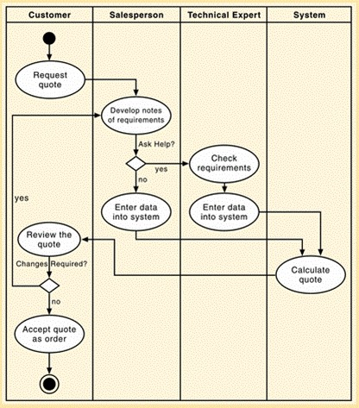
Model Current System
Activity Diagram
A discussion can be found in the text in Chapter 3, page 73
Used to show actions and events in the order they take place
Sequence
Crossing of swim lanes highlights cross functional operation
Swim lane headers identify key functional areas / stakeholders
Useful when there is detailed information about current system at a task level

Slide 11
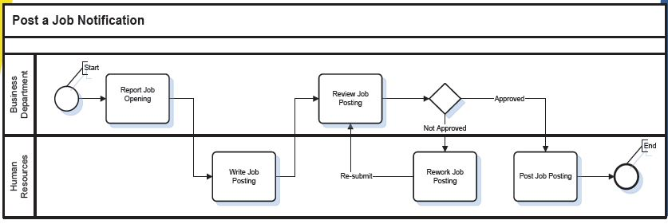
Model Current System
Business Process Modeling (BPM)
A discussion can be found in the text in Chapter 3, page 74
Models key processes and their interactions
Affords opportunity to show processes morph into subprocesses
Functional decomposition
Depicts flow of business activities and how they are connected towards the achievement of a business transaction
Useful when there isn’t a formal system in place currently
Helps keep processing at a more abstract level
Process based
Text, Chapter 3 – page 75

