Slide 1
COMI-1230 Systems Analysis & Design

Slide 2
Week 2 Outline
Traditional SDLC
Project Factors
Steps in Preliminary Investigation
Quick Meeting with Groups

Slide 3
Summary of SDLC
Phase 2. Analysis
Phase 1. Planning
Conduct preliminary investigation
Perform detailed analysis activities:
Study current system
Determine user requirements
Recommend solution
Phase 3. Design
Review project requests
Prioritize project requests
Allocate resources
Identify project development team
Acquire hardware and software, if necessary
Develop details of system
Phase 5. Support
Phase 4. Implementation
Conduct post-implementation system review
Identify errors and enhancements
Monitor system performance
Develop programs, if necessary
Install and test new system
Train users
Convert to new system

Slide 4
Traditional SDLC
Stages:
Plan (Initiation)
Starting point for each system
Requires a system request (in writing)
Reasons for request
Why might a request be made?
To correct problem in existing system
To improve existing system
Outside group may mandate change
Competition can lead to change

Slide 5
Traditional SDLC
Stages:
Plan (Initiation)
Originates from appropriate level (Org Chart)
Can be analyzed in both vertical (traditional) and horizontal views
Vertical view
Shows hierarchy
Chain of command / authority
Horizontal view
Shows functional boundaries
Critical to identify areas that work togehter
As a result of the request:
Preliminary (or Initial) Investigation
Feasibility Study
Economic
Organizational (Cultural)
Technical
Schedule
Resource
Cost/Benefit Analysis

Slide 6
Feasibility
Economic
Development costs
Consultants / employee training
Hardware / Software
Organizational (Cultural)
Competency levels of existing staff
Need to embrace change
Technical
Hardware / Software
Infrastructure
Network / Security
Schedule
Changes to current business cycle
Windows of implementation
Coordinate other projects
Resource
Staff
Time
$$$$

Slide 7
Traditional SDLC
Stages:
Analysis
Once the project is approved and Initiation stage is complete
Identify the detailed system requirements
Requirements Determination / Requirements Specification
Key Activities:
Fact finding / Needs Analysis
Modeling
How does current system operate
Activity Diagram (Chapter 3, page 73) / BPM (Chapter 3, page 74)
Logical Modeling of proposed new system
DFD’s (Data Flow Diagrams) – Chapter 2

Slide 8
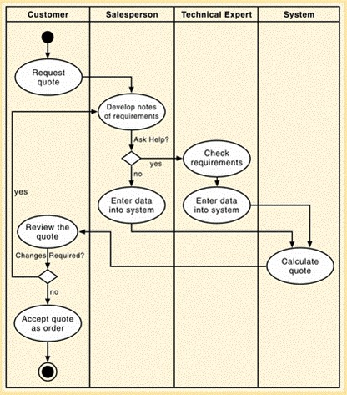
Activity Diagram

Slide 9
BPM

Slide 10
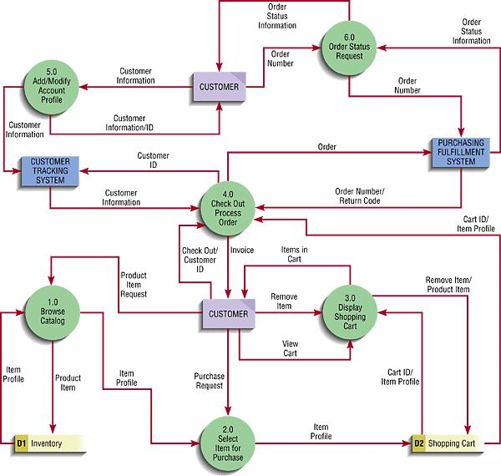
DFD

Slide 11
Traditional SDLC
Stages:
Design
Specify in detail the system to be built based on the requirements as determined in the Analysis Phase
DFD’s are finalized
Data is taken into account
ERD’s
UI is designed
Prototype is developed
Working model of proposed system

Slide 12
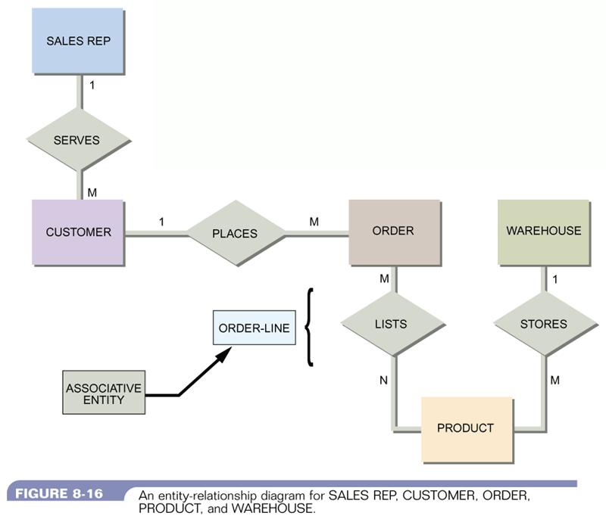
ERD

Slide 13
Traditional SDLC
Stages:
Implementation
Following testing and final approval the system is deployed
Unit Testing
Verify each program works by itself
Systems Test
Verify all programs in the application work together
Integration Test
Verify that the application works wit the other applications in the business
Strategy needs to be developed to ensure the system is functioning properly
Parallel testing
Integration of existing data
Deploy in phases rather than all at once
Determine the critical Stakeholders to include

Slide 14
Traditional SDLC
Stages:
Implementation
Training
Include appropriate people
Show how system works
How to exactly use the new hardware / software

Slide 15
Traditional SDLC
Stages:
Maintenance
Monitor system usage
Attend to bugs/errors
Manage enhancements

Slide 16
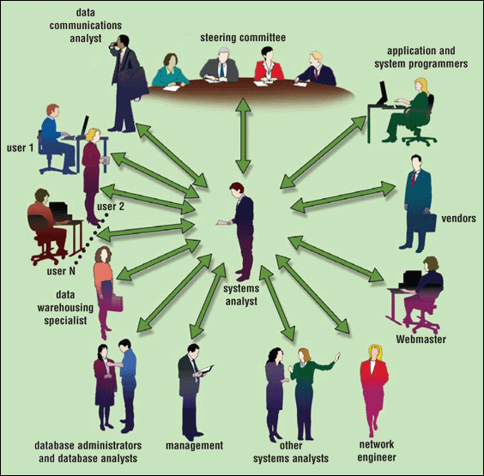
Guidelines for System Development
Arrange tasks into phases (groups of activities)
Involve users (anyone for whom system is being built)
Systems Analyst is critical
Responsible for designing and developing information system
Liaison between users and IT professionals
Project Team
Consists of users, systems analyst, and other IT professionals
Develop clearly defined standards (procedures company expects employees to follow)

Slide 17
Summary of SDLC
Phase 2. Analysis
Phase 1. Planning
Conduct preliminary investigation
Perform detailed analysis activities:
Study current system
Determine user requirements
Recommend solution
Phase 3. Design
Review project requests
Prioritize project requests
Allocate resources
Identify project development team
Acquire hardware and software, if necessary
Develop details of system
Phase 5. Support
Phase 4. Implementation
Conduct post-implementation system review
Identify errors and enhancements
Monitor system performance
Develop programs, if necessary
Install and test new system
Train users
Convert to new system

Slide 18
Factors that influence projects

Slide 19
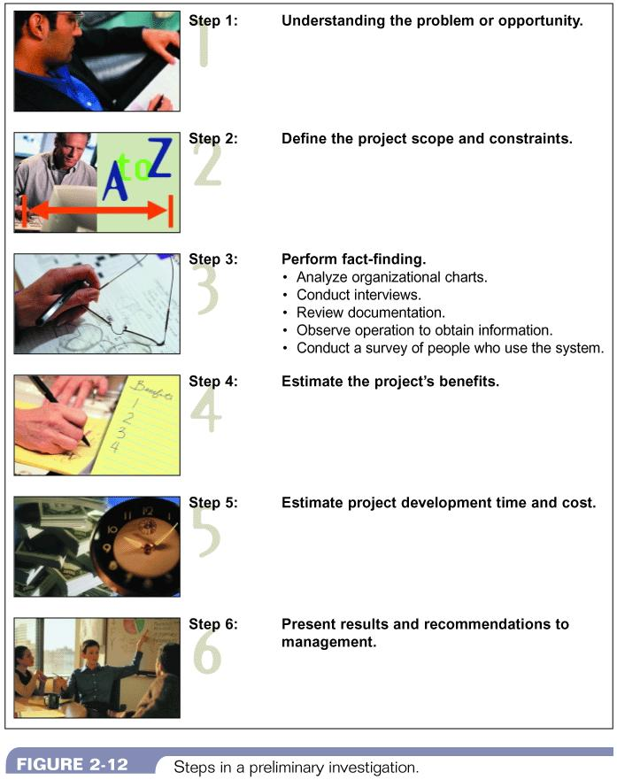
Steps in Preliminary Investigation

Slide 20
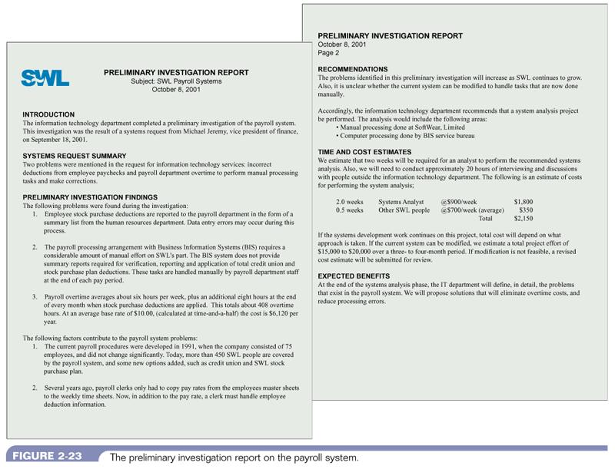
Sample Preliminary Investigation

