Slide 1
COMI-1230 Systems Analysis & Design

Slide 2
Week 12 Outline
Database Review
Data Modeling
ERD (Entity Relationship Diagram)
Normalization
Finalizing your Data

Slide 3
Database Review
Terminology
DDL
Data Definition
Used to construct the physical database
Uses SQL command such as CREATE TABLE
DML
Data Manipulation
Used to access and maintain the database
SQL
Structured Query Language
Table
Data repository within database
Made up of rows and columns
Logically referred to as an Entity
Primary Key
Unique identifier for each table in the database
Can be composed of one or multiple (Composite Key) columns
Cannot contain null values
Foreign Key
A column or columns in a table that are a primary key in another table
Used to allow Relationships (or linking) among tables

Slide 4
Database Review
Terminology
Entity Integrity
Database rule that requires all tables to have a primary key
Referential Integrity
Database rule that requires that ALL foreign key values have a matching primary key value in another table
The primary key value MUST occur first
Cornerstone of relationships
Connectivity
Notation used to describe the type and occurrences in a relationship
Types:
1:1
1:M
M:N
ERD (Entity Relationship Diagram)
Database model that depicts the entities (tables) and their relationships
Logical model of the database structure
Used to construct and describe the database from an abstract point of view

Slide 5
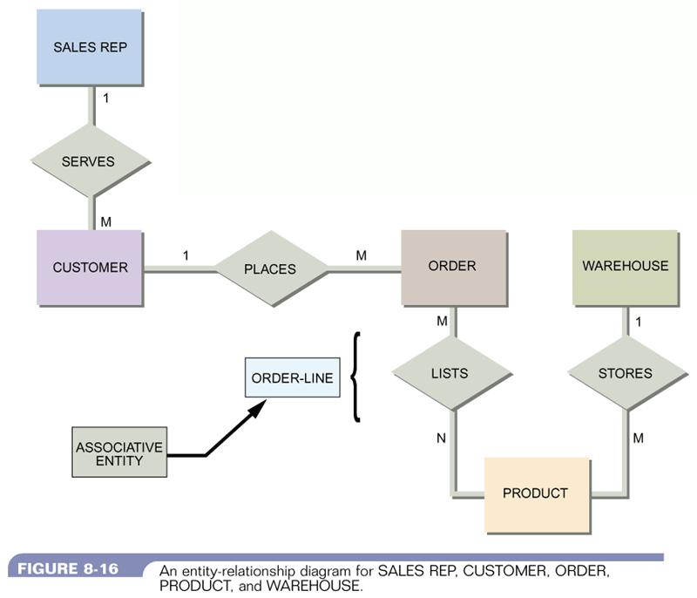
Database Modeling
Steps
Use the DFD to help determine the data required in the database
Sample documents also provide insight to the data required
Take a logical approach first
Construct the tables you feel are required and then develop an ERD to identify relationships

Slide 6
Database Modeling
Steps
Normalize the ERD when you are satisfied with it’s construction
This is an iterative process
What you uncover in normalization will result in changes to the ERD
Identify the primary and foreign key for each table
Ensure your relationships are either 1:1 or 1:M
M:N relationships are not allowed
To reconcile a M:N relationship create a Bridge Entity
Table whose primary key is a composite key containing the primary keys of the two M:N tables

Slide 7
Finalizing your Data
Add the attributes needed to complete each table
Row or field
Ensure you follow naming conventions for your attributes
No two attributes in a table can have the same name
Define the data type for each attribute
Typically:
CHAR
Used for fixed length non-numeric attributes
VARCHAR
Used for attributes that contain non-numeric content and have varying lengths
NUMBER
Used for any number value to be used in a mathematical method
Literal numbers (such as a zip code) should be stored as character
DATE
Used for date/time attributes
Document your database

