Slide 1
COMI-1230 Systems Analysis & Design

Slide 2
Week 1 Outline
Systems Analysis & Design Overview
Overview of Systems Analysis

Slide 3
Systems Analysis & Design Overview
What is Systems Analysis?
Understanding and specifying in detail what the information system should do
Much of what you do as an analyst will be gathering and digesting data and information
What about Systems Design?
Specifying in detail how the components of the system should be implemented
It is critical that the Analysis is done before Design

Slide 4
Systems Analysis & Design Overview
Why is Systems Analysis & Design important?
Critical to the design and support of Information Systems
What is an Information System?
Set of interrelated components that function to provide required information for a specified purpose
Can be described using the simple systems model
I—P—O

Slide 5
Simple System Model
Page 9 of text

Slide 6
Information Systems
Abstraction & Functional Decomposition
You need to see the big picture then be able to drill down to understand the key components
You also need to understand:
System and it’s boundaries
Type of business it supports
Key stakeholders
Type of system strategy being used
Transaction Processing
Office Support
MIS
EIS

Slide 7
The Systems Analyst
Key skills:
Technical knowledge and capability
Business knowledge
Of the specific business or at least the business sector
Communication skills
Teamwork and collaboration are critical
Ability to communicate to a variety of different audiences in way they understand

Slide 8
Framework to manage Systems Analysis & Design
System Development Life Cycle
Types:
Traditional approach
JAD
RAD
OOAD (Chapter 3)
Agile

Slide 9
Traditional Approach
Use Structured Analysis
Rely on process models that show how data flows into a system and is processed by applying business rules resulting in the desired result
More detailed I—P—O
DFD’s are key element
Primarily sequential
AKA Waterfall Model
Five Phases
Plan (or Initiation)
Analysis
Design
Implementation
Support (or Maintenance)

Slide 10
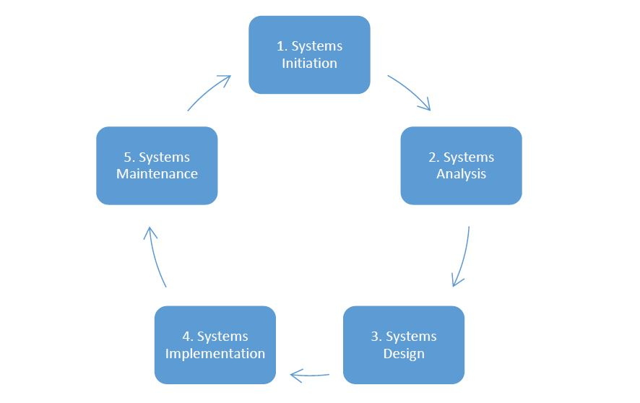
Traditional Approach
Text page 13

Slide 11
Alternate Approaches to Systems Development
JAD (Joint Application Development)
Team based
Involves the development teams and stakeholders to get more input throughout the process and hopefully speed up development
RAD (Rapid Application Development)
Similar to JAD where it involves stakeholders and the development team in a very interactive iterative way to get feedback early and often in the process to speed up the development
Agile
More current approach
Flexible alternative to Traditional Approach
Builds upon the ideas of JAD and RAD

Slide 12
Agile Approach
Intent is to produce a working product as soon as possible using a more adaptive approach that can react better to changes in requirements
Interactive / iterative approach where small prototypes are enhanced over time following regular meetings with stakeholders until it becomes a finished product
Scrums
Includes: Design, Code, and Test activities over a short period of time called Sprints
Usually 1 to 4 weeks
Text page 14

