Slide 1

CCNA Voice 640-461 Cert Guide
CHAPTER 2
Understanding the Pieces of Cisco Unified Communication

Slide 2
Benefits of VoIP for Business:
Reduced cost of Communicating: Forward calls over WAN links instead of expensive PSTN lines
Reduced cost of cabling: Cost cut in half, because of the use of existing Ethernet lines
Seamless voice networks: Where there is data networks there can be voice networks
Take your phone with you: Because the phone gets configuration by MAC address, the phone can be moved seamlessly
IP Softphones: Computer based logical phones that perform all functions of physical phones. (IP Communicator)
Unified e-mail, voice mail and fax: All services can be stored and delivered from a single database

Slide 3
Benefits of VoIP for Business continued:
Increased productivity: VoIP can forward to multiple devices reducing “phone tag”
Feature-rich communication: Data applications can be integrated with the phone.
Open, compatible standards: Different vendors devices can integrate on the same VoIP network

Slide 4
Will the traditional phone system survive?
Most believe that it will be replaced by VoIP.

Slide 5
VoIP Structure:
Endpoints: Phone, Wireless/Cell Phone, Video Phone, IM Client
Applications: Voice mail, Conference Call Applications, Call Center Applications, 911 services
Call Processing: Unified Communications Manager, Unified Communications Manager Express, UC500
Infrastructure: ASA Firewall, Voice Router/ Gateway, Voice Switch

Slide 6
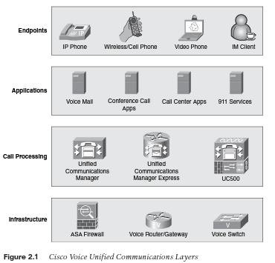

Slide 7
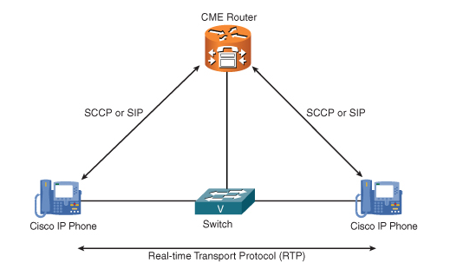
Infrastructure Layer:

Slide 8
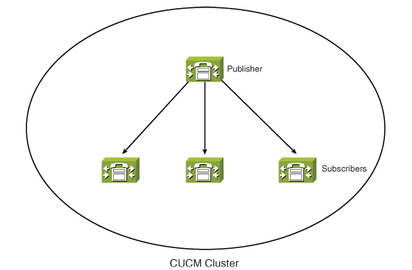
Infrastructure Layer:

Slide 9
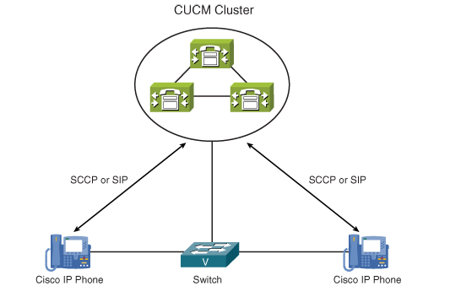
Infrastructure Layer:

Slide 10
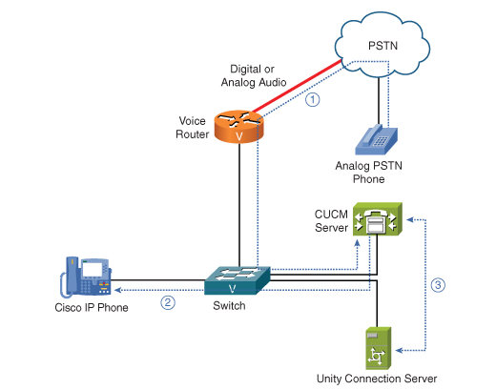
Infrastructure Layer:

Slide 11
Infrastructure Layer:
Traditional PBX systems are “up” 99.999% or down for only five (5) minutes each year!
Configured for fast failover
Include Quality of service (QoS) in network development
Can existing equipment provide service?

Slide 12
Call Processing Layer:
Cisco Unified Communications 500 (UC500): Stand alone solution, supports forty-eight (48) users
Cisco Unified Communications Manager Express (Call Manager Express CME): Supports up to two-hundred fifty (250) users depending on equipment
Cisco Unified Communications Manager Business Edition: Supports up to five-hundred (500) users
Cisco Unified Communications Manager (formerly CallManager) Supports thirty-thousand plus users (30,000+)

Slide 13

Cisco Unified Communications 500 (UC500)

Slide 14
UC500 Features:
Phone support for eight (8) to forty-eight (48) phones
Integrated Voice Mail
Integrated Automated Attendant Answering System
External Music on Hold (MoH) jack to attached external audio source or use WAV file
Support for all common phone features
Built-in Foreign Exchange Office (FXO) ports for analog PSTN connections

Slide 15
UC500 Features continued:
Built-in Foreign Exchange Station (FXS) ports for analog phone / modem / fax connections
Built-in Network Address Translation (NAT) and Firewall support for Internet connectivity
Built-in Virtual private Network (VPN) support for up to ten (10) users
Optional integrated 802.11 wireless network connectivity

Slide 16
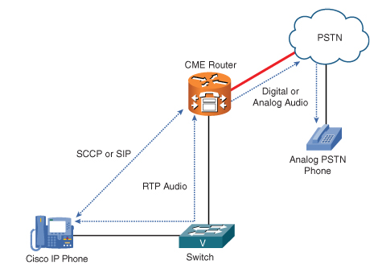
Cisco Unified Communications Manager Express (CME):

Slide 17
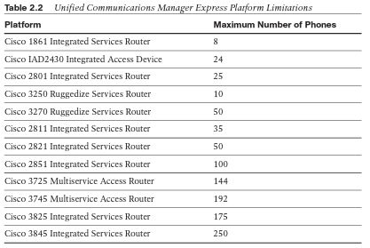
Cisco Unified Communications Manager Express (CME):

Slide 18

Cisco Unified Communications Manager Business Edition:

Slide 19
Cisco Unified Communications Manager Business Edition continued:
Linux based
Five-hundred (500) phones supported
All-in-one solution
Cisco Unified Communications Manager: The call processing component that provides features and functionality
Cisco Unity Connection: Integrated Voice-mail solution
Cisco Unified Mobility: Allows users to be reached from a single phone number by redirecting calls to multiple devices

Slide 20
Cisco Unified Communications Manager:
Added benefits over Business edition-
Redundancy
Scalability
Number of users is thirty-thousand per cluster
Multiple cluster support
Redundancy support
Server based

Slide 21
Application layer:
Cisco Unity Express
Cisco Unity Connection
Cisco Unity

Slide 22
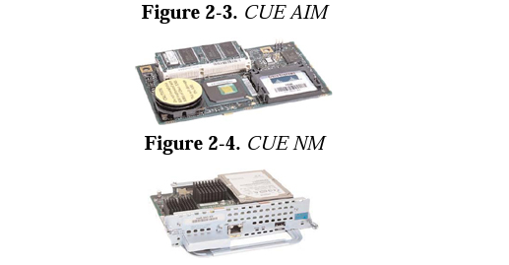
Cisco Unity Express:

Slide 23
Cisco Unity Express:
Smallest Unity Solution
Runs from either a Flash Module or Hard Drive
Can be added to multiple platforms
Flash Advanced Integration Module (AIM) plugs directly into router motherboard
Hard Drive runs as a network module
Runs as a Linux based program and provides:
  Voice-mail
  Automated Attendant
  Message retrieval via e-mail, phone, or web interface

Slide 24
Cisco Unity Connection:
Server solution providing same services as Unity Express
With additional dedicated server modules it can scale up to seven-thousand five-hundred (7500) users

Slide 25
Cisco Unity:
Additional services of:
  Forward voice messages as e-mail attachments
  Users can leave messages for multiple users with a single call
  Users can listen to e-mail messages using text to speech
  users can respond to e-mail messages via phone with audio attachment
  Users can view faxes as TIF files via e-mail

Slide 26
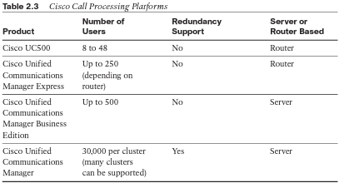

Slide 27
Interactive Voice response / Auto Attendant:
Provides Prompt and Collect features
Call Redirection

Slide 28
Cisco Unified Contact Center:
Can cycle through multiple call agents. Automatic Call Distributor (ACD)
Can direct calls to appropriate agents
Dedicated server based application
Can use Computer Telephony Integration (CTI)
  Information about caller placed on screen
  Uses Caller ID
Supports Chat
Supports Web collaboration
e-mail integration

Slide 29
Additional Applications:
Cisco Unified Meeting Place: Provides a multimedia conference solution
Cisco Unified presence: Provides information of a users availability and reach ability
Cisco Unified Mobility: One single contact phone number which links to phone, mobile phone, instant messenger
Cisco Emergency Responder: Dynamically updates users position / location to 911 system

Slide 30
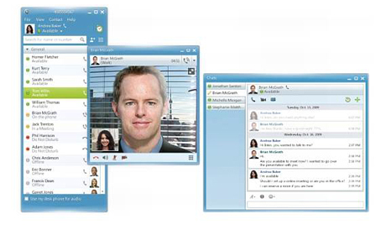
Complete Solution:

Slide 31
Endpoints Layer:
Entry-layer phones
Single lines
Cisco Unified SIP Phone 3911
Cisco 7906G and 7911G
Cisco 7931G

Slide 32

Cisco 3911:
Inline power support
Half-duplex speakerphone
Fixed feature buttons

Slide 33
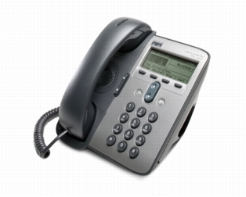
Cisco 7906G and 7911G:
Inline power support
Onscreen softkey support
basic XML service support

Slide 34
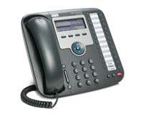
Cisco 7931G:
Inline power support
Built-in switch
Onscreen softkey support
Basic XML service support

Slide 35

Endpoints Layer:
Business-class phones
Built-in switch
Inline power support
Onscreen softkey support
XML Service support
Full-duplex speakerphone and headset option
Cisco 7940G
Cisco 7941G
Cisco 7941G-GE
Cisco 7942G
Cisco 7945G

Slide 36
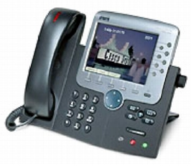
Endpoints Layer:
Touchscreen Cisco IP Phones
Built-in switch
Inline power support
Onscreen softkey support
XML Service support
Full-duplex speakerphone and headset option
Cisco 7970G
Cisco 7975G
Cisco 7971G-GE

Slide 37
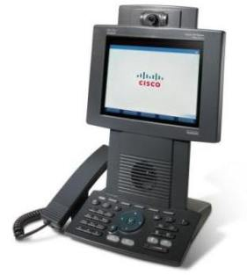
Endpoints Layer:
Specialty Devices
Built-in switch
Inline power support
Onscreen softkey support
XML Service support
Full-duplex speakerphone and headset option
Video Camera
Video Display
Cisco 7985G

Slide 38
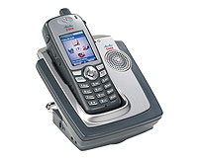
Endpoints Layer:
Specialty Devices
XML Service support
Full-duplex speakerphone
Wireless
Supports 802.11 a,b and g
Cisco 7921G

Slide 39
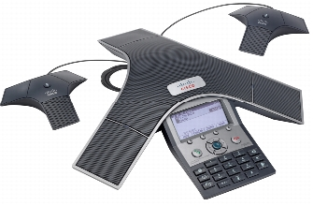
Endpoints Layer:
Specialty Devices
External microphone attachment
Full-duplex speakerphone
Cisco 7937G

Slide 40
Endpoints Layer:
Specialty Devices
  ATA 186/188: Converts up to two (2) analog phones to VoIP devices
  Cisco IP Communicator: IP Softphone computer based
  Cisco VT Advantage: Integrates webcam with the VoIP Phone
  Cisco 7914/7915/7916 expansion module: Expands each phone by fifteen (15) lines

Slide 41
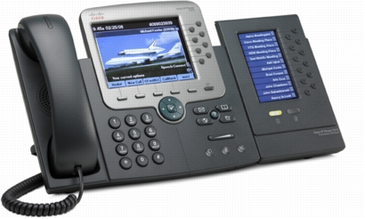
Cisco 7970G with 7916 Expansion Module:

Slide 42
End of Chapter 2

