Slide 1
CompTIA Security+ Study Guide (SY0-501)
Chapter 11:
Security Administration

Slide 2
Chapter 11: Security Administration
Given a scenario, deploy mobile devices securely
Given a scenario, differentiate common account management practices

Slide 3
Connection Types
Cellular
Bluetooth
Wi-Fi
ANT
Infrared
SATCOM

Slide 4
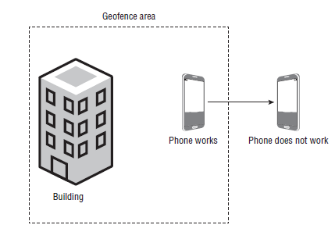
Mobile Devices
Geofencing

Slide 5
Account Management Concepts
Account types
General concepts
Usage audits
Privilege audits
Onboarding
Offboarding

