Slide 1
CompTIA Security+ Study Guide (SY0-501)
Chapter 10: Social Engineering and Other Foes

Slide 2
Chapter 10: Social Engineering and Other Foes
Compare and contrast types of attacks
Explain the importance of physical security controls
Compare and contrast various types of controls
Given a scenario, carry out data security and privacy practices

Slide 3
Social Engineering
Social engineering
The process by which intruders gain access to your facilities, your network, and even to your employees by exploiting the generally trusting nature of people.
Social engineering attacks (types of)
Shoulder surfing
Dumpster diving
Tailgating
Impersonation
Hoaxes
Whaling
Vishing

Slide 4
Principles Behind Social Engineering
Authority
Intimidation
Consensus/social proof
Scarcity
Urgency
Familiarity/liking
Trust

Slide 5
Physical Security
Access controls
A critical part of physical security
Physical barriers
Objective: to prevent access to computers and network systems
Multiple barrier system
Having more than one physical barrier to cross
Systems should have a minimum of three physical barriers

Slide 6
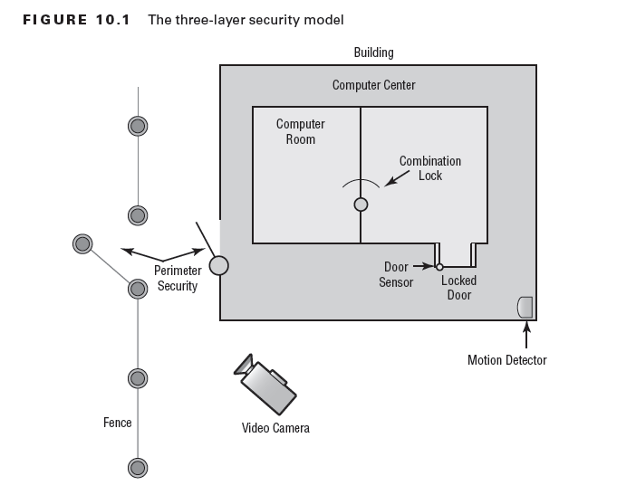

Slide 7
Chapter 10: Social Engineering and Other Foes
Hardware locks and security
Involves applying physical security modifications to secure the system(s)and prevent them from leaving the facility
Mantraps
Require visual identification, as well as authentication, to gain access

Slide 8
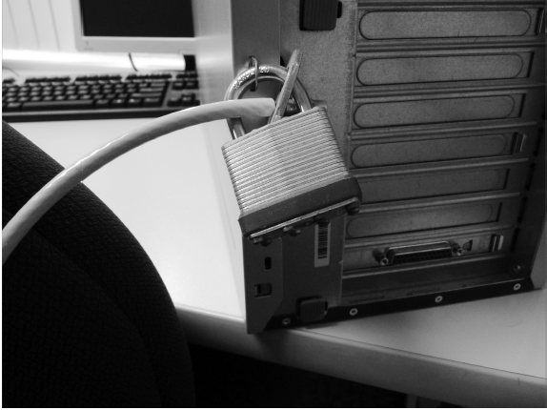
Hardware Locks

Slide 9
Chapter 10: Social Engineering and Other Foes
Video surveillance
Camera vs. guard
Fencing/perimeter security
Access list
Proper lighting
Signs
Guards
Barricades

Slide 10
Chapter 10: Social Engineering and Other Foes
Biometrics
Use some kind of unique biological trait to identify a person, such as fingerprints, patterns on the retina, and handprints
Protected distribution
Alarms
Motion detection

Slide 11
Chapter 10: Social Engineering and Other Foes
Environmental controls
HVAC
Fire suppression
EMI shielding

Slide 12
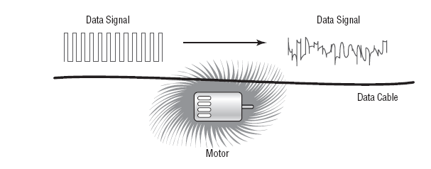
EMI Interference

Slide 13
Products that Solve Most Electrical Line Problems:
Surge protectors
Protect electrical components from momentary or instantaneous increases (called spikes) in a power line
Power conditioners
Active devices that effectively isolate and regulate voltage in a building
Backup power
Generally used in situations where continuous power is needed in the event of a power loss

Slide 14
Chapter 10: Physical and Hardware-Based Security
EMI shielding
Electromagnetic interference (EMI)
frequency interference (RFI)
The process of preventing electronic emissions from your computer systems from being used to gather intelligence and preventing outside electronic emissions from disrupting your information-processing abilities
Hot and cold aisles

Slide 15
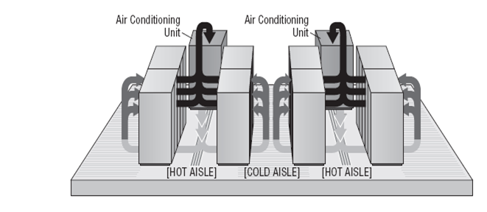
Hot and Cold Aisles

