Slide 1
CompTIA Security+ Study Guide (SY0-501)
Chapter 7:
Host, Data, and Application Security

Slide 2
Chapter 7: Host, Data, and Application Security
Explain threat actor types and attributes
Explain the impact associated with types of vulnerabilities
Explain the security implications of embedded systems
Summarize secure application development and deployment concepts

Slide 3
Threat Actors and Attributes
Script kiddies
Hacktivist
Organized crime
Nation-states/APT
Insiders
Competitors

Slide 4
Use of Open Source Intelligence
ThreatCrowd
OpenPhish
OSINT framework
Shodan

Slide 5
Types of Vulnerabilities
Configuration issues
User issues
Zero-day exploits
Other issues

Slide 6
Embedded Systems Security
IoT: Internet of Things

Slide 7
Application Vulnerabilities
Input vulnerabilities
Memory vulnerabilities

Slide 8
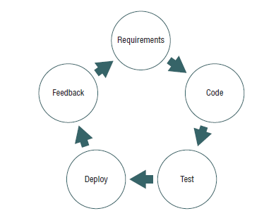
Secure Programming
Prototyping

Slide 9
Specific Types of Software Testing
Unit testing
Integration testing
System testing
User acceptance testing
Regression testing

Slide 10
Patch Management
Hotfix
Patch
Service pack

Slide 11
Database Tier Models
One-tier model
Two-tier model
Three-tier model

Slide 12
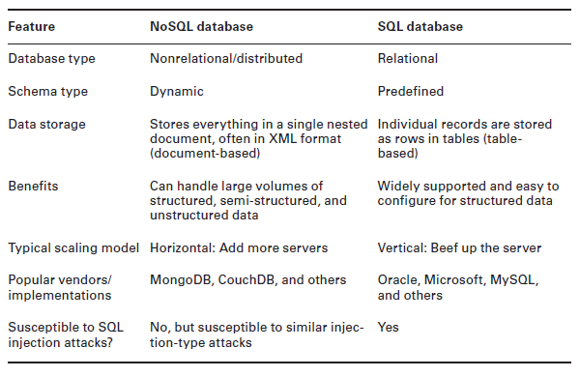
NoSQL vs. SQL

