Slide 1
CompTIA Security+ Study Guide (SY0-501)
Chapter 3:
Understanding Devices and Infrastructure

Slide 2
Chapter 3: Understanding Devices and Infrastructure
Install and configure network components, both hardware- and software-based to support organizational security

Slide 3
Designing with Security in Mind
Firewalls
VPNs and VPN concentrators
Intrusion detection systems

Slide 4
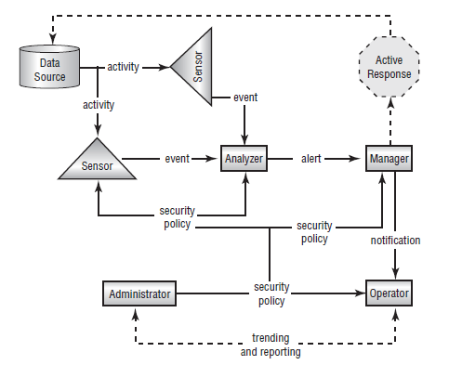
Intrusion Detection Systems

Slide 5
Intrusion Detection Systems
An intrusion detection system (IDS) is software that runs on either individual workstations or network devices to monitor and track network activity.
Intrusion detection systems (IDSs) are becoming integral parts of network monitoring.
Intrusion detection (ID) is the process of monitoring events in a system or network to determine whether an intrusion is occurring
An intrusion is defined as any activity or action that attempts to undermine or compromise the confidentiality, integrity, or availability of resources.

Slide 6
Chapter 3: Protecting Networks
IDSs use four primary approaches
Behavior-based detection
Signature-based detection, also commonly known as misuse-detection IDS (MD-IDS)
Anomaly-detection IDS
Heuristic IDS

Slide 7
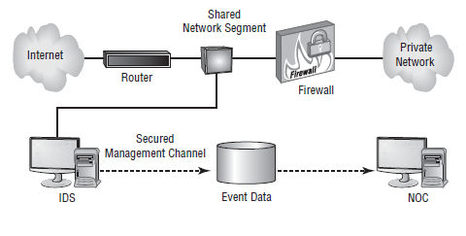
Network-Based IDS

Slide 8
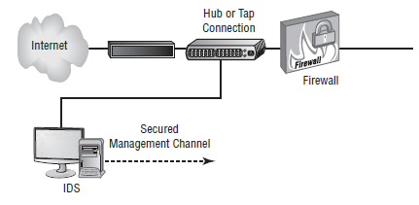
Using a Hub to Attach NIDS to the Network

Slide 9
Implementing a Passive Response
Passive response : The most common type of response to many intrusions. In general, passive responses are the easiest to develop and implement.
Some passive response strategies
Logging
Notification
Shunning

Slide 10
Implementing an Active Response
Active response
Involves taking an action based on an attack or threat
An active response will include one of these reactions:
Terminating processes or sessions
Network configuration changes
Deception

Slide 11
Host-Based IDs
A host-based IDS (HIDS) is designed to run as software on a host computer system.
HIDSs are popular on servers that use encrypted channels or channels to other servers.

Slide 12
Chapter 3: Protecting Networks
Network Intrusion Prevention Systems (NIPSs) focus on prevention. These systems focus on signature matches and then take a course of action.

Slide 13
Security-Related Devices
Router
Switch
Proxy
Load balancer
Access point
SIEM
DLP
NAC
Mail gateway
Bridge
SSL/TLS accelerators
SSL decryptors
Media gateway

