Slide 1
CompTIA Security+ Study Guide (SY0-501)
Chapter 2:
Monitoring and Diagnosing Networks

Slide 2
Chapter 2: Monitoring and Diagnosing Networks
Explain use cases and purpose for frameworks, best practices, and secure configuration guides
Given a scenario, implement secure network architecture concepts
Given a scenario, implement secure systems design
Explain the importance of secure staging
Deployment concepts

Slide 3
Frameworks, Best Practices, and Configuration Guides
ISO Standards
North American Electric Reliability Corporation (NERC)
National Institute of Standards and Technology (NIST)
ISA/IEC-62443
Payment Card Industry Data Security Standard (PCI-DSS)

Slide 4
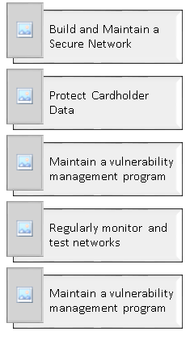
Payment Card Industry Data Security Standard (PCI-DSS)

Slide 5
Open Web Application Security Project (OWASP)
1. Verify for security early and often
2. Parameterize queries
3. Encode data
4. Validate all inputs
5. Implement identity and authentication controls
6. Implement appropriate access controls
7. Protect data
8. Implement logging and intrusion detection
9. Leverage security frameworks and libraries
10. Error and exception handling

Slide 6
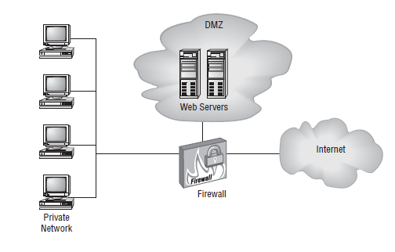
Secure Network Architecture Concepts
Zones
Demilitarized zone (DMZ)
Extranet and intranet
Wireless

Slide 7
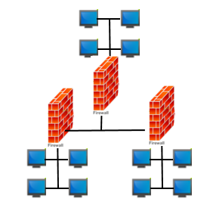
Network Segmentation

Slide 8
Honeypots and Honeynets
Honeypot: A separate system that appears to be an attractive target but is in reality a trap for attackers
Honeynet: A fake network segment that appears to be a very enticing target (a logical extension of a honeypot)

Slide 9
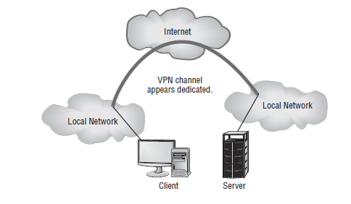
Tunneling/VPN

Slide 10
Security Devices
Firewalls
Software-defined networking (SDN)
IDS/IPS

Slide 11
Secure Systems Design
Hardware and firmware
Operating systems
Peripherals

