Slide 1
Network Device Management using Cisco IOS NetFlow
Notes:
Developed and patented by Cisco in 1996, NetFlow is now the primary network accounting technology in the industry. It answers questions regarding IP traffic such as:
Who are the top users?
How long are the users on the network?
What Internet sites do they use?
Where do the users go on the network?
What percentage of traffic do they use?
What applications do they use?
What are the user usage patterns?
In other words, NetFlow provides a detailed view of network behaviour.
This lesson covers the following exam topics:
Troubleshooting
Utilize netflow data
Monitor NetFlow statistics

Slide 2
Objectives
Upon completing this lesson, you will be able to meet these objectives:
Describe the purpose of NetFlow
Describe the NetFlow architecture
Configure and verify NetFlow on a Cisco device

Slide 3
NetFlow Overview
NetFlow is an application for collecting IP traffic information.
Reports from NetFlow are like a phone bill.
NetFlow enables the following:
  - Measuring who uses network resources
  - Accounting and charging for resource utilization
  - Using the measured information to do effective network planning
  - Using the measured information to customize applications and services
Notes:
NetFlow is a Cisco IOS application that provides statistics on packets flowing through the routing devices in the network. It is emerging as a primary network accounting and security technology.
Cisco IOS NetFlow efficiently provides a key set of services for IP applications, including network traffic accounting, usage-based network billing, network planning, security, DoS monitoring capabilities, and network monitoring.
NetFlow technology creates an environment in which you have the tools to understand how network traffic is flowing. To use an analogy from the telephone industry, NetFlow is like a phone bill, from which you can learn who is talking to whom, how frequently, how long, and so on.
NetFlow is completely transparent to the existing network, including end stations and application software, and network devices such as LAN switches. Also, NetFlow capture and export are performed independently on each internetworking device. NetFlow does not need to be operational on each router in the network.
NetFlow is important for service providers and enterprise customers because it helps address four key requirements:
- Efficiently measuring who is using which network resources for which purpose
- Accounting and charging back according to the resource utilization level
- Using the measured information to do more effective network planning so that resource allocation and deployment are well-aligned with customer requirements
- Using the information to better structure and customize the set of available applications and services to meet user needs and customer service requirements

Slide 4
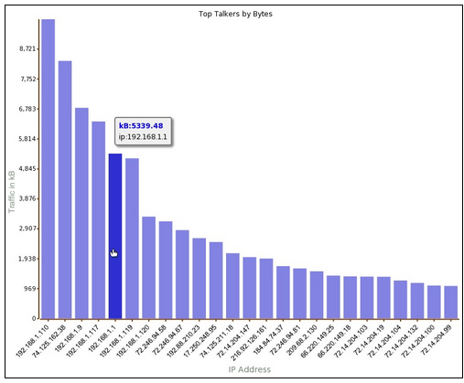
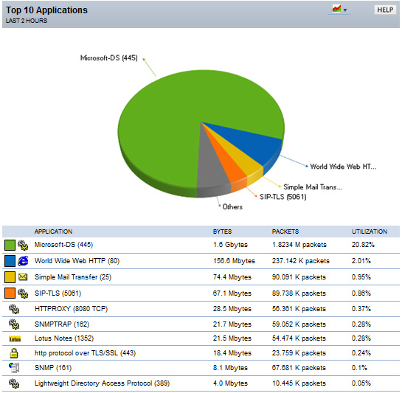
NetFlow Overview (Cont.)
Example of analysis on a NetFlow collector:
Shows top talkers, top listeners, top protocols, and more.
Notes:
There are several NetFlow collectors and analyzers available on the market. These tools enable you to analyze the traffic on your network by showing the top talkers, top listeners, top protocols, and more. You can see the types of traffic (web, mail, FTP, peer-to-peer, and so on) that are on the network, as well as which devices are sending and receiving most of the traffic. Collecting data provides you with forensic-level telemetry on top talkers, top hosts, and top listeners. And because data is preserved over time, you will be able to analyze network usage trends.
Based on the usage of NetFlow analyzers, you will be able to identify the following:
- The major users of the network
- The websites that are routinely visited and what is downloaded
- Who is generating the most traffic
- If you have enough bandwidth to support mission-critical activity
- Who is using excessive bandwidth

Slide 5
NetFlow Overview (Cont.)
NetFlow components:
  - NetFlow-enabled network devices
  - NetFlow collector
NetFlow devices generate NetFlow records that are exported and then collected by a NetFlow collector. Cisco Network Analysis Module is an example of a NetFlow collector. It also processes NetFlow data and provides the results through its GUI.
NetFlow-Enabled Router
NetFlow Collector
Notes:
NetFlow components include the following:
- Network devices that are configured for NetFlow
- NetFlow Collector, which receives NetFlow information from network devices
Network devices collect IP traffic statistics on interfaces where NetFlow is configured. Network devices then export these statistics as NetFlow records to a central server that runs NetFlow Collector software. The Collector also performs traffic analysis.

Slide 6
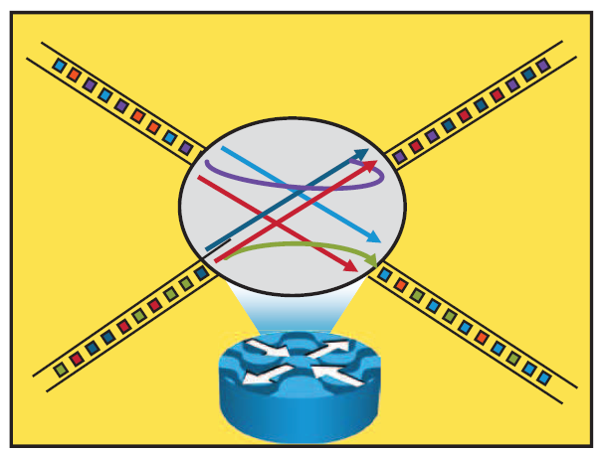
NetFlow Overview (Cont.)
Cisco defines a flow as a unidirectional sequence of packets with seven common values:
  - Source IP address
  - Destination IP address
  - Source port number
  - Destination port number
  - Layer 3 protocol type
  - ToS
  - Input logical interface
Notes:
A NetFlow network flow is defined as a unidirectional stream of packets between a given source and destination. The source and destination are each defined by a network layer IP address and transport layer source and destination port numbers.
A flow is defined by the combination of seven key fields, which define a unique flow. If a packet has one key field that is different from another packet, it is considered to belong to another flow. Flows are stored in the NetFlow cache.
Note ToS is a field in the IP header. It is used as a quality of service (QoS) mechanism to mark IP packets with different priorities in
order to receive different treatment in terms of throughput, reliability, and latency.

Slide 7
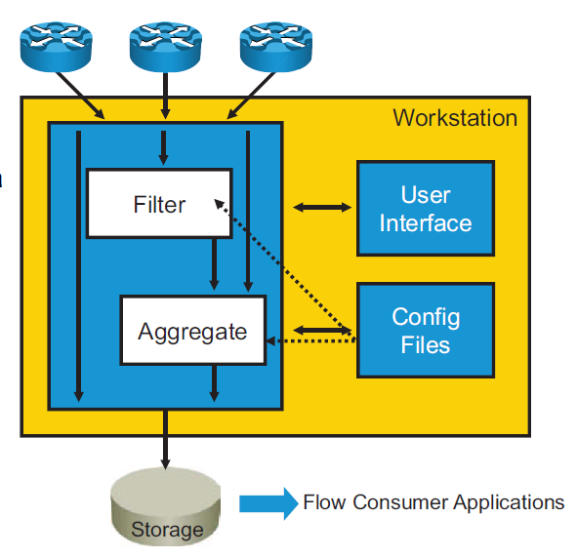
NetFlow Architecture
Routers collecting data
FlowCollector software:
  - Flow record reception (UDP)
  - Reduction and filtering of data volume
Network FlowAnalyzer software for graphical display of data
Notes:
The purpose of FlowCollector is to grab flow export data from multiple routers, filter and aggregate the data according to the policies of the customer (that is, keep the data that you want and discard the rest), and store this summarized or aggregated data instead of raw flow data to minimize disk space consumption. The data is written to a disk at specified intervals in flat files. The customer may run multiple collection schemes or threads concurrently; for example, customers who want data both for planning and for billing may want to store different “cuts” of the data to support these applications via different aggregation schemes.
FlowCollector passively listens to specified UDP ports to receive and process exported NetFlow datagrams. The FlowCollector application provides a high-performance, easy-to-use solution that scales to accommodate consumption of NetFlow export data from multiple devices in order to support key flow-consumer applications, including accounting, billing, and network planning and monitoring.
FlowAnalyzer provides the means to do near real-time visualization and analysis of recorded and aggregated flow data. You can specify the router, the aggregation scheme, and the time interval in which you wish to view and then retrieve the relevant data. You can then sort and visualize the data in a manner that makes sense for the users (with bar charts, pie charts, or histograms of the sorted reports). The data can then be exported to spreadsheets such as Excel for more detailed analysis, trending, reporting, and so on.
Cisco no longer supports its own specific Flow collection/analysis software. Other companies offer free or commercial flow collection/analysis software.
See these links:
http://www.cisco.com/en/US/prod/iosswrel/ps6537/ps6555/ps6601/networking_solutions_products_genericcontent0900aecd805ff72b.html
http://www.cisco.com/en/US/prod/iosswrel/ps6537/ps6555/ps6601/networking_solutions_products_genericcontent0900aecd805ff728.html

Slide 8
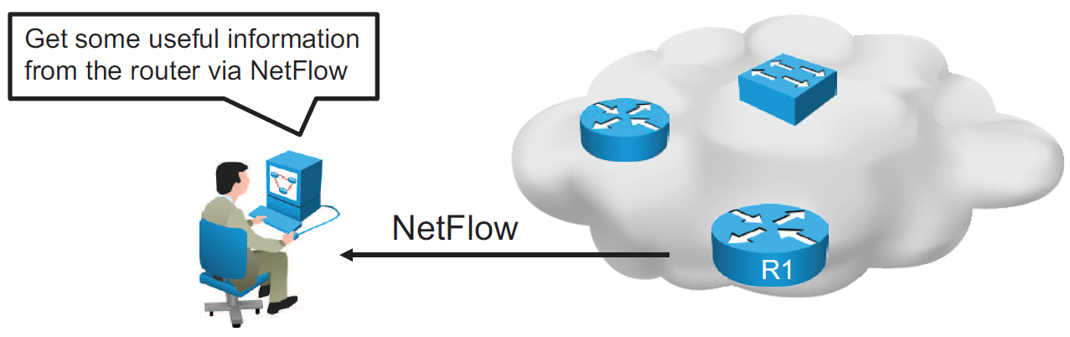
NetFlow Configuration
Configure NetFlow data capture
Configure NetFlow data export
Configure NetFlow data export version
Verify NetFlow, its operation, and statistics
Notes:
To implement NetFlow on a router, you must do the following:
Configure NetFlow data capture: NetFlow can capture data from ingress (incoming) and egress (outgoing) packets.
Configure NetFlow data export: You need to specify the IP address or hostname of the NetFlow collector and the UDP port that the NetFlow collector listens to. Optionally, you can specify an interface to use for the source IP address of the packet sent to the collector.
Configure NetFlow data export version: You can specify the version of NetFlow data export format.
Verify NetFlow, its operation, and statistics: After you have configured NetFlow, you can analyze the exported data on a workstation running an application such as NetFlow Collection Engine or using several show commands on the router itself.
Note Be aware that NetFlow consumes additional memory. If you have memory constraints, you can preset the size of the NetFlow cache so that it contains a smaller number of entries. The default cache size depends on the platform.

Slide 9
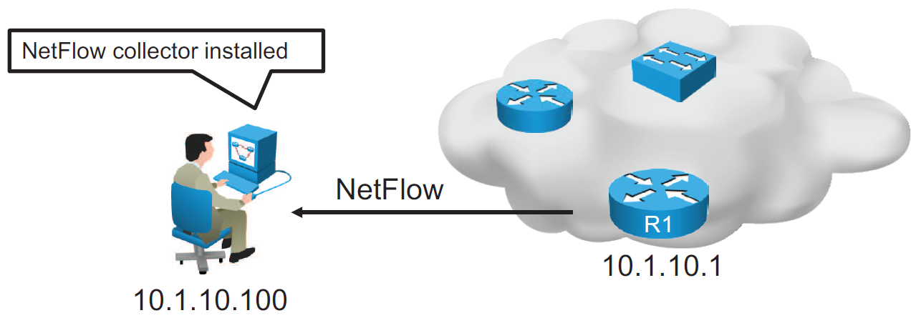
NetFlow Configuration (Cont.)
R1(config)# interface GigabitEthernet0/0
R1(config-if)# ip flow ingress
R1(config-if)# ip flow egress
R1(config-if)# exit
R1(config)# ip flow-export destination 10.1.10.100 9996
R1(config)# ip flow-export version 9
Configuration of NetFlow on router R1
Notes:
Configuration of NetFlow is based on the following commands:
ip flow {ingress | egress}
Enables NetFlow on the interface. Captures traffic that is being received or being transmitted by the interface.
ip flow-export destination ip-address udp-port
IP address of the workstation to which you want to send the NetFlow information and the number of the UDP port on which the workstation is listening for this input. UDP port 9996 is commonly used for NetFlow.
ip flow-export version version
Specifies the version format that the export packet uses.
The figure shows configurations for NetFlow data capture and data export to NetFlow collector with IP address 10.1.10.100, where you can analyze the exported data.
Traffic that is being either received or transmitted by the GigabitEthernet 0/0 interface is captured using the ip flow command. Captured NetFlow information is then sent to the collector with IP address 10.1.10.100 on UDP port 9996. The ip flow-export version command specifies that the export packet uses the version 9 format.
Note NetFlow exports data in UDP in one of five formats (1, 5, 7, 8, and 9). Version 9 is the most versatile data export format but is not backward compatible with version 8 or version 5.

Slide 10
NetFlow Configuration (Cont.)
R1# show ip flow interface
GigabitEthernet0/0
ip flow ingress
ip flow egress
Displays if NetFlow is enabled on an interface
R1# show ip flow export
Flow export v9 is enabled for main cache
Export source and destination details :
VRF ID : Default
Destination(1) 10.1.10.100 (9996)
Version 9 flow records
43 flows exported in 15 udp datagrams
Displays the status and the statistics for NetFlow data export
Notes:
You can use the show ip flow interface command to verify if NetFlow is enabled on an interface. In the example, NetFlow is enabled in the ingress and egress directions on the GigabitEthernet0/0 interface.
Use the show ip flow export command to verify the status and statistics for NetFlow accounting data export. In the example, the configured destination for NetFlow export is 10.1.10.100 using UDP port 9996. The version of the configured flow export is 9.

Slide 11
NetFlow Configuration (Cont.)
R1# show ip cache flow
<output omitted>
IP Flow Switching Cache, 278544 bytes
2 active, 4094 inactive, 31 added
6374 ager polls, 0 flow alloc failures
Active flows timeout in 30 minutes
Inactive flows timeout in 15 seconds
IP Sub Flow Cache, 34056 bytes
2 active, 1022 inactive, 31 added, 31 added to flow
0 alloc failures, 0 force free
1 chunk, 0 chunks added
last clearing of statistics 00:49:48
Protocol Total Flows Packets Bytes Packets Active(Sec) Idle(Sec)
-------- Flows /Sec /Flow /Pkt /Sec /Flow /Flow
TCP-Telnet 19 0.0 19 58 0.1 6.5 11.7
TCP-WWW 14 0.0 8 202 0.0 0.0 1.5
TCP-other 2 0.0 19 98 0.0 2.2 8.9
<output omitted>
SrcIf SrcIPaddress DstIf DstIPaddress Pr SrcP DstP Pkts
Gi0/1 172.16.1.100 Gi0/0 10.2.23.105 01 0401 0017 1341
Displays a summary of the NetFlow accounting statistics
Notes:
You can use the show ip cache flow command to display a summary of NetFlow statistics on a Cisco IOS router. Using this command, you can see which protocols use the highest volume of traffic and between which hosts this traffic flows.
The example shows a summary of NetFlow statistics on the R1 router. Note that the destination port is hex 17, which is equal to decimal 23, the well-known TCP port for Telnet services.

Slide 12
Summary
NetFlow provides statistics on packets flowing through the routing devices in the network.
The configuration part of NetFlow consists of configuring data capture and configuring data export.

