Slide 1
Introduction to IOS 15 Trains, Numbering, and System Image Packaging
A. Peter Anderson
Associate Professor
August 4, 2013

Slide 2
Universal IOS Image
Notes:
One of the major differences between IOS releases prior to 15 and IOS 15 releases is the concept of a Universal Image. A universal image contains all of the features capable on the specific device, but may not be activated by default. Additional features may require the purchase of additional licenses to activate.

Slide 3
What is a Universal Image?
Universal IOS Image contains all Cisco IOS features.
Single universal IOS Image is shipped with the ISR G2 devices.
IOS functionality is determined by the specific licenses applied to the devices.
Only two IOS images for each release:
universalk9: This universal image offers all the Cisco IOS features including strong crypto features such as VPN payload, Secure UC, etc.
universalk9_npe (no payload encryption): This universal image satisfies requirements of import restricted countries. It does not support any strong payload encryption, such as VPN payload, secure voice, etc.
Examples:
c2900-universalk9-mz.SPA.151-4.M.bin
c2900-universalk9_npe-mz.SPA.151.4-M.bin
Notes:
Cuba, Iran, North Korea, Sudan, and Syria. These are Embargoed. Cisco doesn’t ship at all to these Countries.
These are the “Restriction Free” Countries. If you aren’t in this list, Cisco may not be allowed to ship Strong Encryption:
Austria, Australia,
Belgium, Bulgaria, Canada, Cyprus, Czech Republic, Denmark, Estonia, Finland, France,
Germany, Greece, Hungary, Iceland, Ireland, Italy, Japan, Latvia, Lithuania,
Luxembourg, Malta, Netherlands, New Zealand, Norway, Poland, Portugal, Romania,
Slovakia, Slovenia, Spain, Sweden, Switzerland, Turkey, United Kingdom, United States.
Universalk9_npe: npe (no payload encryption)
Include the Short List of Countries Impacted by npe code.

Slide 4
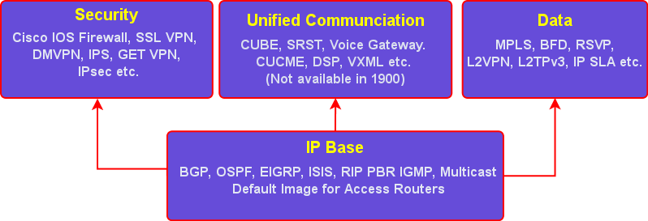
Universal IOS Images
Includes all the available features in a model.
Four technology packages available: IP Base, Security, UC and Data
IP Base Technology Package is enabled by default.
Security, UC and Data Technology Package licenses activate more features.
Notes:
IOS 15.0 universal image aims to reduce the complexity when trying to determine the right license, for the right job.
Features not supported from IOS Release 15 onward:
AppleTalk
Cisco Service Selection Gateway (SSG)
SSG is a switching solution for Service Providers who offer Intranet, Extranet and Internet connections to subscribers using broadband access technology such as DSL, cable modems, or wireless LAN
http://www.cisco.com/en/US/products/ps6589/products_ios_protocol_group_home.html

Slide 5
IOS Release 15 Timeline
Feature inheritance and platform support from 12.4T and 12.4 Mainline
Two major maintenance releases for IOS 15:
M Release (Extended)
T Release (Standard)
FCS: First Customer Ship
The date the software release is first available to customers on Cisco Software Download Center
Notes:
Exceptions to the first statement: Appletalk and Cisco Service Selection Gateway (SSG)
FCS: first customer ship (day 0)
The date the software release is first available to customers on Cisco Software Download Center

Slide 6
What are the Maintenance Releases?
15 M (Extended Maintenance Release):
Ideal for long-term maintenance, enabling customers to qualify, deploy, and remain on the release for an extended period.
15 T (Standard Maintenance Release):
Short deployment releases ideal for latest new features and hardware support before the next M release becomes available.
Incorporates features delivered in previous releases plus incremental new feature enhancements and hardware support.
Provides regular bug fix maintenance rebuilds for 12 months, plus 6 additional months of critical fix support for network affecting bugs.
Incorporates features and hardware support delivered in previous releases.
Provides 44 months of support.
Notes:
T will most likely be used by those who want the latest features (resellers, vendors, students etc.)
M however will most likely be used in production networks, will lag behind T train releases, so hopefully the resellers, vendors and students can learn about the new features prior to deployment.

Slide 7
c2900-universalk9-mz.SPA.151-4.M1.bin
The New IOS 15 Naming Convention
Major Release Number
A.
Minor Release Number
B.
New Feature Release Number
C.
M/T = Ext./Std Maintenance
D.
Maintenance Rebuild Number
E.
Notes:
Ask the audience to name the parts
A. major release number
B. minor release number
C. new feature release number
D.
M = extended maintenance release
T = standard maintenance release
E. maintenance rebuild number
No new features or hardware support are delivered in maintenance rebuilds of release 15 M or T

