Slide 1
Overview of IOS 15 Licensing and Process
A. Peter Anderson
Associate Professor
August 4, 2013

Slide 2
Introduction to Licensing
Notes:
It is important to note that IOS 15 licensing is enforced by activation on ISR G2 devices and by “honor code” on ISR G1 devices.
ISR G1’s don’t require licensing, they go off of the “honor code”, future releases are no longer supported. No UID is needed, if you purchased the IOS it can be loaded onto the device and used without activation.

Slide 3
Available License Types on ISR G2
Permanent Licenses
Evaluation Licenses
Feature Licenses:
Software Activation Feature Licenses
Right to Use Feature Licenses
Subscription Licenses
Counted Licenses
Notes:
There are two major types of licenses:
Permanent
Evaluation
There are three minor types of licenses:
Feature
Subscription
Counted

Slide 4
What is a Permanent License?
A Permanent License never expires.
Once a permanent license is installed on a router, it is good for that particular feature set for the life of the router even across IOS versions. For example, once a UC, Security or Data license is installed on a router, the subsequent features for that license will be active even if the router is upgraded to a new IOS release.
A permanent license is the most common license type used when a feature set is purchased for a device.

Slide 5
What is a Evaluation License?
A Evaluation License is good for a limited amount of time.
ISR G2 includes a full set of 60 day Evaluation License(s) for the Data, UC and Security feature sets.
These can be activated and deactivated at any time to evaluate a feature set before making the decision to convert to a Permanent License.
They also provide a mechanism that gives the user some flexibility before upgrading to a Permanent License.
Only the time a Evaluation License is active counts against the 60 day allotted time.
Once an Evaluation License expires, it cannot be extended.
Notes:
Evaluation Licenses – Allow you to test drive features & verify they’re in that pak before permanently buying.
Evaluation Licenses – Indirectly has helped implementation practices, for example, if we purchased the wrong code, no problem – we have time to purchase it and in the meantime still implement the proper configuration.
Real problem with IP base for switching (EIGRP stub)

Slide 6
What are Feature Licenses?
Software Activation Feature Licenses
Typically upgrades to one or more technology Package Licenses (Data, UC or Security)
Can be delivered with new router or upgraded at a later time.
Licenses are enforced through Cisco Software Licensing framework
Right to Use Feature Licenses
Does not require software activation (honor system)
Can be ordered with new router or upgraded at a later time.
Notes:
Software Activation
Adds a feature which requires an additional license in addition to the technology package.
Cisco Software Licensing Framework – The policing & admin function implemented by Cisco to enforce licensing.
Right to Use Licenses
A Right to Use license scheme is an honor-based model for licensing. Licenses are not tied to an unique device identifier (UDI), product ID, or serial number.
Therefore, if you want to use the feature, nothing is stopping you, but you are expected to have purchased the technology package even though its not enforced through a license.
Software Activation Feature Licenses:
Technology Packages: IPBase, Security, Data, UC
Intrusion Prevention (Subscription)
Content Filtering (Subscription)
SSLVPN (Counted)
SNA Switching
Gatekeeper
CUE (Counted)
Right to Use Feature Licenses:
Land Mobile Radio
VXML Gateway (Counted)
CME (Counted)
SRST (Counted)
CUBE (Counted)

Slide 7
What are Subscription and Counted Licenses?
May be Software Activation or Right-to-Use Feature Licenses
Subscription Licenses
Time-based licenses
Software Activation Feature Licenses - Intrusion Prevention, Content Filtering
Counted Licenses
Enable a defined number of users
Software Activation Feature Licenses – SSLVPN, CUE
Right-to-Use Feature Licenses – VXML, CME, SRST, CUBE
Notes:
Software Activation Feature Licenses:
Technology Packages: IPBase, Security, Data, UC
Intrusion Prevention (Subscription)
Content Filtering (Subscription)
SSLVPN (Counted)
SNA Switching
Gatekeeper
CUE (Counted)
Right to Use Feature Licenses:
Land Mobile Radio
VXML Gateway (Counted)
CME (Counted)
SRST (Counted)
CUBE (Counted)

Slide 8
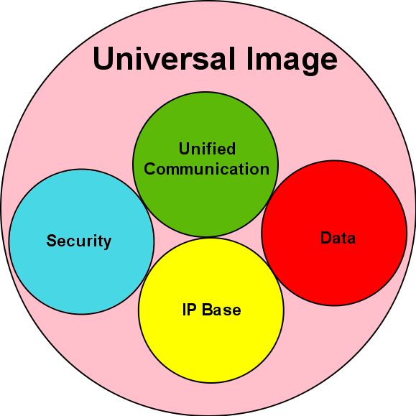
Technology Package Licenses
Technology Package Licenses (Permanent/Evaluation)
IP Base (Permanent Only)
Security
Data
Unified Communication

Slide 9
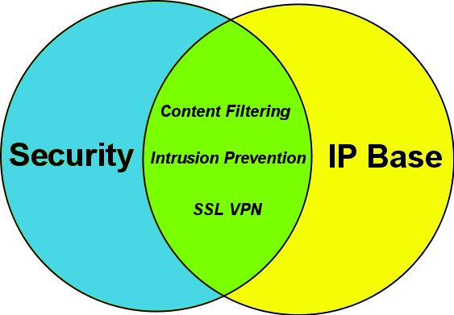
Technology Package License: Security
Security Technology Package License activated:
Additional Software Activation Feature Licenses
Intrusion Prevention (Subscription)
Content Filtering (Subscription)
SSL VPN (Counted)
Notes:
Example: If you needed Intrusion Prevention, you’d have to purchase the Security Technology PAK license first, then you could add (for a cost) the Intrusion Prevention Subscription.

Slide 10
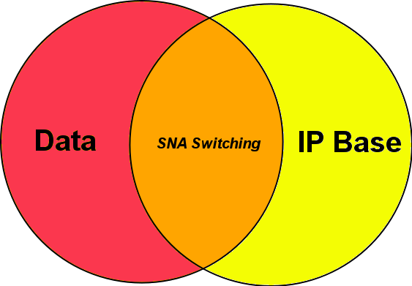
Technology Package License: Data
Data Technology Package License activated:
Additional Software Activation Feature License
SNA (Systems Network Architecture) Switching

Slide 11
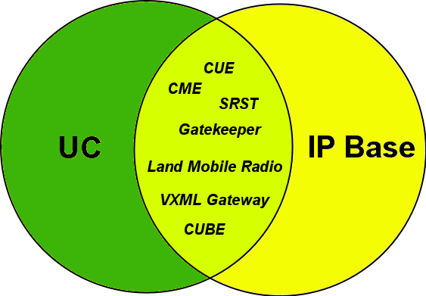
Technology Package License: UC
Unified Communication Technology Package License activated:
Additional Software Activation Feature Licenses
Gatekeeper
CUE (Counted)
Additional Right to Use Feature Licenses
Land Mobile Radio
VXML Gateway (Counted)
CME (Counted)
SRST (Counted)
CUBE (Counted)
Notes:
Example: Similar to purchasing MS Exchange Server (that would be the UC Tech Package here)
Then you need to buy additional Client licenses (that would be like enabling the CME here)

Slide 12
Licensing Process
Step 1: Purchase the Software Package or Feature to Install
A Product Authorization Key (PAK) will be provided upon payment
Acts as a Receipt
Used to obtain a license
Step 2: Obtain A License file
Option 1 -Cisco License Manager, which is a free software application available at http://www.cisco.com/go/clm.
Option 2 -Cisco License Registration Portal: www.cisco.com/go/license
An e-mail containing the license information that you can use to install the license is received
Step 3: Install the License
Copy the license file received to the appropriate file system on the device

