Slide 1
Chapter 9: Advanced OSPF
Instructor Materials
CCNP Enterprise: Core Networking

Slide 2
Chapter 9 Content
This chapter covers the following content:
Areas - This section describes the benefits and functions of areas within an Open Shortest Path First (OSPF) routing domain.
Link-State Announcements - This section explains how OSPF stores, communicates, and builds a topology from the link-state announcements (LSAs).
Discontiguous Networks - This section demonstrates a discontiguous network and explains why such a network cannot distribute routes to all areas properly.
OSPF Path Selection - This section explains how OSPF makes path selection choices for routes learned within the OSPF routing domain.
Summarization of Routes - This section explains how network summarization works with OSPF.
Route Filtering - This section explains how OSPF routes can be filtered on a router.
The (OSPF) protocol scales well with proper network planning. IP addressing schemes, area segmentation, address summarization, and hardware capabilities for each area should considered when designing a network.

Slide 3
Areas
An OSPF area is a logical grouping of routers or, more specifically, a logical grouping of router interfaces.
Area membership is set at the interface level, and the area ID is included in the OSPF hello packet.
An interface can belong to only one area.
All routers within the same OSPF area maintain an identical copy of the link-state database (LSDB).

Slide 4
Areas OSPF Areas
An OSPF area grows in size as the number of network links and routers increase in the area. While using a single area simplifies the topology, there are trade-offs:
Full shortest path first (SPF) tree calculation runs when a link flaps within the area.
The LSDB increases in size and becomes unmanageable.
The LSDB for the area grows, consuming more memory, and lengthening the SPF computation process.
No summarization of route information occurs.
Proper design addresses each of these issues by segmenting the routers into multiple OSPF areas, thereby keeping the LSDB to a manageable size. Sizing and design of OSPF networks should account for the hardware constraints of the smallest router in that area.

Slide 5
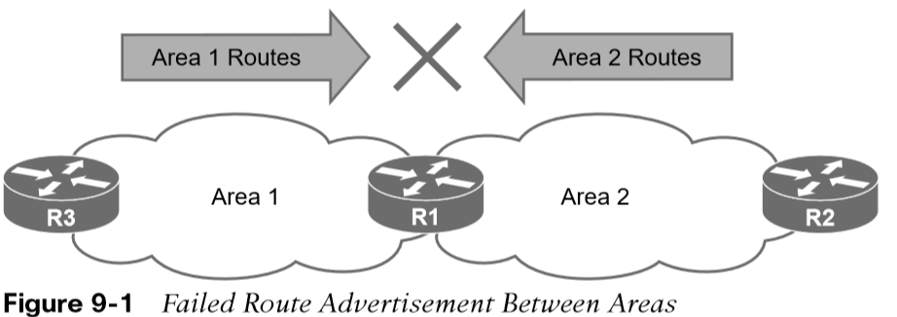
Areas OSPF Areas (Cont.)
In essence, an OSPF area hides the topology from another area but enables the networks to be visible in other areas within the OSPF domain. Segmenting the OSPF domain into multiple areas reduces the size of the LSDB for each area, making SPF tree calculations faster, and decreasing LSDB flooding between routers when a link flaps.
Just because a router connects to multiple OSPF areas does not mean the routes from one area will be injected into another area. Figure 9-1 shows router R1 connected to Area 1 and Area 2. Routes from Area 1 will not advertise into Area 2 and vice versa.

Slide 6
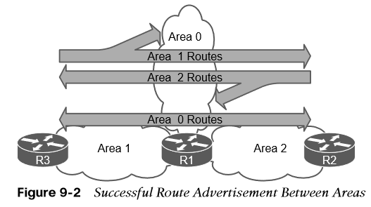
Areas OSPF Area 0 and ABRs
Area 0 is a special area called the backbone. By design, all areas must connect to Area 0 because OSPF expects all areas to inject routing information into the backbone, and Area 0 advertises the routes into other areas.
Area border routers (ABRs) are OSPF routers connected to Area 0 and another OSPF area. ABRs are responsible for advertising routes from one area and injecting them into a different OSPF area.
Figure 9-2 shows that R1 is connected to Area 0, Area 1, and Area 2. R1 is a proper ABR because it now participates in Area 0.

Slide 7
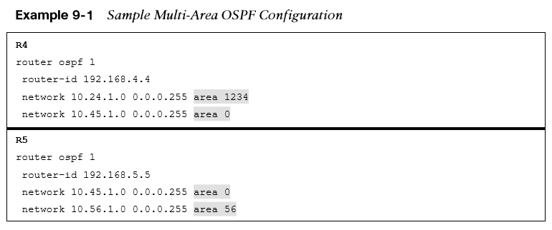
Areas Multi-Area OSPF Configurations and Verifying Interfaces for ABRs
Figure 9-3 shows a larger-scale OSPF multi-area topology. In the topology:
R1, R2, R3, and R4 belong to Area 1234.
R4 and R5 belong to Area 0.
R5 and R6 belong to Area 56.
R4 and R5 are ABRs.
Area 1234 connects to Area 0, and Area 56 connects to Area 0.
Routers in Area 1234 can see routes from routers in Area 0 and Area 56 and vice versa.
Example 9-1 shows the OSPF configuration for the ABRs R4 and R5.
Example 9-2 verifies that interfaces on R4 belong to Area 1234 and Area 0 and that interfaces on R5 belong to Area 0 and Area 56.

Slide 8
Areas Area ID
The area ID is a 32-bit field and can be formatted in simple decimal (0 through 4,294,967,295) or dotted decimal (0.0.0.0 through 255.255.255.255).
During router configuration, the area can use decimal format on one router and dotted-decimal format on a different router, and the routers can still form an adjacency.
OSPF advertises the area ID in dotted-decimal format in the OSPF hello packet.

Slide 9
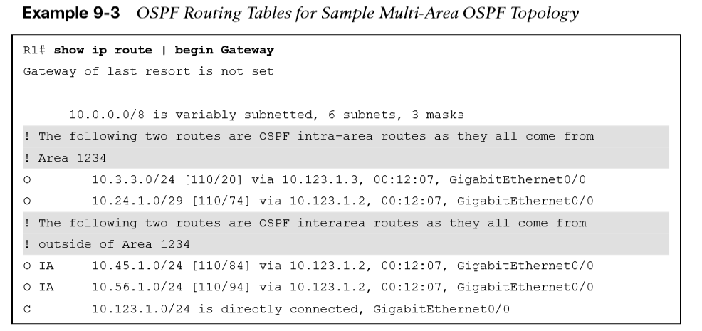
Areas OSPF Intra-Area and Interarea Routes
Network routes that are learned from other OSPF routers within the same area are known as intra-area routes. In Figure 9-3, the network link between R2 and R4 (10.24.1.0/29) is an intra-area route to R1. The IP routing table displays OSPF intra-area routes with an O.
Network routes that are learned from other OSPF routers from a different area using an ABR are known as interarea routes.
Example 9-3 provides the routing table for R1 from Figure 9-3. Notice that R1’s OSPF routing table shows routes from within Area 1234 as intra-area (O routes) and routes from Area 0 and Area 56 as interarea (O IA routes).

Slide 10
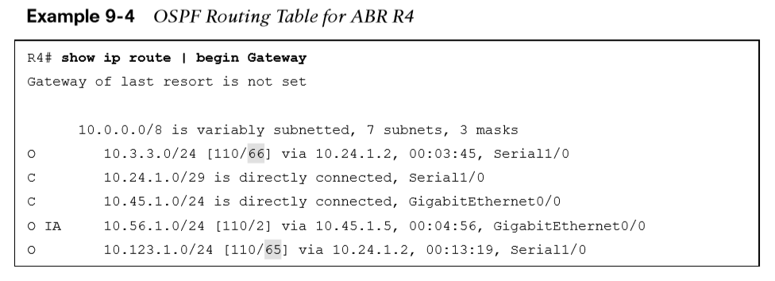
Areas OSPF Inter-Area Routes and Interarea Routes (Cont.)
In Example 9-4, notice that R4’s routing table shows the routes from within Area 1234 and Area 0 as intra-area and routes from Area 56 as interarea because R4 does not connect to Area 56. The metric for the 10.123.1.0/24 and 10.3.3.0/24 networks has drastically increased compared to the metric for the 10.56.1.0/24 network.

Slide 11
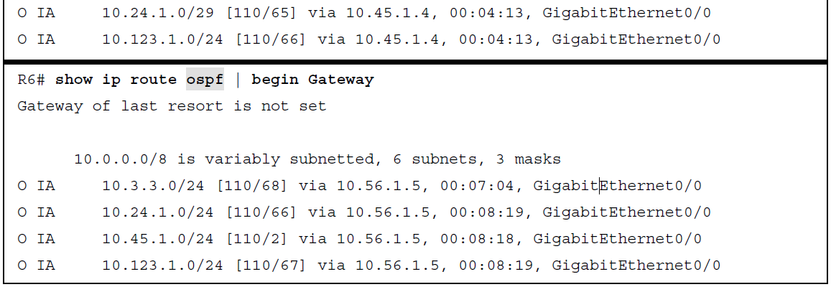
Areas OSPD Inter-Area Routes and Interarea Routes (Cont.)
Example 9-5 provides the routing tables with filtering for OSPF for R5 and R6.
Figure 9-3. R5 and R6 only contain interarea routes in the OSPF routing table because intra-area routes are directly connected.
External routes are routes learned from outside the OSPF domain but injected into an OSPF domain through redistribution. External OSPF routes can come from a different OSPF domain or from a different routing protocol.

Slide 12
Link-State Announcements
When OSPF neighbors become adjacent, the LSDBs synchronize between the OSPF routers.
As an OSPF router adds or removes a directly connected network link to or from its database, the router floods the link-state advertisement (LSA) out all active OSPF interfaces.
The OSPF LSA contains a complete list of networks advertised from that router.

Slide 13
Link-State Announcements OSPF LSA Types for IPv4 Routing
OSPF uses six LSA types for IPv4 routing:
Type 1, router LSA - Advertises the LSAs that originate within an area.
Type 2, network LSA - Advertises a multi-access network segment attached to a DR.
Type 3, summary LSA - Advertises network prefixes originating from a different area.
Type 4, ASBR summary LSA - Advertises a summary LSA for a specific ASBR.
Type 5, AS external LSA - Advertises LSAs for routes that have been redistributed.
Type 7, NSSA external LSA - Advertises redistributed routes in NSSAs.
LSA types 1, 2, and 3, which are used for building the SPF tree for intra-area and interarea routes, are explained in this section.

Slide 14
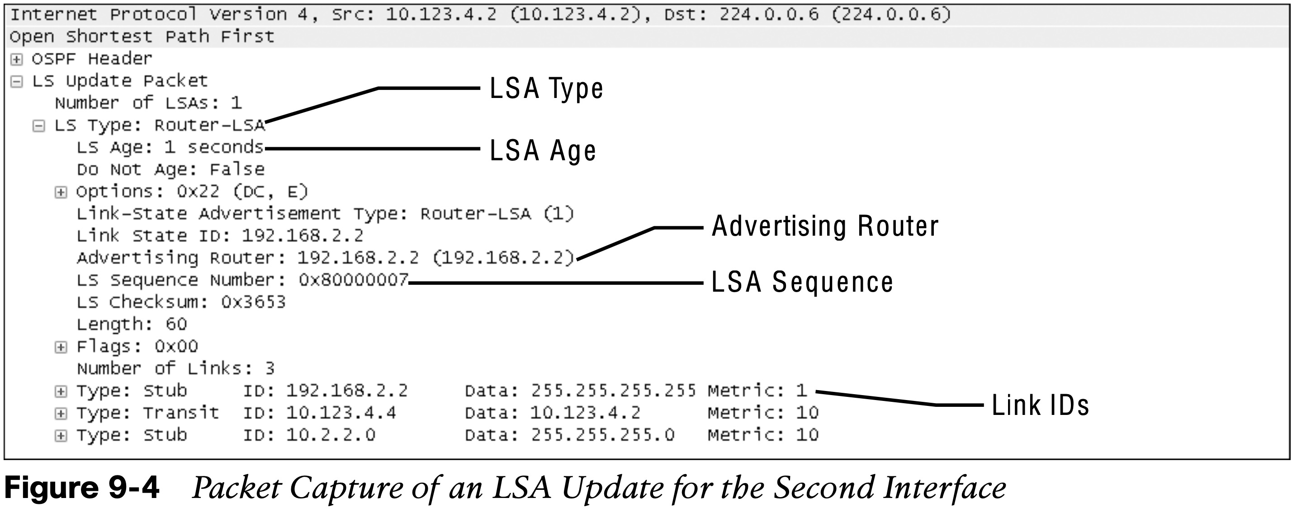
Link-State Announcements Components of the LSA
Components of the LSA include the LSA type, LSA age, sequence number, and advertising router.
LSA age and flooding: Every OSPF LSA includes an age that is entered into the local LSDB and that will increment by 1 every second. When a router’s OSPF LSA age exceeds 1800 seconds (30 minutes) for its networks, the originating router advertises a new LSA with the LSA age set to 0. The LSA is deemed invalid if age reaches 3600.
LSA sequences: OSPF uses the sequence number to overcome problems caused by delays in LSA propagation in a network. The LSA sequence number is a 32-bit number for controlling versioning.
LSA types: All routers within an OSPF area have an identical set of LSAs for that area. The ABRs maintain a separate set of LSAs for each OSPF area.

Slide 15
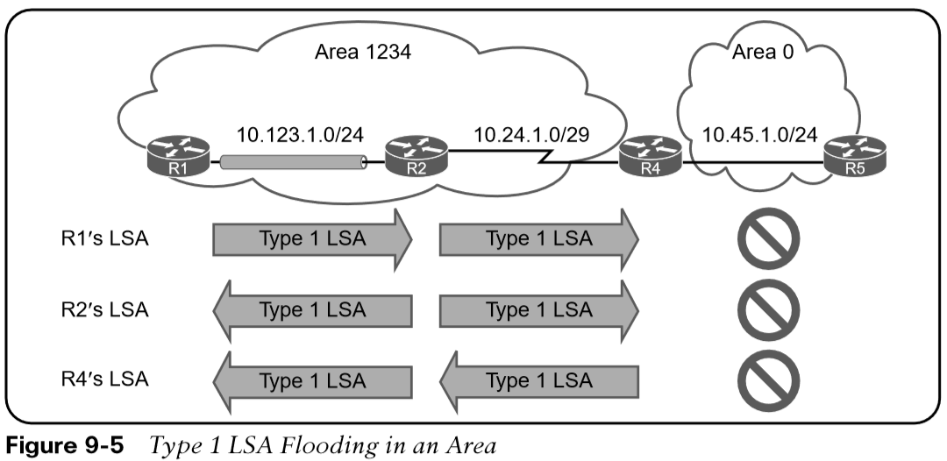
Link-State Announcements LSA Type 1: Router Link
Every OSPF router advertises a type 1 LSA. Type 1 LSAs are the essential building blocks within the LSDB. A type 1 LSA entry exists for each OSPF-enabled link. Type 1 LSAs for an area are shown with the command show ip ospf database router.
Figure 9-5 shows that in this example, the type 1 LSAs are not advertised outside Area 1234, which means the underlying topology in an area is invisible to other areas.
The initial fields of each type 1 LSA indicate the RID for the LSA’s advertising router, age, sequence, link count, and link ID. Every OSPF-enabled interface is listed under the number of links for each router.

Slide 16
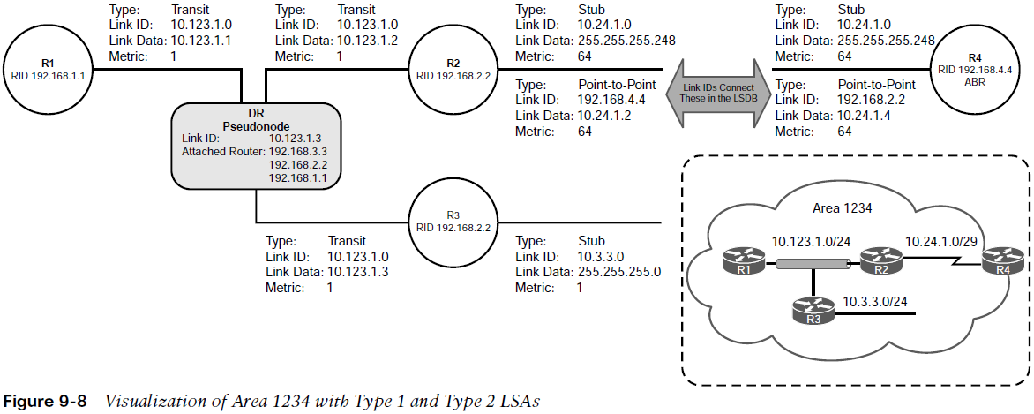
Link-State Announcements LSA Type 2: Network Link
A type 2 LSA represents a multi-access network segment that uses a DR. The DR always advertises the type 2 LSA and identifies all the routers attached to that network segment. If a DR has not been elected, a type 2 LSA is not present in the LSDB because the corresponding type 1 transit link type LSA is a stub. Like type 1 LSAs, type 2 LSAs are not flooded outside the originating OSPF area.
Detailed type 2 LSA information is shown with the command
show ip ospf database network.

Slide 17
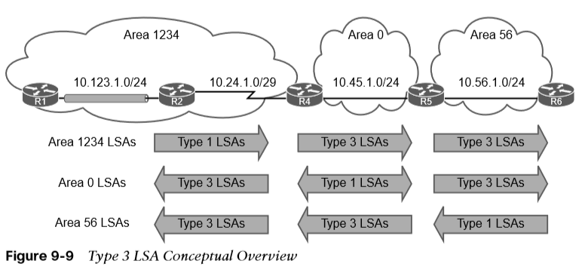
Link-State Announcements LSA Type 3: Summary Link
Type 3 LSAs represent networks from other areas. The role of the ABRs is to participate in multiple OSPF areas and ensure that the networks associated with type 1 LSAs are reachable in the non-originating OSPF areas. Figure 9-9 demonstrates the concept of a type 3 LSA interaction with type 1 LSAs.

Slide 18
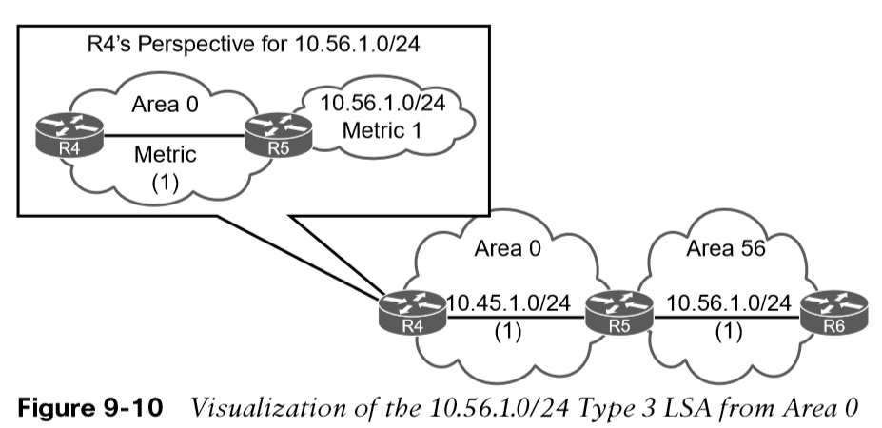
Link-State Announcements LSA Type 3: Summary Link (Cont.)
The advertising router for type 3 LSAs is the last ABR that advertises the prefix. The metric within the type 3 LSA uses the following logic:
If the type 3 LSA is created from a type 1 LSA, it is the total path metric to reach the originating router in the type 1 LSA.
If the type 3 LSA is created from a type 3 LSA from Area 0, it is the total path metric to the ABR plus the metric in the original type 3 LSA.
The type 3 LSA contains the link-state ID (network number), the subnet mask, the IP address of the advertising ABR, and the metric for the network prefix.
Figure 9-10 provides R4’s perspective of the type 3 LSA created by ABR (R5) for the 10.56.1.0/24 network. The total path metric to 10.56.1.0/24 is 2.

Slide 19
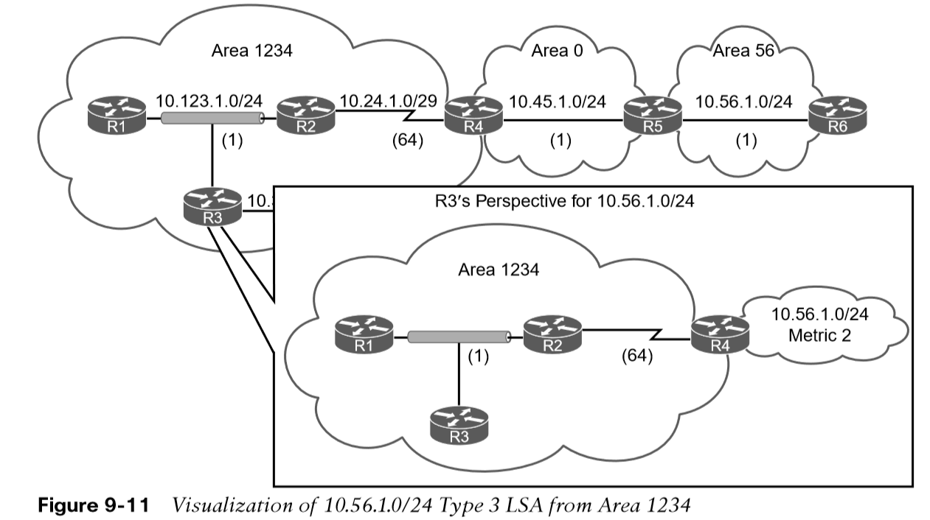
Link-State Announcements LSA Type 3: Summary Link (Cont.)
Figure 9-11 provides R3’s perspective of the type 3 LSA created by ABR (R4) for the 10.56.1.0/24 network.
R3 does not know if the 10.56.1.0/24 network is directly attached to the ABR (R4) or multiple hops away.
R3 knows that its metric to the ABR (R4) is 65 and that the type 3 LSA already has a metric of 2, so its total path metric to reach the 10.56.1.0/24 network is 67.

Slide 20
Discontiguous Networks
This section will cover an example of a discontiguous network.
The simplest fix for a discontiguous network is to ensure that Area 0 is contiguous.

Slide 21
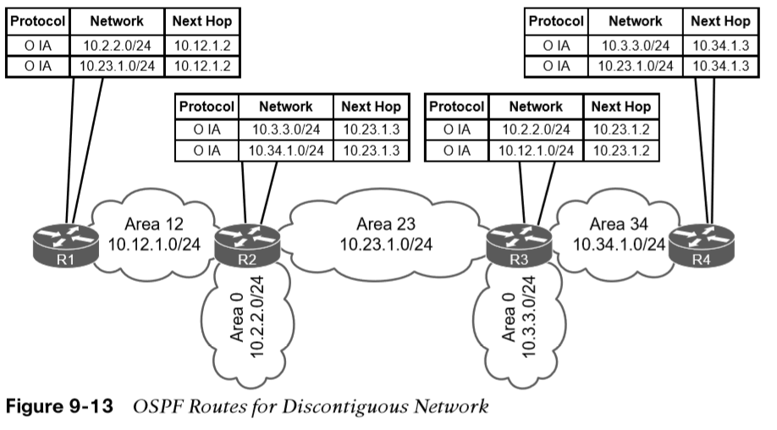
Discontiguous Network Discontiguous Network Example
An OSPF network with this design is discontiguous because interarea traffic is trying to cross a nonbackbone area.
It looks like routes in the routing tables on R2 and R3 in Figure 9-13 are being advertised across area 23. The 10.34.1.0/24 network was advertised into OSPF by R3 and R4 as a type 1 LSA. R3 is an ABR and converts Area 34’s 10.34.1.0/24 type 1 LSA into a type 3 LSA in Area 0. R3 uses the type 3 LSA from Area 0 to generate the type 3 LSA for Area 23. R2 is able to install the type 3 LSA from Area 23 into its routing table.
Note: To assume that the 10.34.1.0/24 route learned by Area 23 would then advertise into R2’s Area 0 and then propagate to Area 12, would be wrong.

Slide 22
Discontiguous Network Rules ABRs Use for Creating Type 3 LSAs
There are three fundamental rules ABRs use the for creating type 3 LSAs:
Type 1 LSAs received from an area create type 3 LSAs into the backbone area and nonbackbone areas.
Type 3 LSAs received from Area 0 are created for the nonbackbone area.
Type 3 LSAs received from a nonbackbone area only insert into the LSDB for the source area. ABRs do not create a type 3 LSA for the other areas (including a segmented Area 0).
The simplest fix for a discontiguous network is to ensure that Area 0 is contiguous. There are other functions, like virtual link or usage of GRE tunnels that are not covered in this course.
Real-life scenarios of discontiguous networks involve Area 0 becoming partitioned due to hardware failures.

Slide 23
OSPF Path Selection
OSPF executes Dijkstra’s shortest path first (SPF) algorithm to create a loop-free topology of shortest paths.
All routers use the same logic to calculate the shortest path for each network.
Path selection prioritizes paths by using the following logic: intra-area, interarea, and external routes (which involves additional logic and not covered here)

Slide 24
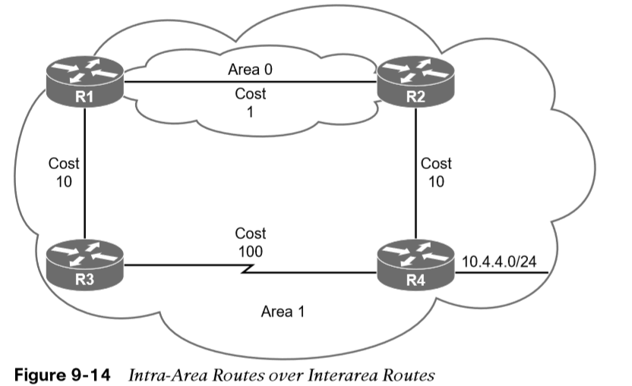
OSPF Path Selection Intra-Area Routes
Routes advertised via a type 1 LSA for an area are always preferred over type 3 LSAs. If multiple intra-area routes exist, the path with the lowest total path metric is installed in the OSPF Routing Information Base (RIB), which is then presented to the router’s global RIB. If there is a tie in metric, both routes install into the OSPF RIB.
In Figure 9-14, R1 is computing the route to 10.4.4.0/24. Instead of taking the faster Ethernet connection, R1 takes the path across the slower serial link to R4 because that is the intra-area path.
In Example 9-6, notice that the metric is 111 and that the intra-area path was selected over the interarea path with the lower total path metric.

Slide 25
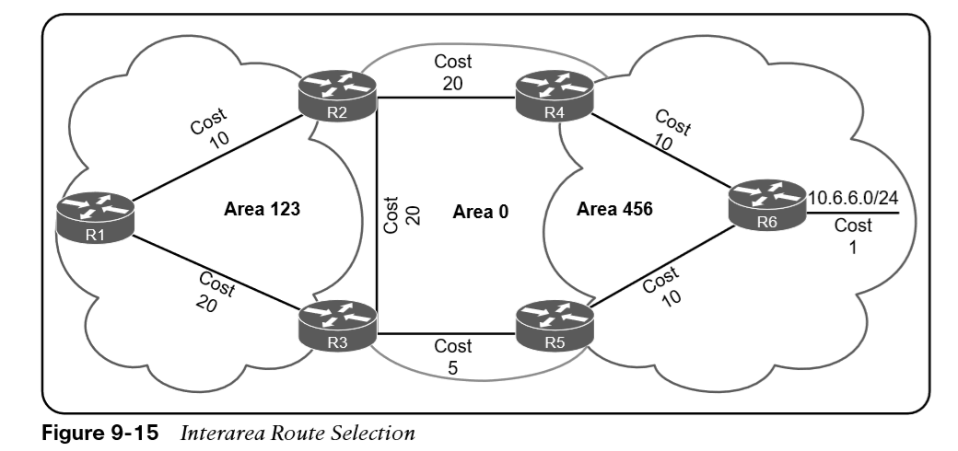
OSPF Path Selection Interarea Routes and Equal Cost Multipathing
The next priority for selecting a path to a network is selection of the path with the lowest total path metric to the destination. If there is a tie in metric, both routes install into the OSPF RIB. All interarea paths for a route must go through Area 0 to be considered.
In Figure 9-15, R1 is computing the path to R6. R1 uses the path R1–R3–R5–R6 because its total path metric is 35 versus the R1–R2–R4–R6 path, with a metric of 40.
If OSPF identifies multiple paths in the path selection algorithms, those routes are installed into the routing table as equal-cost multipathing (ECMP) routes. The default maximum number of ECMP paths is four paths.

Slide 26
Summarization of Routes
Route scalability is a large factor for the IGP routing protocols used by service providers because there can be thousands of routers running in a network.
Splitting up an OSPF routing domain into multiple areas reduces the size of the LSDB for each area.
While the number of routers and networks remains the same within the OSPF routing domain, the detailed type 1 and type 2 LSAs are exchanged for simpler type 3 LSAs.

Slide 27
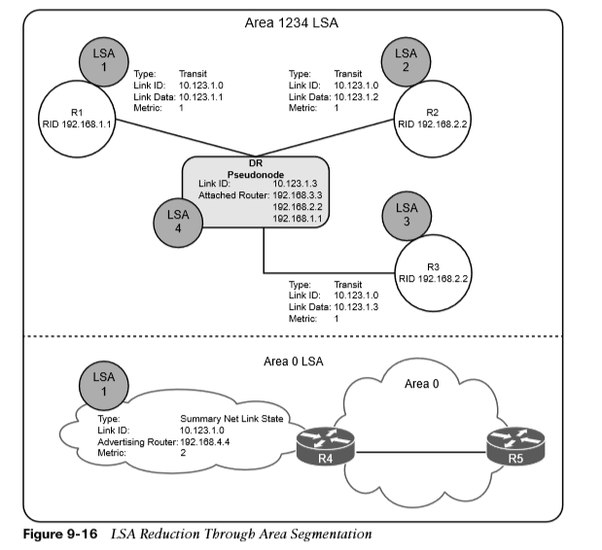
Summarization of Routes Summarization of Routes Example
Referencing our topology for LSAs, in Figure 9-16 for Area 1234, there are three type 1 LSAs and one type 2 LSA for the 10.123.1.0/24 network.
Those four LSAs become one type 3 LSA outside Area 1234.
This illustrates the reduction of LSAs through area segmentation for the 10.123.1.0/24 network.

Slide 28
Summarization of Routes Summarization Fundamentals
Another method of shrinking the LSDB involves summarizing network prefixes. An OSPF area needs to accommodate the smallest and slowest router in that area.
Summarization of routes also helps SPF calculations run faster. Because all routers within an area must maintain an identical copy of the LSDB, summarization occurs between areas on the ABRs.
Summarization can eliminate the SPF calculation outside the area for the summarized prefixes because the smaller prefixes are hidden.

Slide 29
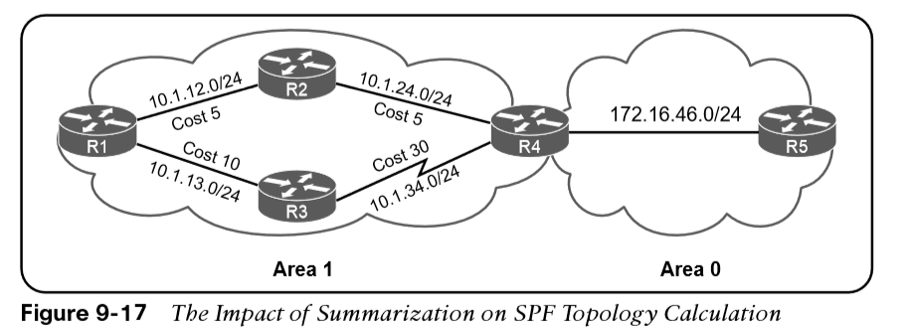
Summarization of Routes Summarization Fundamentals (Cont.)
Figure 9-17 provides a simple network topology where the serial link between R3 and R4 adds to the path metric, and all traffic uses the other path to reach the 172.16.46.0/24 network. If the 10.1.12.0/24 link fails, all routers in Area 1 have to run SPF calculations. R4 identifies that the 10.1.13.0/24 and 10.1.34.0/24 networks will change their next hop through the serial link. Both of the type 3 LSAs for these networks need to be updated with new path metrics and advertised into Area 0. The routers in Area 0 run an SPF calculation only on those two prefixes.

Slide 30
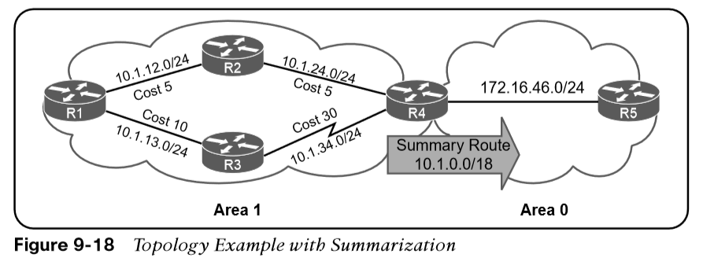
Summarization of Routes Summarization Fundamentals (Cont.)
Figure 9-18 shows the networks in Area 1 being summarized at the ABR into the aggregate 10.1.0.0/18 prefix. If the 10.1.12.0/24 link fails, all the routers in Area 1 still run the SPF calculation, but routers in Area 0 are not impacted because the 10.1.13.0/24 and 10.1.34.0/24 networks are not known outside Area 1.

Slide 31
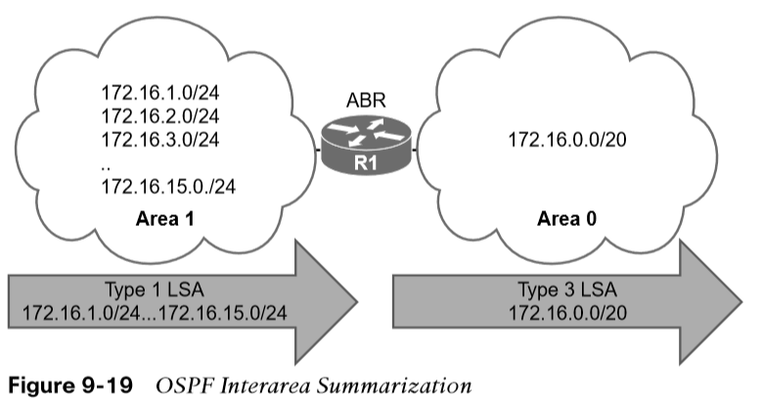
Summarization of Routes Interarea Summarization
Interarea summarization reduces the number of type 3 LSAs that an ABR advertises into an area when it receives type 1 LSAs.
The network summarization range is associated with a specific source area for type 1 LSAs.
When a type 1 LSA within the summarization range reaches the ABR from the source area, the ABR creates a type 3 LSA for the summarized network range.
The ABR suppresses the more specific type 3 LSAs, thereby preventing the generation of the subordinate route’s type 3 LSAs. Interarea summarization does not impact the type 1 LSAs in the source area.
Summarization works only on type 1 LSAs and is normally configured so that summarization occurs as routes enter the backbone from nonbackbone areas.
Figure 9-19 shows 15 type 1 LSAs (172.16.1.0/24 through 172.16.15.0/24) being summarized into one type 3 LSA (the 172.16.0.0/20 network).

Slide 32
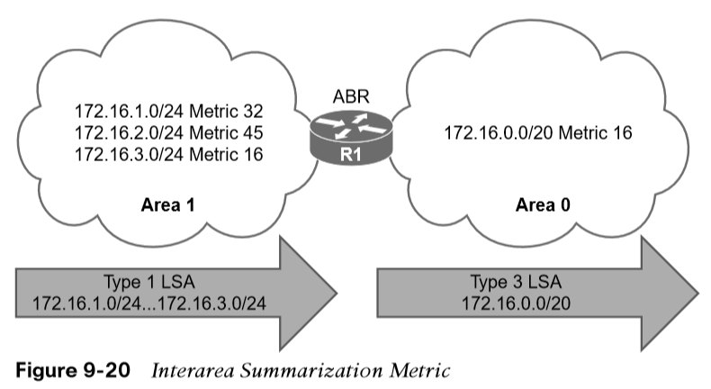
Summarization of Routes Summarization Metrics
The default metric for the summary LSA is the smallest metric associated with an LSA. However, it can be set as part of the configuration.
OSPF behaves identically to Enhanced Interior Gateway Routing Protocol (EIGRP) and checks every prefix within the summarization range when a matching type 1 LSA is added or removed. If a lower metric is available, the summary LSA is advertised with the newer metric; if the lowest metric is removed, a newer and higher metric is identified, and a new summary LSA is advertised with the higher metric.
In Figure 9-20, R1 summarizes three prefixes with various path costs.

Slide 33
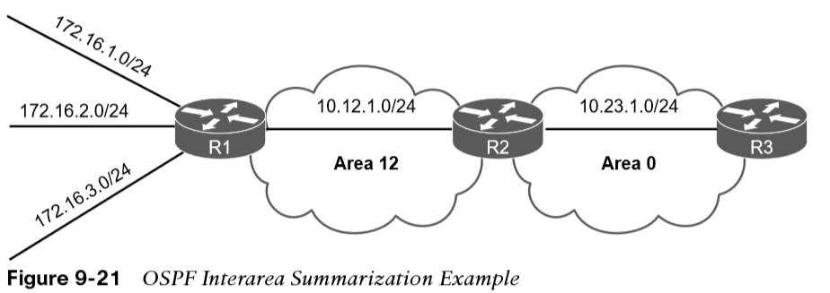
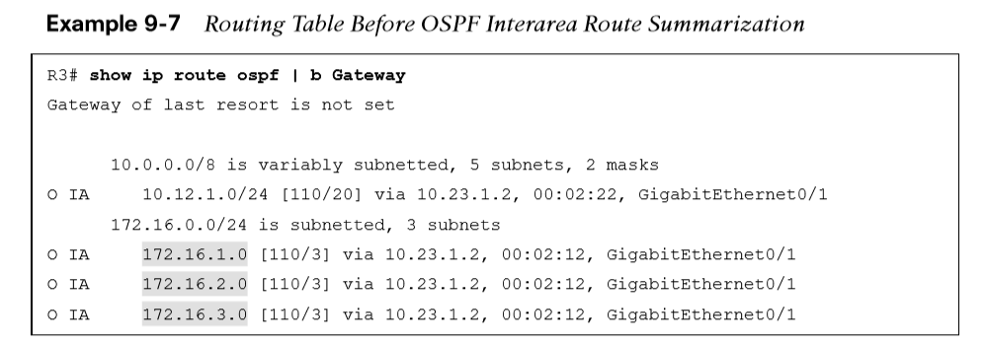
Summarization of Routes Configuration of Interarea Metrics
To define the summarization range and associated area, use the command area area-id range network subnet-mask [advertise | not-advertise] [cost metric] under the OSPF process on the ABR.
The default behavior is to advertise the summary prefix, so the keyword advertise is not necessary.
Appending the cost metric keyword to the command statically sets the metric on the summary route.
Figure 9-21 provides a topology example in which R1 is advertising the 172.16.1.0/24, 172.16.2.0/24, and 172.16.3.0/24 networks.
Example 9-7 displays the routing table on R3 before summarization. Notice that the 172.16.1.0/24, 172.16.2.0/24, and 172.16.3.0/24 networks are all present.

Slide 34
Summarization of Routes Configuration of Interarea Metrics (Cont.)
Example 9-8 provides R2’s configuration for interarea summarization into an aggregate route of 172.16.0.0/16. A static cost of 45 is added to the summary route to reduce CPU load if any of the three networks flap.
Example 9-9 displays R3’s routing table for verification that the smaller routes were suppressed while the summary route was aggregated. Notice that the path metric is 46, whereas previously the metric for the 172.16.1.0/24 network was 3.

Slide 35
Summarization of Routes Configuration of Interarea Metrics (Cont.)
The ABR performing interarea summarization installs a discard route. The discard route is a route to the Null0 interface that matches the summarized network range. Discard routes prevent routing loops where portions of the summarized network range do not have a more specific route in the RIB. The AD for the OSPF summary discard route for internal networks is 110, and it is 254 for external networks.
Example 9-10 shows the discard route on R2 for the 172.16.0.0/16 prefix.

Slide 36
Route Filtering
Route filtering is a method for selectively identifying routes that are advertised or received from neighbor routers.
Route filtering may be used to manipulate traffic flows, reduce memory utilization, or improve security.
Filtering of routes with vector-based routing protocols is straightforward as the routes are filtered as routing updates are advertised to downstream neighbors.
With link-state routing protocols such as OSPF, every router in an area shares a complete copy of the linkstate database. Therefore, filtering of routes generally occurs as routes enter the area on the ABR.

Slide 37
Route Filtering Filtering with Summarization
One of the easiest methodologies for filtering routes is to use the not-advertise keyword during prefix summarization. This prevents creation of any type 3 LSAs for any networks in that range, thus making the subordinate routes visible only within the area where the route originates.
The full command structure is area area-id range network subnet-mask not-advertise under the OSPF process.
In the configuration in 9-11 we see that R2 can filter out any of the type 1 LSAs that are generated in Area 12 from being advertised into Area 0.
Example 9-12 shows R3’s routing table after the area filtering configuration has been placed on R2.

Slide 38
Route Filtering Area Filtering
Although filtering via summarization is very easy, it is limited in its ability. For example, in Figure 9-22, if the 172.16.1.0/24 network needs to be present in Area 0 but removed in Area 34, it is not possible to filter the route using summarization.

Slide 39
Route Filtering Area Filtering (Cont.)
Other network designs require filtering of OSPF routes based on other criteria. OSPF supports filtering when type 3 LSA generation occurs, allowing for the original route to be installed in the LSDB for the source area so that the route can be installed in the RIB of the ABR. Filtering can occur in either direction on the ABR. Figure 9-23 demonstrates the concept.
Figure 9-24 expands on the sample topology and demonstrates that the ABR can filter routes as they advertise out of an area or into an area.

Slide 40
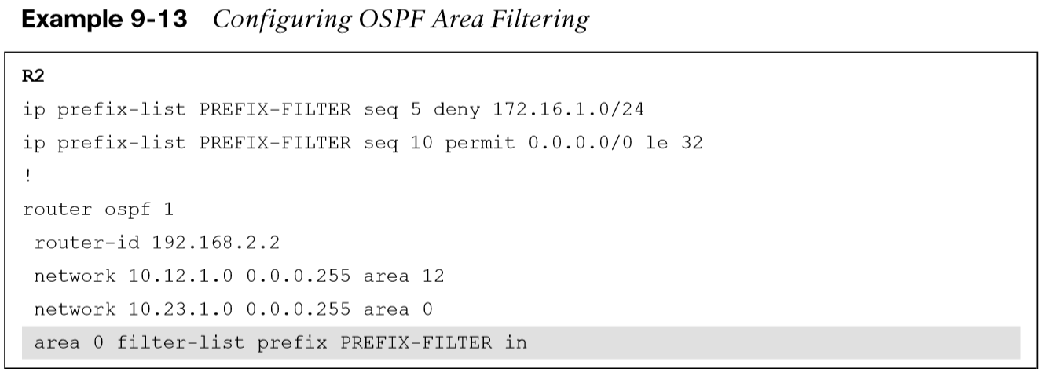
Route Filtering Area Filtering (Cont.)
OSPF area filtering is accomplished by using the command area area-id filter-list prefix prefix-list-name {in | out} on the ABR. Example 9-13 provides a configuration for R2 and R3.

Slide 41
Route Filtering Local OSPF Filtering
In some scenarios, routes need to be removed only on specific routers in an area. OSPF is a link-state protocol that requires all routers in the same area to maintain an identical copy of the LSDB for that area. A route can exist in the OSPF LSDB, but it could be prevented from being installed in the local RIB. This is accomplished by using a Distribute List.
Figure 9-25 illustrates this concept.

Slide 42
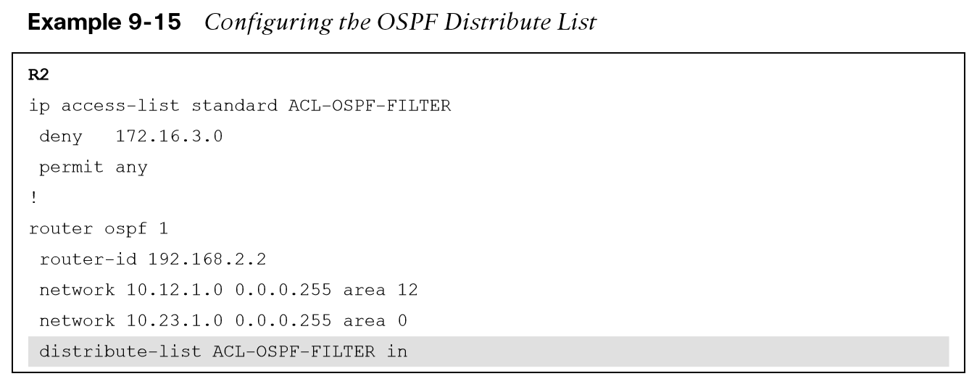
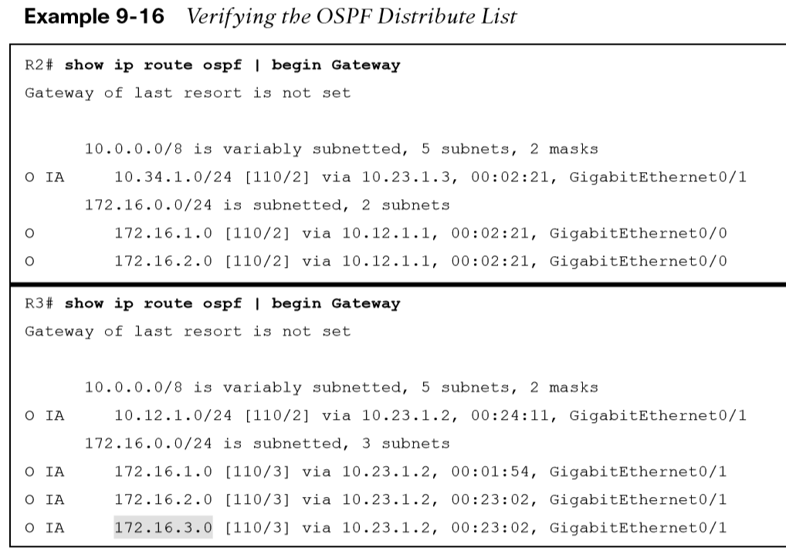
Route Filtering Configuring the OSPF Distribute List
A distribute list is configured under the OSPF process with the command distribute-list {acl-number | acl-name | prefix prefix-list-name | route-map route-map-name} in.
Example 9-16 shows the routing tables for R2 and R3. The 172.16.3.0/24 network is removed from R2’s RIB but is present on R3’s RIB.

Slide 43
Prepare for the Exam

Slide 44
Prepare for the Exam Key Topics for Chapter 9
Description
Area 0 backbone
Area border routers
Area ID
Link-state announcements
Type 1 LSA Flooding in an Area
Visualization of Type 1 LSAs
LSA type 2: network link
Visualization of Area 1234 with Type 1 and Type 2 LSAs

Slide 45
Prepare for the Exam Key Topics for Chapter 9 (Cont.)
Description
LSA type 3 summary link
Type 3 LSA Conceptual
ABR rules for type 3 LSAs
OSPF path selection
Summarization of routes
Interarea summarization
Configuration of interarea summarization
OSPF Area Filtering
OSPF Distribute List Filtering Logic

Slide 46
Prepare for the Exam Key Terms for Chapter 9
Term
area border router (ABR)
backbone area
discontiguous network
interarea route
intra-area route
router LSA
summary LSA

Slide 47
Prepare for the Exam Command Reference for Chapter 9
Task | Command Syntax
Initialize the OSPF process | router ospf process-id
Summarize routes as they are crossing an OSPF ABR | area area-id range network subnet-mask [advertise | not-advertise] [cost metric]
Filter routes as they are crossing an OSPF ABR | area area-id filter-list prefix prefix-list-name {in | out}
Filter OSPF routes from entering the RIB | distribute-list {acl-number | acl-name | prefix prefix-list-name | route-map route-map-name} in
Display the LSAs in the LSDB | show ip ospf database [router | network | summary]

