Slide 1
Chapter 5: VLAN Trunks and EtherChannel Bundles
Instructor Materials
CCNP Enterprise: Core Networking

Slide 2
Chapter 5 Content
This chapter covers the following content:
VLAN Trunking Protocol (VTP) - This section provides an overview of how switches become aware of other switches and prevent forwarding loops.
Dynamic Trunking Protocol (DTP) - This section examines the improvements made to STP for faster convergence.
EtherChannel Bundle -This section explains how multiple physical interfaces can be combined to form a logical interface to increase throughput and provide seamless resiliency.

Slide 3
VLAN Trunking Protocol
Cisco created the proprietary protocol, VLAN Trunking Protocol (VTP), to reduce the burden of provisioning VLANs on switches.
Switches that participate in the same VTP domain can have a VLAN created once on a VTP server and propagated to other VTP client switches in the same VTP domain.

Slide 4
VLAN Trunking Protocol The Roles of VTP
There are four roles in the VTP architecture:
VTP Roll | Description
Server | The server switch is responsible for the creation, modification, and deletion of VLANs within the VTP domain.
Client | The client switch receives VTP advertisements and modifies the VLANs on that switch. VLANs cannot be configured locally on a VTP client.
Transparent | VTP transparent switches receive and forward VTP advertisements but do not modify the local VLAN database. VLANs are configured only locally.
Off | A switch does not participate in VTP advertisements and does not forward them out of any ports either. VLANs are configured only locally.

Slide 5
VLAN Trunking Protocol The Versions of VTP
There are three versions of VTP:
Version 1 is default.
Versions 1 and 2 have limited propagation to VLANs numbered 1 to 1005.
VTP Version 3 allows for the full range of VLANs 1 to 4094.
VTP supports having multiple VTP servers in a domain. These servers process updates from other VTP servers just as a client does.
If a VTP domain is Version 3, the primary VTP server must be set with the executive command vtp primary.

Slide 6
VLAN Trunking Protocol VTP Communication
VTP advertises updates by using a multicast address across the trunk links for advertising updates to all the switches in the VTP domain. The three main types of VTP advertisements:
Communication Types | Description
Summary | This advertisement occurs every 300 seconds or when a VLAN is added, removed, or changed. It includes the VTP version, domain, configuration revision number, and time stamp.
Subset | This advertisement occurs after a VLAN configuration change occurs. It contains all the relevant information for the switches to make changes to the VLANs on them.
Client Requests | This advertisement is a request by a client to receive the more detailed subset advertisement. This occurs when a switch with a lower revision number joins the VTP domain and observes a summary advertisement with a higher revision than it has stored locally.

Slide 7
VLAN Trunking Protocol VTP Configuration
The following are the steps for configuring VTP:
Terms | Description
Step 1 | Define the VTP version with the command vtp version {1 | 2 | 3}.
Step 2 | Define the VTP domain with the command vtp domain domain-name. Changing the VTP domain resets the local switch’s version to 0.
Step 3 | Define the VTP switch role with the command vtp mode { server | client | transparent | none }
Step 4 | (Optional) Secure the VTP domain with the command vtp password password (This step is optional but recommended because it helps prevent unauthorized switches from joining the VTP domain.)

Slide 8
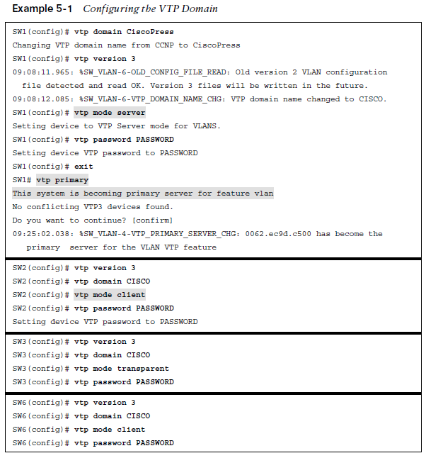
VLAN Trunking Protocol VTP Configuration Example
Example 5-1 demonstrates the VTP configuration on SW1, SW2, SW3, and SW6.
The figure shows sample configurations for three of the VTP roles: SW1 as a client, SW3 as transparent, and the other switches as VTP clients.

Slide 9
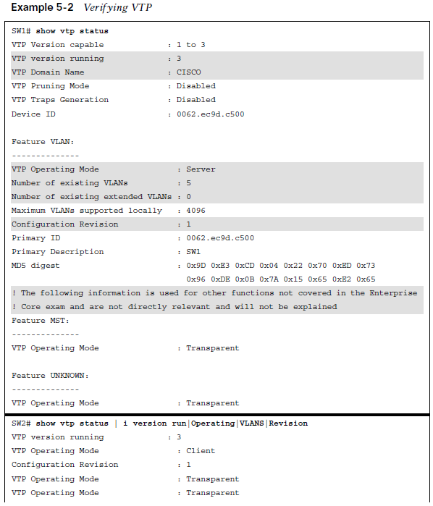
VLAN Trunking Protocol VTP Verification
The VTP status is verified with the command show vtp status as shown in the example.
The most important information displayed is the VTP version, VTP domain name, VTP mode, the number of VLANs (standard and extended), and the configuration version.

Slide 10
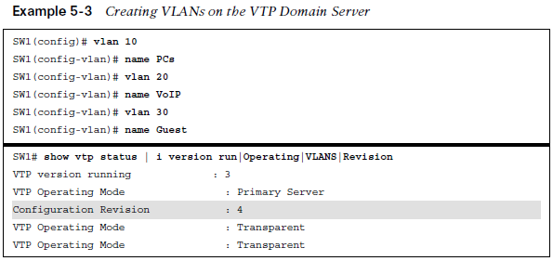
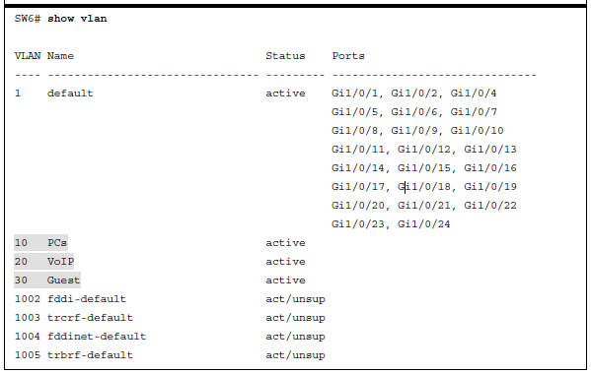
VLAN Trunking Protocol VTP Verification (Cont.)
It is very important that every switch that connects to a VTP domain has the VTP revision number reset to 0. Failing to reset the revision number on a switch could result in the
switch providing an update to the VTP server.
This is not an issue if VLANs are added but is
catastrophic if VLANs are removed because those VLANs will be removed throughout the
domain.

Slide 11
Dynamic Trunking Protocol
Dynamic trunk ports are established by the switch port sending Dynamic Trunking Protocol (DTP) packets to negotiate whether the other end can be a trunk port.
DTP advertises itself every 30 seconds to neighbors so that they are kept aware of its status. DTP requires that the VTP domain match between the two switches.

Slide 12
Dynamic Trunking Protocol DTP Modes
Trunk - The command switchport mode trunk statically places the switch port as a trunk. This mode advertises DTP packets to the other end to establish a dynamic trunk.
Dynamic desirable - Using the command switchport mode dynamic desirable, the switch port acts as an access port, but listens for and advertises DTP packets to the other end to establish a dynamic trunk. If it is successful in negotiation, the port becomes a trunk port.
Dynamic auto: Using the command switchport mode dynamic auto, the switch port acts as an access port, but it listens for DTP packets. It responds to DTP packets and upon successful negotiation the port becomes a trunk port.
Terms | Trunk | Dynamic Desirable | Dynamic Auto
Trunk | ✓ | ✓ | ✓
Dynamic Desirable | ✓ | ✓ | ✓
Dynamic Auto | ✓ | ✓ | X

Slide 13
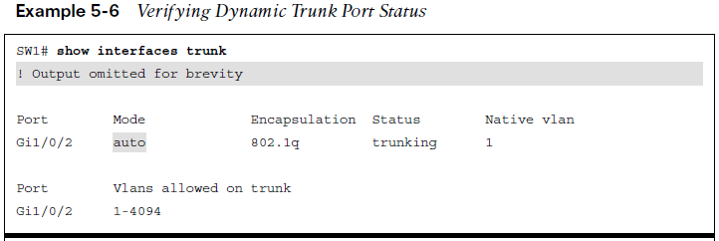
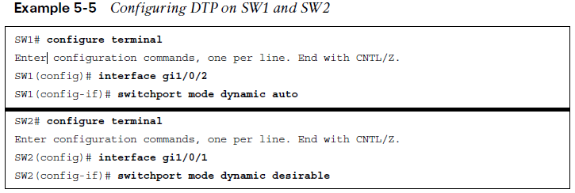
Dynamic Trunking Protocol DTP Mode Configuration
Example 5-5 shows the configuration of DTP on SW1’s Gi1/0/2 as a dynamic auto switch port and SW2’s Gi1/0/1 as a dynamic desirable switch port.
The trunk port status is verified with the command show interface [interface-id] trunk, as shown in Example 5-6.

Slide 14
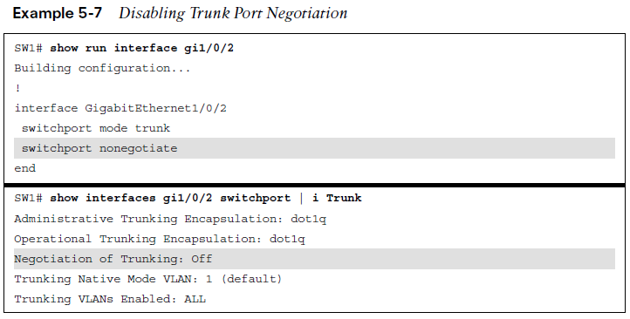
Dynamic Trunking Protocol DTP Mode Off Configuration
A static trunk port attempts to establish and negotiate a trunk port with a neighbor by default.
However, the interface configuration command switchport nonegotiate prevents that port from forming a trunk port. Example 5-7 demonstrates the use of this command. The setting is then verified by looking at the switch port status. Negotiation of Trunk now displays as Off.
Note: As a best practice, configure both ends of a link as a fixed port type (using switchport mode access or switchport mode trunk) to remove any uncertainty about the port’s
operations.

Slide 15
EtherChannel Bundle
Ethernet network speeds are based on powers of 10 (10 Mbps, 100 Mbps, 1 Gbps, 10 Gbps,100 Gbps).
When a link between switches becomes saturated, how can more bandwidth be added to that link to prevent packet loss?

Slide 16
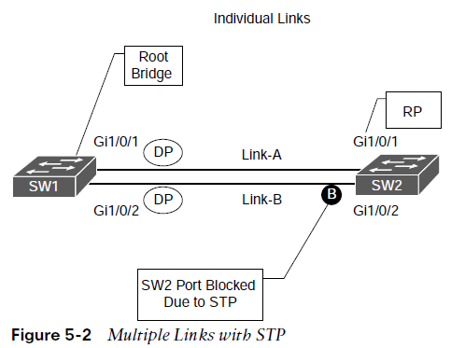
EtherChannel Bundle Multiple Links
Ideally, it would be nice to plug in a second cable and double the bandwidth between the switches. However, Spanning Tree Protocol (STP) will place one of the ports into a blocking state to prevent forwarding loops, as shown in Figure 5-2.

Slide 17
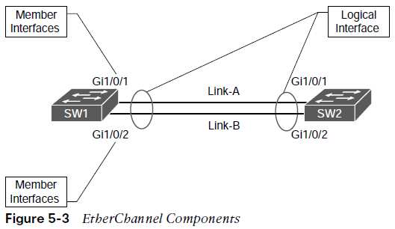
EtherChannel Bundle EtherChannel Components
Figure 5-3 shows some of the key components of an EtherChannel bundle between SW1 and SW2, with their Gi1/0/1 and Gi1/0/2 interfaces.
The physical links can be aggregated into a logical link called an EtherChannel bundle.

Slide 18
EtherChannel Bundle EtherChannel Components (Cont.)
Aspects of EtherChannel:
Etherchannel is defined in the IEEE 802.3AD link aggregation specification.
STP operates on a logical link and not on a physical link.
The logical link will have the bandwidth of any active member interfaces.
It will load balanced across all the links.
EtherChannels can be used for either Layer 2 (access or trunk) or Layer 3 links.
The terms EtherChannel, EtherChannel bundle, and port channel are interchanged frequently on the Catalyst platform, but other Cisco platforms only use the term port channel exclusively.

Slide 19
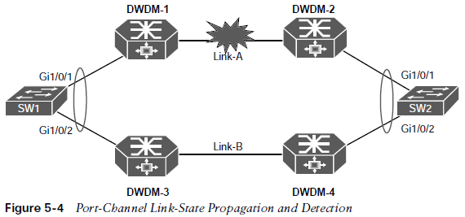
EtherChannel Bundle EtherChannel Link-State
EtherChannel may be created statically or dynamically.
Static EtherChannel does not have a health integrity check. If the physical medium degrades and keeps the line protocol in an up state, the port channel will reflect that link as viable for transferring data.
A common scenario involves the use of intermediary devices and technologies (for example, powered network taps, IPSs, Layer 2 firewalls, DWDM) between devices. It is critical for the link state to be propagated to the other side.

Slide 20
EtherChannel Bundle Dynamic Link Aggregation Protocols
Two common link aggregation protocols are Link Aggregation Control Protocol (LACP) and Port Aggregation Protocol (PAgP).
PAgP is Cisco proprietary and was developed first.
LACP was created as an open industry standard.
All the member links must participate in the same protocol on the local and remote switches.

Slide 21
EtherChannel Bundle PAgP Port Modes
PAgP advertises messages with the multicast MAC address 0100:0CCC:CCCC and the protocol code 0x0104. PAgP can operate in two modes:
PAgP Port Modes | Description
Auto | The interface does not initiate an EtherChannel to be established and does not transmit PAgP packets out of it. If an PAgP packet is received from the remote switch, this interface responds and then can establish a PAgP adjacency. If both devices are PAgP auto, a PAgP adjacency does not form.
Desirable | An interface tries to establish an EtherChannel and transmit PAgP packets out of it. Active PAgP interfaces can establish a PAgP adjacency only if the remote interface is configured to auto or desirable.

Slide 22
EtherChannel Bundle LACP Port Modes
LACP advertises messages with the multicast MAC address 0180:C200:0002. LACP can operate in two modes:
LACP Port Modes | Description
Passive | An interface does not initiate an EtherChannel to be established and does not transmit LACP packets out of it. If an LACP packet is received from the remote switch, this interface responds and then can establish an LACP adjacency. If both devices are LACP passive, an LACP adjacency does not form.
Active | An interface tries to establish an EtherChannel and transmit LACP packets out of it. Active LACP interfaces can establish an LACP adjacency only if the remote interface is configured to active or passive.

Slide 23
EtherChannel Bundle EtherChannel Configurations
It is possible to configure EtherChannels by going into the interface configuration mode for the member interfaces and assigning them to an EtherChannel ID and configuring the appropriate mode:
Static EtherChannel: A static EtherChannel is configured with the interface parameter command channel-group etherchannel-id mode on.
LACP EtherChannel: An LACP EtherChannel is configured with the interface parameter command channel-group etherchannel-id mode {active | passive}.
PAgP EtherChannel: A PAgP EtherChannel is configured with the interface parameter command channel-group etherchannel-id mode {auto | desirable} [non-silent].
By default, PAgP ports operate in silent mode, which allows a port to establish an EtherChannel with a device that is not PAgP capable and rarely sends packets.
Using the optional non-silent keyword requires a port to receive PAgP packets before adding it to the EtherChannel, which is recommended.

Slide 24
EtherChannel Bundle EtherChannel Configurations (Cont.)
The following needs to be considered with EtherChannel configuration:
Configuration settings for the EtherChannel are placed in the port-channel interface.
Member interfaces need to be in the appropriate Layer 2 or Layer 3 (that is, no switch port) before being associated with the port channel.

Slide 25
EtherChannel Bundle Verify Port-Channel Status
As shown in Example 5-9, the command show etherchannel summary provides an overview of all the configured EtherChannels, along with the status and dynamic aggregation protocol for each one.
When viewing the output of the show etherchannel summary command, the first thing that should be checked is the EtherChannel status, which is listed in the Port-channel column.
The status should be SU, as highlighted in Example 5-9.
Note: The status codes are case sensitive, so please pay attention to the case of the field.

Slide 26
EtherChannel Bundle EtherChannel Logical Interface Status Fields
Logical EtherChannel Interface Status Fields are as follows:
U - The EtherChannel interface is working properly.
D - The EtherChannel interface is down.
M - The EtherChannel interface has successfully established at least one LACP adjacency; however, the EtherChannel is configured with a minimum number of active interfaces that exceeds the number of active participating member interfaces. Traffic will not be forwarded across this port channel. The command port-channel min-links min-member-interfaces is configured on the port-channel interface.
S - The port-channel interface is configured for Layer 2 switching.
R - The port-channel interface is configured for Layer 3 routing.

Slide 27
EtherChannel Bundle EtherChannel Member Interface Status Fields
EtherChannel Member Interface Status Fields are as follows:
P - The interface is actively participating and forwarding traffic for this port channel.
H - The port-channel is configured with the maximum number of active interfaces. This interface is participating in LACP with the remote peer, but the interface is acting as a hot standby and does not forward traffic. The command lacp max-bundle number-member-interfaces is configured on the port-channel interface.
I - The member interface has not detected any LACP activity on this interface and is treated as an individual.
w - There is time left to receive a packet from this neighbor to ensure that it is still alive.
s - The member interface is in a suspended state.
r - The switch module associated with this interface has been removed from the chassis.

Slide 28
EtherChannel Bundle Port-Channel Interface Status
The logical interface can be viewed with the command show interface port-channel port-channel-id.
The output includes traditional interface statistics and lists the member interfaces and indicates that the bandwidth reflects the combined throughput of all active member interfaces.

Slide 29
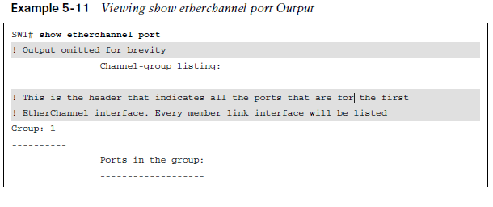
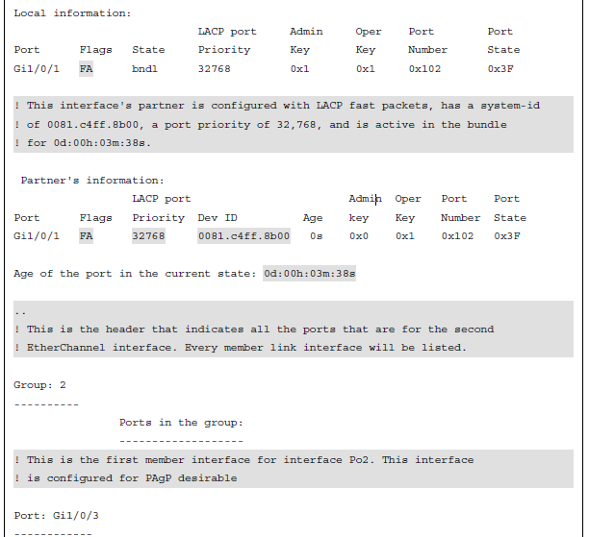
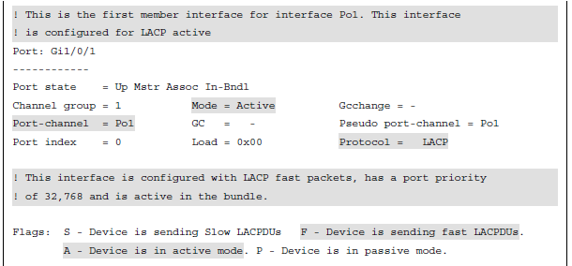
EtherChannel Bundle EtherChannel Neighbors

Slide 30
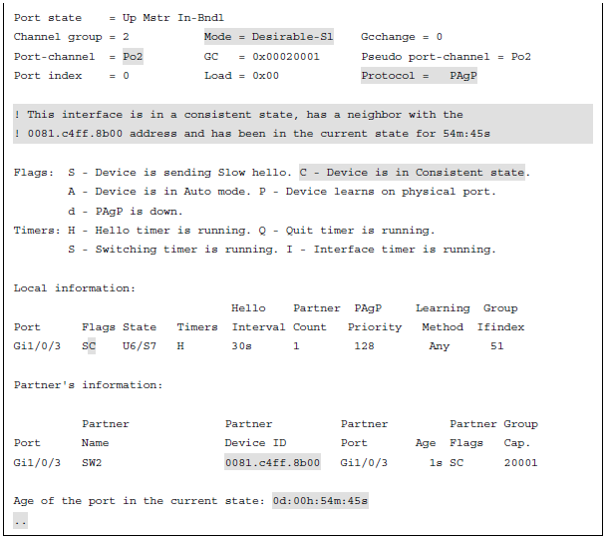
EtherChannel Bundle EtherChannel Neighbors (Cont.)
The output from the show etherchannel port command can provide too much information and slow down troubleshooting when a smaller amount of information is needed.

Slide 31
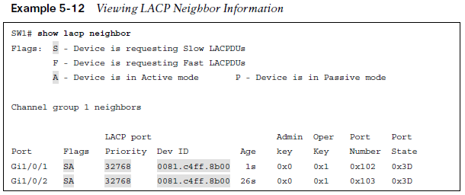
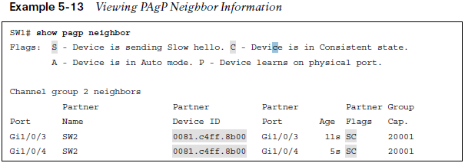
EtherChannel Bundle EtherChannel Neighbors LACP and PAgP
The command show lacp neighbor [detail]
displays additional information about the LACP neighbor and includes the neighbor’s system ID, system priority, and whether it is using fast or slow LACP packet intervals as part of the output.
The command show pagp neighbor displays additional information about the PAgP neighbor
and includes the neighbor’s system ID, remote port number, and whether it is using fast or slow PAgP packet intervals as part of the output.

Slide 32
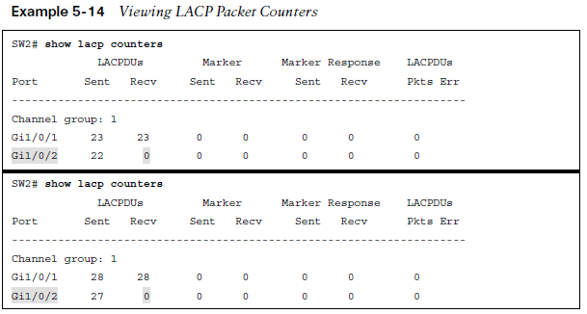
EtherChannel Bundle Verifying EtherChannel Packets LACP and PAgP
A vital step in troubleshooting the establishment of port channels is to verify that LACP or PAgP packets are being transmitted between devices.
The first troubleshooting step that can
be taken is to verify the EtherChannel counters for the appropriate protocol.
The LACP counters can be cleared with the command clear lacp counters. The PAgP counters can be cleared with the command clear pagp counters.

Slide 33
EtherChannel Bundle Advanced LACP Configuration Options
LACP provides some additional tuning that is not available with PAgP.
LACP has the following advanced settings:
LACP Fast
Minimum Number of Port-Channel Member Interfaces
Maximum Number of Port-Channel Member Interfaces
LACP System Priority
LACP Interface Priority

Slide 34
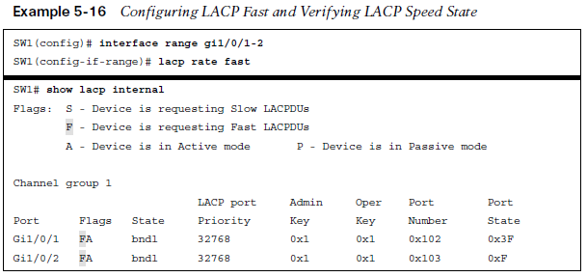
EtherChannel Bundle LACP Fast
The original LACP standards sent out LACP packets every 30 seconds. A link is deemed unusable if an LACP packet is not received after three intervals, 90 seconds.
An amendment to the standards was made so that LACP packets are advertised every 1 second. This is known as LACP fast because a link can be identified and removed in 3 seconds compared to the 90 seconds.
LACP fast is enabled on the member interfaces with the interface configuration command lacp rate fast.
Note: All the interfaces on both switches need to be configured the same (either using LACP fast or LACP slow) for the EtherChannel to successfully come up.

Slide 35
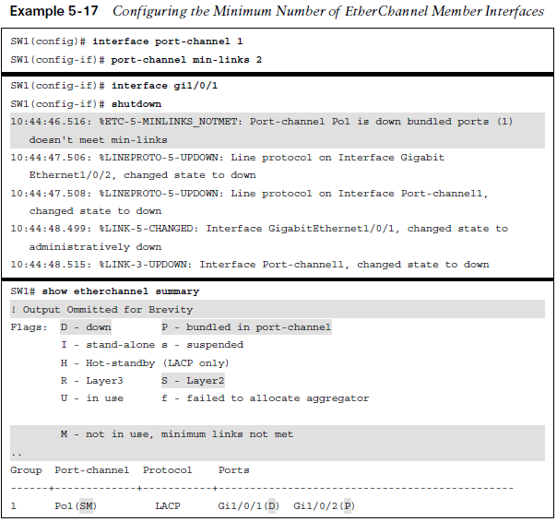
EtherChannel Bundle Minimum Number of Port-Channel Member Interfaces
An EtherChannel interface becomes active and up when only one member interface successfully forms an adjacency with a remote device.
In some design scenarios using LACP, a minimum number of adjacencies is required before a port-channel interface becomes active.
This option can be configured with the port-channel interface command port-channel min-links min-links.
The minimum number of port-channel member interfaces does not need to be
configured on both devices to work properly. However, configuring it on both switches is
recommended to accelerate troubleshooting and assist operational staff.

Slide 36
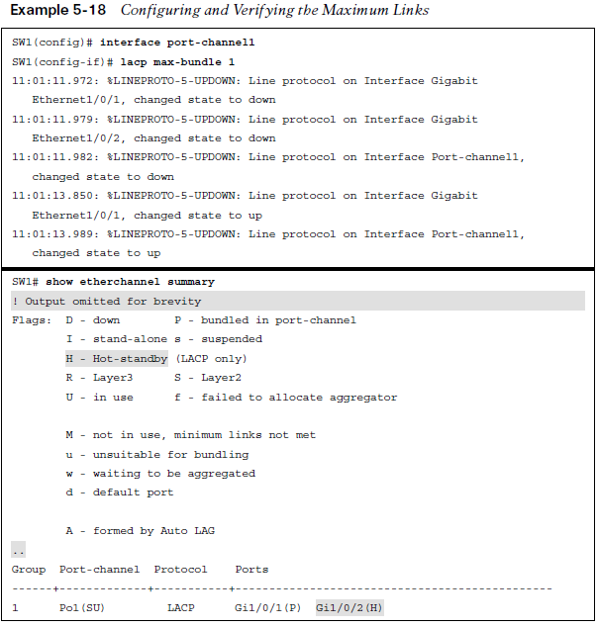
EtherChannel Bundle Maximum Number of Port-Channel Member Interfaces
An EtherChannel can be configured to have a specific maximum number of member interfaces in a port channel.
This may be done to ensure that the active member interface count proceeds with powers of two (for example, 2, 4, 8) to accommodate load-balancing hashes.
The maximum number of member interfaces in a port channel can be configured with the port-channel interface command lacp max-bundle max-links.
The maximum number of port-channel member interfaces needs to be configured only on the master switch for that port channel. However, configuring it on both switches is recommended to accelerate troubleshooting.

Slide 37
EtherChannel Bundle LACP System Priority
The LACP system priority identifies which switch is the master switch for a port channel.
The master switch on a port channel is responsible for choosing which member interfaces are active in a port channel when there are more member interfaces than the maximum number of member interfaces associated with a port-channel interface.
The switch with the lower system priority is preferred.
The LACP system priority can be changed with the command lacp system-priority priority.

Slide 38
EtherChannel Bundle LACP Interface Priority
LACP interface priority enables the master switch to choose which member interfaces are
active in a port channel when there are more member interfaces than the maximum number
of member interfaces for a port channel.
A port with a lower port priority is preferred.
The interface configuration command lacp port-priority priority sets the interface priority.

Slide 39
EtherChannel Bundle Troubleshooting EtherChannel Bundles
A port channel is a logical interface, so all the member interfaces must have the same characteristics. If they do not, problems will occur.
Generally as a rule, when configuring port channels on a switch, place each member interface in the appropriate switch port type (Layer 2 or Layer 3) and then associate the interfaces to a port channel.
All other port-channel configuration is done via the port-channel interface.

Slide 40
EtherChannel Bundle Troubleshooting EtherChannel Bundles
The following configuration settings must match on the member interfaces:
In addition to the matched configuration settings, check the following when troubleshooting the establishment of an EtherChannel bundle:
Ensure that a member link is between only two devices.
Ensure that the member ports are all active.
Ensure that both end links are statically set to on or that either LACP is enabled with at least one side set to active or PAgP is enabled with at least one side set to desirable.
Ensure that all member interface ports are consistently configured (except for LACP port priority).
Verify the LACP or PAgP packet transmission and receipt on both devices.
Match Settings
Port type | Duplex
Port mode | MTU
Native VLAN | Load interval
Allowed VLAN | Storm control
Speed

Slide 41
EtherChannel Bundle Load Balancing Traffic with EtherChannel Bundles
Traffic that flows across a port-channel interface is not forwarded out member links on a round-robin basis per packet.
Instead, a hash is calculated, and packets are consistently forwarded across a link based on that hash, which runs on the various packet header fields.
The load-balancing hash is a system wide configuration that uses the global command port-channel load-balance hash.

Slide 42
EtherChannel Bundle Port-Channel Load Balancing Hash Option
The global command port-channel load-balance hash. The hash option has the following keyword choices:
dst-ip: Destination IP address
dst-mac: Destination MAC address
dst-mixed-ip-port: Destination IP address and destination TCP/UDP port
dst-port: Destination TCP/UDP port
src-dst-ip: Source and destination IP addresses
src-dest-ip-only: Source and destination IP addresses only
src-dst-mac: Source and destination MAC addresses
src-dst-mixed-ip-port: Source and destination IP addresses and source and destination TCP/UDP ports
src-dst-port: Source and destination TCP/UDP ports only
src-ip: Source IP address
src-mac: Source MAC address
src-mixed-ip-port: Source IP address and source TCP/UDP port
src-port: Source TCP/UDP port

Slide 43
EtherChannel Bundle Viewing Port-Channel Hash Algorithm
If the links are unevenly distributed, changing the hash value may provide a different distribution ratio across member links.
For example, if a port channel is established with a router, using a MAC address as part of the hash could impact the traffic flow as the router’s MAC address does not change (as the MAC address for the source or destination will always be the router’s MAC address).
A better choice would be to use the source/destination IP address or base the hash on TCP/UDP session ports.
The command show etherchannel load-balance displays how a switch will load balance network traffic based on its type: non-IP, IPv4, or IPv6.
A hash is a binary function, so links should be in powers of two (for example, 2, 4, 8), to be consistent.
A three-port EtherChannel will not load balance as effectively as a two- or four-port EtherChannel.
The best was to view the load of each member link is with the command show etherchannel port.

Slide 44
Prepare for the Exam

Slide 45
Prepare for the Exam Key Topics for Chapter 5
Description
VLAN Trunking Protocol (VTP)
VTP revision reset
Dynamic Trunking Protocol (DTP)
Disabling DTP
PAgP port modes
LACP port modes
EtherChannel configuration
Minimum number of port-channel member interfaces
Maximum number of port-channel member interfaces
LACP system priority
LACP interface priority
Troubleshooting EtherChannel Bundles
Load balancing traffic with EtherChannel bundles

Slide 46
Prepare for the Exam Key Terms for Chapter 5
Terms
Dynamic Trunking Protocol (DTP)
EtherChannel bundle
member links
LACP interface priority
LACP system priority
load-balancing hash
VLAN Trunking Protocol (VTP)

Slide 47
Prepare for the Exam Command Reference for Chapter 5
Task | Command Syntax
Configure the VTP version | vtp version {1 | 2 | 3}
Configure the VTP domain name | vtp domain domain-name
Configure the VTP mode for a switch | vtp mode { server | client | transparent | none} (required for the first VTP v3 server) vtp primary
Display the STP root bridge and cost | switchport mode dynamic desirable
Configure a switch port to actively attempt to establish a trunk link | switchport mode dynamic auto
Configure the member ports for a static EtherChannel | channel-group etherchannel-id mode on

Slide 48
Prepare for the Exam Command Reference for Chapter 5 (Cont.)
Task | Command Syntax
Configure the member ports for a LACP EtherChannel | channel-group etherchannel-id mode {active | passive}
Configure the member ports for a PAgP EtherChannel | channel-group etherchannel-id mode {auto | desirable} [non-silent]
Configure the LACP packet rate | lacp rate {fast | slow}
Configure the minimum number of member links for the LACP EtherChannel to become active | port-channel min-links min-links
Configure the maximum number of member links in an LACP EtherChannel | lacp max-bundle max-links

Slide 49
Prepare for the Exam Command Reference for Chapter 5 (Cont.)
Task | Command Syntax
Configure a switch’s LACP system priority | lacp system-priority priority
Configure a switch’s LACP port priority | lacp port-priority priority
Configure the EtherChannel load-balancing hash algorithm | port-channel load-balance hash
Display the contents of all current access lists | show access-list [access-list-number | access-list-name}
Display the VTP system settings | show vtp status
Display the switch port DTP settings, native VLANs, and allowed VLANs | show interface [interface-id] trunk
Display a brief summary update on EtherChannel interfaces | show etherchannel summary

Slide 50
Prepare for the Exam Command Reference for Chapter 5 (Cont.)
Task | Command Syntax
Display detailed information for the local EtherChannel interfaces and their remote peers | show interface port-channel
Display information about LACP neighbors | show lacp neighbor [detail]
Display the local LACP system identifier and priority | show lacp system-id
Display the LACP counters for configure interfaces | show lacp counters
Display information about PAgP neighbors | show pagp neighbor
Display the PAgP counters for configured interfaces | show pagp counters
Display the algorithm for load balancing network traffic based on the traffic type | show etherchannel load-balance

