Slide 1
Chapter 29: Introduction to Automation Tools
Instructor Materials
CCNP Enterprise: Core Networking

Slide 2
Chapter 29 Content
This chapter covers the following content:
Embedded Event Manager (EEM) - This section illustrates common use cases and operations of the on-box EEM automation tool as well as the Tcl scripting engine.
Agent-Based Automation Tools - This section examines the benefits and operations of the various agent-based automation tools.
Agentless Automation Tools - This section examines the benefits and operations of the various agentless automation tools.
This chapter is intended to provide a high-level overview of some of the most common configuration management and automation tools that are available.

Slide 3
Embedded Event Manager
Embedded Event Manager (EEM) is a very flexible and powerful Cisco IOS tool. EEM allows engineers to build software applets that can automate many tasks.
EEM enables you to build custom scripts using Tcl. Scripts can automatically execute based on the output of an action or an event on a device.
EEM is all contained within the local device. There is no need to rely on an external scripting engine or monitoring device in most cases.
This section will cover EEM applets, EEM and Tcl scripts, and EEM summary.

Slide 4
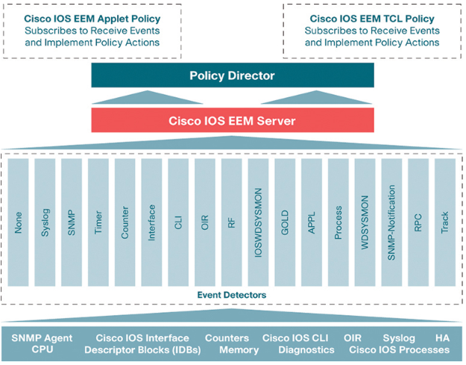
Embedded Event Manager EEM Event Detectors
Figure 29-1 illustrates some EEM event detectors and how they interact with the IOS subsystem.
EEM applets are composed of multiple building blocks. This chapter focuses on two of the primary building blocks that make up EEM applets: events and actions.
EEM applets use a similar logic to the if-then statements used in some of the common programming languages (for instance, if an event happens, then an action is taken).
Figure 29-1
EEM Event Detectors

Slide 5
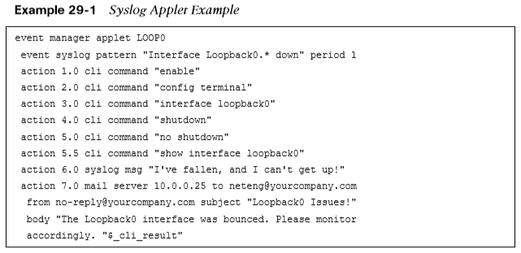
Embedded Event Manager EEM Applets
Example 29-1 shows an applet that is looking for a specific syslog message, stating that the Loopback0 interface went down. If this specific syslog pattern is matched (an event) at least once, then the following actions will be taken:
The Loopback0 interface will be shut down and brought back up.
The router will generate a syslog message that says, “I’ve fallen, and I can’t get up!”
An email message that includes the output of the show interface loopback0 command will be sent to the network administrator.
Remember to include the enable and configure terminal commands at the beginning of actions within an applet.

Slide 6
Embedded Event Manager Debugging Output
Based on the output from the debug event manager action cli command, you can see the actions taking place when the applet is running. Example 29-2 shows the applet being engaged when a user issues the shutdown command on the Loopback0 interface.
(Entire output not shown.)

Slide 7
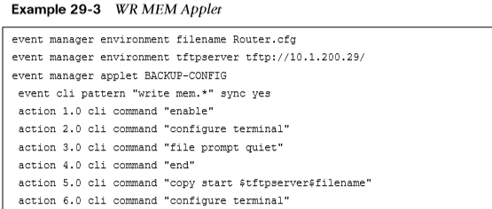
Embedded Event Manager CLI Patterns
When certain commands are entered using the CLI, they trigger an EEM event within an applet. The configured actions then take place as a result of the CLI pattern being matched.
Example 29-3 uses another common EEM applet to match the CLI pattern “write mem.” When the applet is triggered, the following actions are invoked:
The router generates a syslog message that says “Configuration File Changed! TFTP backup successful.”
The startup-config file is copied to a TFTP server.

Slide 8
Embedded Event Manager EEM Environment Values
There are multiple ways to call out specific EEM environment values. Although it is possible to create custom names and values that are arbitrary and can be set to anything, it is good practice to use common and descriptive variables. Table 29-2 lists some of the email variables most commonly used in EEM.
Table 29-2 Common EEM Email Variables
EEM Variable | Description | Example
_email_server | SMTP server IP address or DNS name | 10.0.0.25 or MAILSVR01
_email_to | Email address to send email to | neteng@yourcompany.com
_email_from | Email address of sending party | No-reply@yourcompany.com
_email_cc | Email address of additional email receivers | helpdesk@yourcompany.com

Slide 9
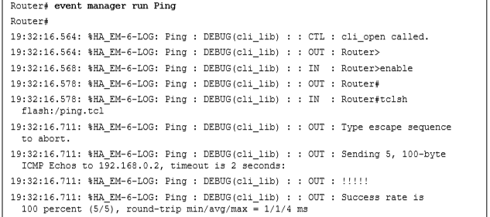
Embedded Event Manager Tcl Scripts
Example 29-4 shows how to manually execute an EEM applet that executes a Tcl script. It shows an EEM script configured with the event none command, which means there is no automatic event that the applet is monitoring, and this applet runs only when it is triggered manually. To manually run an EEM applet, the event manager run applet-name command must be used.
(Entire output not shown.)

Slide 10
Embedded Event Manager Script Contents
Example 29-5 displays a snippet for the exact content of the ping.tcl script used in the manually triggered EEM applet in Example 29-4.
To see the contents of a Tcl script that resides in flash memory, issue the more command followed by the file location and filename.
The more command can be used to view all other text-based files stored in the local flash memory as well.

Slide 11
Embedded Event Manager EEM Summary
The value in using automation and configuration management tools is the ability to move more quickly than is possible with manual configuration.
Automation helps ensure that the level of risk due to human error is reduced by using proven automation methods.
The following are some of the most common and repetitive configurations for which network operators leverage automation tools to increase speed and consistency:
Device name/IP address
Quality of service
Access list entries
Usernames/passwords
SNMP settings
Compliance

Slide 12
Agent-Based Automation Tools
This section covers a number of agent-based tools as well as some of the key concepts to help network operators decide which tool best suits their environment and business use cases.

Slide 13
Agent-Based Automation Tools Puppet
Puppet is a robust configuration management and automation tool. Puppet works with many different vendors and is a commonly used tools used for automation.
Puppet can be used during the entire lifecycle of a device, including initial deployment, configuration management, and repurposing and removing devices in a network.
Puppet uses a puppet master (server) to communicate with devices that have the puppet agent (client) installed locally on the device.
Changes and automation tasks are executed within the puppet console and then shared between the puppet master and puppet agents.
These changes or automation tasks are stored in the puppet database (PuppetDB) so that the tasks can be saved to be pushed out to the puppet agents at a later time.

Slide 14
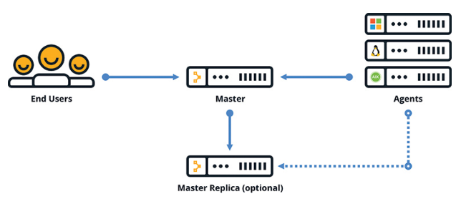
Agent-Based Automation Tools Puppet (Cont.)
Figure 29-2 illustrates the communications path between the puppet master and the puppet agents, as well as the high-level architecture. The solid lines show the primary communications path, and the dotted lines indicate optional high availability.

Slide 15
Agent-Based Automation Tools Puppet (Cont.)
Puppet agents communicate to the puppet master by using different TCP connections. TCP ports uniquely represent a communications path from an agent running on a device or node.
Puppet can periodically verify the configuration on devices. This can be set to any frequency that the network administrator deems necessary. If a configuration is changed, it can be alerted on, and automatically put back to the previous configuration.
There are three different installation types with Puppet. Table 29-3 describes the scale differences between the different installation options.
Table 29-3 Puppet Installation Modes
Installation Type | Scale
Monolithic | Up to 4000 nodes
Monolithic with compile masters | 4000 to 20,000 nodes
Monolithic with compile masters and standalone PE-PostgreSQL | More than 20,000 nodes

Slide 16
Agent-Based Automation Tools Puppet (Cont.)
The recommended deployment is a monolithic installation, which supports up to 4000 nodes. In a very large scale environment, best practices are high availability and centralized management. Administrators may need a master of masters (MoM) to manage the distributed puppet masters and their associated databases.
Large deployments also need compile masters, which are load-balanced Puppet servers. Figure 29-3 shows a typical large-scale enterprise deployment model of Puppet and its associated components.

Slide 17
Agent-Based Automation Tools Puppet Modules
Puppet modules contain these components:
Manifests
Templates
Files
Manifests are the code that configures the clients or nodes running the puppet agent.
Manifests are pushed to the devices using SSL and require certificates to ensure the security of communications between the puppet master and the puppet agents.
Manifests can be saved as individual files and have a file extension .pp.
One module called cisco_ios, contains many manifests and leverages SSH to connect to devices.

Slide 18
Agent-Based Automation Tools Puppet Manifest
Example 29-6 shows an example of a manifest file, named NTP_Server.pp, that configures a Network Time Protocol (NTP) server on a Cisco Catalyst device.
This example shows that the NTP server IP address is configured as 1.2.3.4, and it uses VLAN 42 as the source interface. The line ensure => ‘present’ means that the NTP server configuration should be present in the running configuration of the Catalyst IOS device on which the manifest is running.

Slide 19
Agent-Based Automation Tools Puppet Manifest (Cont.)
Puppet leverages a domain-specific language (DSL) as its “programming language.” It is based on the Ruby language.
Example 29-7 shows a manifest file called MOTD.pp that is used to configure a message-of-the-day (MOTD) banner on Catalyst IOS devices.

Slide 20
Agent-Based Automation Tools Chef
Chef is an open source configuration management tool. Chef is written in Ruby and Erlang, using Ruby for writing code within Chef.
Configuration management tools function in two different types of models: push and pull.
Chef is similar to Puppet in several ways:
Both have free open source versions available
Both have paid enterprise versions available
Both manage code that needs to be updated and stored
Both manage devices or nodes to be configured
Both leverage a pull model
Both function as a client/server model

Slide 21
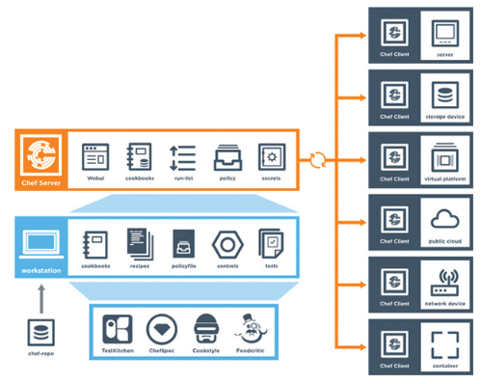
Agent-Based Automation Tools Chef’s Structure
Chef’s structure, terminology, and core components are different from those of Puppet.
Figure 29-4 illustrates the high-level architecture of Chef and the communications path between the various areas within the Chef environment.
Figure 29-4
High-Level Chef Architecture

Slide 22
Agent-Based Automation Tools Chef Components
Although the core concepts of Puppet and Chef are similar, the terminology differs. Whereas Puppet has modules and manifests, Chef has cookbooks and recipes. Table 29-4 compares the components of Chef and Puppet and provides a brief description of each component.
Table 29-4 Puppet and Chef Comparison
Chef Components | Puppet Components | Description
Chef server | Puppet master | Server/master functions
Chef client | Puppet agent | Client/agent functions
Cookbook | Module | Collection of code or files
Recipe | Manifest | Code being deployed to make configuration changes
Workstation | Puppet console | Where users interact with configuration management tools and create code

Slide 23
Agent-Based Automation Tools Chef Components (Cont.)
Code is created on the Chef workstation. This code is stored in a file called a recipe
Once a recipe is created on the workstation, it must be uploaded to the Chef server in order to be used in the environment. knife is the name of the command-line tool used to upload cookbooks to the Chef server.
The command to execute an upload is knife upload cookbookname.
The Chef server can be hosted locally on the workstation, hosted remotely on a server, or hosted in the cloud.
There are four types of Chef server deployments:
Chef Solo - The Chef server is hosted locally on the workstation.
Chef Client and Server -This is a typical Chef deployment with distributed components.
Hosted Chef - The Chef server is hosted in the cloud.
Private Chef - All Chef components are within the same enterprise network.

Slide 24
Agent-Based Automation Tools Chef Server
The Chef server sits in between the workstation and the nodes. All cookbooks are stored on the Chef server which holds all the tools necessary to transfer the node configurations to the Chef clients.
OHAI collects the current state of a node to send the information back to the Chef server through the Chef client service. The Chef server then checks to see if there is any new configuration that needs to be on the node by comparing the information from the OHAI service to the cookbook or recipe.
When a node needs a recipe, the Chef client service handles the communication back to the Chef server to signify the node’s need for the updated configuration or recipe.

Slide 25
Agent-Based Automation Tools Recipe File
Example 29-8 shows a recipe file constructed in Ruby.

Slide 26
Agent-Based Automation Tools SaltStack Overview
SaltStack is built on Python with a Python interface so a user can program directly to SaltStack by using Python code.
However, most of the instructions or states that get sent out to the nodes are written in YAML or a DSL. These are called Salt formulas.
Another key difference from Puppet and Chef is SaltStack’s overall architecture. SaltStack uses systems, which are divided into various categories. SaltStack has masters and minions.
SaltStack uses a distributed messaging platform called 0MQ (ZeroMQ). SaltStack is an event-driven technology that has components called reactors and beacons. A reactor lives on the master and listens for any type of changes in the node or device that differ from the desired state or configuration.
Beacons live on minions. If a configuration changes on a node, a beacon notifies the reactor on the master. This is the remote execution system and it helps determine whether the configuration is in the appropriate state on the minions. These actions are called jobs which when executed can be stored in an external database.

Slide 27
Agent-Based Automation Tools SaltStack Overview (Cont.)
SaltStack uses pillars and grains to control state and send configuration changes. SaltStack grains are run on the minions to gather system information to report back to the master. This information is typically gathered by the salt-minion daemon. Grains can provide specifics to the master about the host.
Pillars store data that a minion can retrieve from the master. Minions can be assigned to pillars.
Data can be stored for a specific node inside a pillar, keeping it separate from any other node that is not assigned to this particular pillar. Confidential data can be secured and only shared with assigned minions.

Slide 28
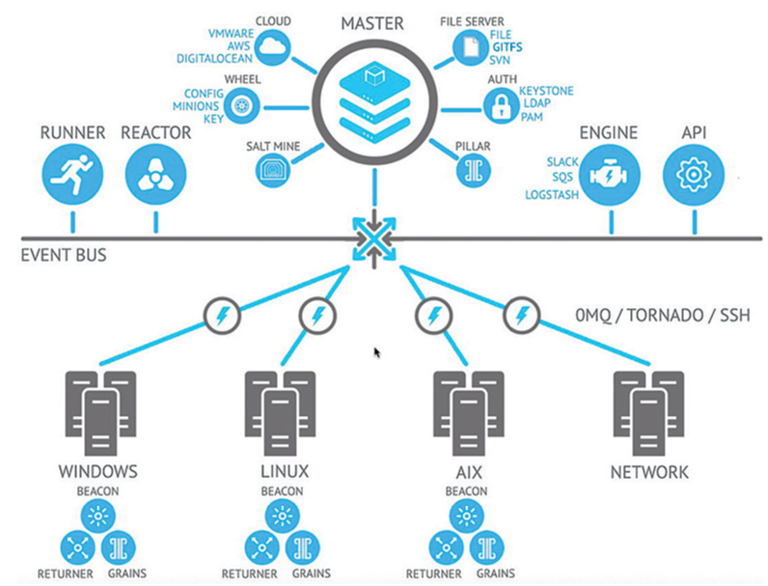
Agent-Based Automation Tools SaltStack Architecture
SaltStack can scale to a very large number of devices. SaltStack also has an enterprise version and a GUI called SynDic.
Figure 29-5 shows the overall architecture of SaltStack and its associated components.

Slide 29
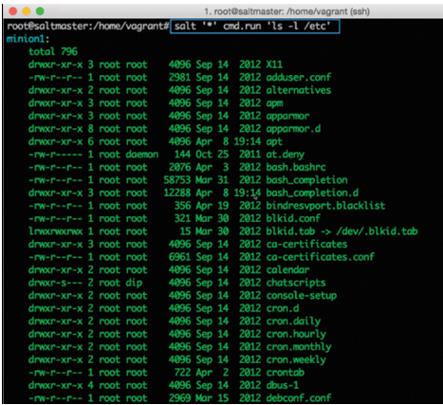
Agent-Based Automation Tools SaltStack CLI
SaltStack has its own DSL. The SaltStack command structure contains targets, commands, and arguments.
The target is the desired system that the command should run.
The command structure uses the module.function syntax followed by the argument.
An argument provides detail to the module and function that is being called on in the command.
Figure 29-6 shows the correct SaltStack syntax as well as a command called cmd.run.

Slide 30
Agentless Automation Tools
This section covers a variety of agentless tools as well as some of the key concepts to help network operators decide which tool best suits their environment and business use cases.

Slide 31
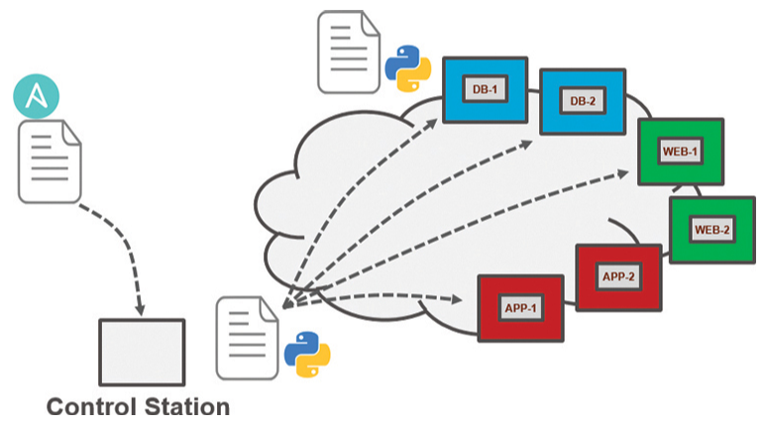
Agentless Automation Tools Ansible Overview
Ansible is an automation tool that is capable of automating cloud provisioning, deployment of applications, and configuration management.
Ansible is agentless, so no software needs to be installed on the client machines. Ansible communicates using SSH. Ansible can use built-in authorization escalation when it needs to raise the level of administrative control.
Ansible sends all requests from a control station. Figure 29-8 illustrates the Ansible workflow.

Slide 32
Agentless Automation Tools Ansible Playbook Components
Ansible uses playbooks to deploy configuration changes or retrieve information from hosts within a network. An Ansible playbook is a structured sets of instructions. An Ansible playbook contains multiple plays, and each play contains the tasks that each player must accomplish in order for the particular play to be successful.
Table 29-5 describes the components used in Ansible and provides some commonly used examples of them.
Components | Description | Use Case
Playbook | A set of plays for remote systems | Enforcing configuration and/or deployment steps
Play | A set of tasks applied to a single host or group of hosts | Grouping a set of hosts to apply policy or configuration to them.
Task | A call to an Ansible module | Logging in to a device to issue a show command to retrieve output.

Slide 33
Agentless Automation Tools Ansible Playbooks in YAML
Ansible playbooks are written using YAML (Yet Another Markup Language). Ansible YAML files usually begin with a series of three dashes (---) and end with a series of three periods (…). Example 29-9 shows a YAML file that contains a list of musical genres.
YAML uses dictionaries that are similar to JSON dictionaries as they also use key/value pairs. Example 29-10 shows a YAML dictionary containing an employee record.

Slide 34
Agentless Automation Tools Ansible CLI Commands
Ansible has a CLI tool that can be used to run playbooks or ad hoc CLI commands on targeted hosts. This tool has very specific commands that you need to use to enable automation. The table below shows the most common Ansible CLI commands and associated use cases.
CLI Command | Use Case
ansible | Runs modules against targeted hosts
ansible-playbook | Runs playbooks
ansible-docs | Provides documentation on syntax and parameters in the CLI
ansible-pull | Changes Ansible clients from the default push model to the pull model
ansible-vault | Encrypts YAML files that contain sensitive data

Slide 35
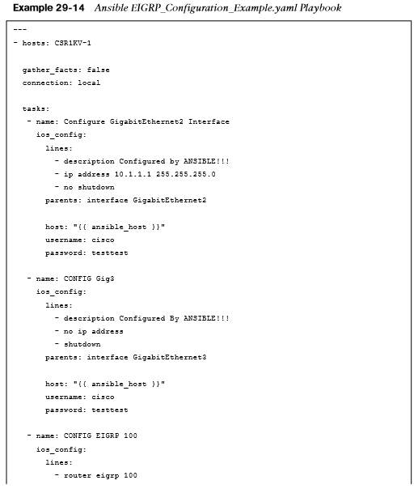
Agentless Automation Tools Ansible Configuration Example
Example 29-14 shows an alternative version of the ConfigureInterface.yaml playbook named EIGRP_Configuration_ Example.yaml, with EIGRP added, along with the ability to save the configuration by issuing a “write memory.”
These tasks are accomplished by leveraging the ios_command module in Ansible. This playbook adds the configuration shown here to the CSR1KV-1 router.

Slide 36
Agentless Automation Tools Puppet Bolt
Puppet Bolt allows you to leverage the power of Puppet without having to install a puppet master or puppet agents on devices or nodes.
It connects to devices by using SSH or WinRM connections. Puppet Bolt is an open source tool that is based on the Ruby language and can be installed as a single package.
Puppet Bolt allows you to execute a change or configuration immediately and then validate it. There are two ways to use Puppet Bolt:
Orchestrator-driven tasks - Orchestrator-driven tasks can leverage the Puppet architecture to use services to connect to devices. This design is meant for large-scale environments.
Standalone tasks - Standalone tasks are for connecting directly to devices or nodes to execute tasks and do not require any Puppet environment or components to be set up in order to realize the benefits and value of Puppet Bolt.

Slide 37
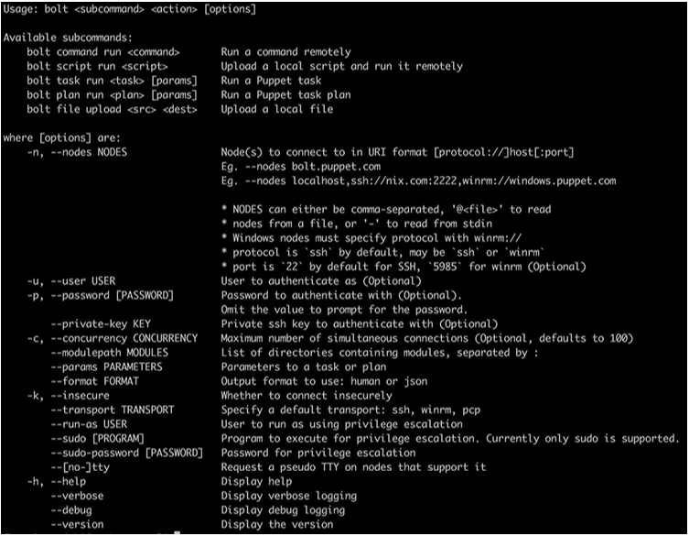
Agentless Automation Tools Puppet Bolt Command Line
Individual commands can be run from the command line by using the command bolt command run command name followed by the list of devices to run the command against.
After a script is built, execute it from the command line against the remote devices that need to be configured, using the command bolt script run script name followed by the list of devices to run the script against. Figure 29-14 shows a list of some of the available commands for Puppet Bolt.

Slide 38
Agentless Automation Tools Puppet Bolt Command Line
Puppet Bolt tasks use an API to retrieve data between Puppet Bolt and the remote device.
Tasks are part of the Puppet modules and use the naming structure modulename::taskfilename.
Tasks can be called from the command line much like commands and scripts. You use the command bolt task run modulename::taskfilename to invoke these tasks from the command line.
The modulename::taskfilename naming structure allows the tasks to be shared with other users on Puppet Forge.
A task is commonly accompanied by a metadata file that is in JSON format. A JSON metadata file contains information about a task, how to run the task, and any comments about how the file is written.

Slide 39
Agentless Automation Tools SaltStack Salt SSH (Server-Only Mode)
SaltStack offers an agentless option called Salt SSH that allows users to run Salt commands without having to install a minion on the remote device or node. The main requirements to use Salt SSH are that the remote system must have SSH enabled and Python installed.
Salt SSH can work in conjunction with the master/minion environment, or it can be used completely agentless across the environment. By default, Salt SSH uses roster files to store connection information for any host that doesn’t have a minion installed. Example 29-16 shows the content structure of this file.

Slide 40
Agentless Automation Tools Comparing Tools
Table 29-7 provides a high-level comparison of the tools covered in this chapter.
Factor | Puppet | Chef | Ansible | SaltStack
Architecture | Puppet masters and puppet agents | Chef server and Chef clients | Control station and remote hosts | Salt master and minions
Language | Puppet DSL | Ruby DSL | YAML | YAML
Terminology | Modules and Manifests | Cookbooks and recipes | Playbooks and plays | Pillars and grains
Support for large-scale deployments | Yes | Yes | Yes | Yes
Agentless version | Puppet Bolt | N/A | Yes | Salt SSH

Slide 41
Prepare for the Exam

Slide 42
Prepare for the Exam Key Topics for Chapter 29
Description
EEM applets and configuration
Puppet
Chef
SaltStack (agent and server mode)
Ansible
Puppet Bolt
SaltStack SSH (server-only mode)
High-Level Configuration Management and Automation Tool Comparison

Slide 43
Prepare for the Exam Key Terms for Chapter 29
Term
Cookbooks
Embedded Event Manager (EEM)
Grain
Manifest
Module
Pillar
Play
Playbook
Recipe
Tcl

