Slide 1

Welcome to the
Community College of Rhode Island
On Line Economics
Course Tour
For Microeconomics and Macroeconomics

Slide 2
Economics On Line Class
What this course is?
  3 credit course
  Same class as the Face to Face class
  A course where students learn the basics of Macroeconomics and / or Microeconomics
  Not self paced
  Scheduled Assignments and Exams
  Blackboard
    Blackboard.ccri.edu
    Or the CCRI home page ccri.edu

Slide 3
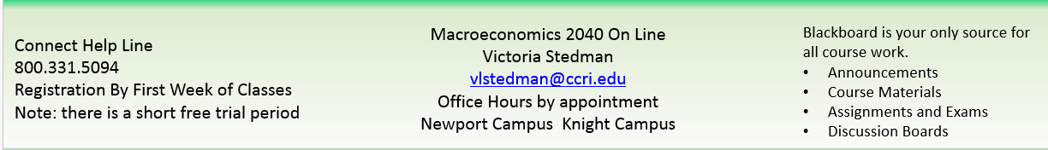
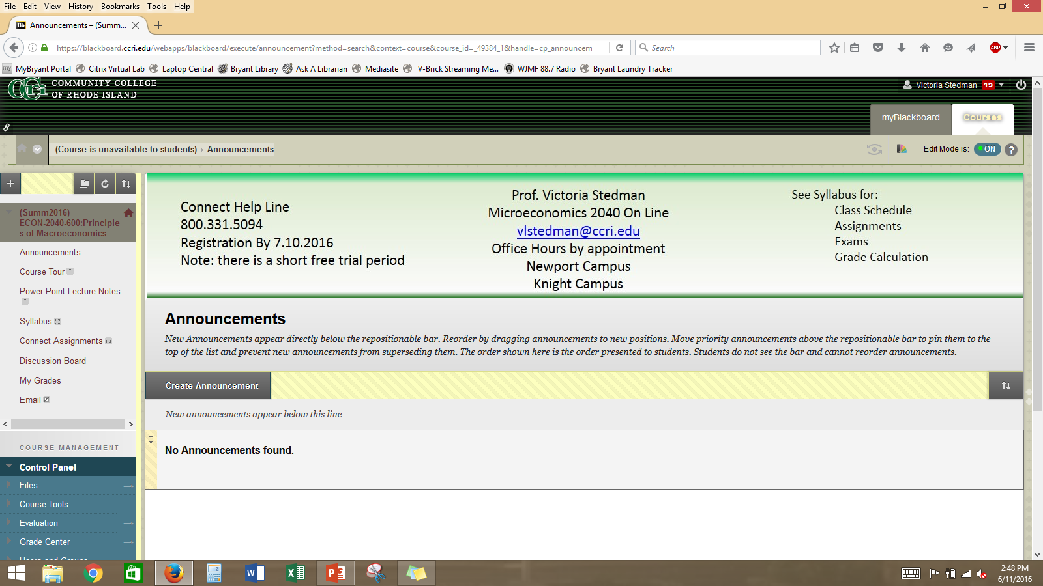
Weekly announcements are posted here and emailed.
Assignments
Discussion Boards
Exams
Reminders
Access to Connect
Register in Connect
Introductory Practice
Weekly Assignments
Weekly Chapter Material
5 to 7 minutes recorded Power Point Files
Topic Specific
Weekly Discussion Topics
Brief response, click on Create Thread
My Grades

Slide 4
Assignments, Discussion Boards, Exams
Communication is the most important tool.
  Questions
  Problems
  vlstedman@ccri.edu I check emails several times each day, 7 days a week.
Assignments, Discussion Boards and Exams will all be available for the current week.
  Assignments are multiple choice questions, graphs and or tables.
  Discussion Boards are short response questions. No references are needed.
  No extensions or do overs.
  There will be weekly announcements reminding you of the due dates.
  The lecture notes are recorded power point notes on each week’s topics.

Slide 5
Connect Assignments and Exams
Textbook
  CCRI bookstore with access (payment) code for Connect
  Other source for purchasing text book or used textbook.
Register in Connect and Assignments
  Access Connect through the Connect Assignments Tab in blackboard.
  Start by going to the Practice Assignment
  The prompts will lead you through the registration process
  Due Dates
Exams
  Via Blackboard
  Due Dates
Final Exam will be posted the last week of classes.

Slide 6
Contact Information
vlstedman@ccri.edu
Office Hours; by appointment
  Newport Campus
  Knight Campus
Remember:
  Communication is the most important tool
  Feel free to email for any reason

