Slide 1
CompTIA Security+ Study Guide (SY0-501)
Chapter 9:
Threats, Attacks, and Vulnerabilities

Slide 2
Chapter 9: Threats, Attacks, and Vulnerabilities
Given a scenario, analyze indicators of compromise and determine the type of malware
Compare and contrast types of attacks

Slide 3
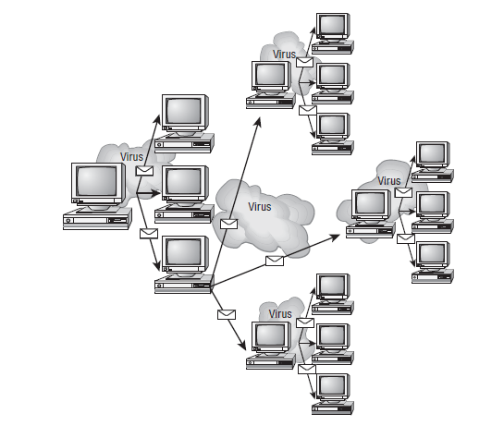
Living in a World of Viruses
Symptoms of a virus infection

Slide 4
Types of Viruses
Armored
Companion
Macro
Multipartite
Phage
Polymorphic
Retrovirus
Stealth

Slide 5
Malware and Crypto-Malware
Worm
Trojan
Rootkit
Keylogger
Adware
Spyware
Bot
DoS and DDoS
RAT
Logic bomb
Backdoor

Slide 6
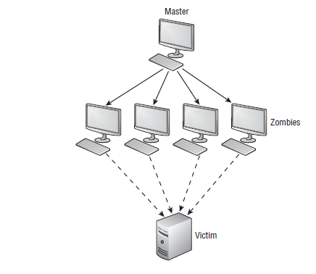
DDoS

Slide 7
Other Attacks
Man-in-the-middle
Buffer overflow
Injection
Cross-site scripting and request Forgery
Privilege escalation

Slide 8
Other Types of Attacks
ARP poisoning
Amplification
DNS poisoning
Domain hijacking
Man-in-the-browser
Zero-day exploits
Replay attacks

Slide 9
Other Types of Attacks
Pass the hash
Hijacking and related attacks
Driver manipulation

Slide 10
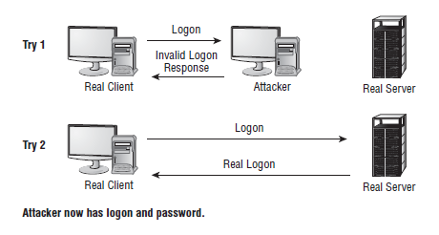
MAC and IP Spoofing Attacks

Slide 11
Five Tasks for Finding Threats
Passively testing security controls
Interpreting results
Identifying vulnerability
Identifying lack of security controls
Identifying common misconfigurations

Slide 12
Security Tools
Vulnerability scanners
Honeypots and honeynets
Port scanner
Banner grabbing

Slide 13
Risk Calculations/Assessment Types
Baseline reporting
Code review
Determine attack surface
Architecture
Design review

