Slide 1


Equipping Today’s Instructors
for Tomorrow’s Students
Academy Conference 2013
Cisco Networking Academy
Syslog, SNMP
Vijay Bhuse, Ph.D.
Instructor
ECPI University

Slide 2
SNMP
SNMP is an application layer protocol that provides a message format for communication between what are termed managers and agents
Components include
  SNMP manager
  SNMP agent
  Management Information Base

Slide 3
SNMP Messages
Get
Set
Trap - unreliable
Trap (SNMPv3 uses ACK) - reliable

Slide 4
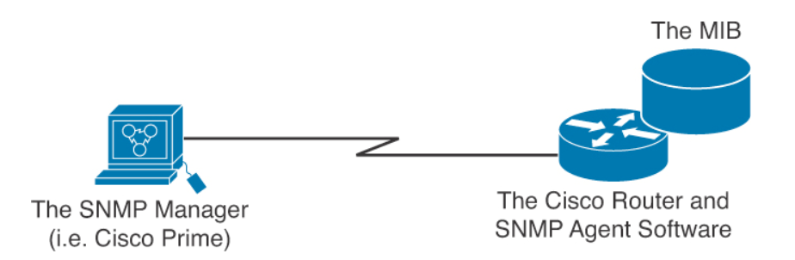
Elements of Simple Network Management Protocol

Slide 5
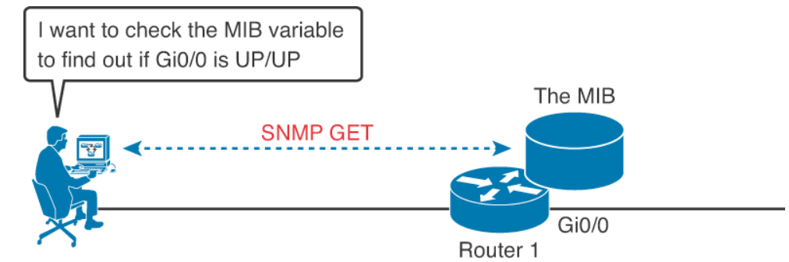
SNMP in Use for Monitoring the Network

Slide 6
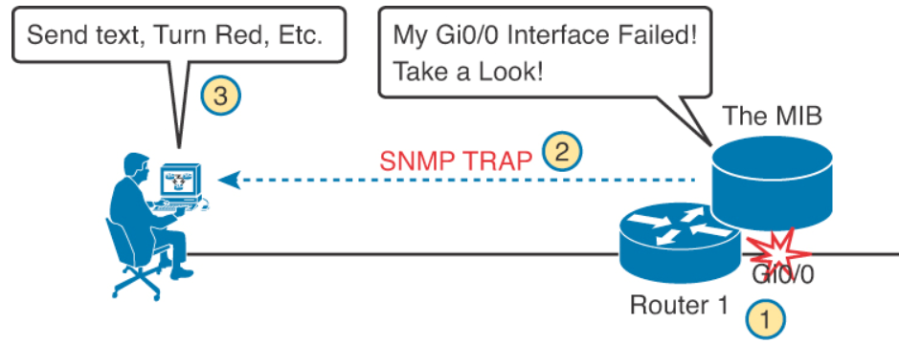
SNMP in Use for Monitoring the Network

Slide 7
The Management Information Base (MIB)
MIB defines each variable as an object ID (OID)
Organizes the into a hierarchy of OIDs, usually shown as a tree
MIB for any device includes some branches of the tree with variables common to many networking devices and branches with variables specific to that device.
Networking equipment vendors like Cisco can define their own private branches of the tree

Slide 8
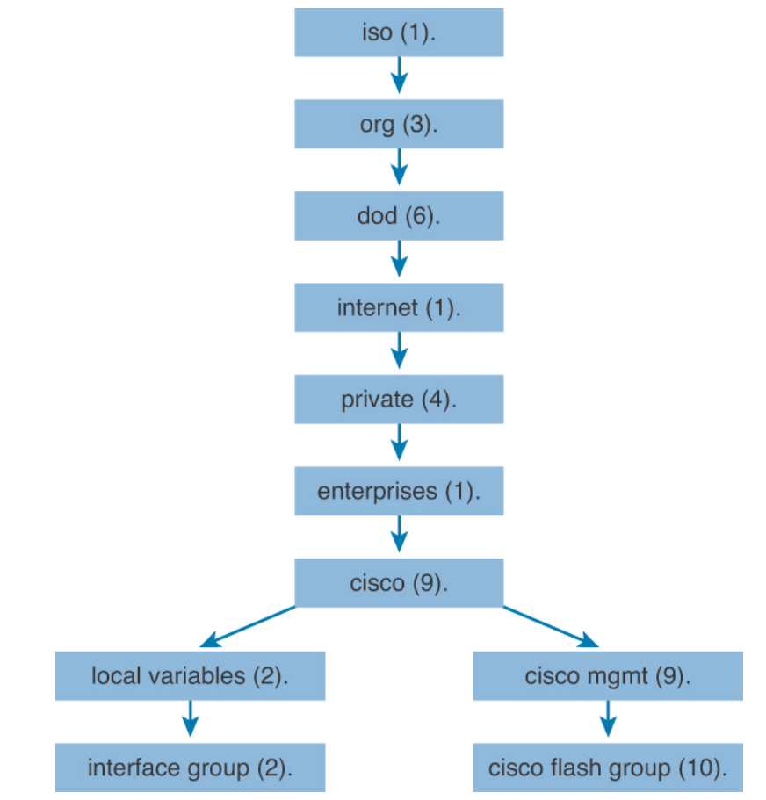
MIB tree

Slide 9
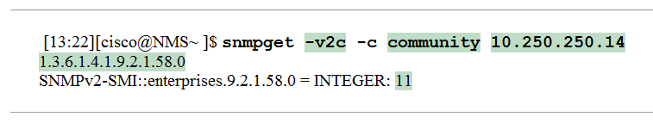
Obtaining MIB value with snmpget
-v2c The version on SNMP in use
-c community The SNMP password, called a community string
10.250.250.14 The IP address of the monitored device
1.3.6.1.4.1.9.2.1.58.0 The numeric object identifier (OID) of the MIB variable

Slide 10
Configuring SNMPv2
There are two types of community strings in SNMP Version 2c:
Read-only (RO): Provides access to the MIB variables, but does not allow these variables to changed, only read. Because security is so weak in Version 2c, many organizations only use SNMP in this read-only mode.
Read-write (RW): Provides read and write access to all objects in the MIB.

Slide 11
Configuring SNMP Version 2c for Read-Only Access
R1(config)# ip access-list standard ACL_PROTECTSNMP
R1(config-std-nacl)# permit host 10.10.10.101
R1(config-std-nacl)# exit
R1(config)# snmp-server community V011eyB@11!!! RO ACL_PROTECTSNMP
R1(config)# snmp-server location Tampa
R1(config)# snmp-server contact Anthony Sequeira
R1(config)# end
R1#

Slide 12
Configuring SNMP Version 2c for Read and Write Access
R2(config)# ip access-list standard ACL_PROTECTSNMP
R2(config-std-nacl)# permit host 10.20.20.201
R2(config-std-nacl)# exit
R2(config)# snmp-server community T3nn1sB@ll RW ACL_PROTECTSNMP
R2(config)# snmp-server location New York
R2(config)# snmp-server contact John Sequeira
R2(config)# end
R2#

Slide 13
SNMPv3
Message integrity: This helps ensure that a packet has not been tampered with in transit
Authentication: This helps ensure that the packet came from a known and trusted source
Encryption: This helps to ensure that information cannot be read if the data is captured in transit

Slide 14
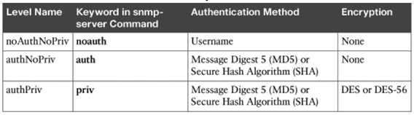
Possible Security modes of SNMPv3

Slide 15
Syslog
Syslog permits various Cisco devices (and some other non-Cisco devices) to send their system messages across the network to syslog servers
You can even build a special out-of-band (OOB) network for this purpose
There are many different Syslog server software packages for Windows and UNIX

Slide 16
Popular destinations for syslog messages
The logging buffer (RAM inside the router or switch)
The console line
The terminal lines
A syslog server

Slide 17
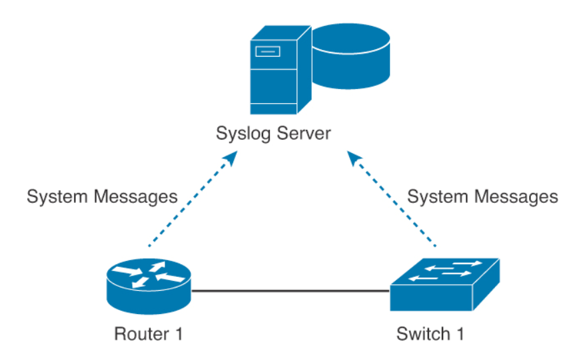
Syslogging in the Network

Slide 18

System Message Format
A timestamp: *Dec 18 17:10:15.079
The facility on the router that generated the message: %LINEPROTO
The severity level: 5
A mnemonic for the message: UPDOWN
The description of the message: Line protocol on Interface FastEthernet0/0, changed state to down

Slide 19
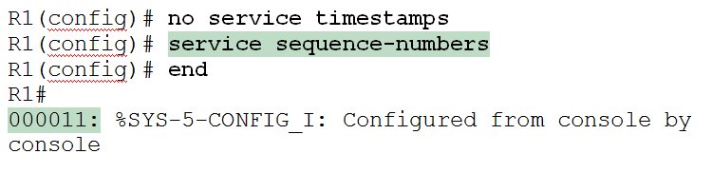
Modifying System Messages

Slide 20
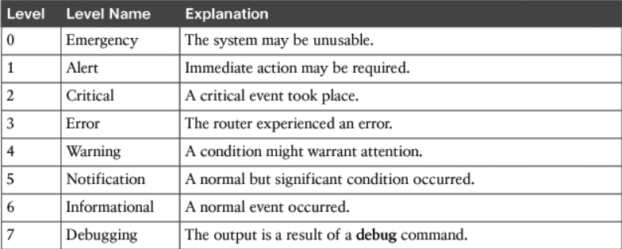
System Message Severity Levels

Slide 21
Configuring and Verifying Syslog
R1(config)#logging 192.168.1.101
R1(config)#logging trap 4
By default, Cisco routers and switches send log messages for all severity levels to the console. On some IOS versions, the device also buffers those log messages by default
  R1(config)# logging console
  R1(config)# logging buffered
R1# show logging

Slide 22
References
Wendell Odom, "Cisco CCNA Routing and Switching ICND2 200-101 Official Cert Guide", Cisco Press, May 14, 2013.

Slide 23
Thank you!

