Slide 1
Module 8: Network Layer
Introduction to Networks v7.0 (ITN)
Notes:
Cisco Networking Academy Program
Introduction to Networks v7.0 (ITN)
Module 8: Network Layer

Slide 2
Module 8: Topics
What will I learn to do in this module?
Topic Title | Topic Objective
Network Layer Characteristics | Explain how the network layer uses IP protocols for reliable communications.
IPv4 Packet | Explain the role of the major header fields in the IPv4 packet.
IPv6 Packet | Explain the role of the major header fields in the IPv6 packet.
How a Host Routes | Explain how network devices use routing tables to direct packets to a destination network.
Router Routing Tables | Explain the function of fields in the routing table of a router.
Notes:
2
8 – Network Layer
8.0 – Introduction
8.0.2 – What will I learn to do in this module?

Slide 3
8.1 Network Layer Characteristics
Notes:
8 – Network Layer
8.1 – Network Layer Characteristics

Slide 4
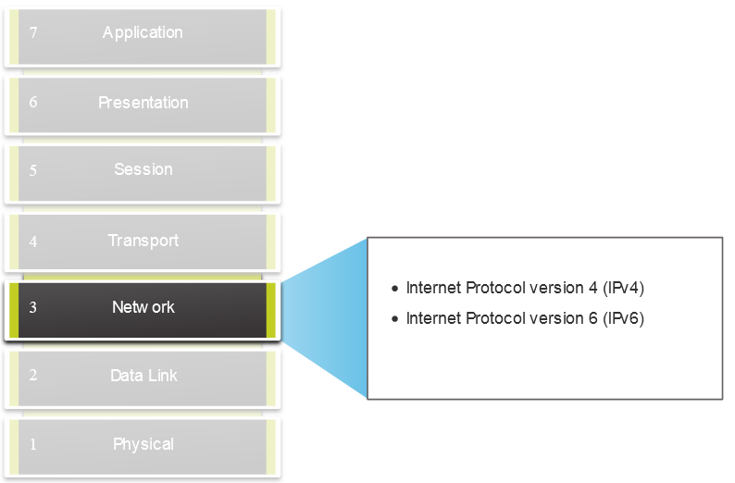
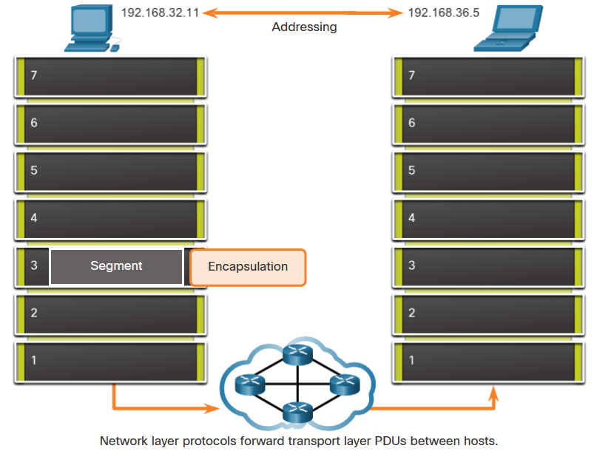
Network Layer Characteristics
The Network Layer
Provides services to allow end devices to exchange data
IP version 4 (IPv4) and IP version 6 (IPv6) are the principle network layer communication protocols.
The network layer performs four basic operations:
  Addressing end devices
  Encapsulation
  Routing
  De-encapsulation
Notes:
8 – Network Layer
8.1 – Network Layer Characteristics
8.1.1 – The Network Layer

Slide 5
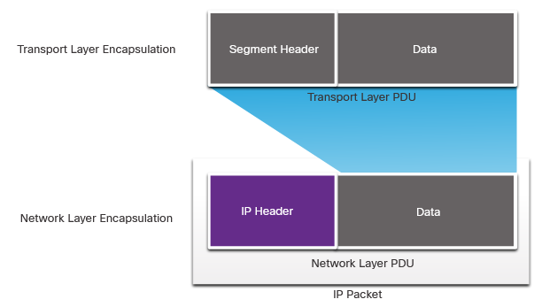
Network Layer Characteristics
IP Encapsulation
IP encapsulates the transport layer segment.
IP can use either an IPv4 or IPv6 packet and not impact the layer 4 segment.
IP packet will be examined by all layer 3 devices as it traverses the network.
The IP addressing does not change from source to destination.
Note: NAT will change addressing, but will be discussed in a later module.
Notes:
8 – Network Layer
8.1 – Network Layer Characteristics
8.1.2 – IP Encapsulation

Slide 6
Network Layer Characteristics
Characteristics of IP
IP is meant to have low overhead and may be described as:
  Connectionless
  Best Effort
  Media Independent
Notes:
8 – Network Layer
8.1 – Network Layer Characteristics
8.1.3 – Characteristics of IP

Slide 7
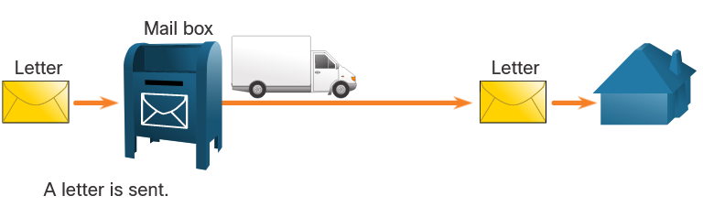
Network Layer Characteristics
Connectionless
IP is Connectionless
IP does not establish a connection with the destination before sending the packet.
There is no control information needed (synchronizations, acknowledgments, etc.).
The destination will receive the packet when it arrives, but no pre-notifications are sent by IP.
If there is a need for connection-oriented traffic, then another protocol will handle this (typically TCP at the transport layer).
Notes:
8 – Network Layer
8.1 – Network Layer Characteristics
8.1.4 – Connectionless

Slide 8
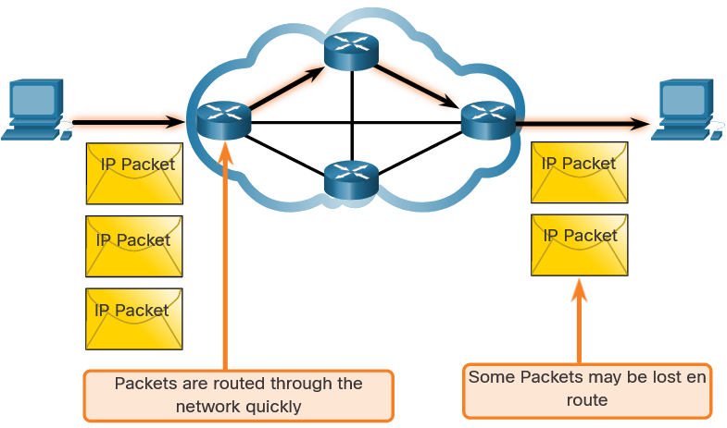
Network Layer Characteristics
Best Effort
IP is Best Effort
IP will not guarantee delivery of the packet.
IP has reduced overhead since there is no mechanism to resend data that is not received.
IP does not expect acknowledgments.
IP does not know if the other device is operational or if it received the packet.
Notes:
8 – Network Layer
8.1 – Network Layer Characteristics
8.1.5 – Best Effort

Slide 9
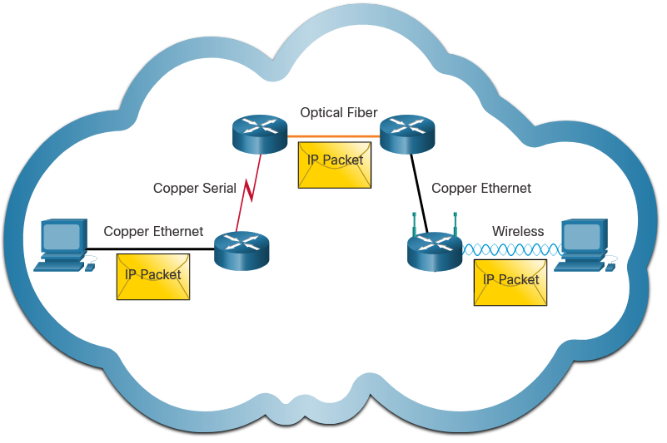
Network Layer Characteristics
Media Independent
IP is unreliable:
  It cannot manage or fix undelivered or corrupt packets.
  IP cannot retransmit after an error.
  IP cannot realign out of sequence packets.
  IP must rely on other protocols for these functions.
IP is media Independent:
  IP does not concern itself with the type of frame required at the data link layer or the media type at the physical layer.
  IP can be sent over any media type: copper, fiber, or wireless.
Notes:
8 – Network Layer
8.1 – Network Layer Characteristics
8.1.6 – Media Independent
8.1.7 Check Your Understanding – IP Characteristics

Slide 10
Network Layer Characteristics
Media Independent (Contd.)
The network layer will establish the Maximum Transmission Unit (MTU).
  Network layer receives this from control information sent by the data link layer.
  The network then establishes the MTU size.
Fragmentation is when Layer 3 splits the IPv4 packet into smaller units.
  Fragmenting causes latency.
  IPv6 does not fragment packets.
  Example: Router goes from Ethernet to a slow WAN with a smaller MTU
Notes:
8 – Network Layer
8.1 – Network Layer Characteristics
8.1.6 – Media Independent
8.1.7 Check Your Understanding – IP Characteristics

Slide 11
8.2 IPv4 Packet
Notes:
8 – Network Layer
8.2 – IPv4 Packet

Slide 12
IPv4 Packet
IPv4 Packet Header
IPv4 is the primary communication protocol for the network layer.
The network header has many purposes:
  It ensures the packet is sent in the correct direction (to the destination).
  It contains information for network layer processing in various fields.
  The information in the header is used by all layer 3 devices that handle the packet
Notes:
8 – Network Layer
8.2 – IPv4 Packet
8.2.1 – IPv4 Packet Header

Slide 13
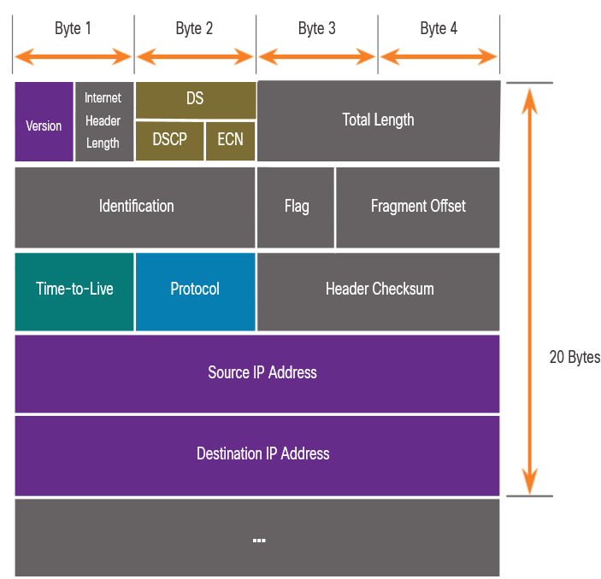
IPv4 Packet
IPv4 Packet Header Fields
The IPv4 network header characteristics:
  It is in binary.
  Contains several fields of information
  Diagram is read from left to right, 4 bytes per line
  The two most important fields are the source and destination.
Protocols may have may have one or more functions.
Notes:
8 – Network Layer
8.2 – IPv4 Packet
8.2.2 – IPv4 Packet Header Fields

Slide 14
IPv4 Packet
IPv4 Packet Header Fields
Significant fields in the IPv4 header:
Function | Description
Version | This will be for v4, as opposed to v6, a 4 bit field= 0100
Differentiated Services | Used for QoS: DiffServ – DS field or the older IntServ – ToS or Type of Service
Header Checksum | Detect corruption in the IPv4 header
Time to Live (TTL) | Layer 3 hop count. When it becomes zero the router will discard the packet.
Protocol | I.D.s next level protocol: ICMP, TCP, UDP, etc.
Source IPv4 Address | 32 bit source address
Destination IPV4 Address | 32 bit destination address
Notes:
8 – Network Layer
8.2 – IPv4 Packet
8.2.2 – IPv4 Packet Header Fields

Slide 15
IPv4 Packet
Video – Sample IPv4 Headers in Wireshark
This video will cover the following:
IPv4 Ethernet packets in Wireshark
The control information
The difference between packets
Notes:
8 – Network Layer
8.2 – IPv4 Packet
8.2.3 – Video – Sample IPv4 Headers in Wireshark
8.2.4 – Check Your Understanding – IPv4 Packet

Slide 16
8.3 IPv6 Packets
Notes:
8 – Network Layer
8.3 – IPv6 Packets

Slide 17
IPv6 Packets
Limitations of IPv4
IPv4 has three major limitations:
  IPv4 address depletion – We have basically run out of IPv4 addressing.
  Lack of end-to-end connectivity – To make IPv4 survive this long, private addressing and NAT were created. This ended direct communications with public addressing.
  Increased network complexity – NAT was meant as temporary solution and creates issues on the network as a side effect of manipulating the network headers addressing. NAT causes latency and troubleshooting issues.
Notes:
8 – Network Layer
8.3 – IPv6 Packets
8.3.1 – Limitations of IPv4

Slide 18
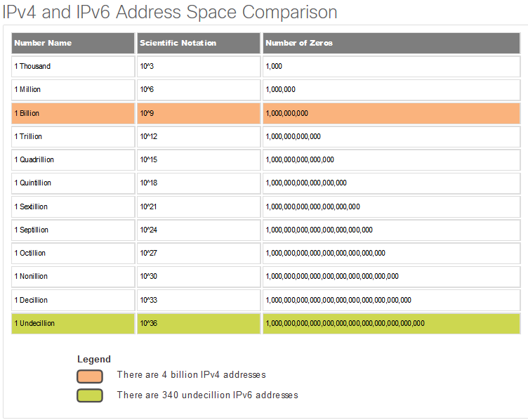
IPv6 Packets
IPv6 Overview
IPv6 was developed by Internet Engineering Task Force (IETF).
IPv6 overcomes the limitations of IPv4.
Improvements that IPv6 provides:
  Increased address space – based on 128 bit address, not 32 bits
  Improved packet handling – simplified header with fewer fields
  Eliminates the need for NAT – since there is a huge amount of addressing, there is no need to use private addressing internally and be mapped to a shared public address
Notes:
8 – Network Layer
8.3 – IPv6 Packets
8.3.2 – IPv6 Overview

Slide 19
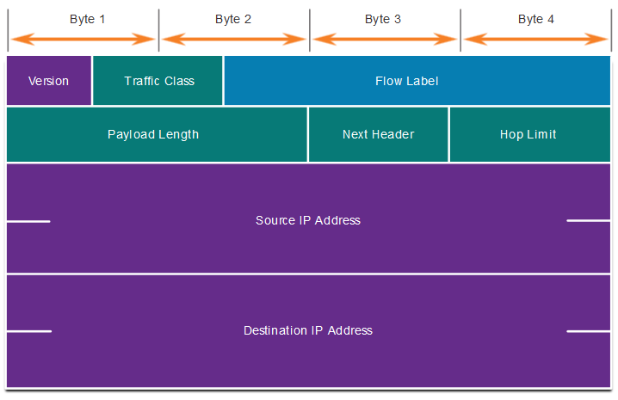
IPv6 Packets
IPv4 Packet Header Fields in the IPv6 Packet Header
The IPv6 header is simplified, but not smaller.
The header is fixed at 40 Bytes or octets long.
Several IPv4 fields were removed to improve performance.
Some IPv4 fields were removed to improve performance:
  Flag
  Fragment Offset
  Header Checksum
Notes:
8 – Network Layer
8.3 – IPv6 Packets
8.3.3 – IPv4 Packet Header Fields in the IPv6 Packet Header

Slide 20
IPv6 Packets
IPv6 Packet Header
Significant fields in the IPv6 header:
Function | Description
Version | This will be for v6, as opposed to v4, a 4 bit field= 0110
Traffic Class | Used for QoS: Equivalent to DiffServ – DS field
Flow Label | Informs device to handle identical flow labels the same way, 20 bit field
Payload Length | This 16-bit field indicates the length of the data portion or payload of the IPv6 packet
Next Header | I.D.s next level protocol: ICMP, TCP, UDP, etc.
Hop Limit | Replaces TTL field Layer 3 hop count
Source IPv4 Address | 128 bit source address
Destination IPV4 Address | 128 bit destination address
Notes:
8 – Network Layer
8.3 – IPv6 Packets
8.3.4 – IPv6 Packet Header

Slide 21
IPv6 Packets
IPv6 Packet Header (Cont.)
IPv6 packet may also contain extension headers (EH).
EH headers characteristics:
provide optional network layer information
are optional
are placed between IPv6 header and the payload
may be used for fragmentation, security, mobility support, etc.
Note: Unlike IPv4, routers do not fragment IPv6 packets.
Notes:
8 – Network Layer
8.3 – IPv6 Packets
8.3.4 – IPv6 Packet Header (Cont.)

Slide 22
IPv6 Packets
Video – Sample IPv6 Headers in Wireshark
This video will cover the following:
IPv6 Ethernet packets in Wireshark
The control information
The difference between packets
Notes:
8 – Network Layer
8.3 – IPv6 Packets
8.3.5 – Video – Sample IPv6 Headers in Wireshark
8.3.6 – Check Your Understanding – IPv6 Packets

Slide 23
8.4 How a Host Routes
Notes:
8 – Network Layer
8.4 – How a Host Routes

Slide 24
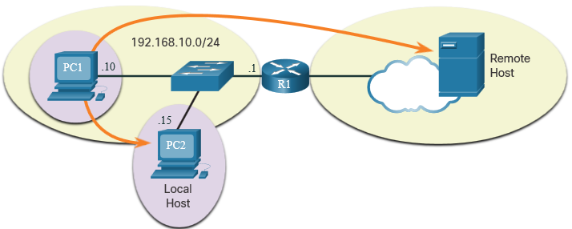
How a Host Routes
Host Forwarding Decision
Packets are always created at the source.
Each host devices creates their own routing table.
A host can send packets to the following:
  Itself – 127.0.0.1 (IPv4), ::1 (IPv6)
  Local Hosts – destination is on the same LAN
  Remote Hosts – devices are not on the same LAN
Notes:
8 – Network Layer
8.4 – How a Host Routes
8.4.1 – Host Forwarding Decision

Slide 25
How a Host Routes
Host Forwarding Decision (Cont.)
The Source device determines whether the destination is local or remote
Method of determination:
  IPv4 – Source uses its own IP address and Subnet mask, along with the destination IP address
  IPv6 – Source uses the network address and prefix advertised by the local router
Local traffic is dumped out the host interface to be handled by an intermediary device.
Remote traffic is forwarded directly to the default gateway on the LAN.
Notes:
8 – Network Layer
8.4 – How a Host Routes
8.4.1 – Host Forwarding Decision (Cont.)

Slide 26
How a Host Routes
Default Gateway
A router or layer 3 switch can be a default-gateway.
Features of a default gateway (DGW):
  It must have an IP address in the same range as the rest of the LAN.
  It can accept data from the LAN and is capable of forwarding traffic off of the LAN.
  It can route to other networks.
If a device has no default gateway or a bad default gateway, its traffic will not be able to leave the LAN.
Notes:
8 – Network Layer
8.4 – How a Host Routes
8.4.2 – Default Gateway

Slide 27
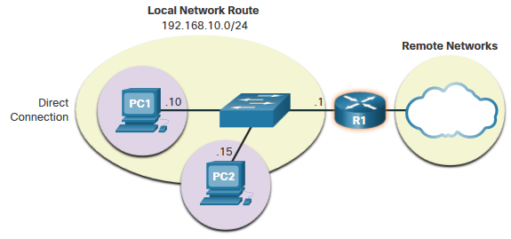
How a Host Routes
A Host Routes to the Default Gateway
The host will know the default gateway (DGW) either statically or through DHCP in IPv4.
IPv6 sends the DGW through a router solicitation (RS) or can be configured manually.
A DGW is static route which will be a last resort route in the routing table.
All device on the LAN will need the DGW of the router if they intend to send traffic remotely.
Notes:
8 – Network Layer
8.4 – How a Host Routes
8.4.3 – A Host Routes to the Default Gateway

Slide 28
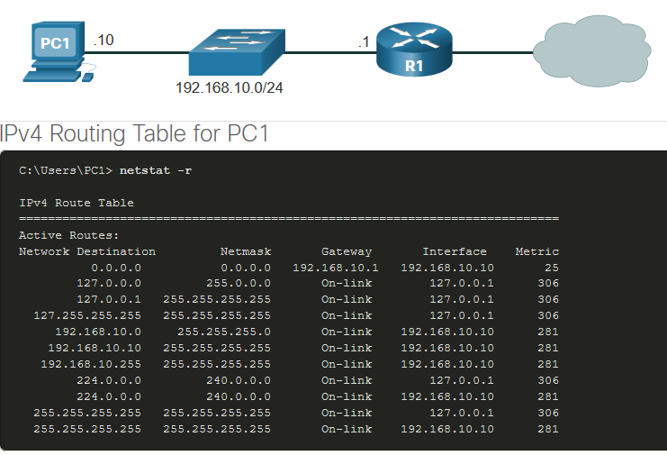
How a Host Routes
Host Routing Tables
On Windows, route print or netstat -r to display the PC routing table
Three sections displayed by these two commands:
  Interface List – all potential interfaces and MAC addressing
  IPv4 Routing Table
  IPv6 Routing Table
Notes:
8 – Network Layer
8.4 – How a Host Routes
8.4.4 – Host Routing Tables
8.4.5 – Check Your Understanding – How a Host Routes

Slide 29
8.5 Introduction to Routing
Notes:
8 – Network Layer
8.5 – Introduction to Routing

Slide 30
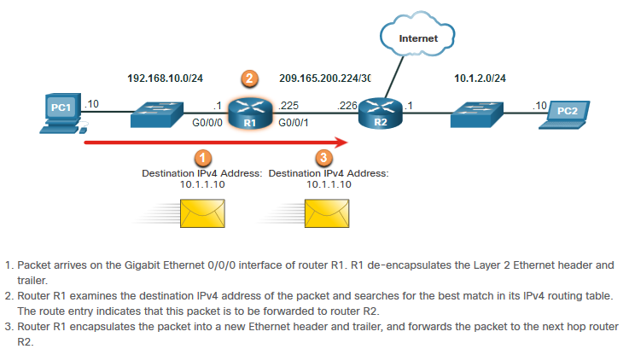
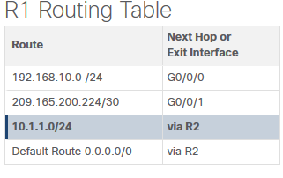
Introduction to Routing
Router Packet Forwarding Decision
What happens when the router receives the frame from the host device?
Notes:
8 – Network Layer
8.5 – Introduction to Routing
8.5.1 – Router Packet Forwarding Decision

Slide 31
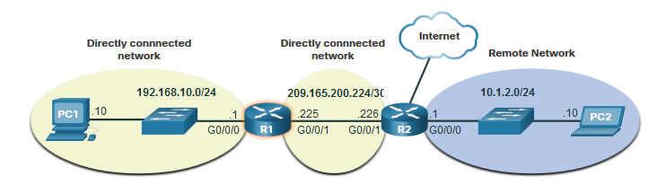
Introduction to Routing
IP Router Routing Table
There three types of routes in a router’s routing table:
Directly Connected – These routes are automatically added by the router, provided the interface is active and has addressing.
Remote – These are the routes the router does not have a direct connection and may be learned:
  Manually – with a static route
  Dynamically – by using a routing protocol to have the routers share their information with each other
Default Route – this forwards all traffic to a specific direction when there is not a match in the routing table
Notes:
8 – Network Layer
8.5 – Introduction to Routing
8.5.2 – IP Router Routing Table

Slide 32
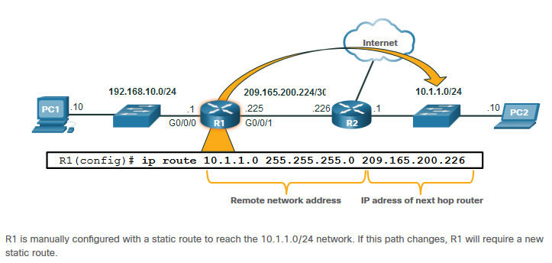
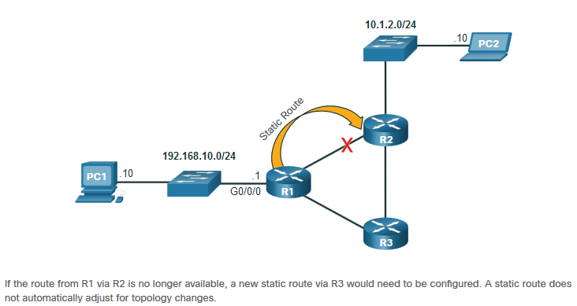
Introduction to Routing
Static Routing
Static Route Characteristics:
Must be configured manually
Must be adjusted manually by the administrator when there is a change in the topology
Good for small non-redundant networks
Often used in conjunction with a dynamic routing protocol for configuring a default route
Notes:
8 – Network Layer
8.5 – Introduction to Routing
8.5.3 – Static Routing

Slide 33
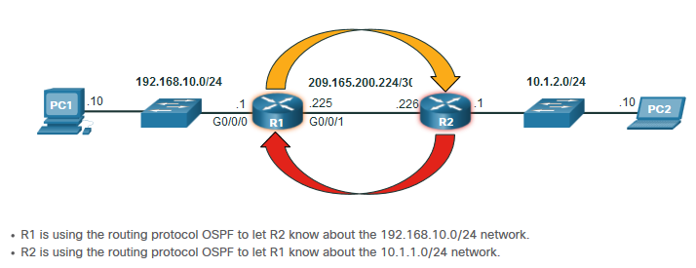
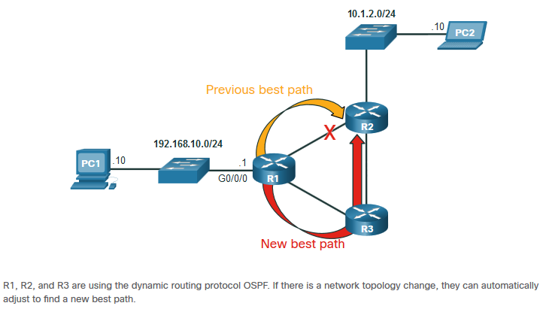
Introduction to Routing
Dynamic Routing
Dynamic Routes Automatically:
Discover remote networks
Maintain up-to-date information
Choose the best path to the destination
Find new best paths when there is a topology change
Dynamic routing can also share static default routes with the other routers.
Notes:
8 – Network Layer
8.5 – Introduction to Routing
8.5.4 – Dynamic Routing

Slide 34
Introduction to Routing
Video – IPv4 Router Routing Tables
This video will explain the information in the IPv4 router routing table.
Notes:
8 – Network Layer
8.5 – Introduction to Routing
8.5.5 – Video – IPv4 Router Routing Tables

Slide 35
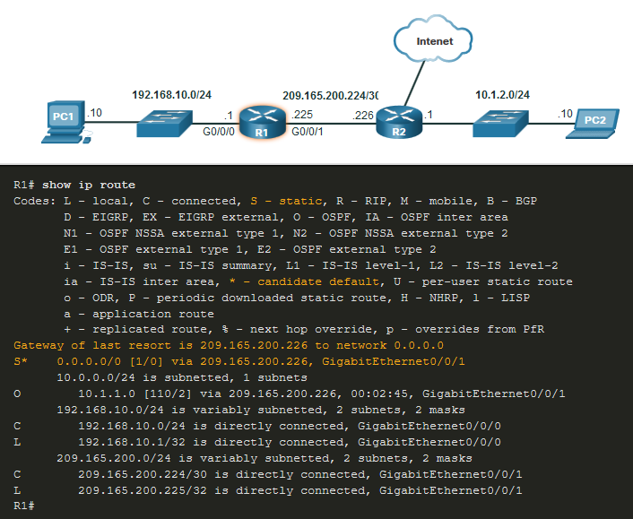
Introduction to Routing
Introduction to an IPv4 Routing Table
The show ip route command shows the following route sources:
  L - Directly connected local interface IP address
  C – Directly connected network
  S – Static route was manually configured by an administrator
  O – OSPF
  D – EIGRP
This command shows types of routes:
  Directly Connected – C and L
  Remote Routes – O, D, etc.
  Default Routes – S*
Notes:
8 – Network Layer
8.5 – Introduction to Routing
8.5.6 – Introduction to an IPv4 Routing Table
8.5.7 – Check Your Understanding – Introduction to Routing

Slide 36
8.6 Module Practice and Quiz
Notes:
8 – Network Layer
8.6 – Module Practice and Quiz

Slide 37
Module Practice and Quiz
What did I learn in this module?
    IP is connectionless, best effort, and media independent.
    IP does not guarantee packet delivery.
    IPv4 packet header consists of fields containing information about the packet.
    IPv6 overcomes IPv4 lack of end-to-end connectivity and increased network complexity.
    A device will determine if a destination is itself, another local host, and a remote host.
    A default gateway is router that is part of the LAN and will be used as a door to other networks.
    The routing table contains a list of all known network addresses (prefixes) and where to forward the packet.
    The router uses longest subnet mask or prefix match.
    The routing table has three types of route entries: directly connected networks, remote networks, and a default route.
Notes:
8 – Network Layer
8.6 – Module Practice and Quiz
8.6.1 – What did I learn in this module?

Slide 38
Network Layer
New Terms and Commands
Encapsulation
Routing
De-encapsulation
Data payload
Packet
Internet Protocol Version 4 (IPv4)
Internet Protocol Version 6 (IPv6)
Network Layer PDU = IP Packet
IP Header
Best effort delivery
Media independent
Connectionless
Unreliable
Maximum Transmission Unit (MTU)
Version
Differentiated Services (DS)
Time-to-Live (TTL)
Internet Control Message Protocol (ICMP)
Identification, Flags, Fragment Offset fields
Network Address Translation (NAT)
Traffic Class
Flow Label
Payload Length
Next Header
Hop Limit
Extension Headers
Local host
Remote host
Default Gateway
Notes:
New Terms and Commands

Slide 39
Network Layer
New Terms and Commands
netstat –r
route print
interface list
IPv4 Route Table
IPv6 Route Table
directly-connected routes
remote routes
default route
show ip route
route source
destination network
outgoing interface
administrative distance
metric
next-hop
route timestamp
Notes:
New Terms and Commands

