Slide 1
Module 12: IPv6 Addressing
Introduction to Networks v7.0 (ITN)
Notes:
Cisco Networking Academy Program
Introduction to Networks v7.0 (ITN)
Module 12: IPv6 Addressing

Slide 2
Module Objectives
Module Title: IPv6 Addressing
Module Objective: Implement an IPv6 Addressing scheme.
Topic Title | Topic Objective
IPv4 Issues | Explain the need for IPv6 addressing.
IPv6 Address Representation | Explain how IPv6 addresses are represented.
IPv6 Address Types | Compare types of IPv6 network addresses.
GUA and LLA Static Configuration | Explain how to Configure static global unicast and link-local IPv6 network addresses.
Dynamic Addressing for IPv6 GUAs | Explain how to configure global unicast addresses dynamically.
Notes:
2
12- IPv6 Addressing
12.0.2 What will I learn to do in this module

Slide 3
Module Objectives (Cont.)
Module Title: IPv6 Addressing
Module Objective: Implement an IPv6 Addressing scheme.
Topic Title | Topic Objective
Dynamic Addressing for IPv6 LLAs | Configure link-local addresses dynamically.
IPv6 Multicast Addresses | Identify IPv6 addresses.
Subnet an IPv6 Network | Implement a subnetted IPv6 addressing scheme.
Notes:
3
12- IPv6 Addressing
12.0.2 What will I learn to do in this module

Slide 4
12.1 IPv4 Issues
Notes:
12-IPv6 Addressing
12.1 IPv4 Issues

Slide 5
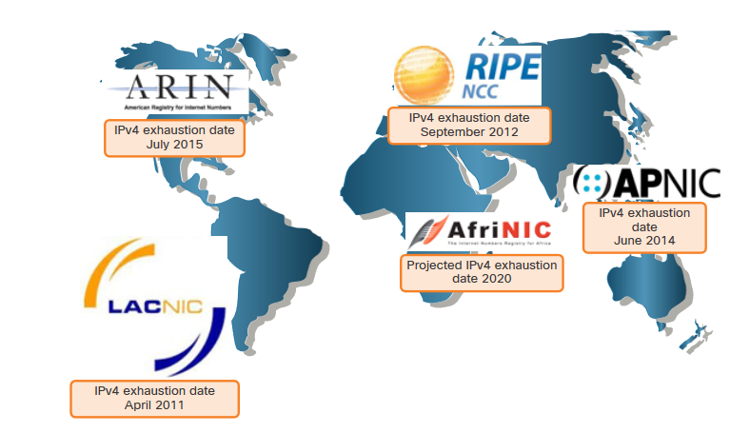
IPv4 Issues
Need for IPv6
IPv4 is running out of addresses. IPv6 is the successor to IPv4. IPv6 has a much larger 128-bit address space.
The development of IPv6 also included fixes for IPv4 limitations and other enhancements.
With an increasing internet population, a limited IPv4 address space, issues with NAT and the IoT, the time has come to begin the transition to IPv6.
Notes:
12 – IPv6 Addressing
12.1 – IPv4 Issues
12.1.1 – Need for IPv6

Slide 6
IPv4 Issues
IPv4 and IPv6 Coexistence
Both IPv4 and IPv6 will coexist in the near future and the transition will take several years.
The IETF has created various protocols and tools to help network administrators migrate their networks to IPv6. These migration techniques can be divided into three categories:
  Dual stack -The devices run both IPv4 and IPv6 protocol stacks simultaneously.
  Tunneling – A method of transporting an IPv6 packet over an IPv4 network. The IPv6 packet is encapsulated inside an IPv4 packet.
  Translation - Network Address Translation 64 (NAT64) allows IPv6-enabled devices to communicate with IPv4-enabled devices using a translation technique similar to NAT for IPv4.
Note: Tunneling and translation are for transitioning to native IPv6 and should only be used where needed. The goal should be native IPv6 communications from source to destination.
Notes:
12 – IPv6 Addressing
12.1 – IPv4 Issues
12.1.2 – IPv4 and IPv6 Coexistence
12.1.3 – Check Your Understanding – IPv4 Issues

Slide 7
12.2 IPv6 Address Representation
Notes:
12-IPv6 Addressing
12.2 IPv4 Address Representation

Slide 8
IPv6 Address Representation
IPv6 Addressing Formats
IPv6 addresses are 128 bits in length and written in hexadecimal.
IPv6 addresses are not case-sensitive and can be written in either lowercase or uppercase.
The preferred format for writing an IPv6 address is x:x:x:x:x:x:x:x, with each “x” consisting of four hexadecimal values.
In IPv6, a hextet is the unofficial term used to refer to a segment of 16 bits, or four hexadecimal values.
Examples of IPv6 addresses in the preferred format:
        2001:0db8:0000:1111:0000:0000:0000:0200
        2001:0db8:0000:00a3:abcd:0000:0000:1234
Notes:
12 – IPv6 Addressing
12.2 – IPv6 Address Representation
12.2.1 – IPv6 Addressing Formats

Slide 9
IPv6 Address Representation
Rule 1 – Omit Leading Zero
The first rule to help reduce the notation of IPv6 addresses is to omit any leading 0s (zeros).
  Examples:
01ab can be represented as 1ab
09f0 can be represented as 9f0
0a00 can be represented as a00
00ab can be represented as ab
Note: This rule only applies to leading 0s, NOT to trailing 0s, otherwise the address would be ambiguous.
Type | Format
Preferred | 2001 : 0db8 : 0000 : 1111 : 0000 : 0000 : 0000 : 0200
No leading zeros | 2001 : db8 : 0 : 1111 : 0 : 0 : 0 : 200
Notes:
12 – IPv6 Addressing
12.2 – IPv6 Address Representation
12.2.2 – Omit Leading Zero

Slide 10
IPv6 Address Representation
Rule 2 – Double Colon
A double colon (::) can replace any single, contiguous string of one or more 16-bit hextets consisting of all zeros.
Example:
2001:db8:cafe:1:0:0:0:1 (leading 0s omitted) could be represented as 2001:db8:cafe:1::1
Note: The double colon (::) can only be used once within an address, otherwise there would be more than one possible resulting address.
Type | Format
Preferred | 2001 : 0db8 : 0000 : 1111 : 0000 : 0000 : 0000 : 0200
Compressed | 2001:db8:0:1111::200
Notes:
12 – IPv6 Addressing
12.2 – IPv6 Address Representation
12.2.2 – Rule 2 – Double Colon
12.2.4 – Activity – IPv6 Address Representation

Slide 11
12.3 IPv6 Address Types
Notes:
12-IPv6 Addressing
12.2 IPv4 Address Types

Slide 12
IPv6 Address Types
Unicast, Multicast, Anycast
There are three broad categories of IPv6 addresses:
Unicast – Unicast uniquely identifies an interface on an IPv6-enabled device.
Multicast – Multicast is used to send a single IPv6 packet to multiple destinations.
Anycast – This is any IPv6 unicast address that can be assigned to multiple devices. A packet sent to an anycast address is routed to the nearest device having that address.
Note: Unlike IPv4, IPv6 does not have a broadcast address. However, there is an IPv6 all-nodes multicast address that essentially gives the same result.
Notes:
12 – IPv6 Addressing
12.3 – IPv6 Address Types
12.3.1 – Unicast, Multicast, Anycast

Slide 13
IPv6 Address Types
Address Type | Description | Topology
Unicast | “One to One” An address destined for a single interface. A packet sent to a unicast address is delivered to the interface identified by that address.
Multicast | “One to Many” An address for a set of interfaces (typically belonging to different nodes). A packet sent to a multicast address will be delivered to all interfaces identified by that address.
Anycast | “One to Nearest” (Allocated from Unicast) An address for a set of interfaces. In most cases these interfaces belong to different nodes. A packet sent to an anycast address is delivered to the closest interface as determined by the IGP.

Slide 14
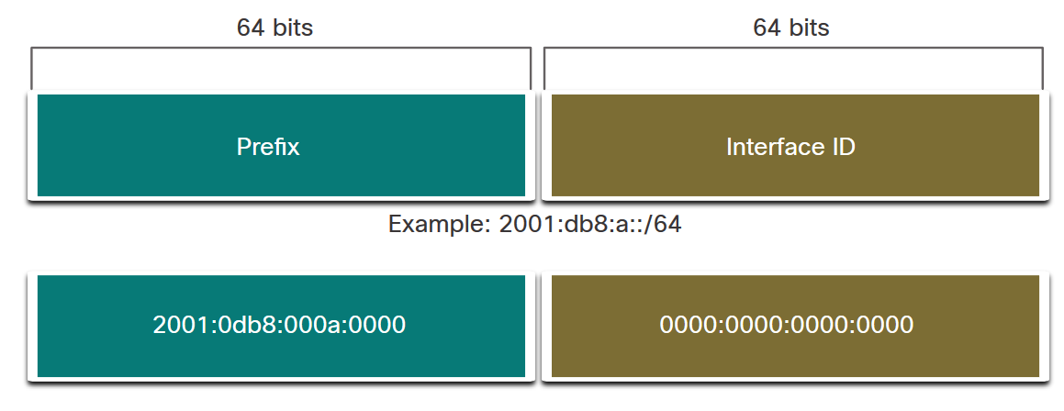
IPv6 Address Types
IPv6 Prefix Length
Prefix length is represented in slash notation and is used to indicate the network portion of an IPv6 address.
The IPv6 prefix length can range from 0 to 128. The recommended IPv6 prefix length for LANs and most other types of networks is /64.
Note: It is strongly recommended to use a 64-bit Interface ID for most networks. This is because stateless address autoconfiguration (SLAAC) uses 64 bits for the Interface ID. It also makes subnetting easier to create and manage.
Notes:
12 – IPv6 Addressing
12.3 – IPv6 Address Types
12.3.2 – IPv6 Prefix Length

Slide 15
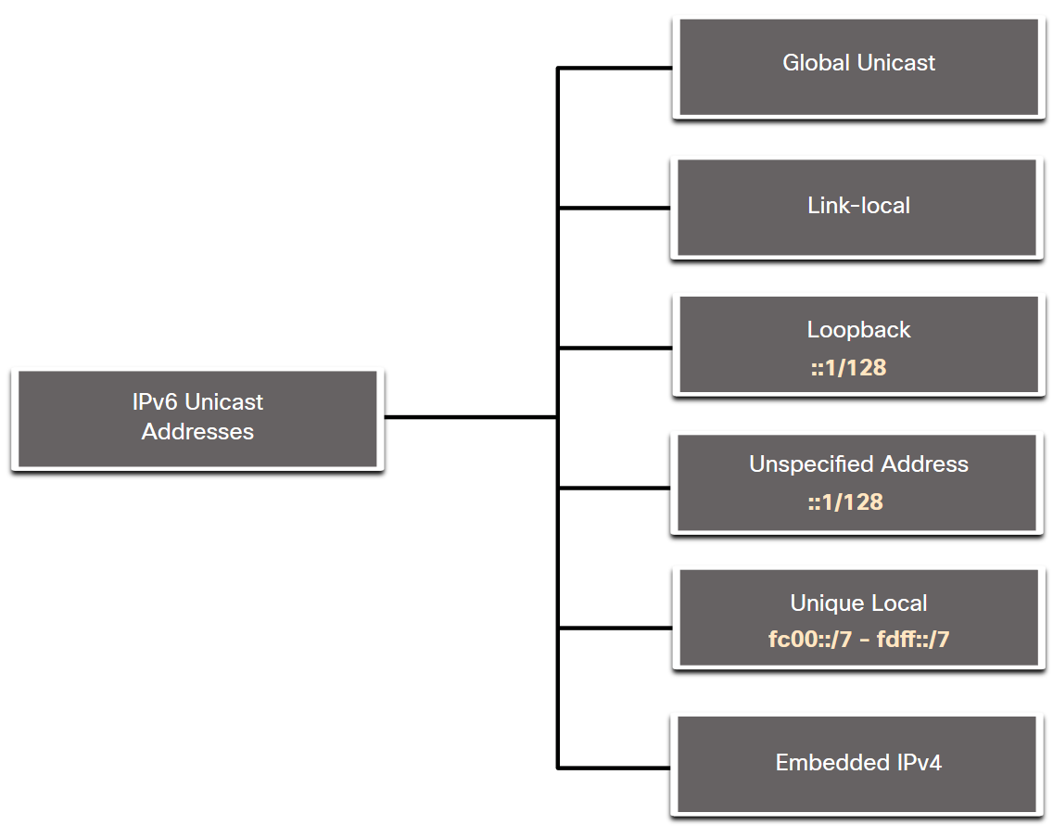
IPv6 Address Types
Types of IPv6 Unicast Addresses
Unlike IPv4 devices that have only a single address, IPv6 addresses typically have two unicast addresses:
Global Unicast Address (GUA) – This is similar to a public IPv4 address. These are globally unique, internet-routable addresses.
Link-local Address (LLA) - Required for every IPv6-enabled device and used to communicate with other devices on the same local link. LLAs are not routable and are confined to a single link.
Notes:
12 – IPv6 Addressing
12.3 – IPv6 Address Types
12.3.3 – Types of IPv6 unicast Addresses

Slide 16
Special IPv6 Addresses
IPv6 Address | Description
::/0 | All routes and used when specifying a default static route. It is equivalent to the IPv4 quad-zero (0.0.0.0).
::/128 | Unspecified address and is initially assigned to a host when it first resolves its local link address.
::1/128 | Loopback address of local host. Equivalent to 127.0.0.1 in IPv4.
FE80::/10 | Link-local unicast address. Similar to the Windows autoconfiguration IP address of 169.254.x.x.
FF00::/8 | Multicast addresses.
All other addresses | Global unicast address.

Slide 17
Reserved IPv6 Multicast Addresses
Reserved Multicast Address | Description
FF02::1 | All nodes on a link (link-local scope).
FF02::2 | All routers on a link.
FF02::9 | All routing information protocol (RIP) routers on a link.
FF02::1:FFxx:xxxx | All solicited-node multicast addresses used for host autoconfiguration and neighbor discovery (similar to ARP in IPv4). The xx:xxxx is the far right 24 bits of the corresponding unicast or anycast address of the node.
FF05::101 | All Network Time Protocol (NTP) servers.

Slide 18
Neighbor Discovery ICMPv6 Packet Types
Neighbor Discovery uses four ICMPv6 packet types:
  Neighbor Solicitation and Neighbor Advertisement messages
  Router Solicitation and Router Advertisement messages
ICMPv6 Message | Type | Description
Neighbor Solicitation (NS) | 135 | Sent by a host to determine the link-layer address of a neighbor. Used to verify that a neighbor is still reachable. An NS is also used for Duplicate Address Detection (DAD).
Neighbor Advertisement (NA) | 136 | A response to a NS message. A node may also send unsolicited NA to announce a link-layer address change.
Router Advertisement (RA) | 134 | RAs contain prefixes that are used for on-link determination or address configuration, a suggested hop limit value, MTU value, etc. RAs are sent either periodically, or in response to a RS message.
Router Solicitation (RS) | 133 | When a host is booting it send s out an RS requesting routers to immediately generate an RA rather than wait for their next scheduled time.

Slide 19
IPv6 Address Types
A Note About the Unique Local Address
The IPv6 unique local addresses (range fc00::/7 to fdff::/7) have some similarity to RFC 1918 private addresses for IPv4, but there are significant differences:
Unique local addresses are used for local addressing within a site or between a limited number of sites.
Unique local addresses can be used for devices that will never need to access another network.
Unique local addresses are not globally routed or translated to a global IPv6 address.
Note: Many sites use the private nature of RFC 1918 addresses to attempt to secure or hide their network from potential security risks. This was never the intended use of ULAs.
Notes:
12 – IPv6 Addressing
12.3 – IPv6 Address Types
12.3.4 – A Note About the Unique Local Address

Slide 20
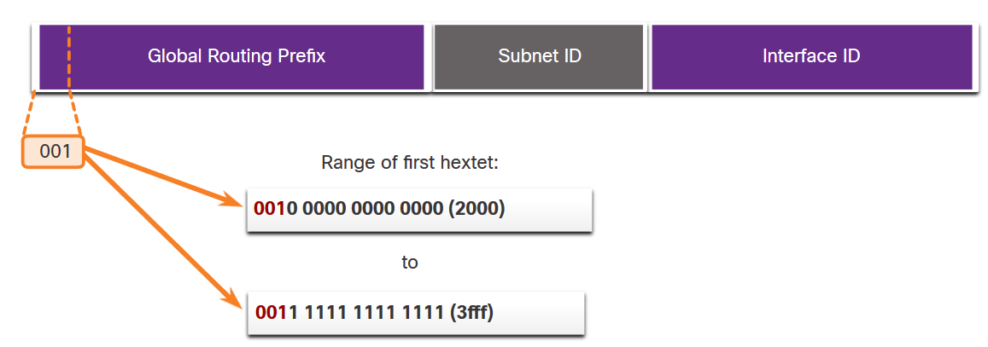
IPv6 Address Types
IPv6 GUA
IPv6 global unicast addresses (GUAs) are globally unique and routable on the IPv6 internet.
Currently, only GUAs with the first three bits of 001 or 2000::/3 are being assigned.
Currently available GUAs begins with a decimal 2 or a 3 (This is only 1/8th of the total available IPv6 address space).
Notes:
12 – IPv6 Addressing
12.3 – IPv6 Address Types
12.3.5 – IPv6 GUA

Slide 21
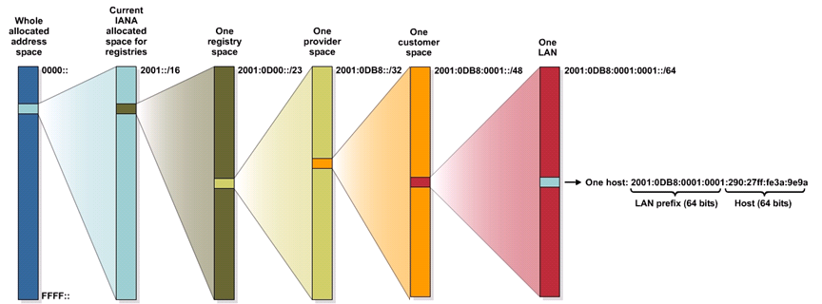
IPv6 Address Allocation Process
The following displays how IPv6 global unicast addresses are allocated by the IANA.
  Only a small portion (12.5%) of the IPv6 address space is being allocated to the Registries in the range of 2001::/16.

Slide 22
IPv6 Global Unicast Address
The global unicast address typically consists of:
  A 48-bit global routing prefix
  A 16-bit subnet ID
  A 64-bit interface ID (typically in EUI-64 bit format discussed later).
Subnet
ID
Global Routing Prefix
Interface ID
/23
/32
/48
/64
2001 0010 | 0008 |  |  | 21B:D5FF:FE5B:A408
Registry
ISP Prefix
Site Prefix
Subnet Prefix

Slide 23
IPv6 Address Types
IPv6 GUA Structure
Global Routing Prefix:
  The global routing prefix is the prefix, or network, portion of the address that is assigned by the provider, such as an ISP, to a customer or site. The global routing prefix will vary depending on ISP policies.
Subnet ID:
  The Subnet ID field is the area between the Global Routing Prefix and the Interface ID. The Subnet ID is used by an organization to identify subnets within its site.
Interface ID:
  The IPv6 interface ID is equivalent to the host portion of an IPv4 address. It is strongly recommended that in most cases /64 subnets should be used, which creates a 64-bit interface ID.
Note: IPv6 allows the all-0s and all-1s host addresses can be assigned to a device. The all-0s address is reserved as a Subnet-Router anycast address, and should be assigned only to routers.
Notes:
12 – IPv6 Addressing
12.3 – IPv6 Address Types
12.3.5 – IPv6 GUA Structure

Slide 24
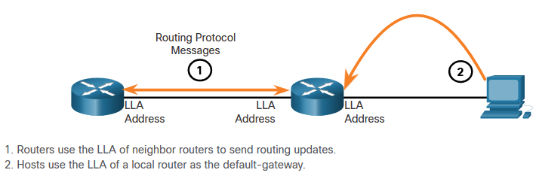
IPv6 Address Types
IPv6 LLA
An IPv6 link-local address (LLA) enables a device to communicate with other IPv6-enabled devices on the same link and only on that link (subnet).
Packets with a source or destination LLA cannot be routed.
Every IPv6-enabled network interface must have an LLA.
If an LLA is not configured manually on an interface, the device will automatically create one.
IPv6 LLAs are in the fe80::/10 range.
Notes:
12 – IPv6 Addressing
12.3 – IPv6 Address Types
12.3.6 – IPv6 LLA
12.3.7 – Check Your Understanding – IPv6 Address Types

Slide 25
12.4 GUA and LLA Static Configuration
Notes:
12-IPv6 Addressing
12.4- GUA and LLA Static Configuration

Slide 26
GUA and LLA Static Configuration
Static GUA Configuration on a Router
Most IPv6 configuration and verification commands in the Cisco IOS are similar to their IPv4 counterparts. In many cases, the only difference is the use of ipv6 in place of ip within the commands.
The command to configure an IPv6 GUA on an interface is: ipv6 address ipv6-address/prefix-length.
The example shows commands to configure a GUA on the G0/0/0 interface on R1:
R1(config)# interface gigabitethernet 0/0/0
R1(config-if)# ipv6 address 2001:db8:acad:1::1/64
R1(config-if)# no shutdown
R1(config-if)# exit
Notes:
12 – IPv6 Addressing
12.4 – GUA and LLA Static Configuration
12.4.1 – Static GUA Configuration on a Router

Slide 27
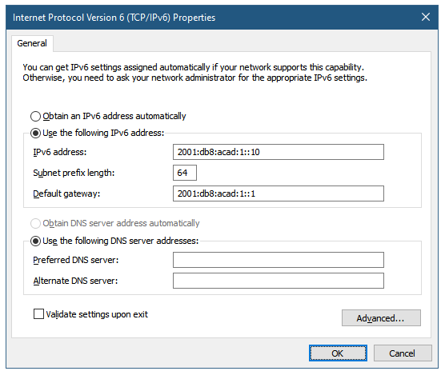
GUA and LLA Static Configuration
Static GUA Configuration on a Windows Host
Manually configuring the IPv6 address on a host is similar to configuring an IPv4 address.
The GUA or LLA of the router interface can be used as the default gateway. Best practice is to use the LLA.
Note: When DHCPv6 or SLAAC is used, the LLA of the router will automatically be specified as the default gateway address.
Notes:
12 – IPv6 Addressing
12.4 – GUA and LLA Static Configuration
12.4.2 – Static GUA Configuration on a Windows Host

Slide 28
GUA and LLA Static Configuration
Static GUA Configuration of a Link-Local Unicast Address
Configuring the LLA manually lets you create an address that is recognizable and easier to remember.
LLAs can be configured manually using the ipv6 address ipv6-link-local-address link-local command.
The example shows commands to configure a LLA on the G0/0/0 interface on R1
R1(config)# interface gigabitethernet 0/0/0
R1(config-if)# ipv6 address fe80::1:1 link-local
R1(config-if)# no shutdown
R1(config-if)# exit
Note: The same LLA can be configured on each link as long as it is unique on that link. Common practice is to create a different LLA on each interface of the router to make it easy to identify the router and the specific interface.
Notes:
12 – IPv6 Addressing
12.4 – GUA and LLA Static Configuration
12.4.3 – Static GUA Configuration of a Link-Local Unicast Address
12.4.4 – Syntax Checker – GUA and LLA Static Configuration

Slide 29
12.5 Dynamic Addressing for IPv6 GUAs
Notes:
12-IPv6 Addressing
12.5 IPv4 Dynamic Addressing for IPv6 GUAs

Slide 30
Dynamic Addressing for IPv6 GUAs
RS and RA Messages
Devices obtain GUA addresses dynamically through Internet Control Message Protocol version 6 (ICMPv6) messages.
  Router Solicitation (RS) messages are sent by host devices to discover IPv6 routers
  Router Advertisement (RA) messages are sent by routers to inform hosts on how to obtain an IPv6 GUA and provide useful network information such as:
    Network prefix and prefix length
    Default gateway address
    DNS addresses and domain name
  The RA can provide three methods for configuring an IPv6 GUA :
    SLAAC
    SLAAC with stateless DHCPv6 server
    Stateful DHCPv6 (no SLAAC)
Notes:
12 – IPv6 Addressing
12.5 – Dynamic Addressing for IPv6 GUAs
12.5.1 – RS and RA Messages

Slide 31
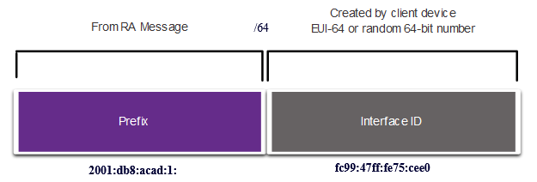
Dynamic Addressing for IPv6 GUAs
Method 1: SLAAC
SLAAC allows a device to configure a GUA without the services of DHCPv6.
Devices obtain the necessary information to configure a GUA from the ICMPv6 RA messages of the local router.
The prefix is provided by the RA and the device uses either the EUI-64 or random generation method to create an interface ID.
Notes:
12 – IPv6 Addressing
12.5 – Dynamic Addressing for IPv6 GUAs
12.5.2 – Method 1: SLAAC

Slide 32
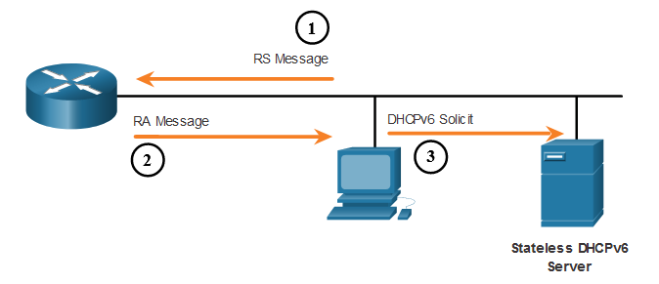
Dynamic Addressing for IPv6 GUAs
Method 2: SLAAC and Stateless DHCP
An RA can instruct a device to use both SLAAC and stateless DHCPv6.
The RA message suggests devices use the following:
    SLAAC to create its own IPv6 GUA
    The router LLA, which is the RA source IPv6 address, as the default gateway address
    A stateless DHCPv6 server to obtain other information such as a DNS server address and a domain name
Notes:
12 – IPv6 Addressing
12.5 – Dynamic Addressing for IPv6 GUAs
12.5.3 – Method 2: SLAAC and Stateless DHCP

Slide 33
Dynamic Addressing for IPv6 GUAs
Method 3: Stateful DHCPv6
An RA can instruct a device to use stateful DHCPv6 only.
Stateful DHCPv6 is similar to DHCP for IPv4. A device can automatically receive a GUA, prefix length, and the addresses of DNS servers from a stateful DHCPv6 server.
The RA message suggests devices use the following:
    The router LLA, which is the RA source IPv6 address, for the default gateway address.
    A stateful DHCPv6 server to obtain a GUA, DNS server address, domain name and other necessary information.
Notes:
12 – IPv6 Addressing
12.5 – Dynamic Addressing for IPv6 GUAs
12.5.4 – Method 3: Stateful DHCPv6

Slide 34
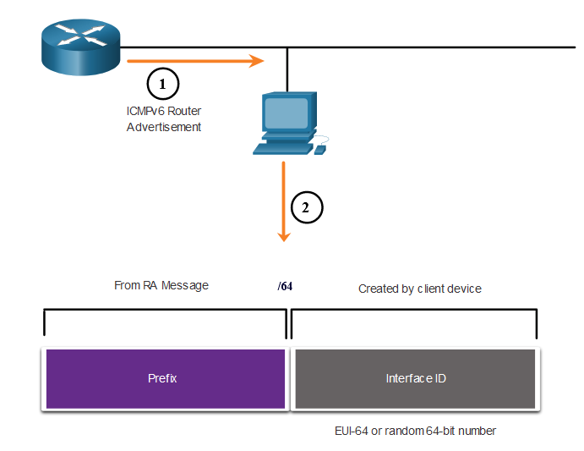
Dynamic Addressing for IPv6 GUAs
EUI-64 Process vs. Randomly Generated
When the RA message is either SLAAC or SLAAC with stateless DHCPv6, the client must generate its own interface ID.
The interface ID can be created using the EUI-64 process or a randomly generated 64-bit number.
Notes:
12 – IPv6 Addressing
12.5 – Dynamic Addressing for IPv6 GUAs
12.5.5 – EUI-64 Process vs. Randomly Generated

Slide 35
Dynamic Addressing for IPv6 GUAs
EUI-64 Process
The IEEE defined the Extended Unique Identifier (EUI) or modified EUI-64 process which performs the following:
A 16 bit value of fffe (in hexadecimal) is inserted into the middle of the 48-bit Ethernet MAC address of the client.
The 7th bit of the client MAC address is reversed from binary 0 to 1.
Example:
48-bit MAC | fc:99:47:75:ce:e0
EUI-64 Interface ID | fe:99:47:ff:fe:75:ce:e0
Notes:
12 – IPv6 Addressing
12.5 – Dynamic Addressing for IPv6 GUAs
12.5.6 – EUI-64 Process

Slide 36
Dynamic Addressing for IPv6 GUAs
Randomly Generated Interface IDs
Depending upon the operating system, a device may use a randomly generated interface ID instead of using the MAC address and the EUI-64 process.
Beginning with Windows Vista, Windows uses a randomly generated interface ID instead of one created with EUI-64.
C:\> ipconfig
Windows IP Configuration
Ethernet adapter Local Area Connection:
Connection-specific DNS Suffix . :
IPv6 Address. . . . . . . . . . . : 2001:db8:acad:1:50a5:8a35:a5bb:66e1
Link-local IPv6 Address . . . . . : fe80::50a5:8a35:a5bb:66e1
Default Gateway . . . . . . . . . : fe80::1
C:\>
Note: To ensure the uniqueness of any IPv6 unicast address, the client may use a process known as Duplicate Address Detection (DAD). This is similar to an ARP request for its own address. If there is no reply, then the address is unique.
Notes:
12 – IPv6 Addressing
12.5 – Dynamic Addressing for IPv6 GUAs
12.5.7 – Randomly Generated Interface IDs
12.5.8 – Check Your Understanding – Dynamic Address for IPv6 GUAs

Slide 37
12.6 Dynamic Addressing for IPv6 LLAs
Notes:
12-IPv6 Addressing
12.6 IPv4 Dynamic Addressing for IPv6 LLAs

Slide 38
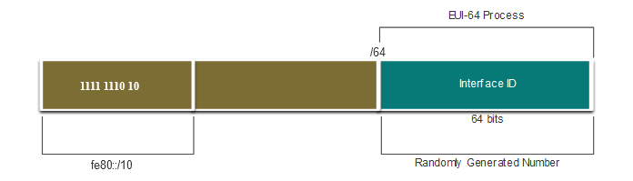
Dynamic Addressing for IPv6 LLAs
Dynamic LLAs
All IPv6 interfaces must have an IPv6 LLA.
Like IPv6 GUAs, LLAs can be configured dynamically.
The figure shows the LLA is dynamically created using the fe80::/10 prefix and the interface ID using the EUI-64 process, or a randomly generated 64-bit number.
Notes:
12 – IPv6 Addressing
12.6 – Dynamic Addressing for IPv6 LLAs
12.6.1 – Dynamic LLAs

Slide 39
Dynamic Addressing for IPv6 LLAs
Dynamic LLAs on Windows
Operating systems, such as Windows, will typically use the same method for both a SLAAC-created GUA and a dynamically assigned LLA.
EUI-64 Generated Interface ID:
C:\> ipconfig
Windows IP Configuration
Ethernet adapter Local Area Connection:
Connection-specific DNS Suffix . :
IPv6 Address. . . . . . . . . . . : 2001:db8:acad:1:fc99:47ff:fe75:cee0
Link-local IPv6 Address . . . . . : fe80::fc99:47ff:fe75:cee0
Default Gateway . . . . . . . . . : fe80::1
C:\>
Random 64-bit Generated Interface ID:
C:\> ipconfig
Windows IP Configuration
Ethernet adapter Local Area Connection:
Connection-specific DNS Suffix . :
IPv6 Address. . . . . . . . . . . : 2001:db8:acad:1:50a5:8a35:a5bb:66e1
Link-local IPv6 Address . . . . . : fe80::50a5:8a35:a5bb:66e1
Default Gateway . . . . . . . . . : fe80::1
C:\>
Notes:
12 – IPv6 Addressing
12.6 – Dynamic Addressing for IPv6 LLAs
12.6.2 – Dynamic LLAs on Windows

Slide 40
Dynamic Addressing for IPv6 LLAs
Dynamic LLAs on Cisco Routers
Cisco routers automatically create an IPv6 LLA whenever a GUA is assigned to the interface. By default, Cisco IOS routers use EUI-64 to generate the interface ID for all LLAs on IPv6 interfaces.
Here is an example of a LLA dynamically configured on the G0/0/0 interface of R1:
R1# show interface gigabitEthernet 0/0/0
GigabitEthernet0/0/0 is up, line protocol is up
Hardware is ISR4221-2x1GE, address is 7079.b392.3640 (bia 7079.b392.3640)
(Output omitted)
R1# show ipv6 interface brief
GigabitEthernet0/0/0 [up/up]
FE80::7279:B3FF:FE92:3640
2001:DB8:ACAD:1::1
Notes:
12 – IPv6 Addressing
12.6 – Dynamic Addressing for IPv6 LLAs
12.6.3 – Dynamic LLAs on Cisco Routers

Slide 41
Dynamic Addressing for IPv6 LLAs
Verify IPv6 Address Configuration
Cisco routers automatically create an IPv6 LLA whenever a GUA is assigned to the interface. By default, Cisco IOS routers use EUI-64 to generate the interface ID for all LLAs on IPv6 interfaces.
Here is an example of a LLA dynamically configured on the G0/0/0 interface of R1:
R1# show interface gigabitEthernet 0/0/0
GigabitEthernet0/0/0 is up, line protocol is up
Hardware is ISR4221-2x1GE, address is 7079.b392.3640 (bia 7079.b392.3640)
(Output omitted)
R1# show ipv6 interface brief
GigabitEthernet0/0/0 [up/up]
FE80::7279:B3FF:FE92:3640
2001:DB8:ACAD:1::1
Notes:
12 – IPv6 Addressing
12.6 – Dynamic Addressing for IPv6 LLAs
12.6.4 – Verify IPv6 Address Configuration
12.6.5 – Syntax Checker – Verify IPv6 Address Configuration

Slide 42
Module Practice and Quiz
Packet Tracer – Configure IPv6 Addressing
In this Packet Tracer, you will do the following:
Configure IPv6 Addressing on the router
Configure IPv6 Addressing on the servers
Configure IPv6 Addressing on the clients
Test and verify network connectivity
Notes:
12 – IPv6 Addressing
12.6 – Dynamic Addressing for IPv6 LLAs
12.6.6 – Packet Tracer – Configure IPv6 Addressing

Slide 43
12.7 IPv6 Multicast Addresses
Notes:
12-IPv6 Addressing
12.7 IPv4 Multicast Addresses

Slide 44
IPv6 Multicast Addresses
Assigned IPv6 Multicast Addresses
IPv6 multicast addresses have the prefix ff00::/8. There are two types of IPv6 multicast addresses:
  Well-Known multicast addresses
  Solicited node multicast addresses
Note: Multicast addresses can only be destination addresses and not source addresses.
Notes:
12 – IPv6 Addressing
12.7 – IPv6 Multicast Addresses
12.7.1 – Assigned IPv6 Multicast Addresses

Slide 45
IPv6 Multicast Addresses
Well-Known IPv6 Multicast Addresses
Well-known IPv6 multicast addresses are assigned and are reserved for predefined groups of devices.
There are two common IPv6 Assigned multicast groups:
  ff02::1 All-nodes multicast group - This is a multicast group that all IPv6-enabled devices join. A packet sent to this group is received and processed by all IPv6 interfaces on the link or network.
  ff02::2 All-routers multicast group - This is a multicast group that all IPv6 routers join. A router becomes a member of this group when it is enabled as an IPv6 router with the ipv6 unicast-routing global configuration command.
Notes:
12 – IPv6 Addressing
12.7 – IPv6 Multicast Addresses
12.7.2 – Well-Known IPv6 Multicast Addresses

Slide 46
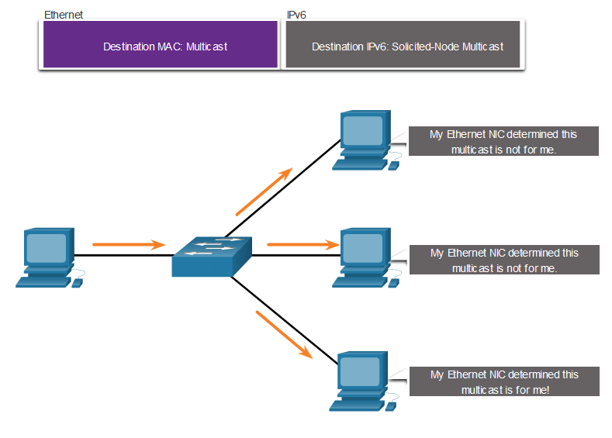
IPv6 Multicast Addresses
Solicited-Node IPv6 Multicast
A solicited-node multicast address is similar to the all-nodes multicast address.
A solicited-node multicast address is mapped to a special Ethernet multicast address.
The Ethernet NIC can filter the frame by examining the destination MAC address without sending it to the IPv6 process to see if the device is the intended target of the IPv6 packet.
Notes:
12 – IPv6 Addressing
12.7 – IPv6 Multicast Addresses
12.7.3 – Solicited-Node IPv6 Multicast Address
12.7.4 – Lab – Identify IPv6 Addresses

Slide 47
Module Practice and Quiz
Lab – Identify IPv6 Addresses
In this lab, you complete the following objectives:
Identify the Different Types of IPv6 Addresses
Examine a Host IPv6 Network Interface and Address
Practice IPv6 Address Abbreviation
Notes:
12 – IPv6 Addressing
12.7 – IPv6 Multicast Addresses
12.7.4 – Lab – Identify IPv6 Addresses

Slide 48
12.8 Subnet an IPv6 Network
Notes:
12-IPv6 Addressing
12.8 Subnet an IPv6 Network

Slide 49
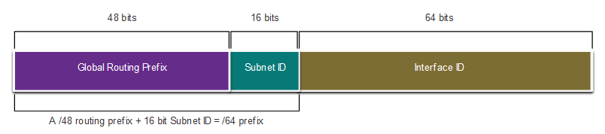
Subnet an IPv6 Network
Subnet Using the Subnet ID
IPv6 was designed with subnetting in mind.
A separate subnet ID field in the IPv6 GUA is used to create subnets.
The subnet ID field is the area between the Global Routing Prefix and the interface ID.
Notes:
12 – IPv6 Addressing
12.8 – Subnet an IPv6 Network
12.8.1 – Subnet Using the Subnet ID

Slide 50
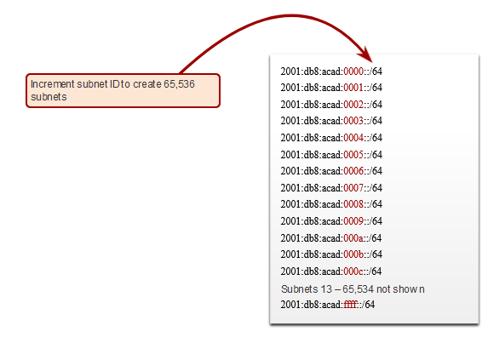
Subnet an IPv6 Network
IPv6 Subnetting Example
Given the 2001:db8:acad::/48 global routing prefix with a 16 bit subnet ID.
Allows 65,536 /64 subnets
The global routing prefix is the same for all subnets.
Only the subnet ID hextet is incremented in hexadecimal for each subnet.
Notes:
12 – IPv6 Addressing
12.8 – Subnet an IPv6 Network
12.8.2 – IPv6 Subnetting Example

Slide 51
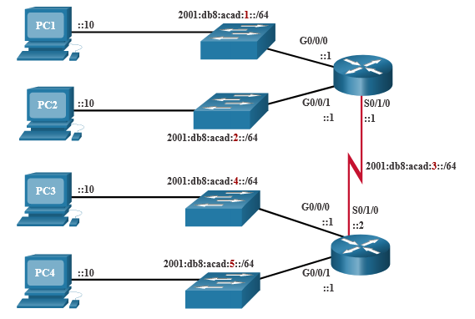
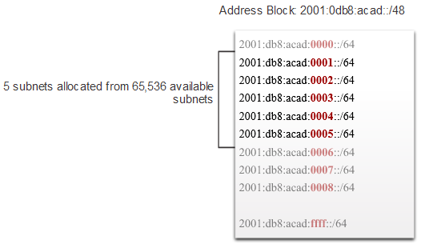
Subnet an IPv6 Network
IPv6 Subnet Allocation
The example topology requires five subnets, one for each LAN as well as for the serial link between R1 and R2.
The five IPv6 subnets were allocated, with the subnet ID field 0001 through 0005. Each /64 subnet will provide more addresses than will ever be needed.
Notes:
12 – IPv6 Addressing
12.8 – Subnet an IPv6 Network
12.8.3 – IPv6 Subnet Allocation

Slide 52
Subnet an IPv6 Network
Router Configured with IPv6 Subnets
The example shows that each of the router interfaces on R1 has been configured to be on a different IPv6 subnet.
R1(config)# interface gigabitethernet 0/0/0
R1(config-if)# ipv6 address 2001:db8:acad:1::1/64
R1(config-if)# no shutdown
R1(config-if)# exit
R1(config)# interface gigabitethernet 0/0/1
R1(config-if)# ipv6 address 2001:db8:acad:2::1/64
R1(config-if)# no shutdown
R1(config-if)# exit
R1(config)# interface serial 0/1/0
R1(config-if)# ipv6 address 2001:db8:acad:3::1/64
R1(config-if)# no shutdown
Notes:
12 – IPv6 Addressing
12.8 – Subnet an IPv6 Network
12.8.4 – Router Configured with IPv6 Subnets
12.8.5 – Check Your Understanding – Subnet an IPv6 Network

Slide 53
2.9 Module Practice and Quiz
Notes:
12 – IPv6 Addressing
12.9 – Module Practice and Quiz

Slide 54
Module Practice and Quiz
Packet Tracer – Implement a Subnetted IPv6 Addressing Scheme
In this Packet Tracer, you will do the following:
Determine IPv6 subnets and addressing scheme
Configure IPv6 addressing on routers and PCs
Verify IPv6 connectivity
Notes:
12 – IPv6 Addressing
12.9 – Module Practice and Quiz
12.9.1 – Packet Tracer – Implement a Subnetted IPv6 Addressing Scheme

Slide 55
Module Practice and Quiz
Lab – Configure IPv6 Addresses on Network Devices
In this lab, you complete the following objectives:
Set up the topology and configure basic router and switch settings
Configure IPv6 addresses manually
Verify end-to-end connectivity
Notes:
12 – IPv6 Addressing
12.9 – Module Practice and Quiz
12.9.2 – Lab – Configure IPv6 Addresses on Network Devices

Slide 56
Module Practice and Quiz
What did I learn in this module?
IPv4 has a theoretical maximum of 4.3 billion addresses.
The IETF has created various protocols and tools to help network administrators migrate their networks to IPv6. The migration techniques can be divided into three categories: dual stack, tunneling, and translation.
IPv6 addresses are 128 bits in length and written as a string of hexadecimal values.
The preferred format for writing an IPv6 address is x:x:x:x:x:x:x:x, with each “x” consisting of four hexadecimal values.
There are three types of IPv6 addresses: unicast, multicast, and anycast.
An IPv6 unicast address uniquely identifies an interface on an IPv6-enabled device.
IPv6 global unicast addresses (GUAs) are globally unique and routable on the IPv6 internet.
An IPv6 link-local address (LLA) enables a device to communicate with other IPv6-enabled devices on the same link and only on that link (subnet).
The command to configure an IPv6 GUA on an interface is ipv6 address ipv6-address/prefix-length.
A device obtains a GUA dynamically through ICMPv6 messages. IPv6 routers periodically send out ICMPv6 RA messages, every 200 seconds, to all IPv6-enabled devices on the network.
Notes:
12 – WLAN Concepts
12.8 – Module Practice and Quiz
12.9.3 – What did I learn in this module?
12.9.4 – Module Quiz – IPv6 Addressing

Slide 57
Module Practice and Quiz
What did I learn in this module? (Cont.)
RA messages have three methods: SLAAC, SLAAC with a stateless DHCPv6 server, and stateful DHCPv6 (no SLAAC).
The interface ID can be created using the EUI-64 process or a randomly generated 64-bit number.
The EUIs process uses the 48-bit Ethernet MAC address of the client and inserts another 16 bits in the middle of MAC address to create a 64-bit interface ID.
Depending upon the operating system, a device may use a randomly generated interface ID.
All IPv6 devices must have an IPv6 LLA. An LLA can be configured manually or created dynamically.
Cisco routers automatically create an IPv6 LLA whenever a GUA is assigned to the interface.
There are two types of IPv6 multicast addresses: well-known multicast addresses and solicited node multicast addresses.
Two commonIPv6 assigned multicast groups are: ff02::1 All-nodes multicast group and ff02::2 All-routers multicast group.
A solicited-node multicast address is similar to the all-nodes multicast address. The advantage of a solicited-node multicast address is that it is mapped to a special Ethernet multicast address.
IPv6 was designed with subnetting in mind. A separate subnet ID field in the IPv6 GUA is used to create subnets.
Notes:
12 – WLAN Concepts
12.8 – Module Practice and Quiz
12.9.3 – What did I learn in this module?
12.9.4 – Module Quiz – IPv6 Addressing

Slide 58
Module 12: WLAN Concepts
New Terms and Commands
Hextet Link-local address (LLA) ipv6 address show ipv6 interface brief SLAAC Router advertisement Router solicitation EUI-64 Solicited node multicast

