Slide 1
DIPLOMACY
IMPACTS
Cyber
LIVES
Diplomacy
Opportunities
careers.state.gov

Slide 2
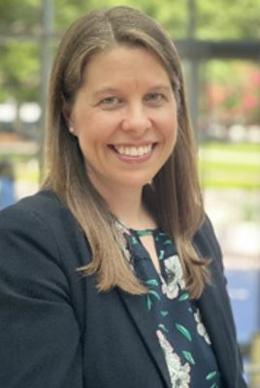
Who am I?
U.S. Foreign Service Officer (Diplomat)
Over 13 years experience
Served in Central African Republic, Argentina, Washington, D.C., and Switzerland
Originally from Vermont!
Michelle Kayser
Michelle Kayser, Diplomat in Residence – New England
DIRNewEngland@state.gov

Slide 3
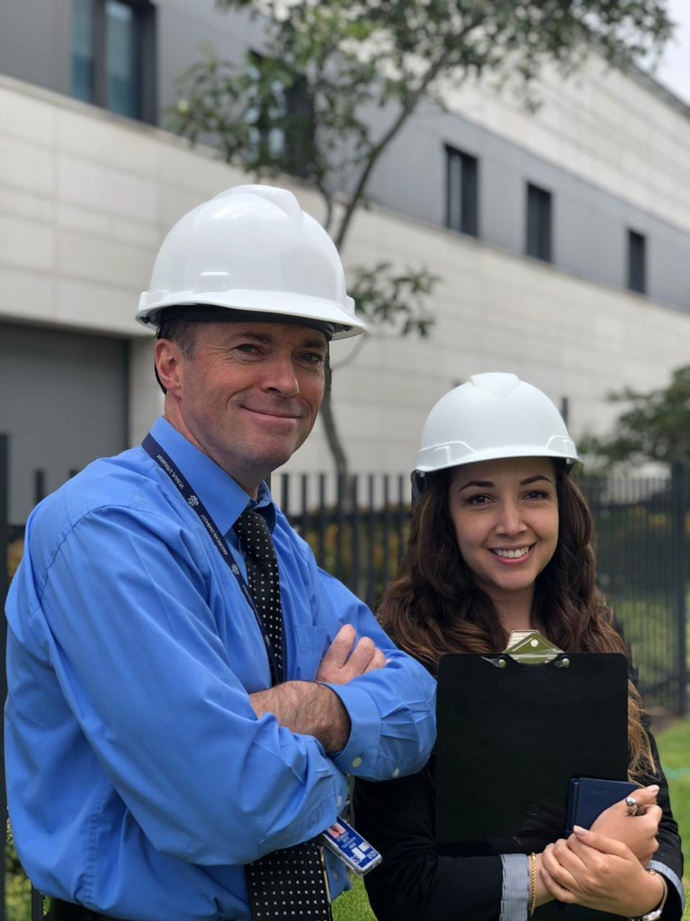
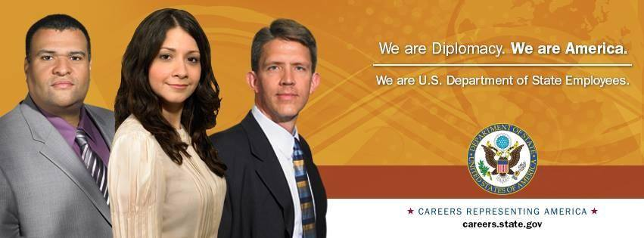
Who We Are
Nation’s Oldest Cabinet Agency
Lead U.S. Foreign Policy and
Diplomatic Engagement
Protect the interests of U.S. Citizens
Our Primary Mission: To promote peace and stability in areas of vital interest to America and build a freer, more prosperous and secure world.
Michelle Kayser, Diplomat in Residence – New England
DIRNewEngland@state.gov

Slide 4
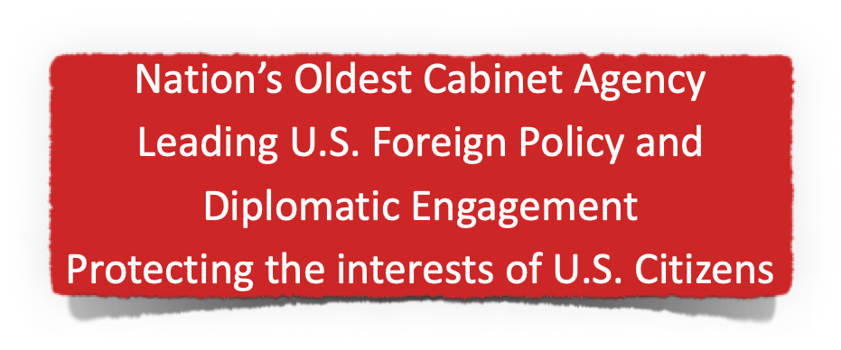
70,000 Employees in the U.S. and Overseas
14,000 Foreign Service Americans
8,000 Generalists
6,000 Specialists
11,000 Civil Service
45,000 Locally Employed Staff (non-US citizen employees at overseas missions)
Michelle Kayser, Diplomat in Residence – New England
DIRNewEngland@state.gov

Slide 5
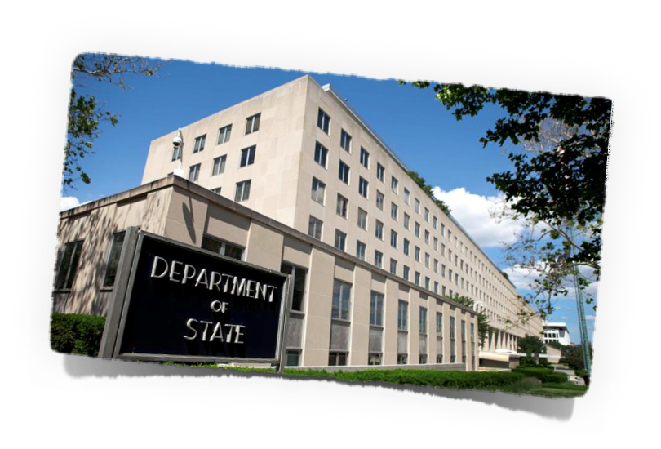
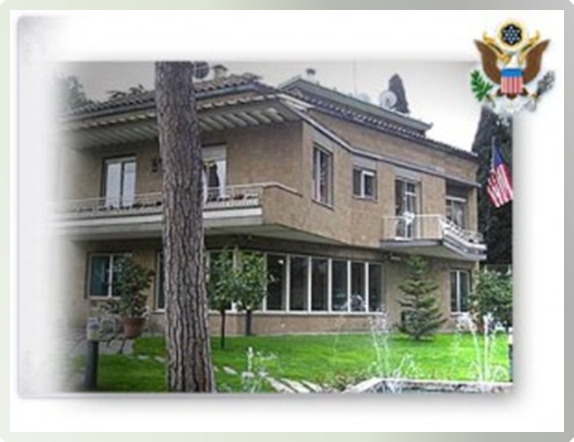
Where We Are
276 posts abroad in 191 countries
Headquarters in Washington, D.C.
Passport agencies and field offices are located throughout the U.S.
Michelle Kayser, Diplomat in Residence – New England
DIRNewEngland@state.gov

Slide 6
To understand and improve a diverse world, we must also be diverse.
All academic disciplines are useful in the U.S. State Department.
Michelle Kayser, Diplomat in Residence – New England
DIRNewEngland@state.gov

Slide 7
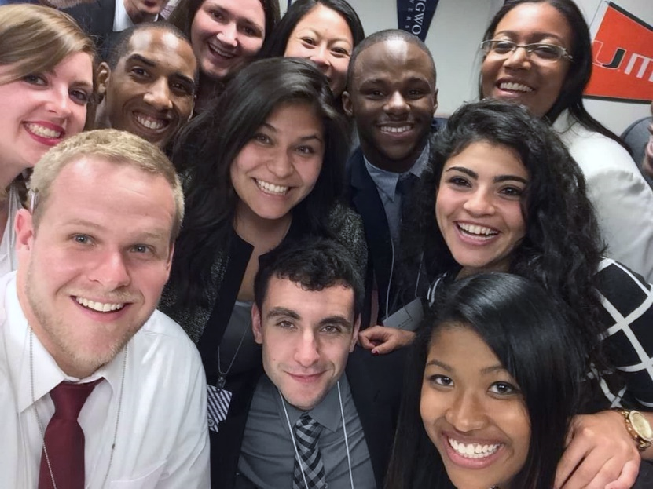
Student Internship Program
PAID internship with the opportunity to work in one of the many bureaus located
in Washington D.C.
Summer, Spring, and Fall cycles.
Eligibility/Requirements
Be a U.S. citizen
Have a minimum 3.2 GPA
Be able to receive either a Public Trust, Secret or Top Secret clearance
Be a Undergraduate (juniors and seniors) or Graduate Student
A student is an individual who is enrolled in a degree-seeking program in an accredited college or university
An applicant is considered a current or rising junior
See careers.state.gov for further details and how to apply
Michelle Kayser, Diplomat in Residence – New England
DIRNewEngland@state.gov

Slide 8
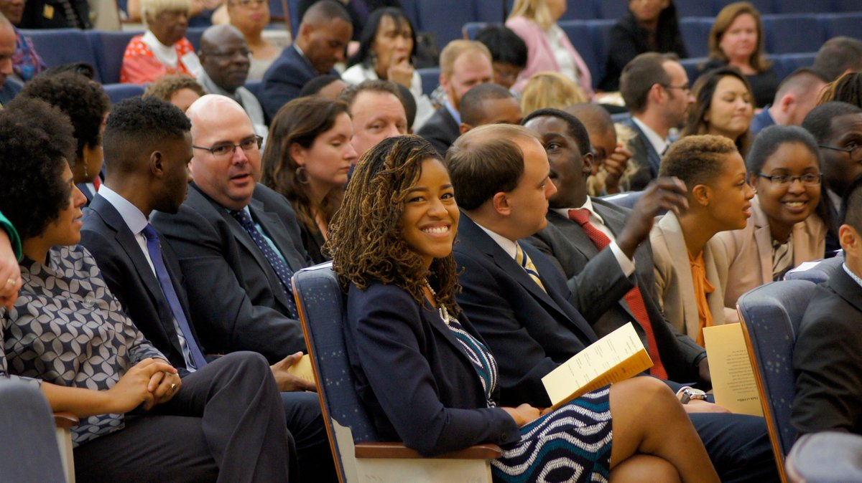
Student Internship Program
Internship Compensation
Hired as a temporary employee – GS-4 Level, Step 1
10 Week Internship
Transportation/Lodging Covered
Important Dates
Summer 2024 Program
Applications open NOW until October 9th
Internship Dates May to September (once Security Clearance is received)
https://www.usajobs.gov/job/751321700
Michelle Kayser, Diplomat in Residence – New England
DIRNewEngland@state.gov

Slide 9
Internship Fields of Study
African Affairs
Arms Control and International Security
Building Design and Construction
Conflict Resolution and Stabilization
Counterterrorism
Criminal Justice and Law Enforcement
Cybersecurity Operations
Data Science
East Asian and Pacific Affairs
Economics
Emerging Technology and Cyberspace Policy
Environmental Sciences
European and Eurasian Affairs
Facilities Management
Finance
Gender Studies
Global Public Health
Human Resources and Talent Management
Human Rights and Democracy Promotion
Information Technology
International Governmental Organizations
International Law
Law Enforcement
Legislative Affairs
Logistics Management, Operations, Contracting, Procurement
Marketing and Communications
Maritime Policy
National Security
Near Eastern Affairs
Public Diplomacy and Public Affairs
Science, Technology, Engineering, and Math (STEM)
Security Engineering and Countermeasures
South and Central Asian Affairs
Western Hemisphere Affairs
Michelle Kayser, Diplomat in Residence – New England
DIRNewEngland@state.gov

Slide 10
Student Internship Program
The Internship Experience
Participate in meetings with senior-level U.S. Government or foreign government officials
Draft, edit, or contribute to cables, reports, communications, talking points, or other materials used by policymakers in furthering U.S. foreign policy objectives
Support events, including international and/or multilateral meetings and conferences
Engage directly with U.S. audiences in helping to explain the work of the Department of State or foreign audiences in helping to promote U.S. foreign policy and improve understanding of U.S. culture and society
Michelle Kayser, Diplomat in Residence – New England
DIRNewEngland@state.gov

Slide 11
Student Internship Program
Ideal Candidates:
ALL majors are encouraged to apply
Strong essay answers
Commitment to public service
Articulate goals for the internship
You do not necessarily need to have:
A language skill
International travel or living aboard experience
Michelle Kayser, Diplomat in Residence – New England
DIRNewEngland@state.gov

Slide 12
U.S. Foreign Service Internship Program (USFSIP)
Applications open in August each year
Merit and need-based, rising Juniors & Seniors with 3.2 GPA
Two consecutive, paid summer internships (domestic/abroad):
Three weeks of academic and professional training in Washington followed by seven weeks working in a policy office at State
A ten-week assignment in a U.S. Embassy or Consulate abroad
Same compensation as SIP (GS-4 level, transportation, & lodging)
Michelle Kayser, Diplomat in Residence – New England
DIRNewEngland@state.gov

Slide 13
Virtual Student Federal Service Internship (VSFS)
Virtual internship -- 10 hours per week from September to May
Applications open in July
All enrolled students with high school degree are eligible to apply!
Eligibility Requirements:
U.S. Citizenship
High school graduate enrolled in a degree-seeking program in an accredited college or university
An Undergraduate, Graduate, or Doctorate Student for the duration of the internship/academic year
if the student has been out of school for no more than 5 months and has plans to return to school within 5 months
A student must be returning to school immediately following the internship
Michelle Kayser, Diplomat in Residence – New England
DIRNewEngland@state.gov

Slide 14
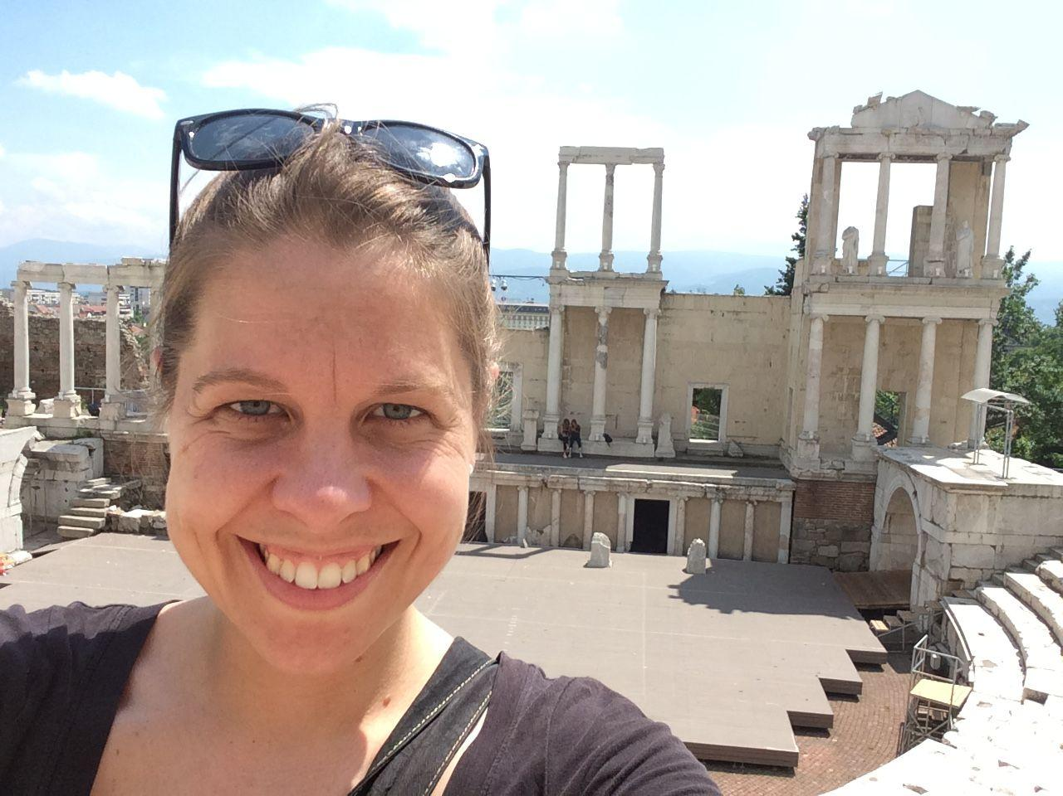
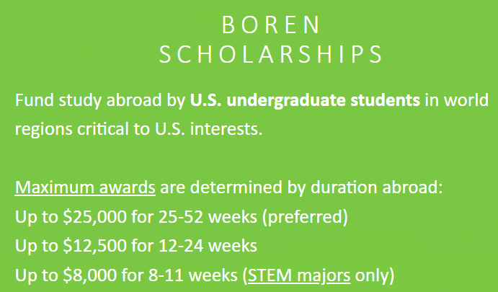
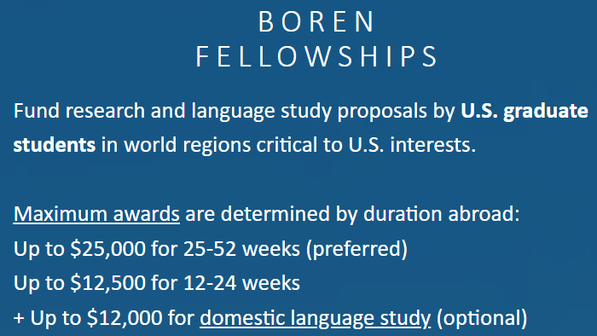
Study Abroad Opportunities
Gilman Scholarships for Pell Grant Recipients and Active Duty Military Dependents – gilmanscholarship.org
Critical Language Scholarship – clscholarship.org
Boren Scholars/Fellows -- https://www.borenawards.org/
Michelle Kayser, Diplomat in Residence – New England
DIRNewEngland@state.gov

Slide 15
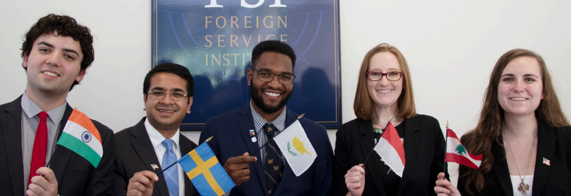
FAIT Fellowship
Up to $43,500 annually (for 2 years) in academic funding for tuition, room and board, books, mandatory fees and travel
Two summer internships (with up to $11,000 in stipend support):
one at a domestic at the Department of State in Washington, D.C.
one overseas at a U. S. embassy or consulate
Professional development, including a 10-week series during the first summer internship in D.C.
Mentoring from a Foreign Service IMS throughout the duration of the fellowship
An appointment as a Foreign Service IMS upon successful completion of the program and Foreign Service entry requirements
*Fellows agree to a minimum five-year commitment upon entry into the Foreign Service.
https://www.faitfellowship.org/
Michelle Kayser, Diplomat in Residence – New England
DIRNewEngland@state.gov

Slide 16
Clarke Fellowship
Up to $24,000 annually for tuition for a two-year, full-time master’s degree program
Up to $18,000 annually during the two years of graduate study for room and board, books/laboratory fees, and other academic expenses, and travel between your residence and graduate school.
Two summer practicums (with stipends, housing, and travel allowances):
one in Washington, D.C. with the Diplomatic Security Service
one overseas at a U. S. embassy or consulate
Personalized mentoring and professional development opportunities
*Fellows agree to a minimum 3-year commitment
upon entry into the Diplomatic Security Service
https://clarkedsfellowship.org/
Michelle Kayser, Diplomat in Residence – New England
DIRNewEngland@state.gov

Slide 17
Clarke Fellowship Eligibility
Be at least 19 years old and no older than 32 years old (except for preference-eligible veterans)
Pass the Physical Readiness Test (PRT) if selected as a finalist for the fellowship
Have a valid U.S. driver’s license if selected as a finalist for the fellowship
https://clarkedsfellowship.org/clarke-ds-fellowship/physical-readiness-test/
Michelle Kayser, Diplomat in Residence – New England
DIRNewEngland@state.gov

Slide 18
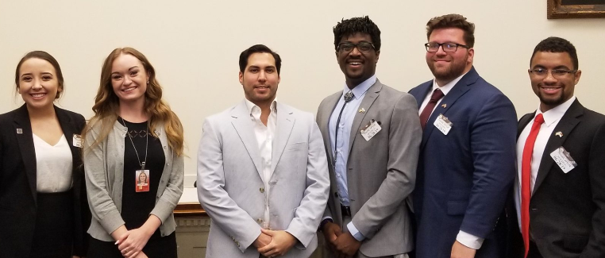
Rangel Summer Enrichment Program
A 6-week summer program for undergraduate students with two major components:
Two courses and a seminar to enhance knowledge and skills related to U.S. foreign policy, economics, and writing
The program introduces participants to government and non-government professionals who work on global issues, arranges visits to various international affairs institutions, and helps students explore graduate school, scholarship, fellowship, internship, and professional options in international affairs
Students live at Howard University, attend classes, and participate in a variety of programs with foreign affairs professionals at Howard and at diverse locations around Washington, DC.
The Program covers the costs for tuition, travel, housing, and two meals per day. It also provides a stipend of $3,300.
Eligibility:
U.S. citizenship
Undergraduates, at least sophomore status at time of application
Minimum cumulative GPA of 3.2 on a 4.0 scale at the time of application
https://rangelprogram.org/summer-enrichment-program/overview-eligibility/
Michelle Kayser, Diplomat in Residence – New England
DIRNewEngland@state.gov

Slide 19
Cyber & Networking Opportunities at State
The Bureau of Cyberspace and Digital Policy (CDP) promotes U.S. national and economic security by leading, coordinating, and elevating foreign policy on cyberspace and digital technologies. It builds partnerships to shape the international environment so Americans and people everywhere can prosper. CDP strives for a world in which every person can access the opportunities that come with digital connectivity to build thriving economies and societies and works to counter challenges to this vision from authoritarian states.
Michelle Kayser, Diplomat in Residence – New England
DIRNewEngland@state.gov

Slide 20
4 Policy Units:
International Cyberspace Security (ICS)
International Information and Communications Policy (ICP)
Digital Freedom (DFU)
Strategic Planning and Communications Unit (SPC)
Michelle Kayser, Diplomat in Residence – New England
DIRNewEngland@state.gov

Slide 21
Key Topics:
Promoting Stability and Security in Cyberspace
Advancing the Digital Economy
Advancing Digital Freedom
Building Digital Connectivity and Global Cyber Capacity
Michelle Kayser, Diplomat in Residence – New England
DIRNewEngland@state.gov

Slide 22
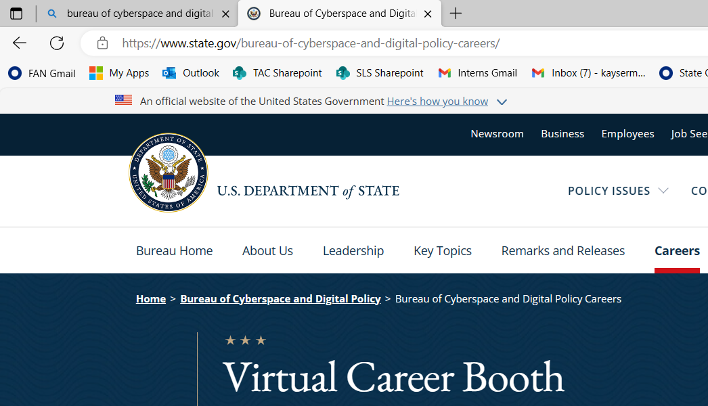
Careers with CDP:
Michelle Kayser, Diplomat in Residence – New England
DIRNewEngland@state.gov

Slide 23
Cyber & Networking Opportunities at State
The Bureau of Information Resource Management (IRM)’s mission is to create an interconnected, secure, and informed Department through the prioritized, secure, and innovative application of IT resources. Our vision is to drive necessary and effective operations and collaboration across the Department, its partners, and foreign audiences.
Michelle Kayser, Diplomat in Residence – New England
DIRNewEngland@state.gov

Slide 24
Information Management Specialists manage and operate information technology infrastructure, including PC local and wide area networks, telecommunications systems, telephone and UHF/VHF programs, and diplomatic pouch and mail services.
You would be responsible for ensuring the safety and integrity of all information, by protecting classified material, providing on-going technical support, and optimizing systems and network operations.
Every day, you’ll encounter new challenges that will broaden your expertise in the face of rapidly evolving technologies and systems outside your area of expertise. As you travel abroad and experience new cultures, your work will make a lasting impact on building peace and prosperity.
Michelle Kayser, Diplomat in Residence – New England
DIRNewEngland@state.gov

Slide 25
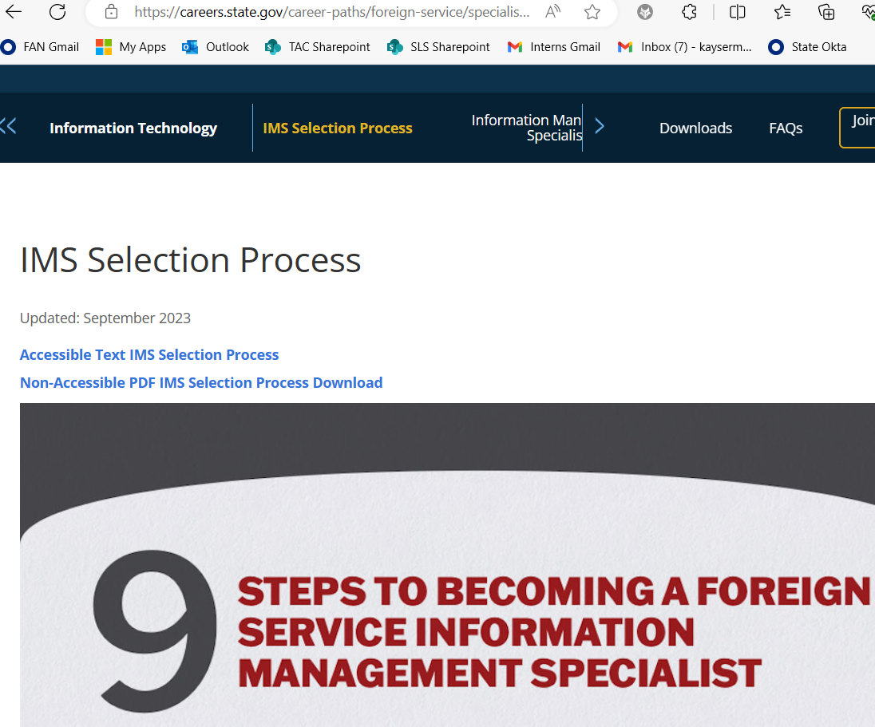
Careers with IRM:
https://careers.state.gov/career-paths/foreign-service/specialist/information-technology/ims-selection-process/
or
https://www.usajobs.gov/job/681046200
Michelle Kayser, Diplomat in Residence – New England
DIRNewEngland@state.gov

Slide 26
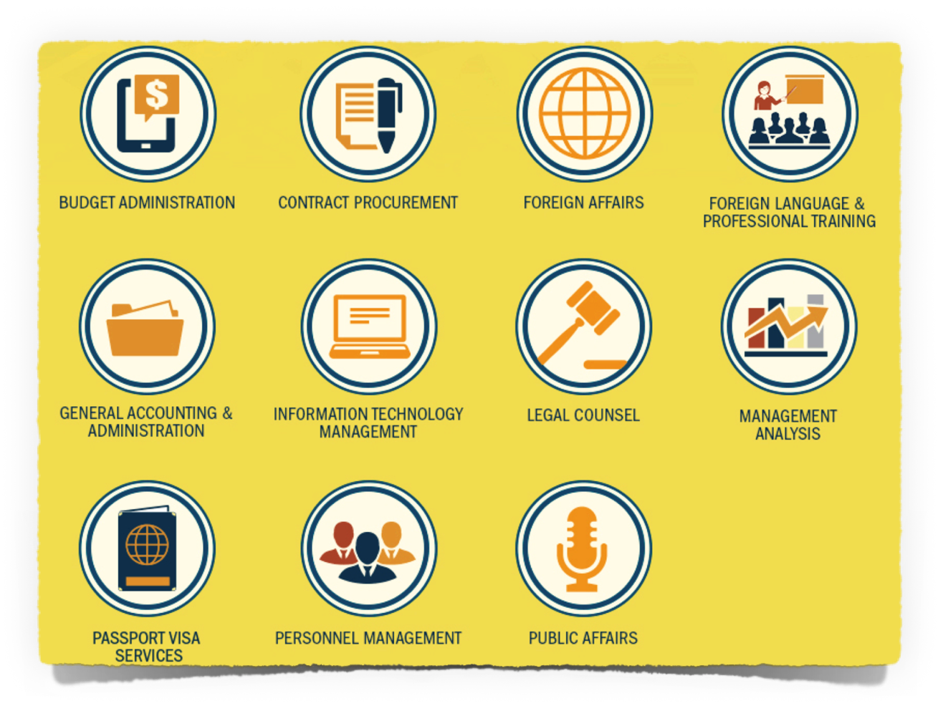
Apply now:
https://careers.state.gov/apply-now/#civilservice
Michelle Kayser, Diplomat in Residence – New England
DIRNewEngland@state.gov

Slide 27
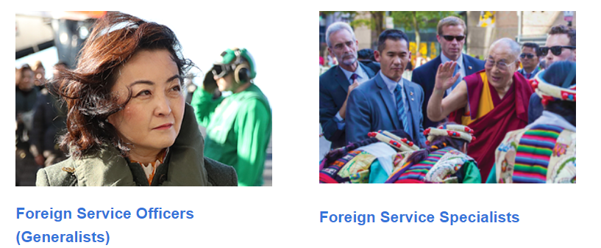
The Foreign Service
Michelle Kayser, Diplomat in Residence – New England
DIRNewEngland@state.gov

Slide 28
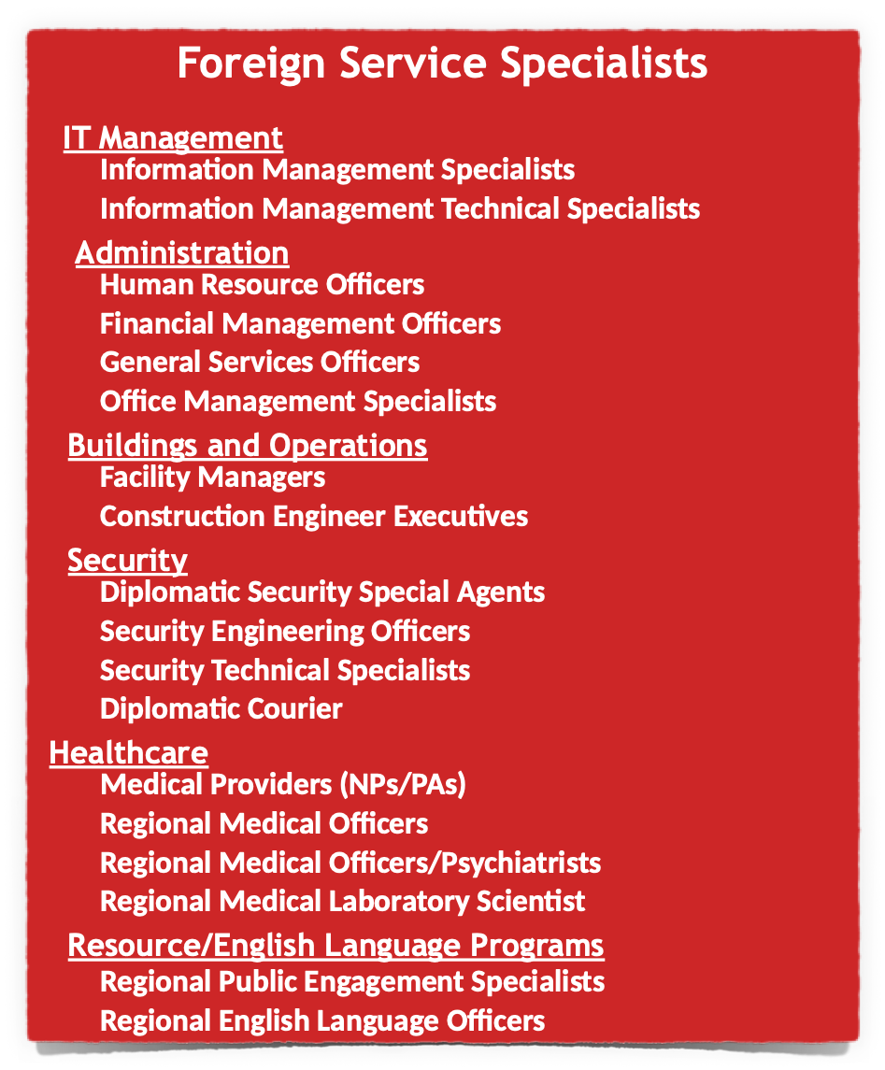
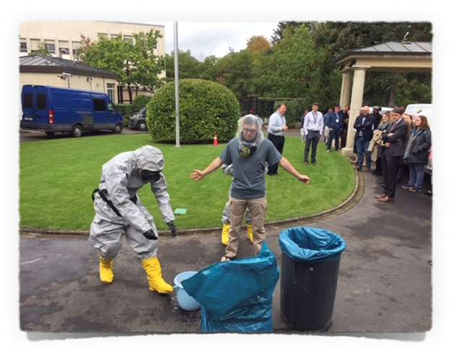
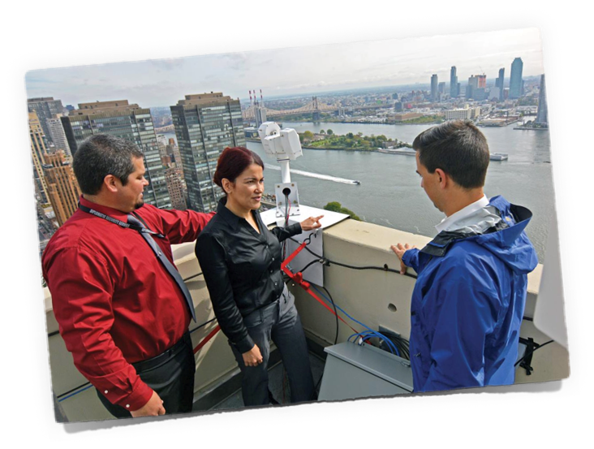
Michelle Kayser, Diplomat in Residence – New England
DIRNewEngland@state.gov

Slide 29
Foreign Service Generalists
https://careers.state.gov/career-paths/recruitment-events/recorded-events/
Notes:
Who takes the FSOT? Foreign Service Generalists (also known as Foreign Service Officers or FSOs). As a generalist, you must select one of these five career tracks.

Slide 30
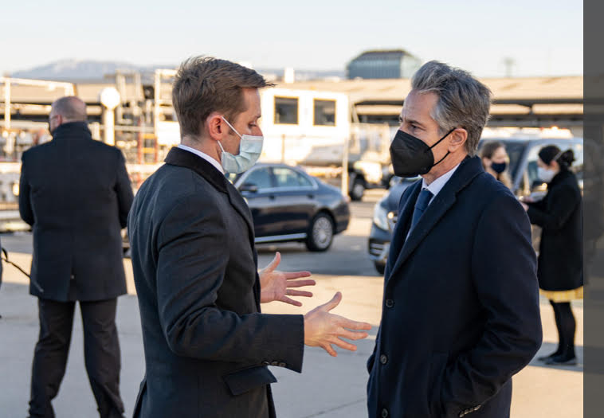
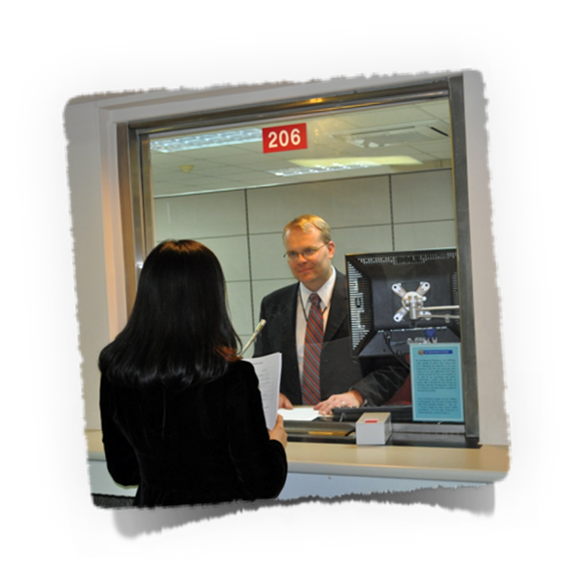
Foreign Service Generalists
Public Diplomacy
Management
Consular
Economics/Political
Human Resources
Financial Management
Logistics
Information Systems
Medical
Community Liaison
Facilities Management
American Citizens’ Services
Citizenship/Passports
Arrest Cases
Death Cases
Federal Benefits
Visas
Immigration
Refugees
Notarials
Press
Culture
Exchanges
Online Library
Cultural Center
Domestic Politics
Trade
Human Rights
Finance
Arms Control Issues
Environment
Narcotics
Energy
Telecommunications
Michelle Kayser, Diplomat in Residence – New England
DIRNewEngland@state.gov

Slide 31
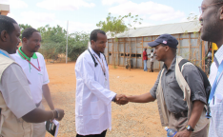
Impact the World, Impact Your World
Using the Department’s Position in the World to Shape it
Not just advancing U.S. interests, but using your skills and experiences to tackle global challenges
A career you can be proud of…you can do work that is meaningful
Michelle Kayser, Diplomat in Residence – New England
DIRNewEngland@state.gov

Slide 32
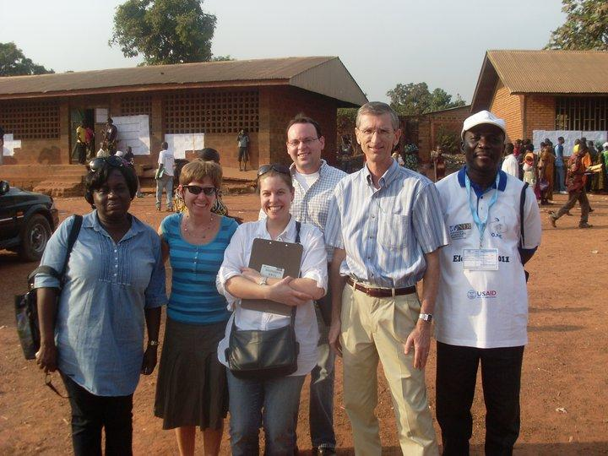
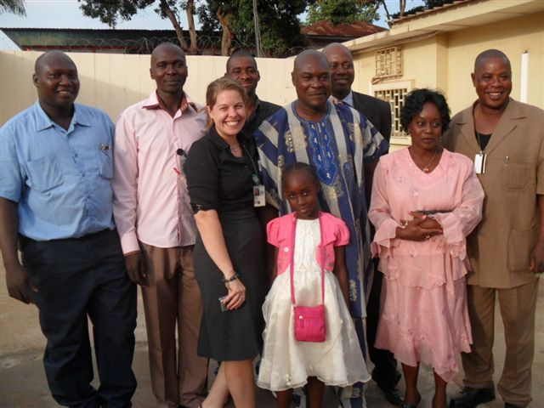
Impact the World, Impact Your World
Intersection of Adventure and Stability
Continuous Growth (Language, Leadership, & Professional Training)
Govt. Provided (Nice) Housing/Utilities
Paid education for kids K-12, Student Loan Repayment
Location dependent additional allowances/differential
Pension, Thrift Savings Plan, Health Benefits
Holidays and Leave
Michelle Kayser, Diplomat in Residence – New England
DIRNewEngland@state.gov

Slide 33
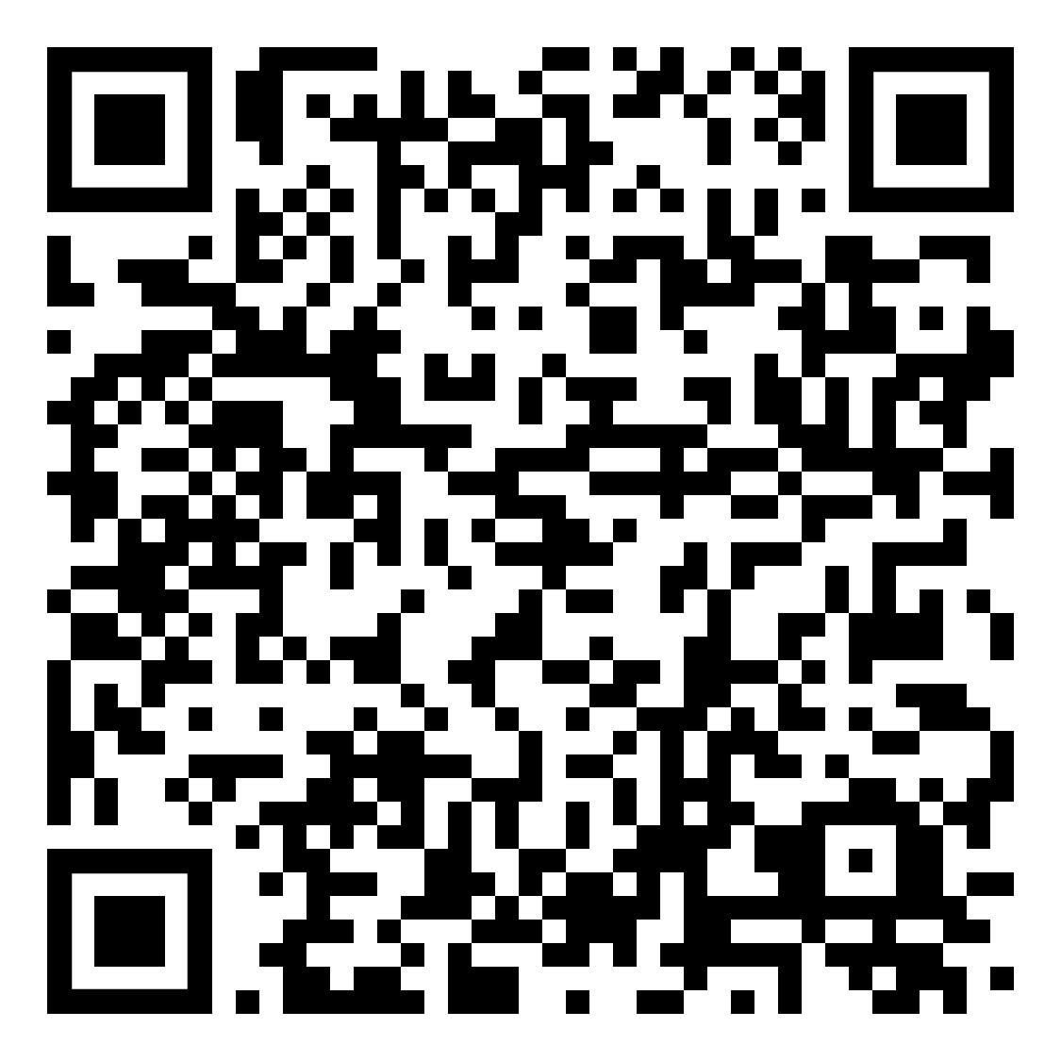
Your Resource – Diplomat in Residence New England
Michelle Kayser– DIRNewEngland@state.gov
Join Our Talent Network!
Michelle Kayser, Diplomat in Residence – New England
DIRNewEngland@state.gov

